Slide 1
The Ministry of Finance of the Kyrgyz Republic
Cash Management and Cash Flow Forecasting
The Central Treasury
Bishkek 2017

Slide 2
Inter-Agency Coordination Council (ICC)
of the KR Ministry of Finance (MoF) and the KR National Bank (NB)
Why:
Align short-term monetary and fiscal policy and agree on the level of domestic borrowings using government securities.
Objectives:
To agree on short-term cash management measures in the banking system;
To determine adequate level of borrowings per month to be made by the KR MoF.
ICC meetings frequency:
The ICC meets twice a month: every fourth Thursday – at the level of deputy heads of the Parties, every second Thursday – at the expert level.
The ICC meetings may be convened as needed to address pressing issues that must be resolved ASAP.
The Ministry of Finance of the Kyrgyz Republic

Slide 3
The Inter-Agency Coordination Council (ICC)
Approved by joint ordinance of the KR MoF and KR NB №69-0 dated April 21, 2010.
The ICC comprises:
From the RK MoF:
Deputy Minister of Finance – Director of the Central Treasury of the Ministry of Finance – co-chair;
Head, Budget Policy Division, KR MoF;
Head, Sovereign Debt Management Division, KR MoF;
Head, Public Revenues Forecasting Division, KR MoF;
Head, Cash Forecasting and Contracts Registration Unit, Central Treasury of the MoF;
Staff, Cash Forecasting and Contracts Registration Unit, Central Treasury of the MoF– ICC secretary.
The Ministry of Finance of the Kyrgyz Republic

Slide 4
The Inter-Agency Coordination Council (ICC)
Approved by joint ordinance of the KR MoF and KR NB №69-0 dated April 21, 2010.
The ICC comprises:
From the KR NB:
Deputy Governor of the National Bank responsible for monetary policy – co-chair;
Head, Economic Department of the KR NB;
Head, Monetary Operations Department, KR NB;
Head, Monetary Policy Unit, Economic Department of the KR NB;
Head, Macroeconomic and Financial Market Analysis Unit, Economic Department of the KR NB;
Staff, Monetary Policy Unit, Economic Department of the KR NB – ICC secretary.
The Ministry of Finance of the Kyrgyz Republic

Slide 5
The Inter-Agency Coordination Council (ICC)
Information for ICC discussions:
KR NB:
Expected NB notes issue size;
CPI forecast compared to December of the previous year;
CPI forecast compared to the same period of the previous year.
KR MoF:
Size of government securities issue by the MoF;
Forecast of changes in the balances of Government accounts with the National Bank;
State budget revenues and expenditures forecast presented in the IMF format;
Information on cash execution of the national budget;
Forecast of government revenues (except sales of T-notes and T-bills) and government expenditures (except T-notes and T-bills payments);
A note on the state budget execution progress.
The Ministry of Finance of the Kyrgyz Republic

Slide 6
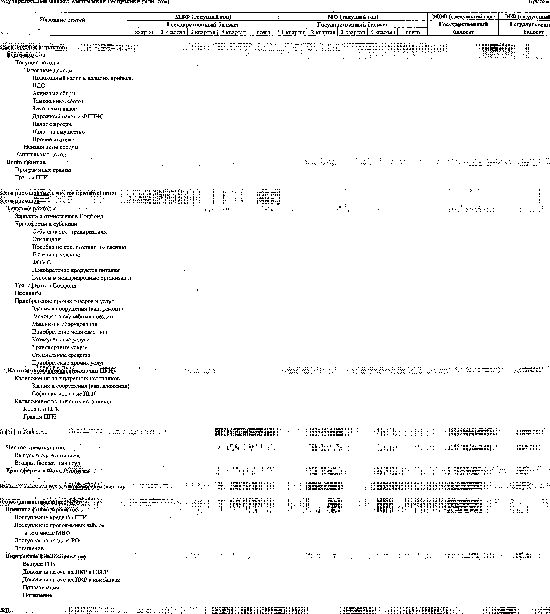
The Ministry of Finance of the Kyrgyz Republic

Slide 7
Thank you!
The Ministry of Finance of the Kyrgyz Republic

