Slide 1


Results of TCOP Activities in FY2018
Tirana, Albania
May 21-23, 2018

Slide 2

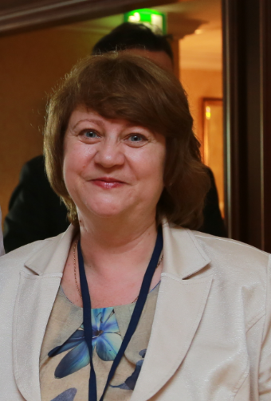
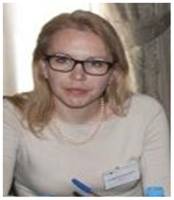
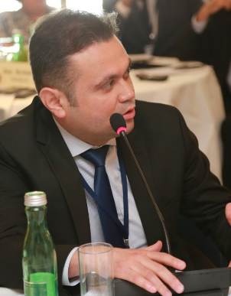
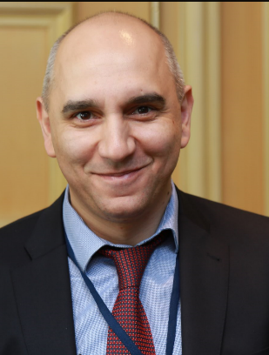
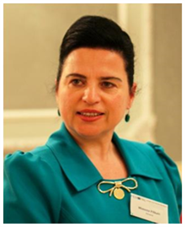
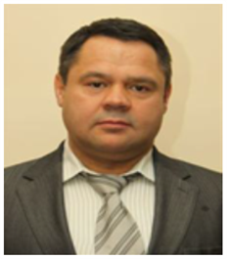
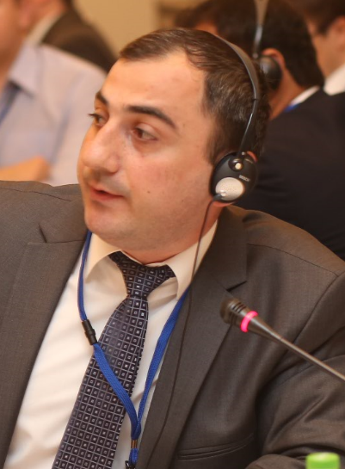
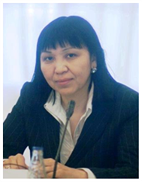
Ilyas Tufan,
TCOP Vice Chair,
Department Head, Treasury,
Turkey
Angela Voronin,
TCOP Chair,
Head,
State Treasury,
Moldova
Ludmila Gurianova
TCOP Vice Chair,
Deputy Head
State Treasury
Belarus
Executive Committee
Treasury Community of Practice
Mimoza Pilkati
Deputy Dep. Head
State Treasury,
Nazim Kasumzade Department Head, State Treasury Agency,
Azerbaijan
Albania
Levan Todua
Department Head, State Treasury, Georgia
Zaifun Yernazarova
Department Head,
Ministry of Finance,
Kazakhstan
Alexander Demidov,
Deputy Head
State Treasury,
Russia

Slide 3

TCOP Action Plan for FY2018
(July 2017 – June 2018)
Was developed in accordance with :
  PEMPAL Strategy for 2017-2022
  Results of TCOP member surveys, including the one in Vienna in June 2017
Is meant to provide for
achievement of PEMPAL TCOP strategic goals:
  Promotion of PFM reforms of high priority for TCOP members, with the focus on reforms of national treasuries
  Provision of TCOP members with high quality resources and knowledge services
  Establishment of highly professional community of treasury specialists in TCOP countries
  Gaining support for TCOP activities and for activities of PEMPAL as a whole from top management of treasuries from member countries.

Slide 4
TCOP continues to work in 4 key thematic areas
y
Function
Evolution of treasury role and functions
IT
Use of information technologies in treasury operations
Cash
Cash management
A/R
Accounting and reporting in the public sector

Slide 5
Activities implemented between July 2017 - May 2018
TCOP Plenary meetings
1 TCOP Plenary meeting with participation of 44 persons (Tirana 2018)
Small format workshops
3 small format workshops (Chisinau and Baku), with participation of 116 TCOP members
Thematic videoconferences
3 videoconferences with participation of 54 TCOP members
Executive Committee
4 ExCom meetings (including 3 videoconferences)

Slide 6
TCOP Thematic Groups
Cash Management Group(13 countries).
Evolution of Treasury Role and Functions Group (15 countries)
Public Sector Accounting and Reporting Group (14 countries)
Use of IT in Treasury Operations Group (11 countries)

Slide 7
Cash Management Group
Established in 2015. The group includes 13 countries (Albania, Azerbaijan, Belarus, Georgia, Kazakhstan, Kyrgyzstan, Macedonia, Moldova, Russian Federation, Tajikistan, Turkey, Croatia and Montenegro)
From the moment of its establishment, the group held:
  3 thematic workshops (Ankara, Moscow, Chisinau)
  6 videoconferences
  1 thematic survey
The group held 1 event in the reporting period:
  Thematic workshop in Chisinau– October 2017.

Slide 8
Cash Management Group:
Workshop in Chisinau, Moldova
Event Objectives
Development of a deeper understanding by participants of priority issues in cash management and forecasting based on Moldovan experiences
Key Outcomes
Participants were exposed to the Moldovan experiences in cash management, including the TSA operations, relations with the central bank and debt management function.
Participants
Members of the TCOP thematic group on cash management – 43 participants from 11 countries
The detailed report and materials of the event are published on PEMPAL website: www.pempal.org
Enhancement of knowledge about relationship between cash management and debt management functions

Slide 9

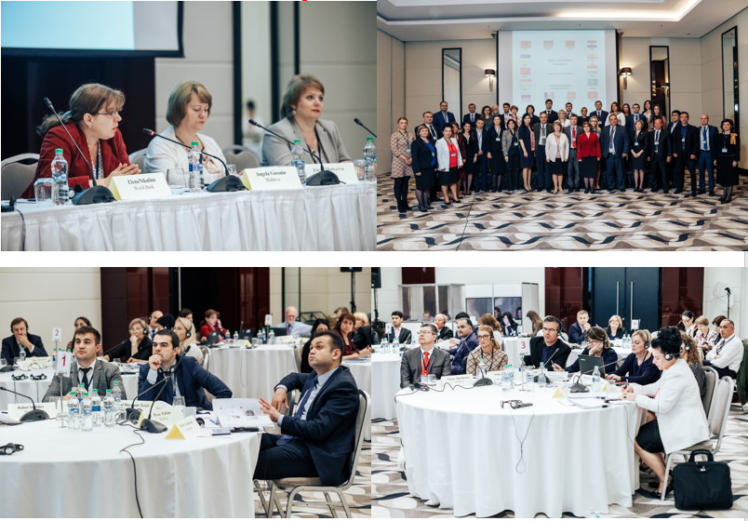
Workshop in Chisinau

Slide 10
Key Outputs of
Cash Management Group’s Activities
The group explored the experiences of Albania, Azerbaijan, Georgia, Moldova, Turkey and Russia in cash management
Members of the group enhanced their understanding of such aspects as TSA operation, active cash management tools, cash balance targeting, interaction with central banks, interaction with a debt management function.
Knowledge products were developed – Report on the thematic survey on TSA operation in TCOP countries, and Note on servicing agreements with central banks.

Slide 11
Use of IT in Treasury Operations Group
Established in 2013. The group is comprised of 11 countries (Albania, Azerbaijan, Belarus, Georgia, Kazakhstan, Kyrgyzstan, Moldova, Russian Federation, Tajikistan, Turkey and Ukraine)
From the moment of its establishment the group held:
4 workshops (Minsk, Tbilisi, Chisinau, Baku)
3 study visits (Ankara, Seoul, Vienna)
8 videoconferences
During FY2018 the group held 3 events:
  2 videoconferences: on December 12, 2017 and on March 1, 2018
  Thematic workshop in Baku – April 10-12, 2018

Slide 12
Thematic videoconference– experiences of Kazakhstan, December 2017
Event objectives
Exchange of information between the group members on the recent developments in the use of IT in public finance management
Key outcomes
Participants learned from the experience of Kazakhstan in implementation of the 4th tier budgets at the local level, discussed the changes in information systems needed to support the process.
Participants
Members of the TCOP thematic group on use of IT in treasury operations – 15 participants from 6 countries
A brief report and a presentation are published on PEMPAL website: www.pempal.org
Main postulates for Baku meeting concept were agreed upon.
Launch of Baku event preparations

Slide 13
Thematic videoconference – experiences of Georgia, March 2017
Event Objectives
Exchange of information between the group members on the recent developments in the use of IT in public finance management
Key Outcomes
Colleagues from Georgia shared the information on the FMIS developments to support transition to the accruals-based accounting method.
Participants
Members of the TCOP thematic group on use of IT in treasury operations – 28 participants from 7 countries
Presentation is published on PEMPAL website www.pempal.org
Further preparation for Baku event
Further preparation for the current meeting was discussed, specifically, preparation for the session on news sharing planned for April 11.
Based on the discussion outcomes, a modified version of the Georgia’s presentation is included in the agenda of a joint meeting with the Accounting Group on April 12

Slide 14
Workshop in Baku, April 10-12, 2018
Event Objectives
Discussion of topics of priority interest for group participants from the Azerbaijan example
Learning about the approaches to automation of accounting and reporting at the budget user level
Key Outcomes
Participants got a detailed information on the experiences of Azerbaijan Treasury information system development and an extensive application of information technologies for public finance management.
Participants
Members of the TCOP thematic group on use of IT in treasury operations – 35 participants from 10 countries
Materials of the event could be found at the PEMPAL website: www.pempal.org
A joint meeting with the Public Sector Accounting Group discussed models for automation of accounting and financial reporting at the budget user level.

Slide 15
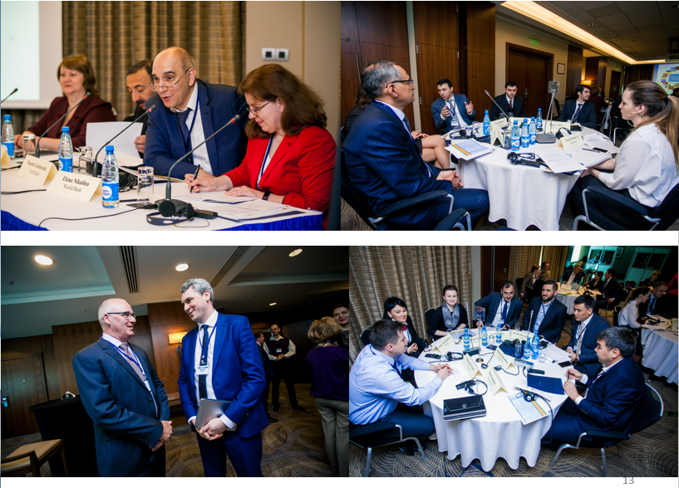
Workshop in Baku

Slide 16
Main Results of the Group’s Work
Exposure to the experience of some countries in FMIS implementation and discussion of its potential application in TCOP countries
Deeper understanding of issues related to establishment of IT support services in the ministries of finance/treasury offices
A joint discussion of automation approaches to accounting and financial reporting at the level of budget users with the relevant accounting group
Review of the resources of the World Bank’s FMIS
Provision of PEMPAL library with materials from the completed activities to make them available for further use

Slide 17
Key results of the Group’s work–country cases
Belarus colleagues made use of the TCOP peer experts’ opinion in the process of conceptualizing their new FMIS
Colleagues from Georgia got new ideas in Seoul on integration of a treasury information system with a public procurement system.
Colleagues from Tajikistan developed a better insight into the Turkish information system’s functionality and it helped them in adaptation of it to their country’s needs.

Slide 18
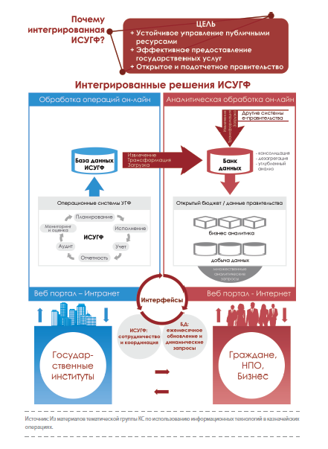
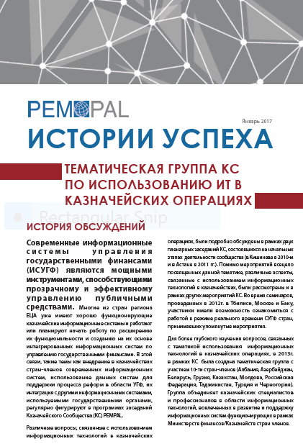
Publication of Group’s Success Story
Notes:
Краткая характеристика (демонстрация) нового вебсайта PEMPAL. Со слайда есть гиперлинк на сайт PEMPAL. Отметить особо библиотеку, и показать где находится информация о мероприятиях КС. Упомянуть про Новости, анонсы мероприятий и 3 языка сайта. В конце упомянуть еще раз про Продукты знаний и показать где размещены на сайте.

Slide 19
Public Sector Accounting and Financial Reporting Group
In 2013 special groups were established to work in 3 areas:
  - Accounting of Government Assets
  - Consolidation of Financial Reports
  - Accounting Standards
The latter continues its work and currently includes representatives from 14 countries (Albania, Azerbaijan, Belarus, Croatia, Georgia, Kazakhstan, Kyrgyzstan, Macedonia, Moldova, Russia, Tajikistan, Turkey, Montenegro, and Ukraine)
Since its establishment the Group on Accounting Standards has held:
  4 workshops (Podgorica, Tbilisi, Minsk and Baku)
  1 videoconference
In FY2018 the Group had
Thematic workshop in Baku, Azerbaijan: on April 12-13, 2018.

Slide 20
Workshop in Baku, April 10-12, 2018
Event Objectives
Learning about the approaches to automation of accounting and financial reporting at the budget user level
Information sharing between countries on the recent developments in public sector accounting and reporting reforms
Key Outcomes
A joint meeting with the IT Group discussed models for automation of accounting and financial reporting at the budget user level
Participants
Members of TCOP TG on Accounting Standards – 35 participants from 12 countries
Event materials are published on the PEMPAL website: www.pempal.org
Participants learned about the progress in public accounting reforms in member countries and other countries of the region

Slide 21
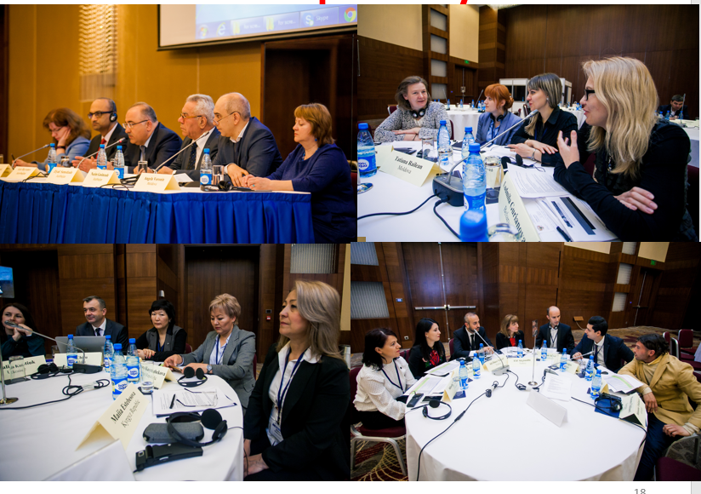
Workshop in Baku

Slide 22
Main results of the group work
Peer expert support provided to several countries, including Belarus, Georgia and Montenegro, regarding the implementation of international standards
Guidelines to identify mismatch between national methodology and international standards reviewed with examples of application
Experience of several countries explored regarding implementation of accounting standards aligned with international standards
Approaches to automation of accounting and financial reporting at the budget user level discussed jointly with the IT group

Slide 23
Evolution of Treasury Role and Function Group
Established in 2016. The Group includes 15 countries (Albania, Azerbaijan, Armenia, Belarus, Bulgaria, Croatia, Georgia, Kazakhstan, Kyrgyzstan, Moldova, Russia, Serbia, Tajikistan, Turkey, and Ukraine)
The Group’s proposals impacted the topics of the TCOP’s annual plenary meetings
  2016 – Evolution of treasury role and functions (Chisinau),
  2017 – Risk management (Vienna),
  2018 – Performance measurement and monitoring (Tirana)
In FY2018 the Group held a
  Thematic videoconference- April 2018

Slide 24
Thematic Videoconference–
Experience of Moldova, April 2018
Event Objectives
Information sharing between group members on recent developments related to changes of treasury role and functions
Key Outcomes
Participants learned about the recent experience of Moldova in treasury reorganization and discussed the lessons learnt.
Participants
Members of TCOP TG on Accounting Standards – 15 participants from 7 countries
Presentation is published on the PEMPAL website: www.pempal.org
Discussion of preparations for a plenary session in Tirana
Concept of the plenary session in Tirana approved

Slide 25
Knowledge Products Developed under TCOP
Practical guidelines on consolidation of financial reports, 2016
Note on Service Agreements with Central Banks, 2017
Report on the results of the survey on Treasury Single Account Operation Practices in PEMPAL member countries, 2016
Integration of budget classification and chart of accounts, success stories from TCOP countries, 2014
Final report on activities of the TCOP Asset Management thematic group, 2015.

Slide 26
Further Steps
Confirm TCOP thematic priorities for the upcoming period. Align the 2019-20 TCOP Action Plan accordingly.
Provide further details for TCOP Action Plan for FY2019 incorporating the survey results of TCOP members in Tirana
  identify the topics of planned activities
  expand the leadership of thematic groups
  identify the location and time of events, including TCOP Plenary Meeting in 2019.
Notes:
- Краткая информация о решениях принятых в рамках заседания ИК ПС PEMPAL в Вене, относительно новой Стратегии PEMPAL .
Представление информации о порядке проведения опроса членов КС в рамках заседания в Кишиневе
Краткая информация о Плане деятельности на 2017ф.г. (бюджет, формат запланированных мероприятий)

Slide 27
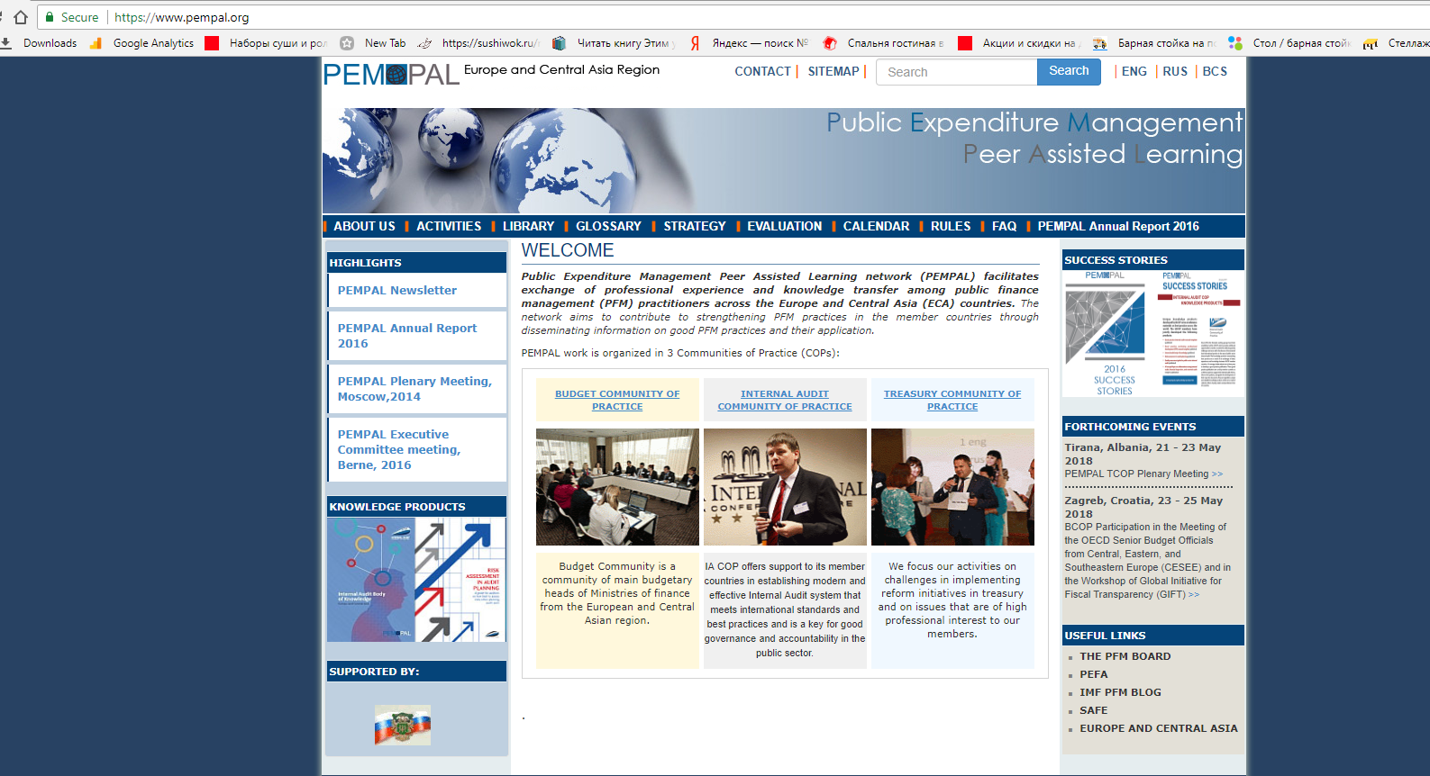
Information on TCOP Activities
Notes:
Краткая характеристика (демонстрация) нового вебсайта PEMPAL. Со слайда есть гиперлинк на сайт PEMPAL. Отметить особо библиотеку, и показать где находится информация о мероприятиях КС. Упомянуть про Новости, анонсы мероприятий и 3 языка сайта. В конце упомянуть еще раз про Продукты знаний и показать где размещены на сайте.

Slide 28
Thank you for your attention!

