Slide 1
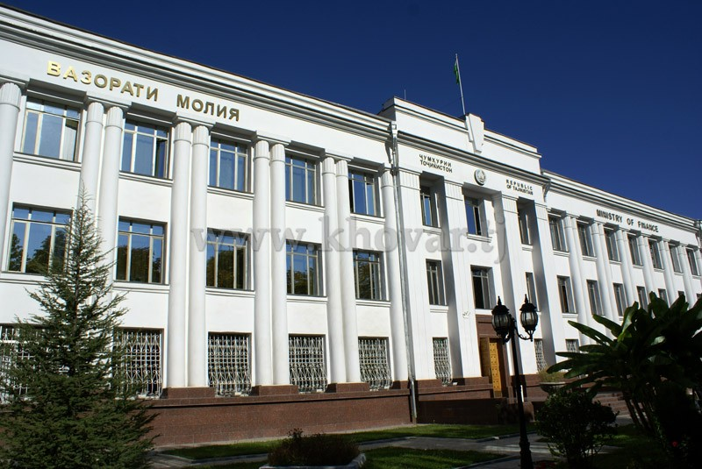
Ministry of Finance of the Republic of Tajikistan
Cash Flow Forecasting

Slide 2
Ministry of Finance of the Republic of Tajikistan
New structure of the central treasury chief directorate of the ministry of finance of the republic of tajikistan
First Deputy Minister of Finance
Director, Central Treasury Chief Directorate
First Deputy Director
Budget Funds Department
Deputy Director
Budget Execution Department
Deputy Director
Reporting Department
Territorial Treasury branches in provinces, regions, cities and districts
Cash Forecasting and revenue accounting unit
Cash planning unit
Bank accounts management unit
Social sector finance unit
Central government bodies finance unit
Defense and law-enforcement finance unit
Economy sectors finance unit
Commitment control and mamanegment unit
Reporting methodology and treasury operations unit
Budget reporting consolidation unit
Financial reporting unit (ТIPSAS)

Slide 3
Ministry of Finance of the Republic of Tajikistan
The CTCD strategic development plan stipulates for the achievement of the following outcomes:
Establishing a fully functional TSA;
Implementing a revenue and expenditure forecasting and cash flow planning system;
Implementing effective cash management processes

Slide 4
Ministry of Finance of the Republic of Tajikistan

Slide 5
Ministry of Finance of the Republic of Tajikistan

Slide 6
Ministry of Finance of the Republic of Tajikistan
TSA covers all funds held in the accounts of the national and local budgets. In accordance with the Public Finance Management Strategy, the Agency for Social Insurance and Pensions at the Government of the Republic of Tajikistan shall transfer all its accounts to TSA. In the future all budgetary funds shall be placed in the TSA.
Deficit funding sources are as follows:
Issue of Treasury Bills of Exchange;
Revenues generated by privatization of public property;
Economy Development Stabilization Fund
Revenues from sub-loan agreements

Slide 7
Ministry of Finance of the Republic of Tajikistan
Treasury single account
National accounts
Transfers of national taxes and revenues
Local budget accounts
Other accounts
Foreign currency accounts in the National Bank
National Budget Accounts
Local treasury accounts
Accounts of joint investment projects
Accounts for special funds of local budgets
Accounts for special funds of the national budget
Other accounts

Slide 8
Ministry of Finance of the Republic of Tajikistan
Main issues in producing forecasts:
- Lack of methodology;
- The forecasting process is not automated
- lack f systematic receipt of data from revenue administrators;
- Using Excel in the process of forecasting;
- Expanding the coverage of cash flow forecasts to match the coverage of TSA and national government;
- No daily cash flow forecasts and a rolling cash plan for 12 months;
- No fixed deadlines approved by the Ministry of Finance for various payments.

Slide 9
Ministry of Finance of the Republic of Tajikistan
thank you for your attention!

