Slide 1
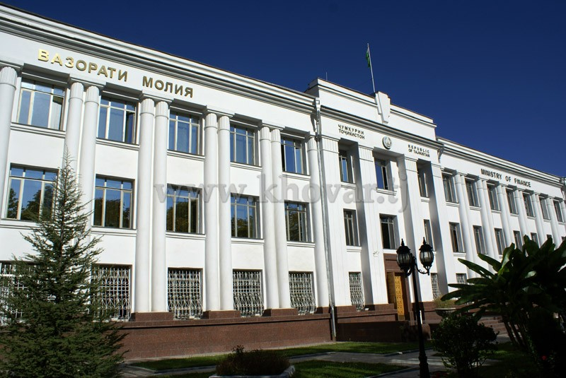
MINISTRY OF FINANCE OF THE REPUBLIC OF TAJIKISTAN
Kishinev 2016

Slide 2
MINISTRY OF FINANCE OF THE REPUBLIC OF TAJIKISTAN
History of treasury development
1996-1998 | 2000-2002 | 2006-2014 | 2010-2016
Decree of the Government of the Republic of Tajikistan “On Creation of the Treasury System in the Republic of Tajikistan”, July 18, 1996, No. 327 | In 2000, the new budget classification was introduced which determined the structure of the budget based on functional and economic principles of allocation | In 2006, the electronic payment system was introduced at the level of the Central Treasury and the National Bank of Tajikistan | Form January 1, 2015, public finance management information system “TFMIS” was implemented in the Main office of the Central Treasury, and all budget institutions and entities funded from the MOCT were connected to it
Decree of the Government of the Republic of Tajikistan “On approving the Regulation on the Central Treasury Office”, January 15, 1997, No. 36 | Law of the Republic of Tajikistan "On the Treasury", which established legal and organizational grounds for the treasury in the Republic of Tajikistan, 2001 | Law of the Republic of Tajikistan “On the Treasury”, new version, 2008 | From January 1, 2016, all local treasury bodies are connected to the information system
In 1998, work on transfer of budget entities and institutions to financing through the treasury system was completed | “Instruction on maintenance of accounting and reporting on execution of the state budget in the Treasury”, Order of the Minister of Finance of the RT of February 20, 2002, No. 33 | In 2010, the new information system TIMS was introduce | At the stage of coordination and approval the new Law of the Republic of Tajikistan “On the Treasury”
 | In 2002, the first information system “ACS –Treasury” was implemented, it operated until the end of 2009 | In 2010-2014, the «TIMS» information system was implemented in all local treasuries
Moldova, Kishinev, June 1 - 3, 2016

Slide 3
MINISTRY OF FINANCE OF THE REPUBLIC OF TAJIKISTAN
NEW STRUCTURE OF THE MAIN OFFICE OF THE CENTRAL TREASURY
MINISTRY OF FINANCE OF THE REPUBLIC OF TAJIKISTAN
First Deputy Minister of Finance
Director of the Main Office of the Central Treasury
First Deputy Director
Budget Funds Directorate
Deputy Director
Budget Execution Directorate
Deputy Director
Reporting Directorate
Local treasury bodies in oblasts, regions, cities and districts
Cash Forecasting and Revenue Accounting Department
Cash Planning Department
Bank Account Management Department
Social Sector Financing Department
Department of Funding Central Public Governing Bodies
Department of Funding Defense and Law Enforcement Bodies
Department of Funding Branches of Economy
Department for Managing Control over Commitments
Department for Methodology of Treasury Reporting
Budget Reporting Execution Department
Financial Statements Department (ТIPSAS)
Total number of treasury employees 472 , out of them 58 – CT, 414 – LT
Moldova, Kishinev, June 1 - 3, 2016

Slide 4
MINISTRY OF FINANCE OF THE REPUBLIC OF TAJIKISTAN
MAIN FUNCTIONS OF TREASURY BODIES ACCORDING TO THE CURRENT LEGISLATION:
ACCOUNTING FOR REVENUES OF THE REPUBLICAN AND LOCAL BUDGETS;
Timely financing of budget expenditure items;
Exercise of permanent control over execution of the republican and local budgets;
Managing the treasury single account;
Control over special state funds and over earmarked funds of budget entities;
Preparation of state budget periodic reports;
SERVING THE INTERNAL AND EXTERNAL PUBLIC DEBT;
DEVELOPMENT OF INSTRUCTIONS, ACCOUNTING AND REPORTING FORMS RELATED TO EXECUTION OF THE STATE BUDGET;
ADMINISTRATION AND CONTROL OVER CASH EXECUTION OF REVENUES AND EXPENDITURES OF THE REPUBLICAN AND LOCAL BUDGETS.
Moldova, Kishinev, June 1 - 3, 2016

Slide 5
MINISTRY OF FINANCE OF THE REPUBLIC OF TAJIKISTAN
Strategic development plan for the main office of the central treasury, Ministry of finance of the Republic of Tajikistan, for 2011-2016
For the next five years MOCT of the MoF of the RT set the following goals:
To manage cash and bank transactions of the Government of the Republic of Tajikistan according to international standards;
To improve budget execution and to ensure available funding for budget entities in accordance with the annual budget needs;
To ensure relevant funding needed to meet mid-term budget needs.
Moldova, Kishinev, June 1 - 3, 2016

Slide 6
MINISTRY OF FINANCE OF THE REPUBLIC OF TAJIKISTAN
Organizational development;
Improvement of working skills;
Development of the accounting policy and standards;
Enhancement of capacities of employees in the sphere of information technologies.
Strategic development plan of the treasury consists of the following parts:
Moldova, Kishinev, June 1 - 3, 2016

Slide 7
MINISTRY OF FINANCE OF THE REPUBLIC OF TAJIKISTAN
Significant changes in the treasury from the time of its establishment | Main goals of these changes
Implementation of the information system “ACS – Treasury” | Ensuring efficient execution of the budget
Implementation of the TSA (RB and LB) | Better cash management
Implementation of the electronic payment system in the Central Treasury; | Improvement of efficiency of payments
Integration of the budget classification with the unified charts of accounts (UCA) | Preparation of financial reports in accordance with IPSAS
Implementation of the departmental classification and of the classification of funding sources (implementation of the “TIMS” information system) | Ensuring efficient execution of the budget taking into consideration reform of the budget planning system.
Implementation of new treasury functions in the framework of the Treasury Development Strategic Plan (implementation of the public finance management system “TFMIS”) | Full modernization of the PFM system
Moldova, Kishinev, June 1 - 3, 2016

Slide 8
MINISTRY OF FINANCE OF THE REPUBLIC OF TAJIKISTAN
KEY RESULTS
The Strategic development plan of MOCT envisions achievement of the following results:
Creation of the fully functional TSA;
Implementation of the commitment control system;
Implementation of the revenue forecast and cash planning system;
Implementation of efficient cash management processes
Preparation of financial reports in accordance with IPSAS
Moldova, Kishinev, June 1 - 3, 2016

Slide 9
MINISTRY OF FINANCE OF THE REPUBLIC OF TAJIKISTAN
THE FOLLOWING STRATEGIC RISKS WERE IDENTIFIED WITH RESPECT TO THE STRATEGIC DEVELOPMENT PLAN:
The MOCT development plan is too ambitious;
Insufficient political commitment;
Relevant technologies are not sufficient to convert to new activities;
STEPS TO REDUCE STRATEGIC RISKS:
To assign responsibility for implementation of the MOCT Development Plan to one of MOCT deputy directors and to create Working Groups by development areas;
To develop a detailed implementation plan;
By the time new treasury functions are implemented, the appropriate ICT infrastructure should be in place;
To create within the Ministry of Finance of the RT a relevant structure to provide support in the IT sphere.
Moldova, Kishinev, June 1 - 3, 2016

Slide 10
MINISTRY OF FINANCE OF THE REPUBLIC OF TAJIKISTAN
THANK YOU FOR ATTENTION!
Moldova, Kishinev, June 1 - 3, 2016

