Slide 1
Evolution of the Treasury System of the Azerbaijan Republic
Ministry of Finance of the Azerbaijan Republic State Treasury Agency
June 2016
Kishinev

Slide 2
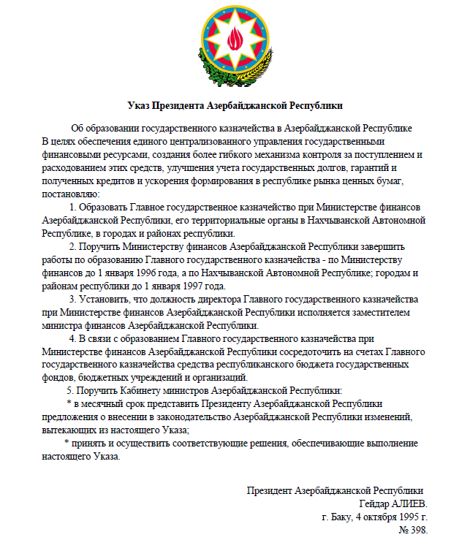
Ministry of Finance of the Azerbaijan Republic State Treasury Agency
Decree of the President of the Azerbaijan Republic “On Establishment of the State Treasury in the Azerbaijan Republic”
As of October 04, 1995

Slide 3
Functions of the Treasury
To participate on the annual basis, in preparation of the State and consolidated budget for the next year and for three years ahead, to prepare reports on cash execution of the budget
To ensure methodological guidance on organization of accounting and reporting for treasury transactions related to execution of the State Budget
To ensure financing of expenses of the approved State Budget depending on revenues of the State Budget and taking into consideration the budget deficit
To use specified sources of financing (liquid funds) to cover the budget deficit
To create accountability in order to ensure transparency in use of public finance in institutions and organizations funded from the State Budget
To prepare a consolidated report on execution of the State Budget
To provide for funding of events and for control over cash execution of off-budgetary funds, taking into consideration approved estimates
To register in treasury books goods, works and services acquired by budget entities.
Other functions

Slide 4
Implemented reforms
Treasury Single Account (TSA)
Public (budget) commitments
Treasury accounting for goods (works and services)
Implementation of the TMIS
Creation of a possibility to keep accounting and reporting both based on cash and accrual methods (GFS and IPSAS)
Transition from ideology of a treasury single account that grants a possibility of having transit treasury accounts to actual performance of all revenue and expenditure related transactions in the treasury single account.
Possibility of external audit of public expenditures and revenues
Maintenance of all treasury transactions carried out in the territory of Azerbaijan starting from financing and finishing with receipt of reports in real time mode
Creation of a broad platform for development of a reference information system for public finance management

Slide 5
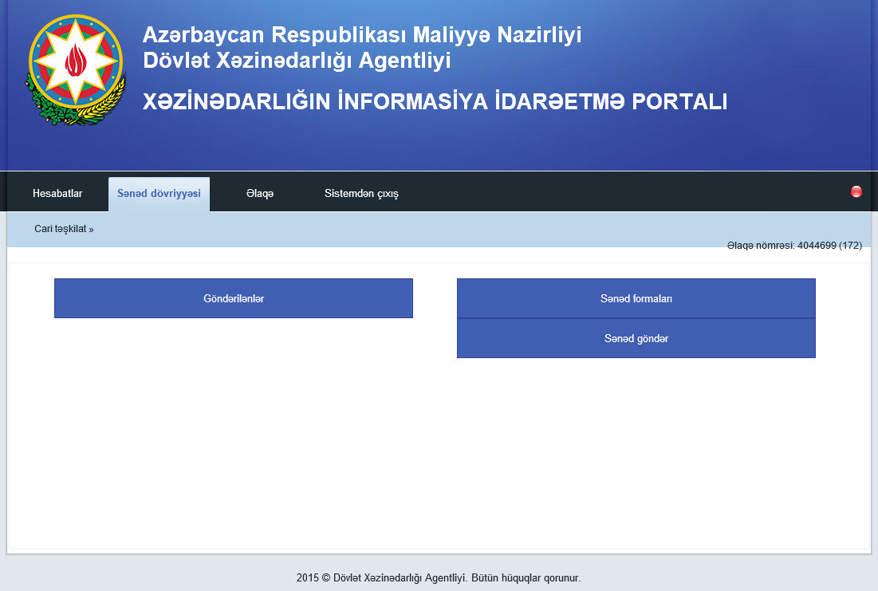
ELECTRONIC PAPER FLOW

Slide 6
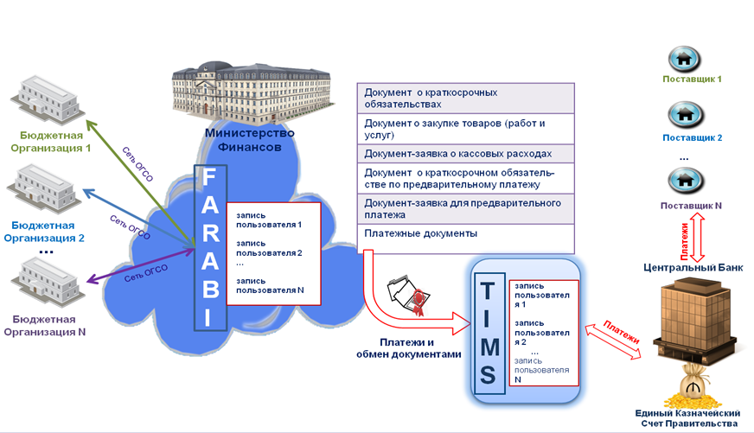
Integration of systems
“Financial and Accounting Reports in Budget Entities” and “Treasury Management Information System”

Slide 7
Plans for Future Development
Connecting budget entities to TMIS
Development and transition to FMIS on the basis of TMIS
Maintenance of accounting in TMIS
Calculation of payroll in TMIS
Human resource management
On-line connection of the foreign currency SWIFT terminal

Slide 8
Tasks
Reorganization of the structure of the Central Treasury in connection with automation of the treasury control functions
Revision of the organizational structure of treasury regional bodies
Redistribution of functions between the Treasury and budget entities
Expansion of the treasury services outreach
Studying experience of other countries
Training of specialists
Employees of budget entities
Employees of the Ministry of Finance
Technical support
Software

