Slide 1
Treasury System of the Republic of Armenia
Evolving treasury functions

Slide 2
Tasks of the Treasury
Organization of work related to cash management and financing expenditures of the Republic of Armenia and of municipalities;
Organization of execution of the state and municipal budgets according to the procedure set by the legislation of the Republic of Armenia;
Organization of methodological support for regulation of relations in connection with execution of the budget of the Republic of Armenia and of municipal budgets;
Organization for accrual of cash that is available for the Republic of Armenia and municipalities and execution at its expense of spendings from the Treasury Single Account;
Ensuring regulation of relations related to preparation, submission and generalization of reports of financial activities of public institutions and to setting accounting norms in the budget sector;
Exercising ex-ante control over payments of public institution made in the course of execution of the state and municipal budgets;

Slide 3
Tasks of the Treasury
Organization of serving financial flows of the Republic of Armenia and municipalities;
Accounting for transactions on off-budgetary funds (accounts) of public institutions;
Getting financial reports on transactions with funds of the state budget of the Republic of Armenia and of municipalities, with off-budgetary funds, evaluation of their reliability, generalization and presentation of information contained in them;
Serving foreign public debt of the Republic of Armenia;
Current management of the internal public debt of the Republic of Armenia;
Accounting for capitalization of commodity loans and grants given to the Republic of Armenia by foreign states and international organizations, coordination and control (monitoring) over execution of functions related to it;
Serving commitments with respect to the Republic of Armenia set by the Government of the Republic of Armenia.

Slide 4
Structure of the Treasury of the RA
The Treasury is a combination of structural units of the administration of the Ministry of Finance of the RA headed by the deputy Minister of Finance, he is the chief treasurer.
Earlier structure of the RA Treasury before 2014.
Earlier scheme of financial transactions (before introduction of the Client-Treasury system)
Local treasury officeLTO44
…
Local treasury office LTO2
Local treasury office LTO1
Central Treasury
Pubic institutions
LTO
Commercial bank
Suppliers and taxpayers
municipalities
CT
CB
Software
Treasury business day: TBD (1998)”
Pubic institutions
TSA
LTO1 TBD
LTO
Suppliers and taxpayers
Commercial bank
LTO44 TBD
LTO2 TBD
municipalities
CT TBD
LTO… TBD
LTO3 TBD
LTO4 TBD

Slide 5
Treasury Single Account
From 1996, with the Central Bank of the Republic of Armenia, a treasury single account was opened in the name of the treasury, and this is an account in drams of the Republic of Armenia.
All funds reserved for the Republic of Armenia and municipalities are accrued into the Treasury Single Account.
All payments are made by the Republic of Armenia and municipalities from the Treasury Single Account.
The Treasury Single Account also includes the following sub-accounts maintained by the treasury, but governing bodies administer the funds
The Treasury Single Account includes the following sub-accounts maintained by the treasury
Funds of the state budget of the Republic of Armenia;
Funds from loans and grants given to the Republic of Armenia by foreign states and international organizations;
Deposit accounts maintained by public bodies.
Off-budgetary funds;
Funds of municipalities;
Funds from the State Social Insurance Fund.

Slide 6
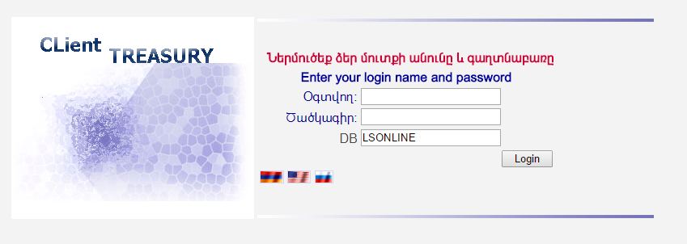
Client-Treasury
In 2010, the system of electronic treasury account management Client-Treasury was developed and implemented in the treasury system of the RA.
The system allows to fill in and submit to the treasury electronically cost estimates, contract extracts, invoices, budget requests, budget and financial commitments, payment orders and other documents, and also allows for reviewing in real time of accounts, for preparation of extracts and certificates.

Slide 7
Funds from loans and grants given to the Republic of Armenia by foreign states and international organizations
From 2010, funds of from loans and grants given to the Republic Armenia by foreign states and international organizations were moved from commercial banks of the RA to the Treasury;
From 2011, funds from loans and grants given to the Republic Armenia are accrued to treasury accounts opened in the name of program implementation offices (PIO).
Scheme of accrual and use of funds from loans and grants given to the Republic of Armenia by foreign states and international organizations
Foreign states and international organizations
Suppliers
PIO
Commercial bank
Client-Treasury
CT (TBD)
CB
TSA
Commercial bank
PIO
Suppliers

Slide 8
Unified data base of the Treasury
In January 2014, data bases of the Central Treasury and of 44 LTOs were merged into a single data base.
New structure of the Treasury
In January 2015, all local treasury offices were eliminated;
All clients of the treasury (public institutions and municipalities) manage their treasury accounts only electronically: through the Client-Treasury system (paper documents were eliminated).
Scheme of financial flows from January 2015.
Pubic institutions
Commercial bank
Client-Treasury
Treasury TBD
CB
municipalities
Commercial bank

Slide 9
Scheme of financing expenditures of budget entities
Expense accounts are opened for public governing bodies and for budget entities in the Treasury in accordance with functional classifications codes of budget expenditures for the current year.
Functional classification of budget expenditures is a grouping of budget expenditures showing areas of financing of key functions of public bodies (Government Finance Statistics /GFS/ 2001).
Budget requests for funding
Public governing bodies
Treasury (TBD)
Client-Treasury
Cost estimates, contract extracts (spending financing schedule), invoices, budget and financial commitments
Budget entities

Slide 10
Scheme of financing budget entities’ expenditures
On the basis of budget requests received electronically from public governing bodies in accordance with codes of functional and economic classifications, and also budget and financial commitments of budget institutions : for financing expenditures during the current day by the software system TBD, a consolidated budget order is formed. Economic classification of budget expenses is grouping of expenses depending on their economic contents (Government Finance Statistics /GFS/ 2001).
By means of electronic confirmation of the consolidated budget order as the first step, the system TBD allocates amounts of financing from the account of public general resources to expense accounts of public governing bodies in accordance with codes of functional and economic classifications;
As the second step, the system TBD transfers amounts of financing from accounts of public governing bodies to expense accounts of budget entities in accordance with codes of functional and economic classifications;
As the third step, the system TBD transfers amounts from accounts of budget entities to bank accounts of suppliers through the electronic system of the CB of the RA “BANKMAIL”.

Slide 11
Scheme of financing expenses of budget entities
Treasury (TBD)
Account
Public general resources
CB
Public governing body account
Transit account for transfers
Commercial bank
Supplier
TSA
Budget entity account

Slide 12
Significant reforms
Significant changes in treasury operations | Main goals of these changes
Treasury Single Account | Single till principle: accrual of all revenues (receipts) and execution of budget expenditures in the treasury single account
Implementation of the software system TBD | Improvement of accounting and organization of control over budget execution
Budget classification (Government Finance Statistics /GFS/ 2001) | Comprehensive analytical structure (is suitable for analysis, planning and policy determination)
Implementation of the software system Client-Treasury | Treasury accounts electronic management
Unified data base | Merging 44 databases of LTO into a single data base

Slide 13
Future reforms
The Ministry of Finance of the Republic of Armenia (MoF) intends to include in the public sector Financial Management Information System of the Government (FMIS).
It is assumed that FMIS would replace software that operates in the MoF now and will fill in a number of other functional possibilities, would serve as a basis for possible expansion of financial management and accountability.
FMIS would consist of the following modules:
Budget planning,
Execution of the budget,
Public debt,
Public procurements,
Accounting,
Report on budget execution.

Slide 14
ՇՆՈՐՀԱԿԱԼՈՒԹՅՈՒՆ
THANK YOU

