Slide 1
































Internal audit
Community of practice
IACOP: Developments, Achievements, and the Way Forward

Slide 2
Our Mission
IACOP offers support to its member countries
in establishing modern and effective Internal Audit system that
meets international standards and best practices and
is a key for good governance and accountability in the public sector
Our Core Values
Professionalism, dedication to reforms, commitment to sharing knowledge
and experience with the community (as professional family of peers),
trust, unity and respect to diversity of 23 member countries
IACOP Motto
unityINdiversity

Slide 3
IACOP Balanced Scorecard
Internal Processes
To maintain and develop a
volunteer network of internal audit professionals through ‘peer’ learning,
knowledge management
with range of activities
Customer
To serve our
governments
Financial
Accomplish donors’ needs and make best value for money of PEMPAL with the help of Secretariat
Learning and Growth
Develop the volunteering, Executive Committee leadership, self sustainability
of IACOP Working Groups, coordination with Steering Committee and other COPs

Slide 4
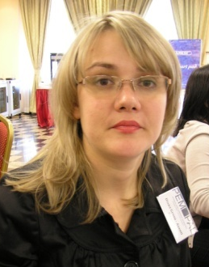
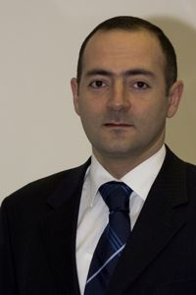
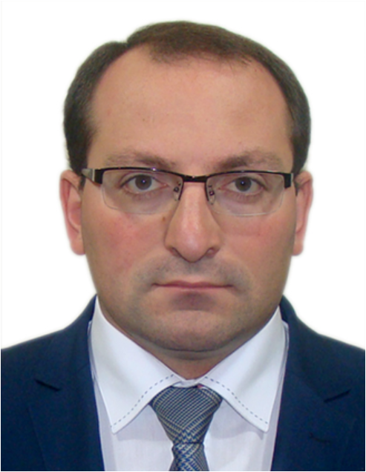
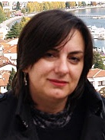
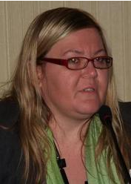
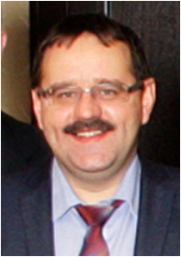
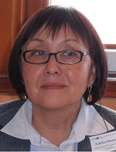
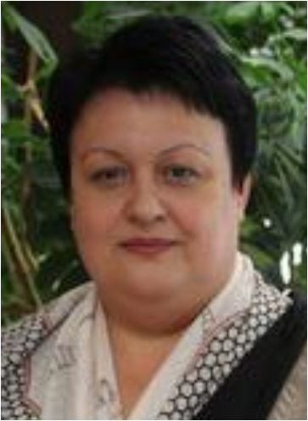
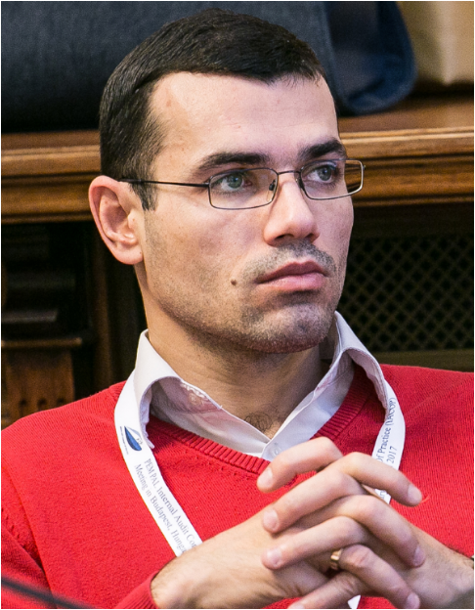
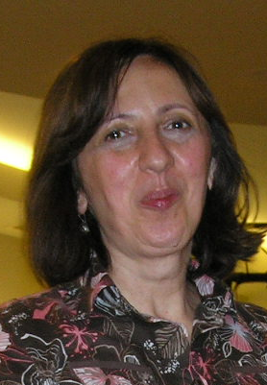
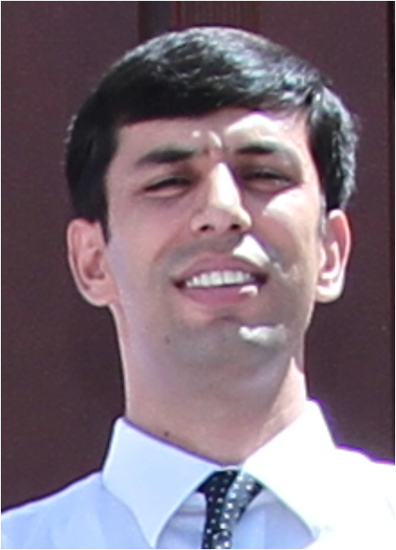
Strong Leadership Team-
IACOP ExCom
Diana
Grosu–Axenti
Resource team
member
Arman Vatyan
WB, Lead
Edgar Mkrtchyan
Chair
Armenia
Amela Muftić
Vice Chair
Bosnia and Herzegovina
Edit Nemeth
Vice Chair
Hungary
Zamira
Omorova
the Kyrgyz
Republic
Stanislav
Bychkov
Russian Federation
Mioara Diaconescu
Romania
Petru Babuci
Moldova
Ljerka Crnković
Croatia
Olimjon Mirzoev
Tajikistan

Slide 5

Internal Audit COP
PEMPAL
Steering Committee
Bank TL (Elena)
SC member (Marius)
Guidance/Fiduciary
Lead of the
Community (Arman)
Executive Committee
led by Chair and two VC
Internal Audit Community of Practice
(23 member countries)
Leadership Coordination
Quality
Assurance
Internal
Control
Audit in
Practice
(AiP)
RIFIX
Risk
Assessment
logistical support
Thematic
meetings
(role of CHU)
Secretariat
World Bank (WB)
Funding, professional support
Information
Professional support
Information
Russia, SECO, Dutch Academy, MC and others
Organizations and professional associations (the IIA, CIPFA, etc.) and resource people

Slide 6
Knowledge Repository in Wiki

Slide 7
Value Created and Impact

Slide 8
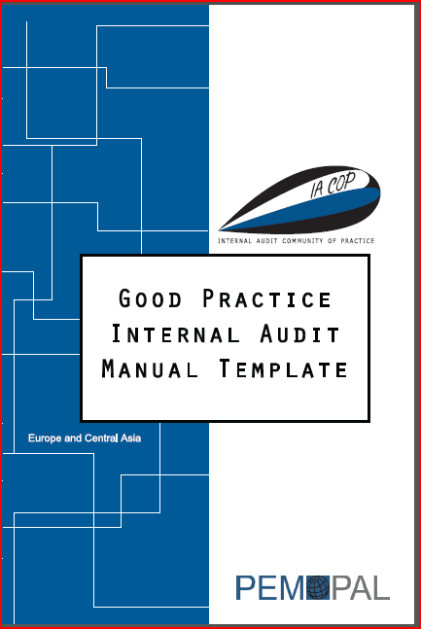
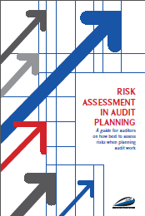

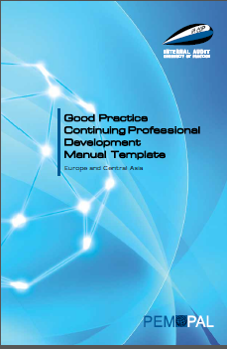
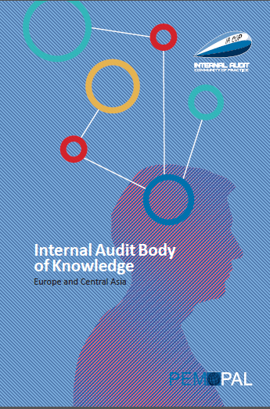
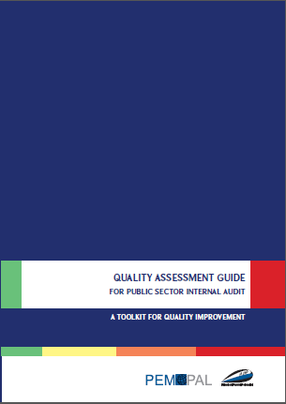
IACOP Good Practice Products
Good Practice IA Manual Template
Good Practice CPD Manual Template
Internal Audit Body of Knowledge
Risk Assessment in Audit Planning
Concept Note on RIFIX (Relationship of Internal Audit with Financial Inspection and External Audit)
Quality Assessment Guide
Newsletters, Communiqués and 100+ other knowledge products

Slide 9
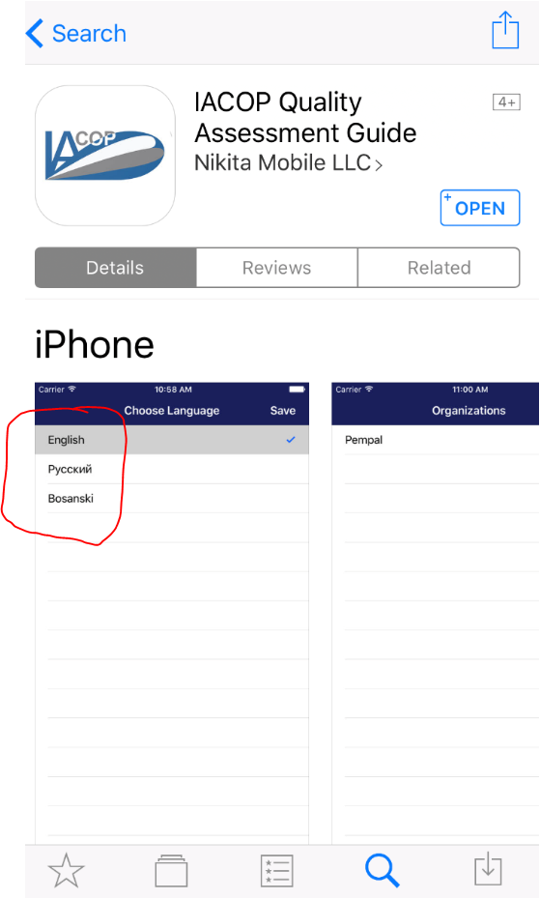
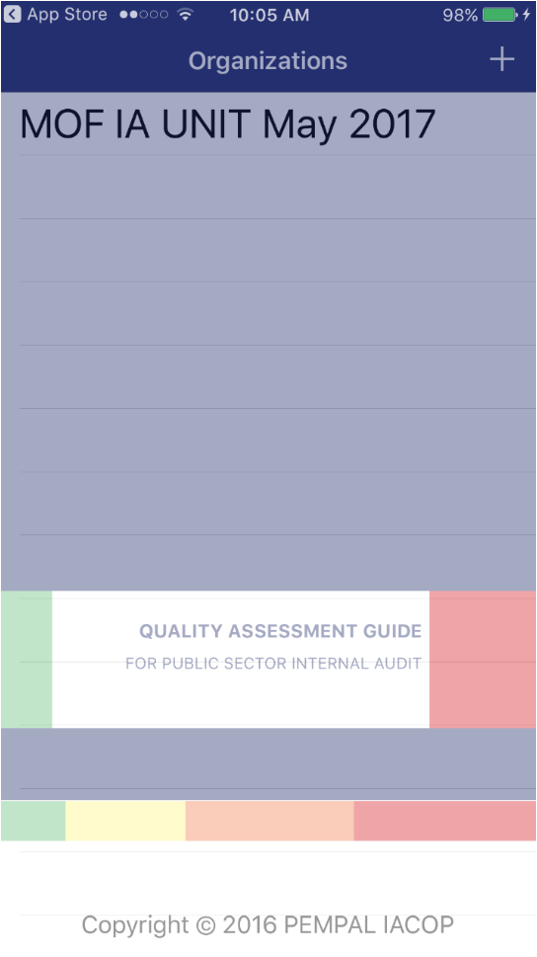
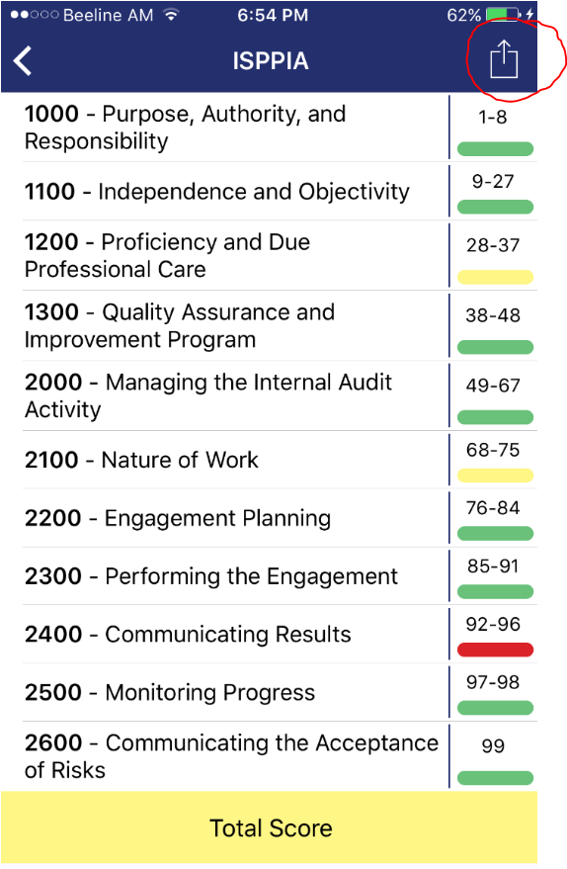
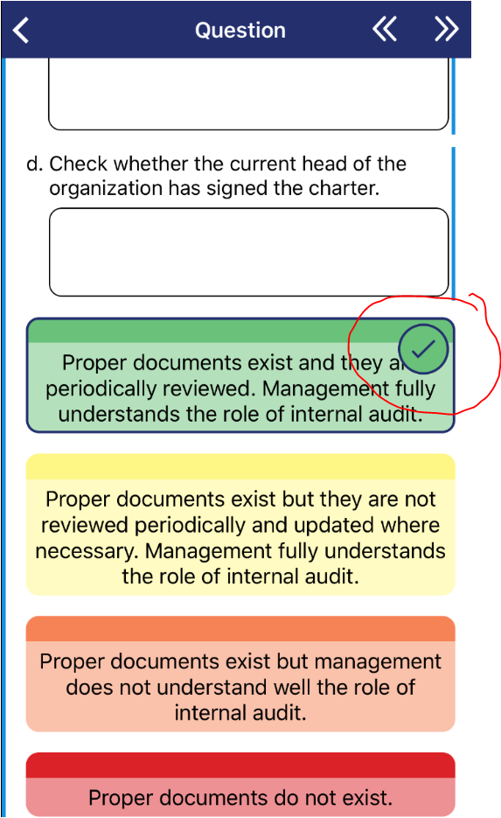
Our new Quality Assessment App

Slide 10
The Way Forward
Priority themes for 2017-2018:
Internal Control WG - FMC implementation with emphasize on accountability and transparency (ICWG)
Audit in Practice WG - Practical implementation of audit cycle, different type and models of audits, including IT solutions (AiP WG)
Central Harmonization Units: challenges at different stages of reform
Promotion of IACOP, including the existing knowledge products and experience gained in ongoing and previous working groups: RIFIX, T&C, CPD, RA, QA
The format of events proposed:
Plenary, working group, thematic meetings, ExCom members and leaders’ meeting, study visit
Promotion activities, including distribution and of existing knowledge products
IACOP peers’ advisory missions and reverse study visit (type of thematic meeting)
Videoconferences, webinars (for thematic meetings)

Slide 11
Thank you

