Slide 1
Personnel registry and labour cost accounting in MFERAC system
MFeRAC
Marjeta Bančič, marjeta.bancic@mf-rs.si
Paula Kolenko, paula.kolenko@mf-rs.si
Slavko Lenarčič, slavko.lenarcic@mf-rs.si

Slide 2
Content
Personnel registry
Payroll
System architecture
Development, maintenance and support

Slide 3
Legislation
Civil Servants Act (ZJU)
Decree on internal organisation, post classification, posts and titles in the bodies of public administration and justice
Public Sector Salary System Act (ZSPJS)
Decree on uniform methodology and forms for calculation and payment of salaries in the public sector
Decree on salaries of directors in the public sector
Fiscal Balance Act (ZUJF)
Other labour legislation and regulations (Employment Relationship Act, Collective labour agreements, …)
Special legislation and other regulations
....
Notes:
Rešitve, ki morajo biti dolgoročno stabilne so urejene v zakonu o javnih financah. Rešitve, ki so potrebne za izvršitev letnega proračuna so predmet letnega zakona o izvrševanju proračuna kot spremljajočem zakonu ob proračunu. Minister za finance in vlada imata pooblastila, da uredita številna vprašanja operativne narave s pod zakonskimi predpisi, kot so pravilniki (npr. pravilnik o postopkih za izvrševanje proračuna), odredbe ( npr. odredba o funkcionalno-programski klasifikaciji državnega proračuna), sklep vlade, ki regulira neko področje ali določa izvajanje nekega ukrepa.
Vsi navedeni zakonski predpisi vsebujejo rešitve, ki določajo in opredeljujejo načela in postopke izvrševanja proračuna. Z njimi se želi vzpostaviti postopke in inštrumente, ki bodo omogočili pravilno, namensko, gospodarno in učinkovito izvrševanje proračuna in v končni posledici uspešnejše delovanje države.
Zakon o računovodstvu ureja vodenje računovodstva v javnem sektorju. Pravilnik o enotnem kontnem načrtu in Pravilnik o računovodstvu MF detajlneje urejata vodenje računovodstva.

Slide 4
KE-SD
Personnel registry and labour costs
  Personnel registry
    Unified management of personnel registry for all state institutions
    Central personnel registry of state administration
    Central personnel registry of judicial authorities
    Personnel departments working in a unified manner
  Labour costs accounting
    Unified payroll of budget users (+ scholarships, other labour costs: employment contracts, freelance contracts, ... )
    Transmission of data to external institutions
    (Tax Administration, Pension Funds, AJPES, Health Insurance Institute, Public Payments Administration, Banks ....)
    Connections between applications KE-SD, DPS and GKS - financial control measures, crediting liabilities and realization

Slide 5
HR processes supported in KE-SD
Human resource planning
Job post classification
Employment of civil servants
Promotion (horizontal and vertical), positioning and fixing of salary
Vacation of civil servants
Education, training, career development and other rights of civil servants
Employment termination

Slide 6
Preparation of systemization
Catalogue of job posts for organizational unit
Human Resources Plan
Organisational
structure of unit
Procedure of job post
classification
confirmation
Act of internal
organization
and job post
classification

Slide 7
Preparation of contracts
Public servant data
Job post
classification
CPR
Central Population Registry
Employment Contracts
Employment Contract
Payroll

Slide 8
Human Resources reporting
The system offers a lot of reports on:
Human Resources plan
Job post classification
Contracts, promotions and evaluations of civil servants
Data on civil servants including payroll…….

Slide 9
Payroll accounting and budget control
Personal data
(Years of service, bank transfer data, ...)
Budget control
Employment Contracts
Decrees
Payroll
payment
system
Work Absence Tracking
Payment orders
Accounting
journal
GL
Receipts,
Deductions
Print of wage checks

Slide 10
Payroll accounting and budget control
Emp/Cont /Scholar | Budget user | Accounting implementer | EXTERNAL INSTITUTIONS
 | Data entry | Accounting parameters entry
 |  | Accounting
 | Checking regularity of accounting
 | Budget control
 | Payment and submission of data
 |  |  | Bank transfer
1
2
2
3
4
6
6
7

Slide 11
Budgetary control and general ledger
Budgetary control - certifying and signing of Decrees,
Preparation of payment orders
Payment: Payroll, taxes, insurances, ...
Data transfer of executed salary payments into the General Ledger

Slide 12

Payroll accounting
Personal data
(Years of service, bank transfer data, ...)
Employment Contracts
Banks
FURS
ZPIZ
ZZZS
Vzajemna
KAD
PPD
AJPES
UJP
SURS
Payroll
Work absence tracking
Receipts,
Deductions
Print of wage checks

Slide 13


Disbursement of wages
UJP
BS
MFERAC
KE-SD
Payment order
Notes:
13

Slide 14






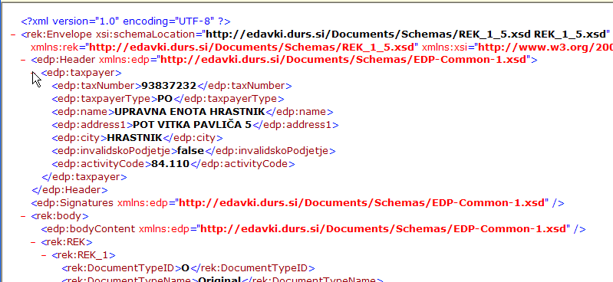
Transmission of data to institutions
Pension and Disability Insurance - M4 form
- data on wages in PS
- Statistics
REK forms
Income tax
MFERAC
KE-SD
Fund ZVPSJU
Fund SODPZ
PZZ
TRR
CREDITS
Zavarovalnica

Slide 15
Reports for staff and users
Output salary wage, which contains all relevant financial information
Information on Personal Income Tax
Information on paid contributions
Notes:
15

Slide 16
KE-SD in MFERAC system
APPrA
NOSD
ORD
FIX-Assets
eMA
INVOICING
CON
TRAVEL-O
KE-Human resouces
eCA
DPS
Budget
DPS
comitments
DPS
orders
SD
Payrolls
SPIS
Reporting
GEN-L
ACC-P
SULP
ACC-R
Scholar
-ship
P-CON
UJPnet
FIX-A
LOANS
FDCR
PL.PR
eVEM

Slide 17
Infrastructure
Client: PC, TS, TS Farm
User: Windows 7 , Windows 8.1, Windows 10
Server: HP UNIX, ORACLE database,
Development tools: Power Builder, ORACLE Designer
Network: HKOM – public administration fast computer network
Notes:
Arhitektura odjemalec strežnik je realizirana tako, da so podatki na baznem strežniku v MF (MNZ, MO), program je pri uporabniku. Zaradi lažje distribucije so aplikacije naložene na lokalnih datotečnih strežnikih.
Arhitektura odjemalec strežnik omogoča dobro razširljivost sistema. Ugotavljamo, da je trenutno glavno ozko grlo tega sistema počasno omrežje (HKOM) na nekaterih segmentih. Podatkovne strežnike periodično nadgrajujemo in zamenjujemo v skladu z naraščanjem števila uporabnikov. Na mestih, kjer je število uporabnikov manjše, smo začeli uvajati terminalske odjemalce, ki so priključeni na terminalski strežnik na MF.
Delovne postaje morajo biti preko hitrega komunikacijskega omrežja (MJU) priključene na bazne strežnike:
- operacijski sistem Windows 98, 2000 ali NT, podpora za MS TCP/IP, Oracle Developer 1.3.2 s SQL net, MFERAC Power Builder, urejevalnik besedil Word 6 (ali več) ali WordPerfect (za nalogo 4.2)
procesor najmanj Pentium II, 266MHz, pomnilnik RAM najmanj 64MB,
vsaj 200 MB razpoložljivega prostora na diskih, (dodatnih 300 MB, če so aplikacije MFERAC naložene na delovno postajo)
Bazni strežnik (na MF za naloge 1, 2, 5, 6, 7 in nalogo 4)
- operacijski sistem: Unix (IBM ali HP ali SUN) ali NT 4.0
baza: Oracle 8.1.5 (ali višje) ,SQL* Net 2.3.4 ,TCP/IP

Slide 18
Architecture – overall picture (with TSFarm)
PU
TS Farm
DP pri PU
HKOM
Public administration computer network
File server
MF
ROMA
DP pri PU
RDP klient
REPLIkacija
MNZ
REX
MORS

MFERAC

Slide 19
System management
Manage users and their rights
System administration:
  Database server
  Terminal servers
  Installation and distribution of new versions
  Production, testing and school environment
  Backup,
Informing of users

Slide 20
Users and support
 | MoF | MoD | MIA
Number of users (KE-SD) | 1630 | 575 | 205
Number of accrued wages | 21.579 | 12.500 | 9.000
Project | Projekt | Technical support
MF-SITS | 3+1 | 5
MF-DJR | 4+1
MIA | 2 | 2
MoD | 2
MPA | 1

Slide 21

Q&A

