Slide 1
Fiscal Framework in Latvia
Nils Sakss
Director of Department
Ministry of Finance

Slide 2
Hierarchy of Laws
Fiscal Discipline Law
Law of Budget and Finance management
Medium Term Budget Law
Annual Budget Law

Slide 3
Fiscal Discipline Law

Slide 4
Architecture
Numerical fiscal rules
Fiscal Discipline Law (FDL)
Top down fiscal planning
3 years fiscal framework
Medium term Budget Framework Law (MTBFL)
Annual budget
Annual Budget Law

Slide 5
Fiscal Discipline Law
Enactment
Main elements
Entered into force: 06.03.2013;
Applicable starting from 2014-2016 MTBF; Impact on budget laws from 2014.
Transitional provisions:
  Declaration of Fiscal Risks (DFR): from 2015-2017 MTBF;
  Fiscal Safety Reserve: 2014: 0; 2015: 0; 2016: 0,1%; 2017 and onwards: according DFR;
  Expenditure smoothing of EU Funds: from 2016;
  Expenditure smoothing of government debt service : from 2017;
  Fiscal Council : from 01.01.2013.
Numerical Fiscal Rules;
Fiscal Risks;
Fiscal Council.

Slide 6

3 Numerical Fiscal Rules
Balance rule
Cyclical part
Structural balance
One-off measures
=
+
+
Expenditure growth rule
Expenditure growth ( net GDP deflator): not more than the average potential GDP growth.
Expenditure ceiling
Fixed in MTBFL for each of next 3 years. Operational tool for preparation of Budget Law ( stabilization, equalization, exceptions).

Slide 7
FDL: interaction of fiscal numerical rules (1)
Not less than minimal allowed structural balance
-0,5% = MTO
Calculation of balance
Calculation of cyclical component
Adding one - off measures
Government decision of size of structural balance
(structural balance target (SBT))
Net of local government projected balance
Net of projected balance of derived public bodies
Net of ESA corrections
Central government revenue projections
Central government fiscal balance
Calculated CG expenditure ceiling (1)
-
=

Slide 8
FDL: interaction of fiscal numerical rules (2)
GG ESA expenditure in previous year
Permissible expenditure growth
Calculated GG ESA expenditure ceiling
Net of ESA expenditure corrections
Net of local government projected expenditure
Calculated CG expenditure ceiling (1)
Calculated expenditure ceiling
Net of derived public bodies projected expenditure
min
Calculated CG expenditure ceiling (2)

Slide 9
FDL: interaction of fiscal numerical rules (3)
Inherited ceiling from previous MTBF 2nd and 3rd year
difference < 0,1% GDP
Expenditure ceiling in MTBF for the 1st and 2nd year
difference
Calculated ceiling
difference > 0,1% GDP
Expenditure ceiling in MTBF for the 3rd year

Slide 10
Max permissible CG expenditure
Max. permissible CG expenditure may differ from CG expenditure ceiling due to allowed modulation.
CG adjusted expenditure
=
CG expenditure
ceiling
-
Debt service smoothed expenditure
-
EU projects smoothed expenditure
Max. permissible CG expenditure
=
CG adjusted expenditure
+
Actual debt service expenditure
+
Actual EU projects
expenditure
-
Fiscal Safety Reserve (FSR)
+
Fiscal Risk expenditure covered by FSR
+
expenditure under Escape Clause
balance neutral expenditure
+/-
+
special one – off (court ruling)

Slide 11
Escape clauses
Natural catastrophes, disasters and other material losses caused by natural or social processes. (>0,1% GDP);
In case of threat to national security according to article 62 of Latvian Constitution;
In case of severe economic downturn (recession).

Slide 12
Fiscal risk management
Fiscal risk management:
  Regular identification, disclosure and mitigation;
  Declaration of fiscal risks annexed to MTBFL;
  Fiscal safety reserve: ( expenditure ceiling in MTBFL – expenditure in Budget Law) depending of fiscal risks, at least 0,1% of GDP.

Slide 13
Modulation
≠
In each single year
Max. permissible CG expenditure
CG expenditure
ceiling
=
In long term
Projected structural balance
≠
Structural Balance Target
In each single year
=
In long term
First «defense line»
Second «defense line»
Expenditure smoothing
Fiscal safety reserve
Automatic correction mechanism

Slide 14
Automatic correction mechanism
(based on Swiss debt break rules) notional account registering deviations of actual structural balance (+/-) from its planned targets. If cumulative deviation is negative and higher than 0,5%, correction is triggered automatically by improving structural balance in next MTBF by extra 0,5% until deviation is fully compensated.

Slide 15
Fiscal Council
http://fiscalcouncil.lv/council
Fiscal Council: main task - monitoring implementation of fiscal rules.
  No direct mandate for independent macroeconomic forecasts, (in meaning of producing or endorsing macroeconomic forecasts), however will provide its opinion, which is not binding.
  issuing annual report and irregularity reports;
  Government response: comply or explain;
  6 members;
  independence safeguards (removal from office, financing).

Slide 16
Fiscal Council (2)
status
Fiscal Council is independent collegiate institution established for the purpose of monitoring of the compliance with this Law.
Council consists of six members;
1) three members of Council are nominated under the joint proposal of president of Bank of Latvia and minister of finance;
2) three members of Council are nominated by at least ten members of the Parliament.
Members of Council shall be experts in financial and economical field from Latvia or from other member state of the European Union with experience in fiscal policy issues.
composition
Members of Council shall be elected by Parliament for six years. The same member of Council shall be reelected not more than twice in consecutive order.
appointment

Slide 17
Financial safeguard mechanism
Hourly salary rate for Council members is determined by applying a coefficient 0.056 to the amount of the average monthly remuneration.
salary
Operational expenditure of the Council shall be planned by Ministry of Finance in separate budget programme under Ministry of Finance prescribing:
  1) remuneration of members of the Council for at least six meetings per year, inter alia for at least eight hours for preparation for each Council meeting;
2) remuneration for Secretary of the Council;
  3) expenditure for external experts not less than 50 percent of the Councils members and Councils Secretary remuneration fund;
  4) compensation of travel expenses and accommodation
budget

Slide 18
Fiscal Space
If positive fiscal space is projected, the procedure for new policy initiatives is launched
Fiscal Discipline Law
Max. permissible CG expenditure
Fiscal space
Previous year CG expenditure
-
one –off expenditure n-1
+
one –off expenditure n
+
adjustments of automatic mechanisms
=
Budget bases

Slide 19
New policy initiatives
After government take a decision to launch new policy initiatives :
Each ministry may submit a proposal for new policy initiatives ;
Proposals are evaluated by cross-sectoral coordination unit and Ministry of Finance.
Evaluations are made against approved development programmes.
All proposals are ranked and presented to the government.
In theory
Government decided to fund measures ranked highest.
Decisions are political taking into account political pressures and governments own perception of most important measures.
In praxis

Slide 20
Maximum permissible amount of the State budget expenditure (bottom- up)
For each ministry maximums permissible expenditure has been determined (bottom up).
maximum permissible expenditure
approved new policy initiatives
budget basis

Slide 21
MTBFL
Structural balance targets have been set for 2016;2018;2018 (-0,9;-1,0;-0,8)
CG adjusted expenditure 2016;2018;2018

Slide 22
MTBFL annex
Top down
(Max. permissible CG expenditure)
Free fiscal space
CG expenditure ceilings in MTBFL
Initial fiscal space
Bottom up
(CG expenditure under no change policy)
Budget basis

Slide 23
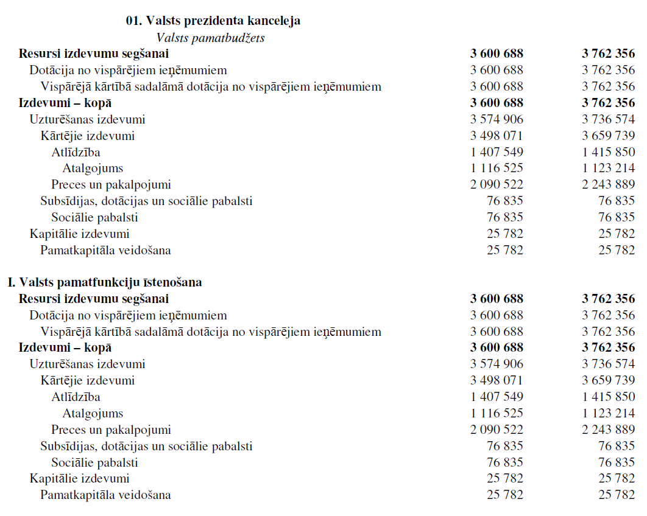
Example of how max. permissible expenditure has been determined
2014
2015

Slide 24
Main Challenges Ahead

Slide 25
Vision
Present | Future
Each year ministries struggles for funds. Good minister is minister who gat more money to his sector | Expenditure for each ministry growing according specific formula. Good minister is minister who get better results with funds available.
No direct link of development programmes and the funds | The reserve has been allocated to support new programmes. Programmes are approved only if funds are allocated.
the thoughts are occupied how to satisfy the next year funding needs | Focusing on medium and long term strategies
some GG sub –sectors out of fiscal control | Fiscal solidarity principle implemented
Weak understanding of GG ESA methodology | General Government accrual reporting is understood by civil servants and politicians.

Slide 26
Open questions
What is a role of rules in budget planning in your country;
Budget preparation – political tool or rules based process – what balance is desirable and realistic?
How to convince politicians to use more rules in budget planning?
Complexity of rules – can it be avoided?

Slide 27
End of presentation

