Slide 1

e-Croatia e-Citizens
Leda Lepri, BEng, MSc
Assistant Minister for e-Croatia
Ministry of Public Administration

Slide 2
2012 Public Sector Informatisation
Coordination Commission
Ms. Milanka Opačić, Deputy Prime Minister of GRC, Chairwoman
11 Ministers, members
11 Ministers, members
11 Ministers, members
11 Ministers, members
L. Lepri, Coordinator
D. Parić, Adviser to Chairwoman

Slide 3


2012 Integration of Basic Registers
2012
Birth Register, Death Register, Marriage Register, Citizenship Register, Electoral Register
2015
Any official document available in entire Croatia

Slide 4

Central Payroll System – COP (Centralni obračun plaća)
RegZap (Registar zaposlenih – Register of Employees)
2,200 institutions (2 excluded – legal issues)
  Information about employees (250,000)
COP (Centralni obračun plaća – Central Payroll System)
  Single system with RegZap
  2 institutions don’t receive wages
  Payroll for 250,000 persons
Advantage:
  Itemised wage breakdown
  Information for negotiations with trade unions
  Wage simulations
  Human Resources management
Implementation issues:
Collective Agreement Systems

Slide 5
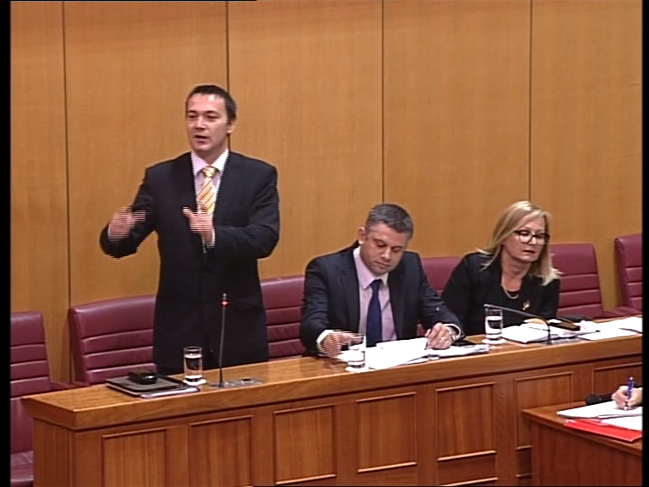
List of legislation
National Information Infrastructure Act (OG
92/2014),(RC information, ProDII, Metaregister, e-Citizens, OOS)
1
Regulation on the Public Register for National Information Infrastructure Projects Coordination (ProDII) (OG 134/2014)
2
3
Decision of the Government of the RC on the Establishment of the National Information Infrastructure Council (OG 72/2015)
Regulation on Organisational and Technical Standards for Connecting with the National Information Infrastructure
(OG 103/2015)
4

Slide 6
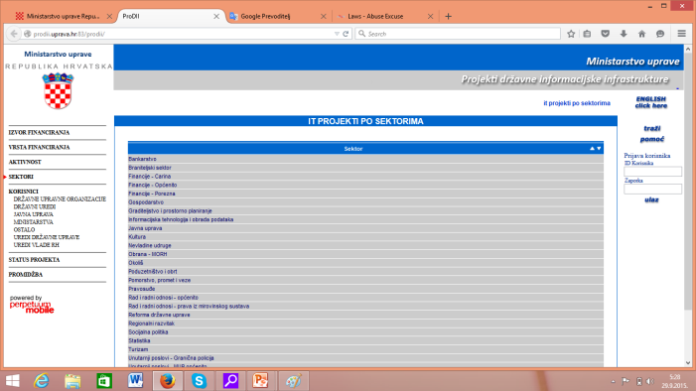
ProDII Public Register
Public Register for DII
(National Information
Infrastructure)
Projects Coordination
Purpose:
ICT projects monitoring and coordination
Rationalisation of investments in ICT projects in the public sector
Transparency of public administration concerning ICT projects

Slide 7

Metaregister
Collaboration tool for the purpose of:
Outline of all public registers (electronic and book registers):
  Information
  Connection and data downloading service
  Announcement of structural changes
  Responsible persons and institutions
Data collection according to the
principle
Once – only
Fundamental interoperability system

Slide 8
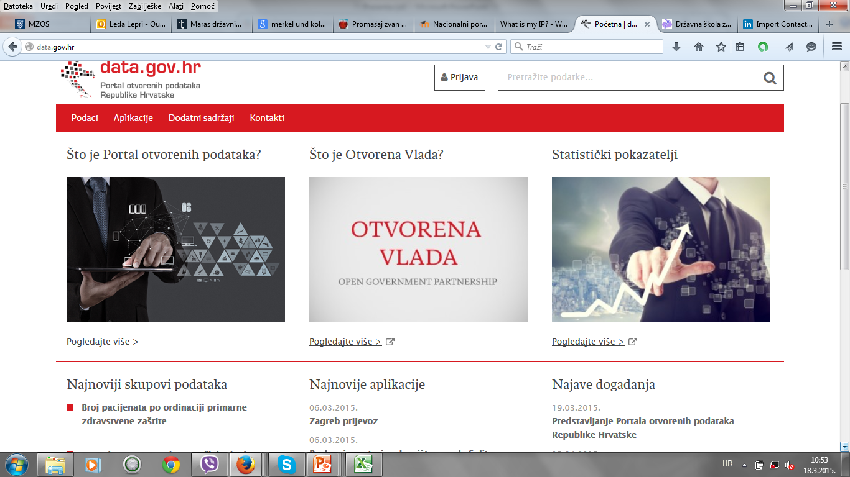
Open data portal data.gov.hr

Slide 9
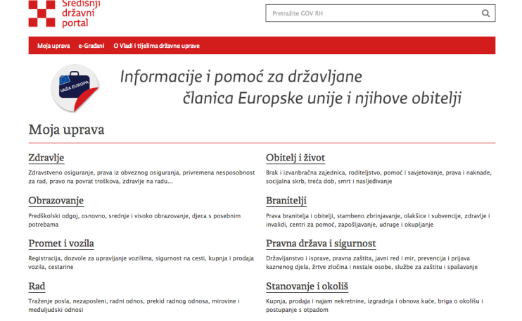
Multi-service approach to public administration reform
CENTRAL PORTAL – GOV.HR

Slide 10
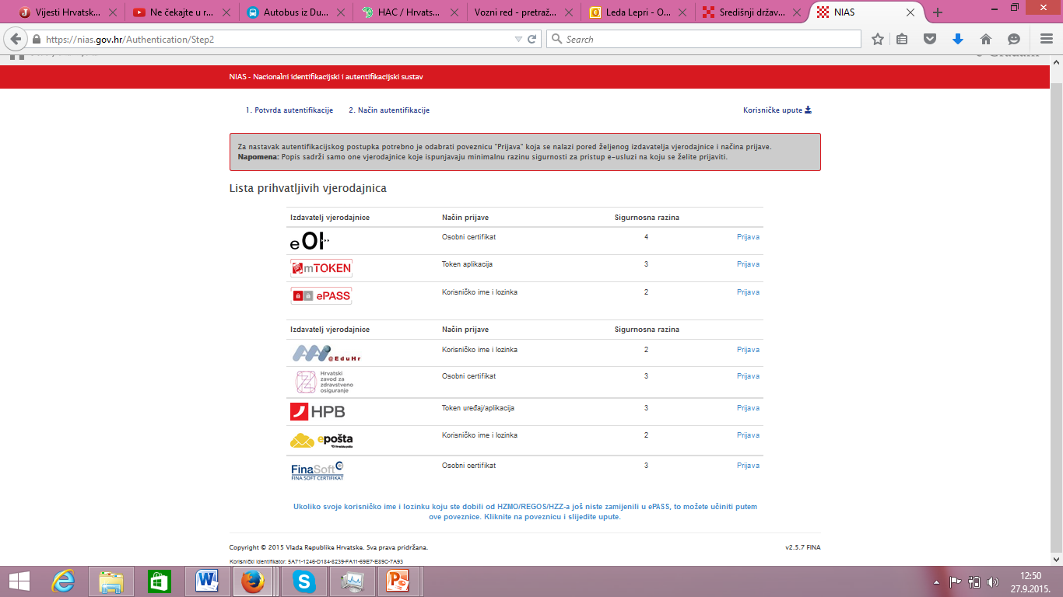
Single Sign On – NIAS (National Identification and Authentication System)
Internet
banking access integrated

Slide 11
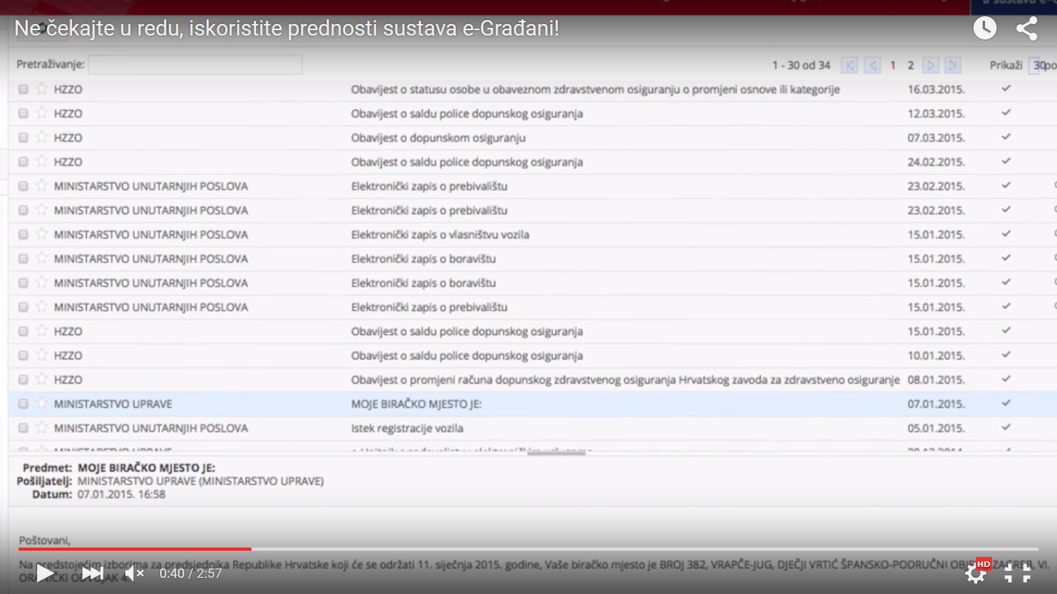
Personal User Inbox

Slide 12
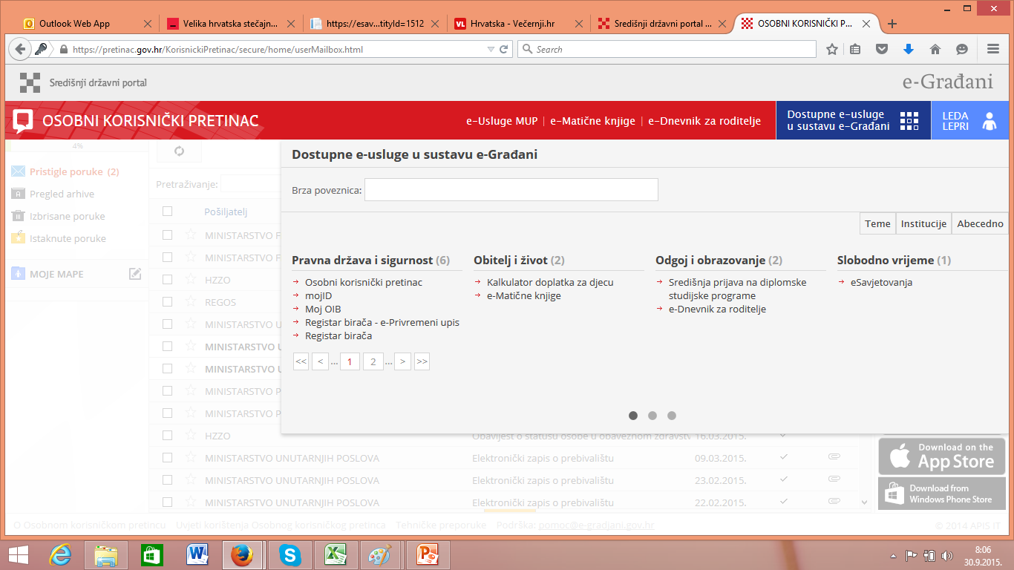
e-Citizens
Customer Oriented e-Government

Slide 13
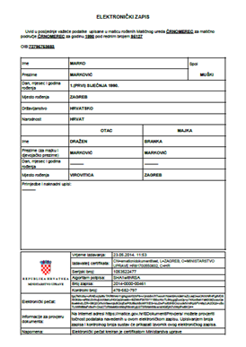
Electronic record

Slide 14
Top 5 e-services of 27 existing services
e-Registers
  Online access to documentation from Birth Register, Marriage Register, Death Register
e-Prescriptions
  List of medications prescribed in the last 6 months
e-Consultations
  Provides access to and impact on decision-making
e-Gradebook
  Connects parents, pupils and teachers
  Raises the quality of education results
e-Electoral Register
  Enables registration of voters at polling stations outside their place of residence
        …trades and crafts

Slide 15
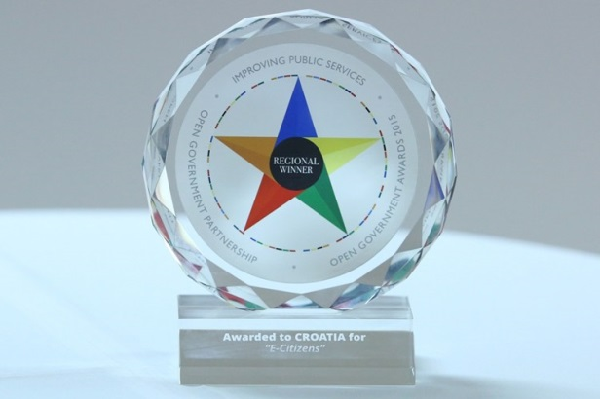
e-Citizens Statistics
E-Citizens declared the best and most innovative regional project in the region Europe for e-administration, at the Global Summit Open Government Partnership Initiatives 2015 in Mexico
200,567 portal users
400 new users / day
from 14 e-services to 28 e-services
2 services / month
3,402,321 uses of e-services

Slide 16

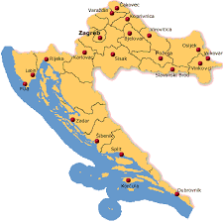

3 years ago….
Dubrovnik-Zagreb
2 days out of office and
Airplane: 85 €
Bus: 50 €
Blablacar: 45 €
Car: 160 €

Slide 17

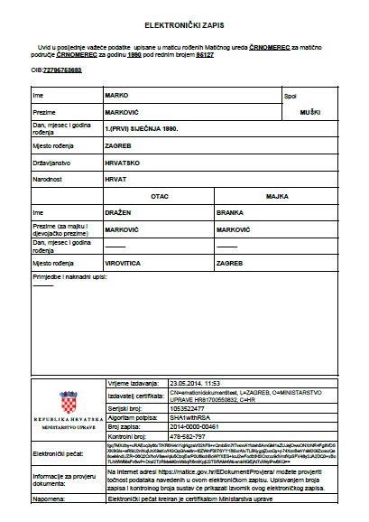
Today…
Dubrovnik-Zagreb
No days out of office
Cost: 0 €

Slide 18
New business model – Cloud Computing
Ministry of Public Administration in charge of strategy and policy
(Administration for e-Croatia)
Private sector
Public procurement
PSB 1
New IT solutions
PSB 2
Application of transition model
Business requests
Analysis
Proposal
National cloud service
PSB 3
PSB n
Notes:
Drafting a new solution:
Preparing the tender dossier (framework agreement)
Implementation of public procurement procedure
Selecting the tenderer(s)
Signing a contract with the Ministry
Signing a contract with a sub-contractor

Slide 19
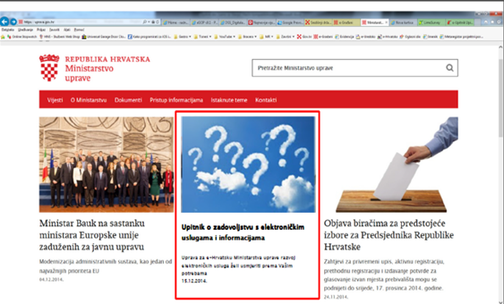
Questionnaire

Slide 20

e-BUSINESS / BUSINESS USER INBOX

Slide 21
e-Business
Project of the GRC with the aim of facilitating online cooperation between public administration and business entities
Online pilot since 1 October 2015 on https: //*.gov.hr
Basic components:
  Portal with public information for business entities
  National Identification and Authentication System for Business Entities (NIASeP)
  Business User Inbox (PKP – Poslovni korisnički pretinac)
  E-services for public entities

Slide 22
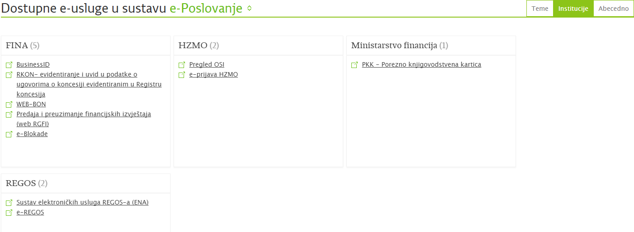
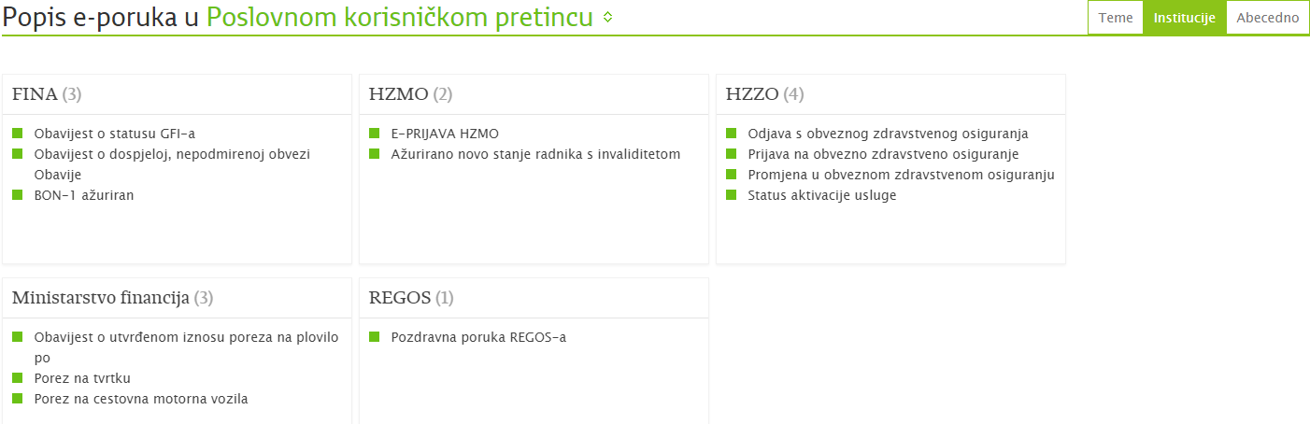
e-Services and messages

Slide 23
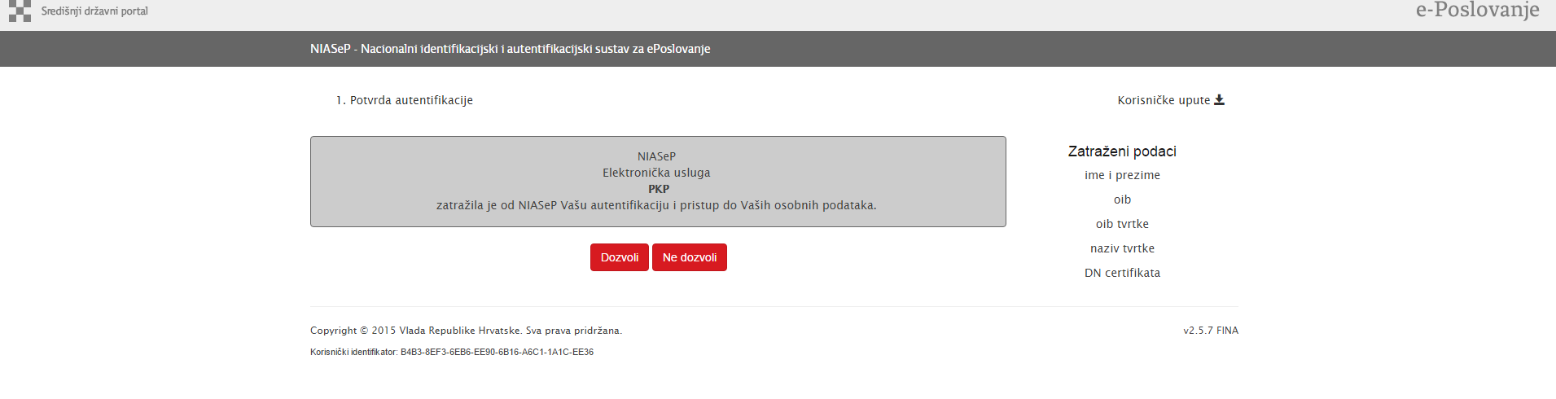
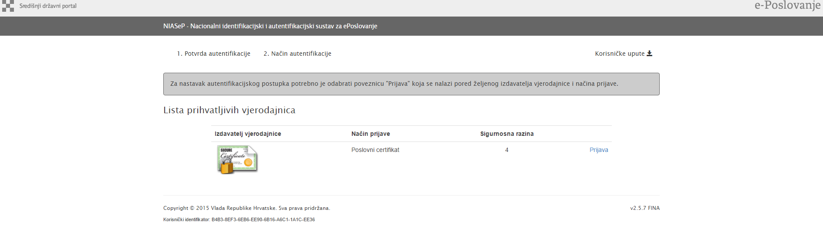
Registration

Slide 24
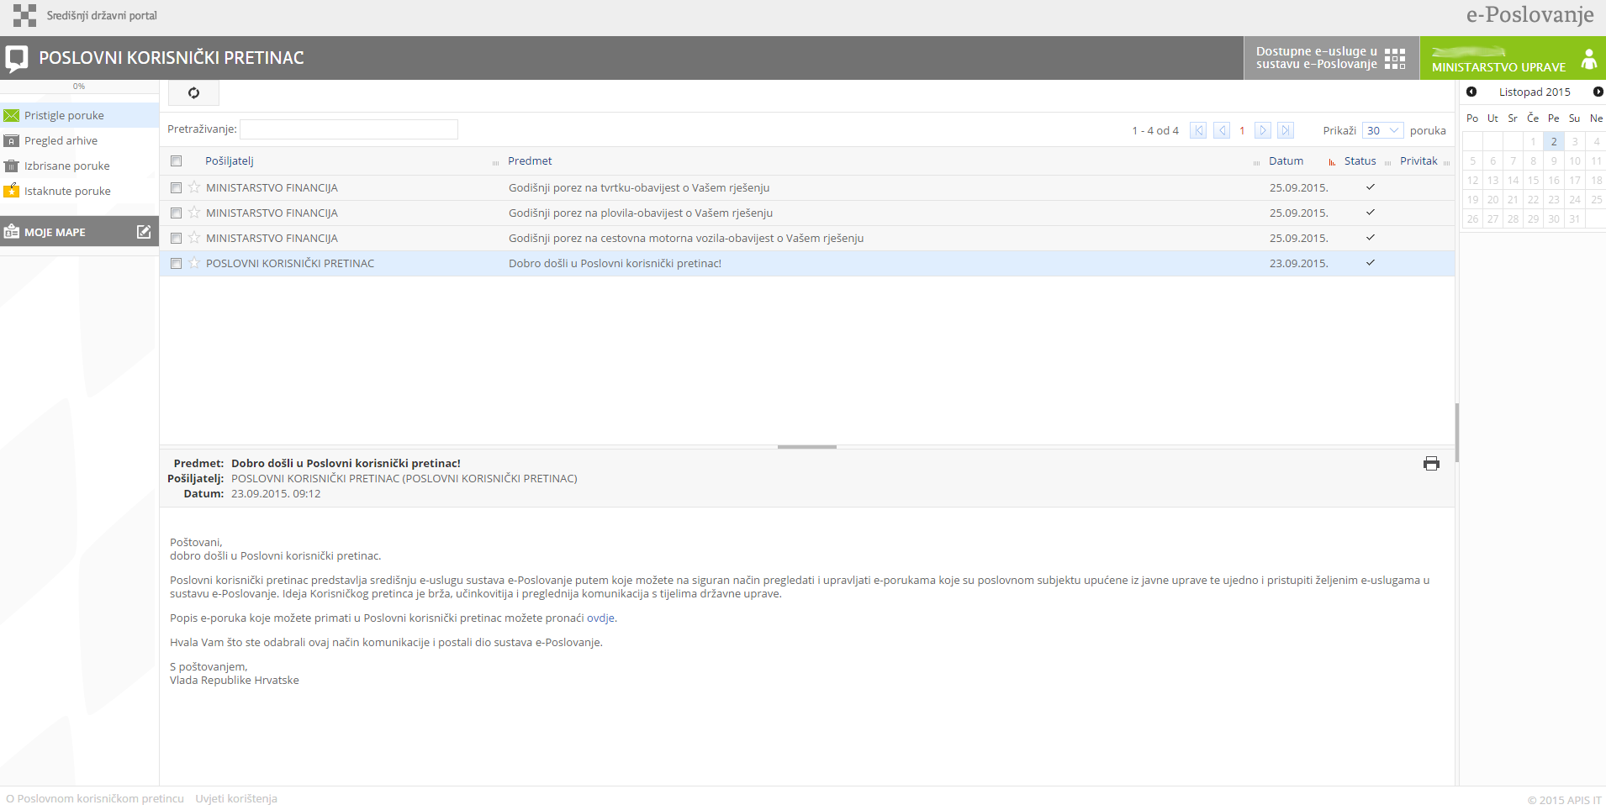
BUSINESS USER INBOX (PKP)

Slide 25
And this is only the beginning…
…authorisation, e-babe, e-Business,
cross-border e-services……
Thank you!!
e-mail: llepri@uprava.hr

