Slide 1
UNIFIED INFORMATION SYSTEM FOR INTERNAL AUDIT

Slide 2
USERS
• Head on Internal Audit Division
• Group Leaders
• Auditors
• Entity’s Head
• Authorized Body
• Administrator

Slide 4
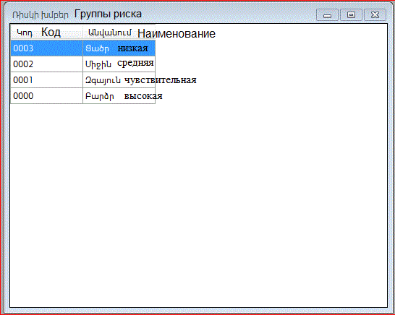

Slide 5
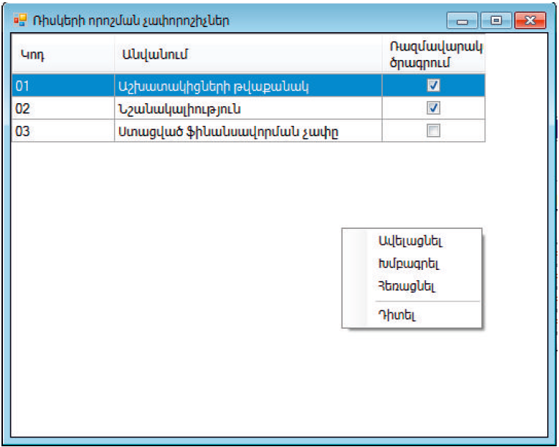
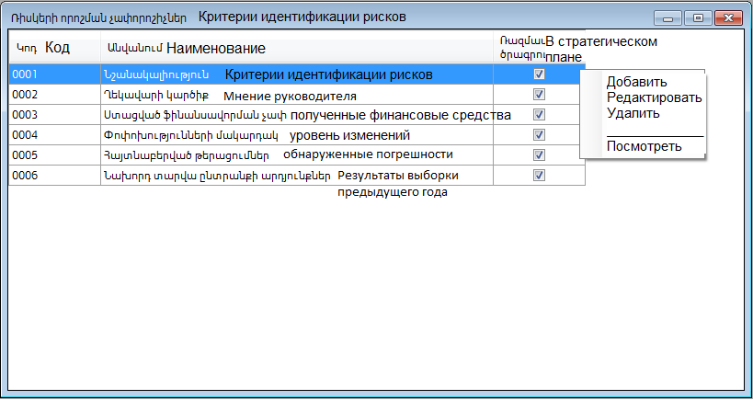

Slide 6
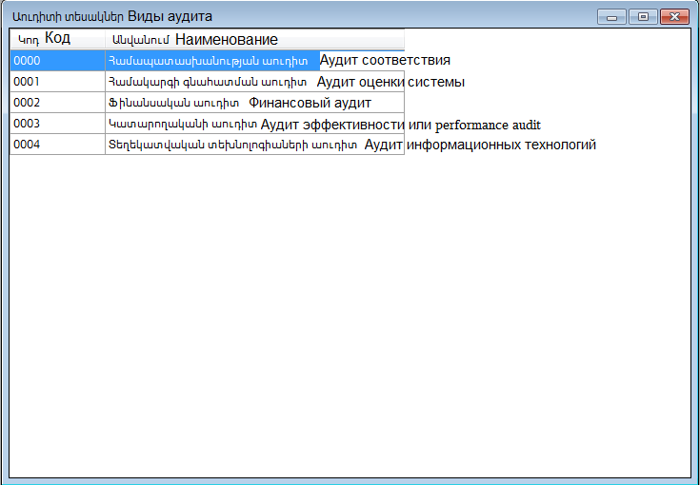

Slide 7
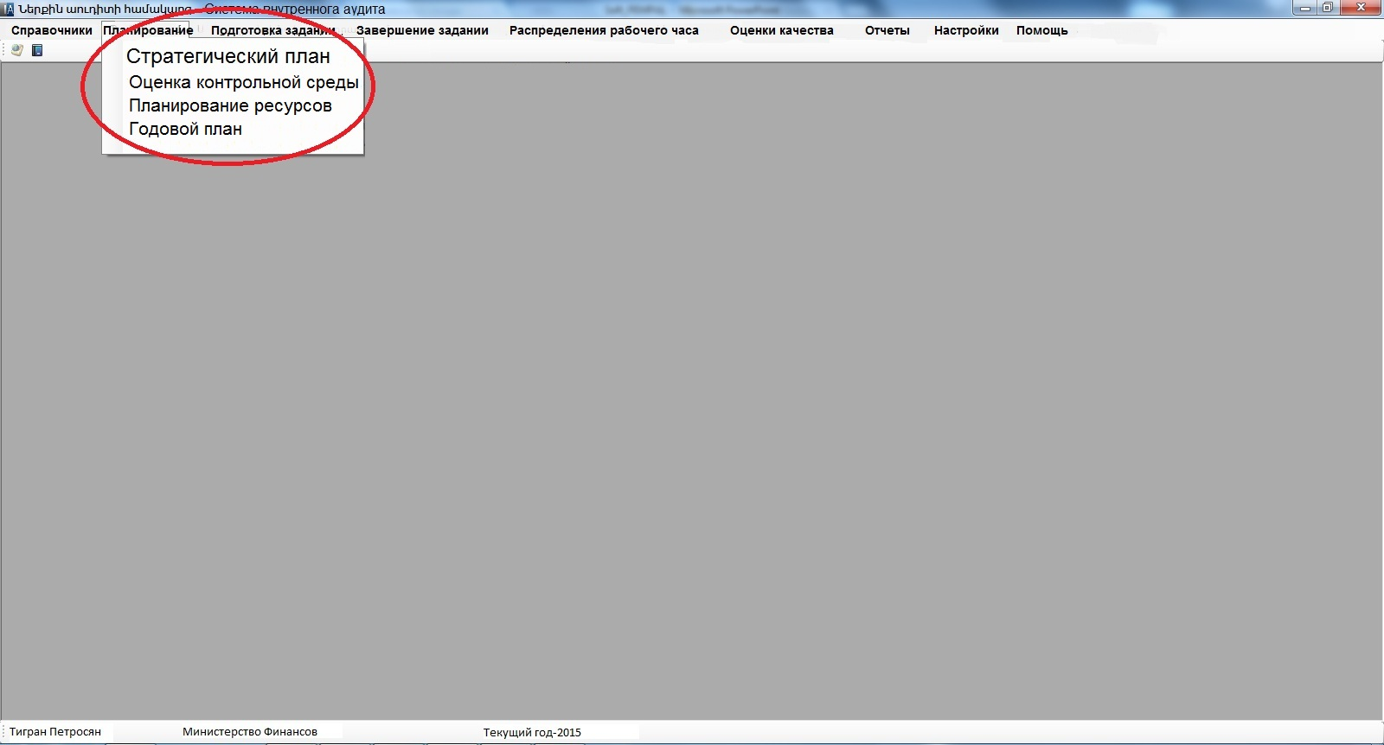

Slide 8
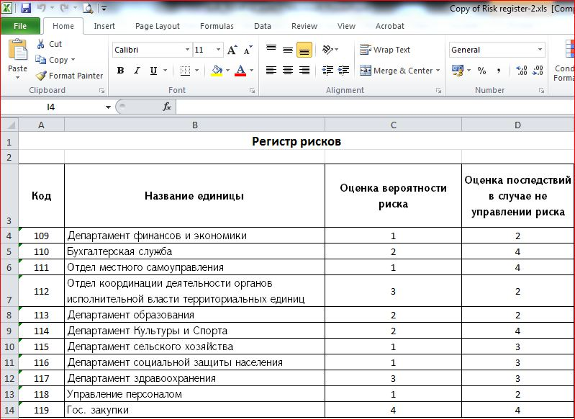

Slide 9
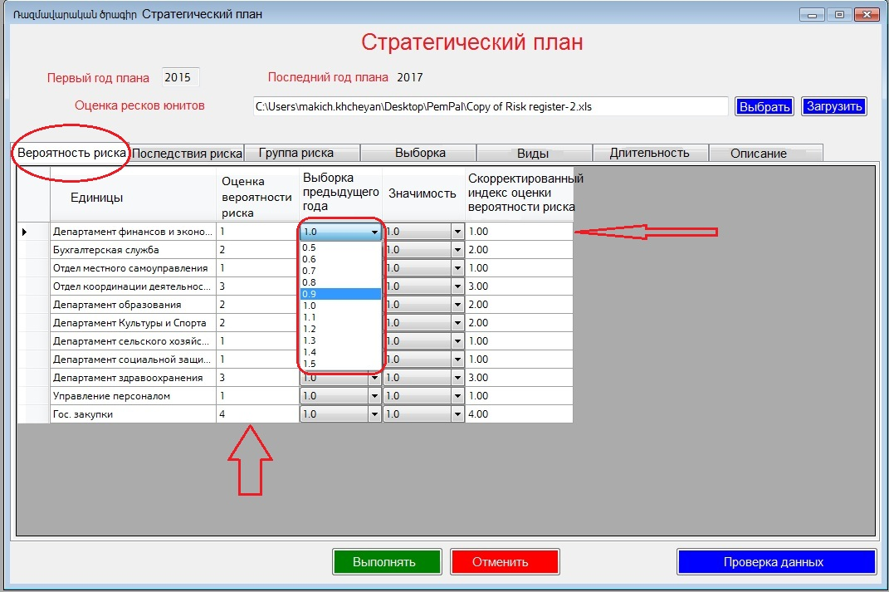

Slide 10
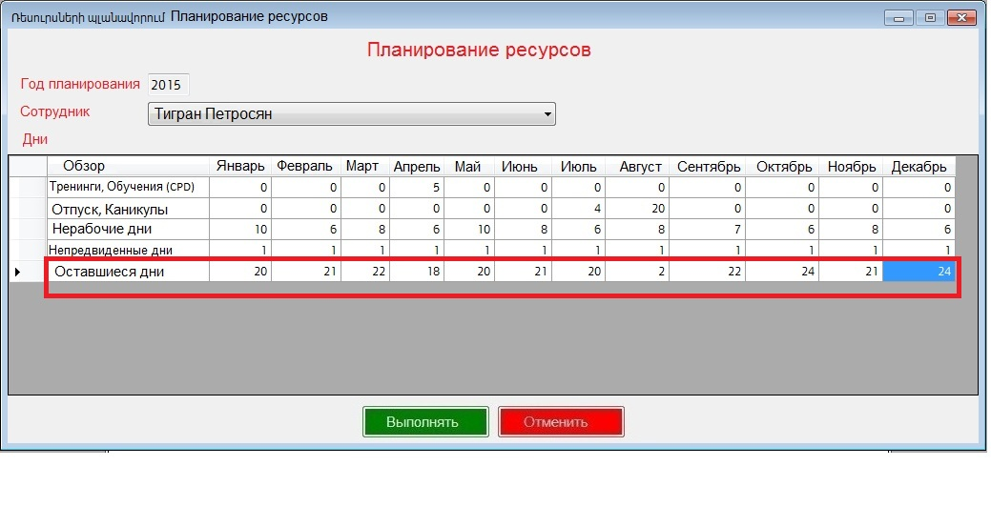

Slide 11
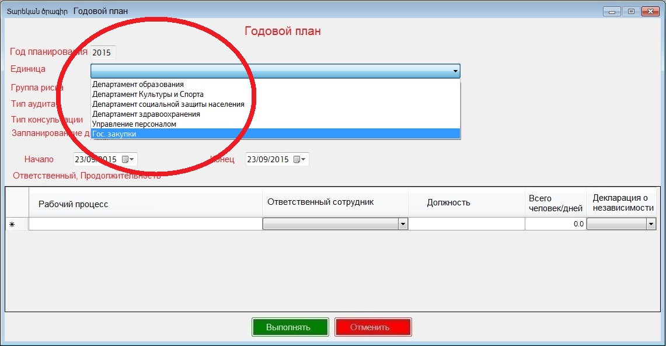

Slide 12
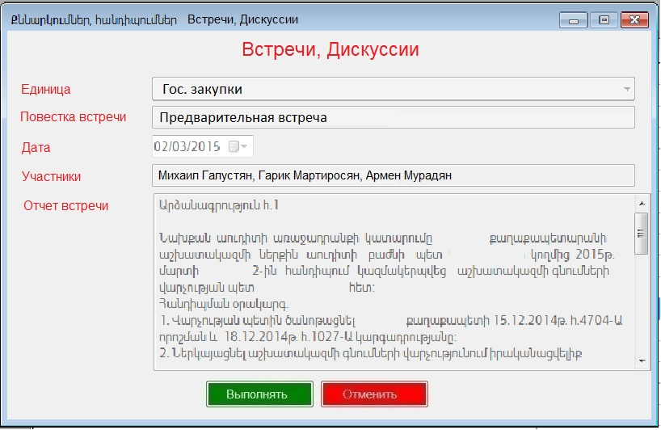

Slide 15
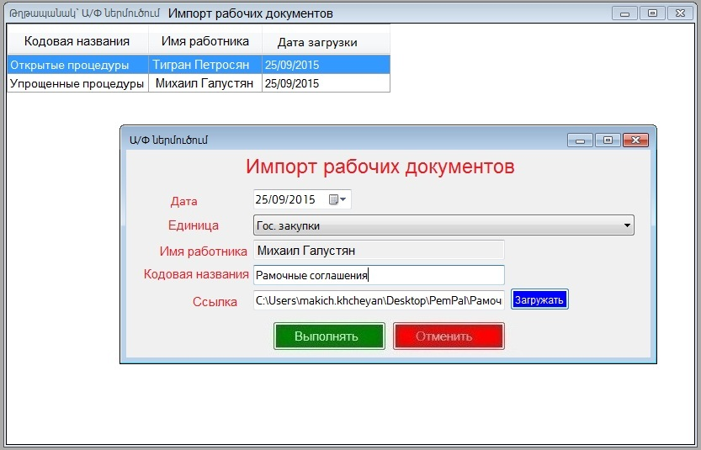

Slide 17
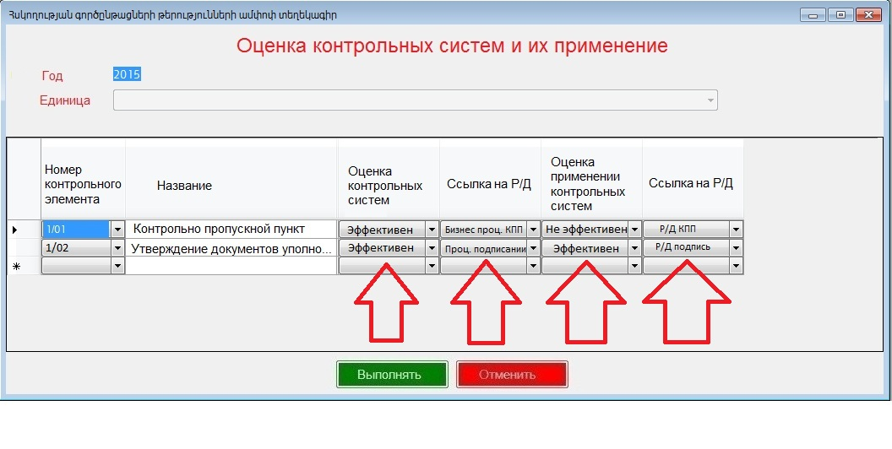

Slide 18
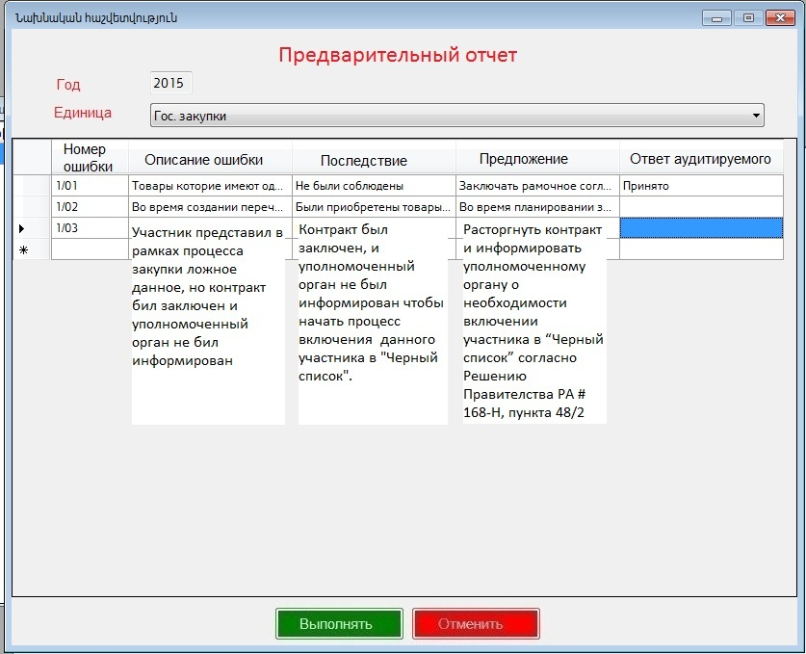

Slide 19
THANK YOU FOR YOUR ATTENTION!
Karen Sedrakyan
Head of Internal Audit Department
Email: Karen_Sedrakyan@taxservice.am
Tel. +374-60-544-789

