Slide 1



  PEMPAL Strategy
  2012-17
  Mid-Term Review
  of Implementation Progress
Elena Nikulina PEMPAL Team Leader, Deanna Aubrey Strategic Adviser
Cross-COP Executive Meeting, Vienna July 16-17, 2015

Slide 2
OBJECTIVES OF MID-TERM REVIEW (MTR)
Review implementation progress at Strategy’s mid-point ie for first 2.5 years from June 2012-December 2014:
  Whether objectives remain achievable within target timeframes and existing resource constraints;
  To formulate proposals for adjustments, which could include adjustments to the Strategy, its results framework, and costings in light of implementation experience; and
  Manage any emerging risks that may impact on full implementation of the Strategy.

Slide 3
INPUTS TO THE REVIEW
COPs prepared submissions based on information required to measure the key performance indicators included in the strategy’s results framework (refer concept note).
Donors provided written comments.
Former Secretariat collated administrative and performance data in accordance with key performance information requirements.
All members invited to participate in an online survey. COP specific and PEMPAL survey results reports produced.
  Draft MTR report was prepared summarizing the results, including reviewing progress of 15 actions in strategy and analyzing available baseline and performance data for 35 performance indicators.

Slide 4

REVISITING THE STRATEGY AND THE RESULTS FRAMEWORK
GOAL: PEMPAL member Governments from Europe and Central Asia more efficiently and effectively use public monies resulting from applying new PFM practices.
OUTCOME: A sustainable, professional public financial management platform through which individual members are networked to strengthen their capacities and to enable them to share learnings and benchmarking between countries.
Objective 4: Awareness of high government and political levels is raised regarding the benefits and value of engaging through PEMPAL
IMPACT
Objective 2: Quality resources and network services, supporting relevant PFM practices, are provided to members
Objective 3: A financially-viable network of public financial management professionals, committed to improving PFM practices, is built and maintained
QUALITY
Objective 1: PFM priorities of member governments are addressed by the PFM network platform
DEPTH AND RELEVANCE

Slide 5
Goal/Impact : PEMPAL member Governments from Europe and Central Asia more efficiently and effectively use public monies resulting from applying new PFM practices
  6 BCOP, 12 TCOP and 17 IACOP countries showing positive impact (refer COP presentations for examples).
  PFM Indicators not comprehensive or up to date across region, but evidence of surveys being regularly used to ascertain reform progress and success stories showing positive impact of PEMPAL.
    A more systematic approach to documenting success stories is needed.
    MTR survey results suggest further opportunities to facilitate members translating learnings into changed practices in work environment.
    MoF Russian Federation suggests to investigate terms and conditions that contribute to PFM development in each member country, to better understand how PEMPAL can strengthen reforms.
  Notwithstanding methodological challenges of measuring the impact of the strategy, PEMPAL has had a visible impact at the member country level.

Slide 6
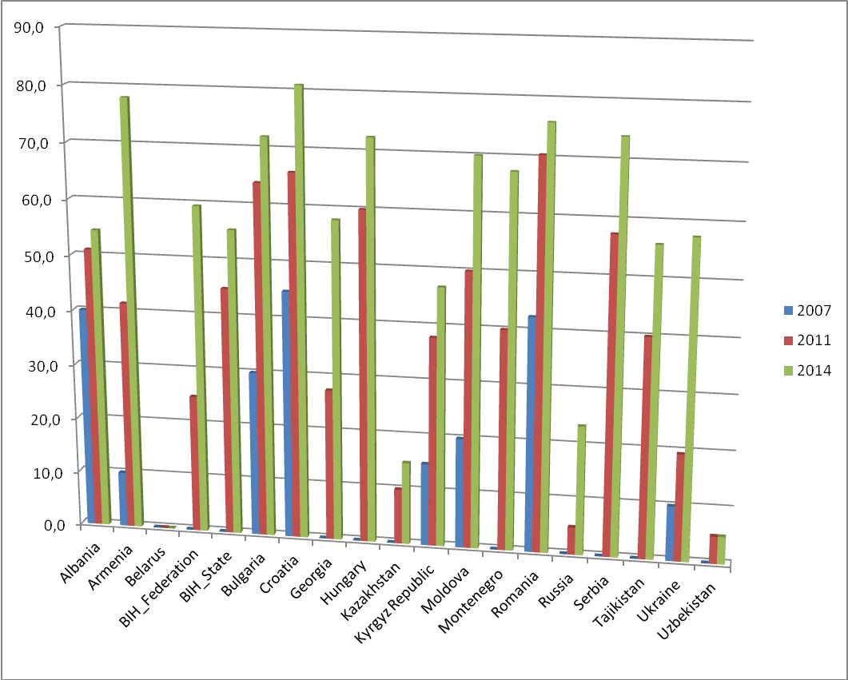
For IACOP, impact assessed as significant (above 75%) in nine countries, high (45-75%) in three countries, moderate in five countries (15-45%), and low (under 15%) in only one country, with increases in impact evident from 2007 and 2011.

Slide 7
  Outcome: A sustainable, professional public financial management platform through which individual members are networked to strengthen their capacities and to enable them to share learnings and benchmarking between countries
    Satisfaction ratings taken from post event surveys, have remained consistently high ranging from 4.3 to a maximum of 5.0 in CY12, CY13 and CY14.
    Opportunities provided by PEMPAL were rated highly. MTR survey respondents feedback (4.4-4.6/5.0) on opportunities to: build relationships with peers in region; build a knowledge base in area of expertise; and bring back learning from COP events and share with organizations.
    Sustainability beyond the current Strategy period is a matter of concern
      Approaches to mitigating the associated risks need to be looked into in the context of upcoming discussions on the future of PEMPAL.
  Good progress is observed at the outcome level of the Strategy, with evidence of new and improved knowledge in PFM practices and continuing and rising high levels of satisfaction.

Slide 8
Feedback from post event surveys remains positive and shows improvement over the review period in most categories.

Slide 9
PEMPAL Output Objectives
Objective 1: PFM priorities of member governments are addressed by the PFM network platform
DEPTH AND RELEVANCE

Slide 10
Objective 1: PFM PRIORITIES OF MEMBER GOVERNMENTS ARE ADDRESSED BY THE PFM NETWORK PLATFORM
Consultation processes to develop member driven action plans strong across all COPs. Increasing use of smaller working group/study visit formats is proving to better target member needs. 13 working groups are currently operating across the network.
COPs need to communicate the strategic underpinnings of their action plans and the progress of activities more effectively to donor partners.
Collaboration between the COPs on cross-cutting themes of joint interest needs further improvement.
  annual cross-COP Executive Committee meetings and periodic cross-COP member meetings held; some cross-COP meeting participation but no evidence of cross-COP projects or initiatives.
Recording and reporting of some types of cross-COP exchanges needs strengthening (ie COP members attending events of other COPs).
Available evidence suggests that mechanisms developed by PEMPAL to target PFM priorities of member governments are working well.

Slide 11
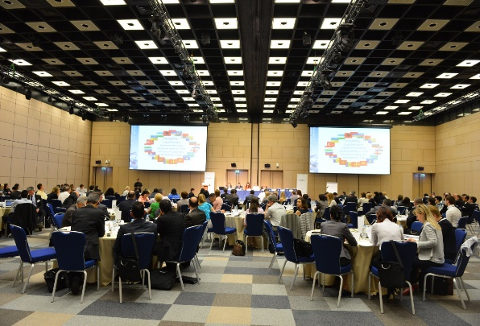
INTEREST SHOWN IN CROSS-COP WORK
AT 2014 MOSCOW PLENARY MEETING

Slide 12
PEMPAL Output Objectives
Objective 2: Quality resources and network services, supporting relevant PFM practices, are provided to members

Slide 13
Objective 2: QUALITY RESOURCES AND NETWORK SERVICES, SUPPORTING RELEVANT PFM PRACTICES, ARE PROVIDED TO MEMBERS (1)
Materials provided by PEMPAL were rated good quality or high quality by most respondents to the MTR surveys, increasing in most types since 2012.
Evidence of more focus by COPs on knowledge products that can be used by member countries (in response to 2012 evaluation recommendations):
  Respondents to the MTR survey, knowledge products used from 1-6 times a year.
  Donors want more information on how the products are being used, and increased focus on ensuring they are kept updated.
  Approach to identifying and reporting on knowledge products could be strengthened.
Solid evidence of high and growing levels of member satisfaction with the quality of resources and services provided by the network indicates very good progress towards achieving this objective.
Notes:
More knowledge products BCOP and TCOP (IACOP already produced such products).
28 knowledge products produced during period under review.

Slide 14
Objective 2: QUALITY RESOURCES AND NETWORK SERVICES, SUPPORTING RELEVANT PFM PRACTICES, ARE PROVIDED TO MEMBERS (2)
High Quality Management, Leadership, Secretariat and Technical Support Services being provided which were all rated high to very high satisfaction in surveys.
Information posted on PEMPAL website
remains in high demand
The rules of operation have been improved
and clarified. Both donors want more active
involvement of COPs in Steering Committee
meetings, and SECO want clarity on role of
observers.
Notes:
More knowledge products BCOP and TCOP (IACOP already produced such products).
28 knowledge products produced during period under review.

Slide 15
Objective 2: QUALITY RESOURCES AND NETWORK SERVICES,
SUPPORTING RELEVANT PFM PRACTICES, ARE PROVIDED TO MEMBERS (3)
Use of VCs reducing costs but accommodation and travel remain largest expense items.
The new contractual arrangement has been effective in improving the quality of secretariat services but the Secretariat decided not to renew its contract past June 2015. Decision on the new secretariat model is needed (interim secretariat team in place, hosted by the WB)

Slide 16
Objective 2: QUALITY RESOURCES AND NETWORK SERVICES,
SUPPORTING RELEVANT PFM PRACTICES, ARE PROVIDED TO MEMBERS (3)
Table : Schedule of 2014 Events by COP, Meeting Format and Location
Note: * COP Plenary (A); Small group meeting (B); Study visit (C); Video Conference: (VC), F-t-F – face-to-face meeting
 | Jan | Feb | Mar | May | Jun | Jul | Sep | Oct | Nov | Dec
BCOP | Austria (C) | (VC) | Turkey (A) | Russian Federation (B) | The Netherlands (B+B) |  | (VC) | Estonia (C) – type B | Slovenia (C)
IACOP | South Africa (C) |  | Montenegro (B+B) | Russian Federation (B) | Hungary (C) |  | Kazakhstan (B) |  |  | Romania (A+B)
TCOP |  | Georgia (A) |  | Russian Federation (A) (VC) | (VC) | (VC) | (VC) (VC) | Belarus (B) (VC) | Montenegro (B) | (VC) (VC) (VC)
Cross-COP |  |  |  | Russian Federation (A)
Steering Com | (VC) |  |  | Russian Federation (F-t-F) |  |  |  | (VC)
Notes:
Budget management skills of former Secretariat were growing, given need to know cost structures of multiple locations ie 26 different locations in 2013 and 2014 (13 each year). Example here from 2014

Slide 17
Objective 2: QUALITY RESOURCES AND NETWORK SERVICES, SUPPORTING RELEVANT PFM PRACTICES, ARE PROVIDED TO MEMBERS (4)
The challenge is to sustain the high overall quality while continuing to encourage stronger participation of the members in producing knowledge resources – in context of continuing growth; new Secretariat support mechanism; reducing inputs from external experts; and reduced COP budget allocations.
 | CY 2012 | CY 2013 | CY 2014
Resource Teams/International Experts | 125 | 241 | 160

Slide 18
PEMPAL Output Objectives
Objective 3: A financially-viable network of public financial management professionals, committed to improving PFM practices, is built and maintained
QUALITY

Slide 19
Objective 3: A FINANCIALLY-VIABLE NETWORK OF PFM PROFESSIONALS, COMMITTED TO IMPROVING PFM PRACTICES, IS BUILT AND MAINTAINED (1)
There is evidence of strong member commitment to the network, high quality of membership as well as increasing provision of in-kind and financial contributions to the program by the member countries.
Membership analyses undertaken for MTR show core membership, coming from target ministries (central coordinating agencies) with some line ministry membership in IACOP (4/65 members).
But significant number of newcomers, with different
approaches evident across COPs on how to ensure
previous knowledge shared.
A revised marketing and communication plan was developed as required under this objective.
  Needs further work with identification of resources, services and collaborations identified.
  Donors want results of PEMPAL disseminated widely, concise reporting with right focus.
  SECO wants focus on acquiring more donor financing and how to address member contributions to become more independent.

Slide 20
Objective 3: A FINANCIALLY-VIABLE NETWORK OF PFM PROFESSIONALS, COMMITTED TO IMPROVING PFM PRACTICES, IS BUILT AND MAINTAINED (2)
Generous donor contributions to PEMPAL MDTF assured stable program funding throughout the Strategy period.
78 additional people (4% of total participation) were funded by member countries, with increasing trend (CY12: 8 people, CY13 42, CY14 28). Most to attend TCOP events (67%, 52 self payers) or BCOP (24%, 19 self payers). Increasing evidence of financial contribution to events also.
Evidence of significant in-kind contributions being made by member countries, but no standardized contribution procedures except PEMPAL guidelines require ‘High Income Countries’ to actively contribute for participation in PEMPAL activities.
Responses to MTR survey indicate some willingness to pay member contributions but members of Executive Committees are more cautious than regular COP members.
SECO suggest for the future members cover travel and accommodation, with donors providing funds for event and Secretariat support. Russian Federation suggests new donors, contributions, cost sharing be considered.
  Collection and reporting of financial and in-kind member contributions needs attention. This objective needs focus before end of strategy.
Notes:
High Income Countries are: Russian Federation, Croatia and Czech Republic (IACOP member only)

Slide 21
Objective 3: A FINANCIALLY-VIABLE NETWORK OF PFM PROFESSIONALS, COMMITTED TO IMPROVING PFM PRACTICES, IS BUILT AND MAINTAINED (3)
PEMPAL CHAMPIONS (+1 EVENT OR +1 SELF PAYERS)
Country | Meetings Hosted | Self-Payers Funded
Russian Federation | For all 3 COPs | 29 (for TCOP mostly)
Georgia | For all 3 COPs | 5 (TCOP)
Albania | For all 3 COPs | -
Turkey | TCOP and BCOP | 3 (BCOP and TCOP)
Montenegro | TCOP and IACOP | 2 (BCOP)
Belarus | TCOP and BCOP (2016) | 5 (TCOP)
Kyrgyz Republic | IACOP (2015) | 19 (for BCOP mostly)
Notes:
High Income Countries are: Russian Federation, Croatia and Czech Republic (IACOP member only)

Slide 22
PEMPAL Output Objectives
Objective 4: Awareness of high government and political levels is raised regarding the benefits and value of engaging through PEMPAL
IMPACT

Slide 23
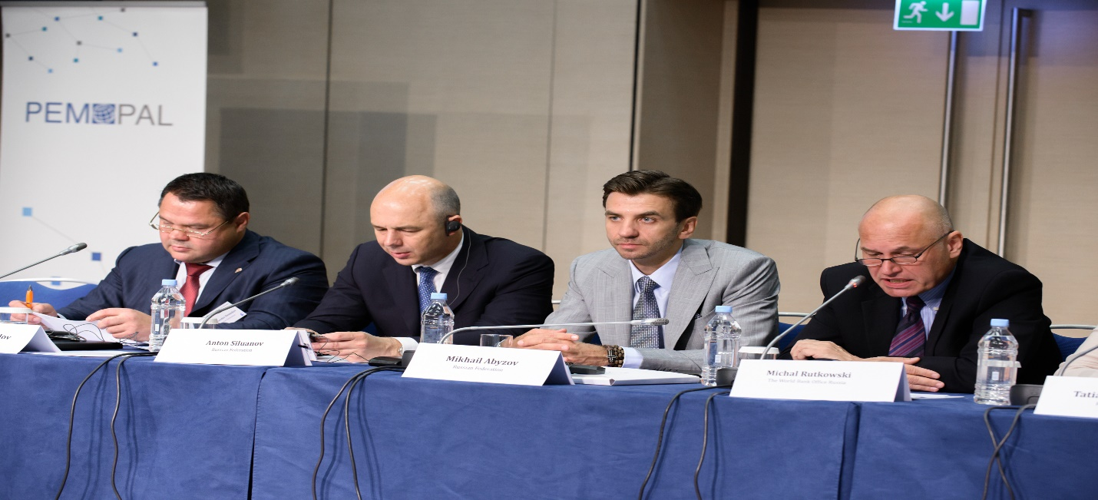
‘ Openness of government is very important. It is a continuous process where governments can benefit from the new developments in other countries ‘ Minister of Finance of the Russian Federation, PEMPAL Cross-COP Meeting, Moscow, 2014

Slide 24
Objective 4: AWARENESS OF HIGH GOVERNMENT AND POLITICAL LEVLES IS RAISED REGARDING THE BENEFITS AND VALUE OF ENGAGING THROUGH PEMPAL (1)
Evidence of high level awareness of the benefits of PEMPAL included in COP submissions and presentations (eg Ministers/Deputy Ministers opening meetings and attending events).
    Hereby, the Ministry of Finance of the Kyrgyz Republic would like to present its respect and take this opportunity to express cordial appreciation and gratitude for the organization of the PEMPAL BCOP Plenary Meeting in Yerevan, Armenia, on 11-13 February 2015. Translation of Letter received by the PEMPAL Secretariat from the Deputy Minister, A. Azimov
Strategy included PEMPAL providing an integrated package of services and products to advance member country reform priorities.
  Need better identification and marketing of services and products.
  Are more targeted interventions needed in member countries? Resourcing?
There is convincing evidence of increased awareness of high government and political levels of the benefits and value of engaging through PEMPAL, however donor partners see the need for investing additional efforts into this objective.
Notes:
CABRI approaches eg. developing positions on certain key PFM issues on a PEMPAL basis or undertaking regional cross-COP projects, and feeding the results into international policy deliberations (such as OECD SBO meetings, Washington meetings).

Slide 25
Objective 4: AWARENESS OF HIGH GOVERNMENT AND POLITICAL LEVLES IS RAISED REGARDING THE BENEFITS AND VALUE OF ENGAGING THROUGH PEMPAL (2)
A revised approach to marketing at senior management levels was implemented with streamlined Thank you letters to Ministers implemented by former Secretariat.
  It is not clear to SECO what extent letters and reports draw higher level management attention to the PEMPAL initiative. There is therefore a need to discuss possible additional instruments for achieving this objective.
  Strategies adopted by other networks such as CABRI could be considered.
No progress on action related to investigating feasibility of transforming PEMPAL into a more formal network of national PFM institutions. Need advice from Steering Committee as to whether this is still a priority and whether funding should be allocated for feasibility study before end of Strategy.
Notes:
Example in strategy – provide information to members on the range of trust funds and technical assistance support options available to countries to assist them achieve PFM reform priorities eg SAFE and Russian Trust Funds, and World Bank’s analytical and advisory services, trust fund, and guarantee program.

Slide 26
CONCLUSIONS
Original objectives of PEMPAL Strategy remain valid and PEMPAL is making good progress at all levels.
The sustainability of the network beyond the current Strategy period presents a concern Several dimensions of sustainability (quality, secretariat support, financing) require attention during the final years of the Strategy implementation.
Donors urge to invest additional efforts to Output Objective 4 (raising political awareness) which they consider is directly related to sustainability.
Current implementation arrangements are working well but the Secretariat services delivery model requires immediate attention.
The cost of the strategy will only slightly exceed original forecasts based on actual and latest projected costs. (Original strategy USD 10.54 million over 5 years, revised estimate USD 10.65 million, USD 110,000 more).

Slide 27
Suggested adjustments to Strategy actions
Action 14, no action has been taken on the assessment of the feasibility of a formal network of PFM institutions, the PEMPAL Executive needs to advise whether this action remains a priority and allocate funding for a feasibility study.
Action 4, sub-action related to the former Secretariat’s contract, is no longer valid and should be revisited in the context of the decision to be taken on the future secretariat model. Similarly, the sub-action requiring benchmarking of the Secretariat mechanism also needs to be revisited.
Further work is needed to complete the following actions by the end of the Strategy:
  Action 3, identifying synergies and working projects between COPs;
  Action 12, mobilization of co-financing and in-kind contributions from members where possible and improving collection and reporting of in-kind financial contributions;
  Action 13, targeted marketing to donors and professional associations.
Strengthening data quality for several indicators could also be considered: number and type of cross-COP exchanges; quality and frequency of use of technology solutions; knowledge products number and type; % of members from targeted functional areas; financial and in-kind member contributions; donor in-kind contributions; and number of Ministers/Deputy Ministers opening or attending events.

Slide 28
- review the findings,
- review and prioritize suggestions for improvement
(Table 1 of MTR Report).
MTR report to be finalized based on the results of this meeting.
Next Steps
to be completed during this meeting

Slide 29
Thank you

