Slide 1
Extended Treasury Single Account System in TÜRKİYE
Barış CAN
Deputy Director General
Yusuf YAVUZ, CFA
Head of Department
November 2023

Slide 2
Outline
Treasury Single Account (TSA) System
Structure of the TSA System in Türkiye
Structure of the Extended TSA System in Türkiye
Benefits of the Extended TSA

Slide 3
TREASURY SINGLE ACCOUNT (TSA) SYSTEM
Definition of the TSA
Full-Fledged TSA Features

Slide 4
Definition of the TSA
“Based on the principle of unity of cash and the unity of treasury, a TSA is a bank account or a set of linked accounts through which the government transacts all its receipts and payments” (Pattanayak & Fainboim, 2010)
“TSA is a bank account or set of linked bank accounts which all government receipts regardless of which entity collects those receipts are transferred into it and all disbursements are made from it” (Pattanayak & Fainboim, 2010)

Slide 5
Full-Fledged TSA Features
✓
✓
✓
✓
Location
Fungibility
Coverage
Timely Information
Timely Transactions
Unified Structure
Information about the Government’s aggregate cash position should be accessed on time.
TSA should be held at the Central Bank.
All transactions should be realized on real time (without delay).
Government agencies should not maintain resources in bank accounts that are beyond the oversight of the Treasury.
The ability to use the one entity’s cash surplus for meeting another entity’s cash deficit.
TSA coverage should be comprehensive and include all general cash resources.
Source: Can (2019)

Slide 6
STRUCTURE of the TSA SYSTEM in TÜRKİYE
Historical Development
Project Plan
Definition of the Extended TSA

Slide 7
Historical Development of the TSA in Türkiye
TSA Features | 1972-2007 (SA) | 2007-2011 (TSCA) | 2011-… (Current TSA) | 2018-… (New TSA)
Operational
Timely Information | 1 week later | Instant access (Partial) | Instant access | Instant access
Timely Transaction (On Average) | Collections – Irregular Payment - Daily | Collections – 2-3 days Payment – Daily | Collections – 2-3 days Payment – Daily | Collections– Daily Payment – Daily
Payment Method | Decentralized | Centralized | Centralized | Centralized
Sweeping Mechanism (Days) | None | On a daily basis | On a daily basis | On a daily basis
Reconciliation Period | 1-2 Weeks | On a daily basis | On a daily basis | On a daily basis
Cash Transfer/Sweeping Process (Manual or Electronic) | Manual Process | Partial Electronic Process | Electronic Process | Electronic Process
Structure
TSA Location | Central Bank | Central Bank | Central Bank | Central Bank
Coverage | General Budget Institutions (Only Regional Units) | General Budget Institutions | General Budget Institutions | Central Government, Local Administrations, Social Security Institutions, State Owner Enterprises, Funds
Bank Accounts Structure | Fragmented | Fragmented | Unified | Unified
Fungibility | Partial Fungible | Completely Fungible | Completely Fungible | Completely Fungible
Authority on TSA | Treasury has partial authority | Treasury has full authority | Treasury has full authority | Treasury has full authority
Remuneration of TSA | None | None | Remunerated daily (CBRT) | Remunerated daily (CBRT). Remunerated daily, weekly, monthly (Other state-owned banks).
Legal basis | Yes | Yes | Yes | Yes
Source: Can (2020)

Slide 8
Project Plan for Transition to New Extended TSA
Preparation of the Project Plan and Documents 
Determining Project Team 
Design of the System 
Documentation of the Processes 
Presentation of the Final System Design to the Top Management 
Collecting the Inventory of Bank Accounts for the Public Sector 
Project & System Design
Preparation of the Draft Legislation 
Presenting the Drafts to the Stakeholders 
Initiating the Enactment Processes 
Completing the Enactment Processes 
Legislative Background
Daily Requesting & Monthly Forecasting Modules 
Accounting Module 
Programming Module 
IFMIS Integration for Institution’s Accounting Systems 
CBRT Internet Banking System Integration 
IT Infrastructure
Opening New Bank Accounts at CBRT and Ziraat Bank 
Establishing the Linkages Between the Accounts 
Banking Infrastructure
Preparing the Regulation for the Pilot Phase 
Initiating the Pilot Phase 
Pilot Phase
Source: Can (2020)

Slide 9
Definition of the Extended TSA
According to Law no. 4749 Regulating Public Finance and Debt Management, Extended TSA is defined as follows:
“Extended TSA refers to the account managed by the Treasury in which the financial resources of public administrations, excluding the Unemployment Insurance Fund, are collected to be held as receivable from the Treasury without being associated with the revenue and expenditure accounts of the budget.”

Slide 10
STRUCTURE of the EXTENDED TSA in TÜRKİYE
Coverage
Transition to the Extended TSA
Progress of Extended TSA
Banking Architecture
Accounting Structure
Process Steps in New TSA System

Slide 11
The Coverage of Extended New TSA
PUBLIC SECTOR
STATE-OWNED ENTERPRISES
SPECIAL BUDGET INSTITUTIONS (Chart II)
GENERAL BUDGET INSTITUTIONS (Chart I)
CENTRAL GOVERNMENT
GENERAL GOVERNMENT
SOCIAL SECURITY INSTITUTIONS
LOCAL GOVERNMENT
FUNDS
REVOLVING FUNDS
REGULATORY AND SUPERVISORY AGENCIES
(Chart III)
MUNICIPALITIES
STATE PROVINVIAL ADMINISTRATIONS
VILLAGES
✓
✓
✓
≌ 70% of the Public Sector Balance
✓
✓
✓
Source: Can (2018)

Slide 12
Transition to Extended TSA
Extending the Coverage
A gradual expansionary process planned and implemented
Most of the public institutions are covered by the Extended TSA
2018
2019
2020
2021
2023
An Extrabudgetary Fund (Pilot)
Special Budget Institutions (Part I)
Regulatory and Supervisory Agencies (Part I)
Extrabudgetary Funds (Part II)
Special Budget Institutions (Part II)
Special Accounts
Development Agencies
Universities (Part I)
Extrabudgetary Funds (Part III)
Regulatory and Supervisory Agencies (Part II)
Universities (Part II)
Other Public dministrations (Part I)
Social Security Institution
Other Public Administrations (Part II)
Source: Can (2019)

Slide 13
Progress of TSA System in Türkiye
2018 – 2023 Strategic Program Targets
Year | Targets (Cumulative) | Realizations (Cumulative) | Status
2018 | 1 | 1 | ✓
2019 | 25 | 40 | ✓
2020 | 65 | 106 | ✓
2021 | 135 | 224 | ✓
2022 | 200 | 224 | ✓
2023 | 230 | 257 | ✓

Slide 14
Extended TSA Institutional Balance Distribution*
Extended TSA Institutional Summary |  | 30.10.2023
 |  | Total
No | TOTAL | 257
1 | SPECIAL ACCOUNTS OF GENERAL BUDGET | 3
2 | SPECIAL BUDGET INSTITUTIONS | 174
 | Universities | 127
 | Other Special Budget Institutions | 47
3 | OTHER PUBLIC ADMINISTRATIONS | 8
4 | REGULATORY AND SUPERVISORY AGENCIES | 11
5 | FUNDS | 4
6 | DEVELOPMENT AGENCIES | 26
7 | INVESTMENT, MONITORING AND COORDINATION DIRECTORATES | 30
8 | SOCIAL SECURITY INSTITUTION | 1

Slide 15
Extended TSA System Bank Accounts
Time Deposit Account (State-Owned Banks)
TSA
New TSA
Time Deposit Account (State-Owned Banks)
TSA
Payment Account
TSA Collection Account
New TSA Payment Account
New TSA Collection Account
New TSA Payment Special Account
New TSA Collection Special Account
Owner
Treasury
Account
CBRT
Accounting Units
Accounting Units
Tax
Offices
Institution (A) Payment Account
Institution (A) Collection Account
Institution (A) Payment Specific Account
Institution (A) Collection Specific Account
Owner
Institutions
Bank
ZiraatBank
& CBRT
Source: Can (2019)

Slide 16
Integration with the Accounting System
All payments, collections, reciprocal receivables and payables recorded in the accounting system.
Reciprocal receivables and payables are ceiling for payments so it act as a control parameter for the system.
Institutions
135 – New TSA Receivables
+Current Financial Resources +Collections +Transfers from General Budget -Payments
135.01 – Budgetary Accounts 135.02 – Special Accounts
Ministry of Treasury and Finance
335 – New TSA Payables
+Current Financial Resources +Collections +Transfers from General Budget -Payments
335.01 – Budgetary Accounts 335.02 – Special Accounts
Source: Can (2020)

Slide 17
The Process Steps of New TSA System - I
Institutions enter monthly cash inflow and collection forecasts for two following months on a daily basis.
Monthly Cash Inflows and Collections Forecasting
Monthly Cash Programming
Daily Cash Requests
Daily Cash Planning
Transfer and Accounting
Accounting records transfer to New Government Accounting Information System via web services.
Debt and receipt recording done via HMBS due to sweeping
Monthly cash programming can be done on a daily basis with programming module.
Daily cash requests are collected via Treasury Single Account Information System. To determine ceiling for the payments gathering budget/cash reserve data are not needed due to sweeping. Payment orders are created via Treasury Information System.
Daily cash requests are required by institutions till 10:30 and late entry is not allowed.
Source: Can (2017)

Slide 18
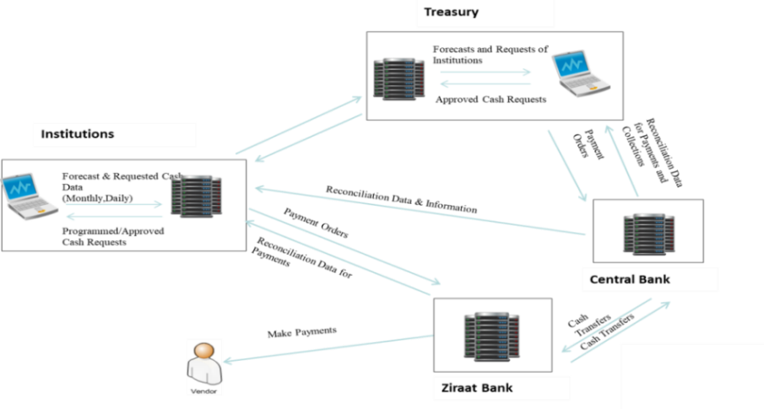
The Process Steps of New TSA System - II
Source: Can (2020)

Slide 19
BENEFITS of the EXTENDED TSA

Slide 20
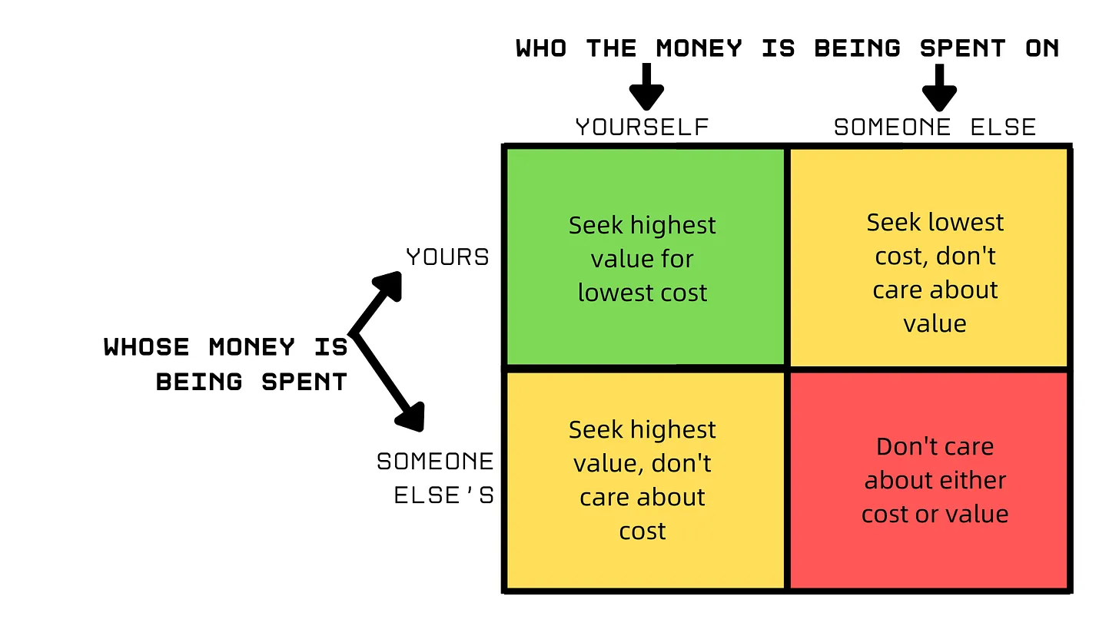
Benefits of the Extended TSA System - I
Uniting all actors towards the same goal
Optimality Condition
Friedman’s Matrix of Spending

Slide 21
Benefits of the Extended TSA System - II
1
2
Cash Management
Debt Management
Enabling public resources to be utilized more efficiently through economies of scale by collecting them in a single pool
Reducing and avoiding unnecessary borrowing by allowing Treasury to use substantial amount of cash
3
Remuneration
Ensuring that public resources are remunerated with the appropriate instruments with optimum rate of return

Slide 22
Benefits of the Extended TSA System - III
Increase in Treasury Cash Reserve
Remuneration Revenue, Positive Contribution to the Budget
Cost-free Financing
Minimizing idle cash resources; Lowering precautionary liquidity reserve

Slide 23
Benefits of the Extended TSA System - IV
Monitoring all public resources in real-time
Enabling public resources to be collected in a single pool and utilizing those more efficiently through economies of scale
Increasing the motivation of instutions to make realistic cash demand
Reducing and avoiding unnecessary borrowing for short-term cash shortage
Allowing public institutions to concentrate on their duties rather than evaluating their cash and reducing bureaucratic processes

Slide 24
Balance and Number of Institutions of Extended TSA System
Approximately 45 billion ₺
increase in balance.

Slide 25
Interest Revenue and Number of Institutions of Extended TSA

Slide 26
Cash Balance Trend of Extended TSA* (million ₺)
*As of September 2023

Slide 27
Payment Trend of Extended TSA* (million ₺)
*As of September 2023

Slide 28
Thank You
THE MINISTRY OF TREASURY AND FINANCE
Directorate General of Public Finance

Slide 29
References
Can, B. (2020). Extended New Treasury Single Account: New Tool for Government Cash Management in Turkey. In: Akdemir, T., Kıral, H. (eds) Public Financial Management Reforms in Turkey: Progress and Challenges, Volume 2. Accounting, Finance, Sustainability, Governance & Fraud: Theory and Application. Springer, Singapore. https://doi.org/10.1007/978-981-15-4226-8_1
Can, B. (2019). “The Likely Impact of Extended Turkish Treasury Single Account System on Public Finance in Turkey”. BDDK Bankacılık ve Finansal Piyasalar Dergisi, 13 (2) , 231-266 . Retrieved from https://dergipark.org.tr/tr/pub/bddkdergisi/issue/57334/812487
Can, B. (2019). “A New Extended Treasury Single Account”. Public Debt Management Report, 59 - 68.
Can, B. (2018). “The Impact of Expansion of Turkish Treasury Single Account System on Public Financial Management in Turkey” (Master Thesis, TOBB University of Economics and Technology).

Slide 30
APPENDIX

Slide 31
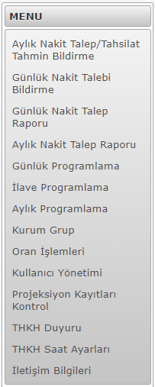
Extended Treasury Single Account Information System - I
Monthly cash inflow/outlow prediction screen
Daily cash request screen
Daily cash request report
Monthly cash request report
Daily cash programming screen
Additional cash request programming screen
Monthly cash programming screen
Institutions by group
Ratio screen
User account management
Projection records control screen
Announcements screen
End of cash request time settings
Contacts informations

Slide 32
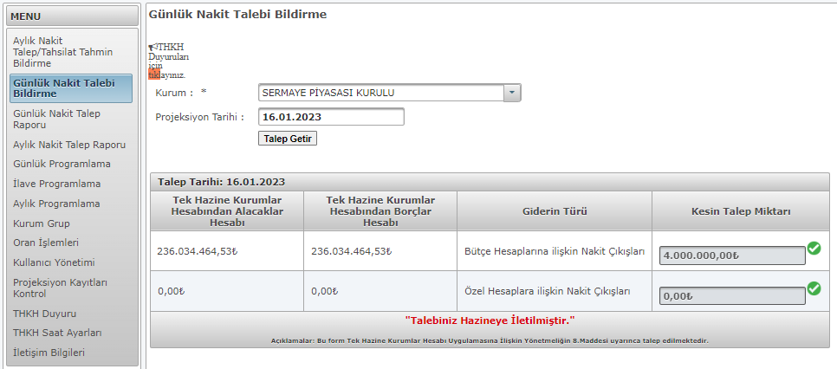
Extended Treasury Single Account Information System - II
Daily Cash Requesting Screen of the Institutions
daily cash request for budgetary accounts
institutions receivables from TSA
payables to institutions from TSA
daily cash request for special accounts

Slide 33
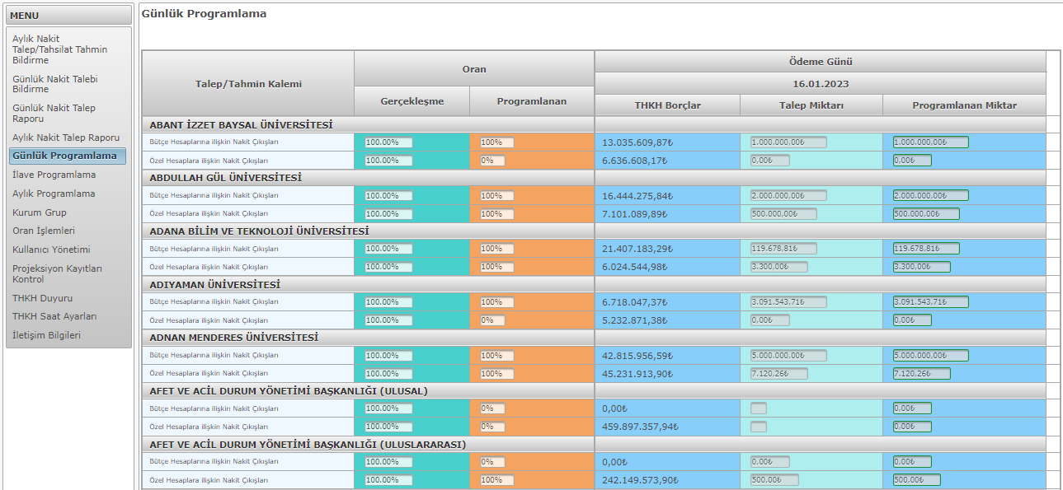
Extended Treasury Single Account Information System - III
Daily Programming Screen of the Treasury
ratios applied to cash requests
list of the public institutions
cash balance of the related institutions
daily requested cash amounts of the related institutions
daily programmed cash amounts by Treasury

Slide 34
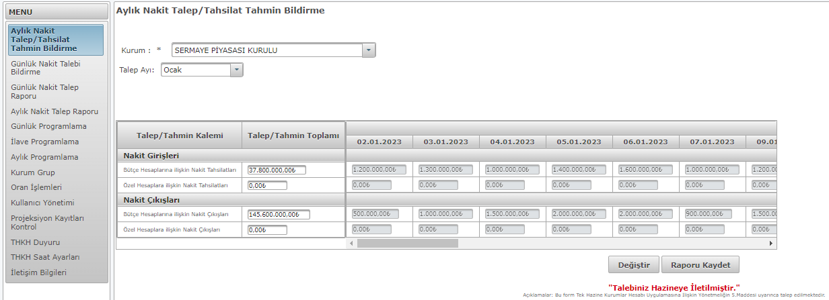
Extended Treasury Single Account Information System - IV
Monthly Cash Inflows/Outflows Prediction Screen of the Institutions
cash inflows prediction on a daily basis
cash outlows prediction on a daily basis

Slide 35
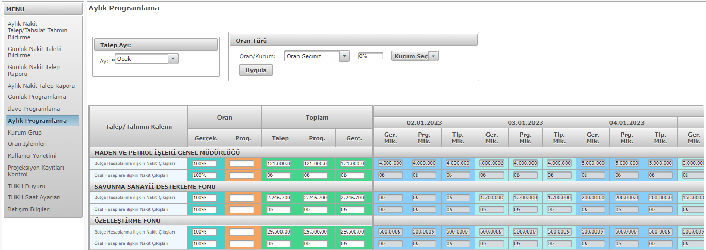
Extended Treasury Single Account Information System - V
Monthly Programming Screen of the Treasury
list of the public institutions
ratios applied to cash predictions
monthly cash predictions of institutions and programmed amounts by the Treasury

