Slide 1

PEMPAL-Treasury COP
Cash Flow Forecasting:
Techniques, Challenges & Practice
Vienna, November 2023
Mike Williams
mike.williams@mj-w.net

Slide 2
Agenda
Cash Flow Forecasting and Cash Planning
International Experience
Building the Forecast
Using the Forecast
The acronyms used are expanded in an Annex

Slide 3
Cash Flow Forecasting : Some Distinctions
Forecasts of the Government cash balance are essential for 2 reasons
To facilitate orderly achievement of budget targets; to ensure that budgeted expenditure is smoothly financed avoiding delays; and to give early warning of any problems
To devise the financing strategies needed to meet cash management objectives
Distinguish between…..
Financial Programming/Cash Planning
Linked to budget execution
Cash Forecasting
Forecasts independent of control totals
Forecasts based on budget profiles
Profiles often linked to appropriations
Risk confusing targets and forecasts (revenue “forecasts” may be constrained to budget target)
0bjectives:
Controlling spending profile to ensure cash availability
Developing financing plan
what “will” happen” not what “should” happen
Two objectives
Ensuring that cash is available when required, with no risk of cash rationing
Minimising use of cash over the period ahead
Often managed separately from budget execution processes
&

Slide 4
Typical Annual Cash Plan
GFSM presentation that flows from “above the line” to financing or “below the line” items helps focus on policy options, mainly financing choices. A split between inflows and outflows is more difficult to interpret.

Slide 5
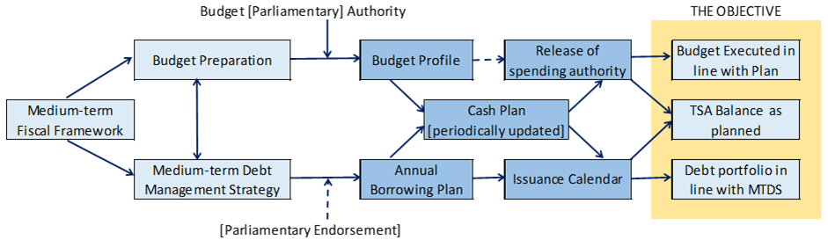
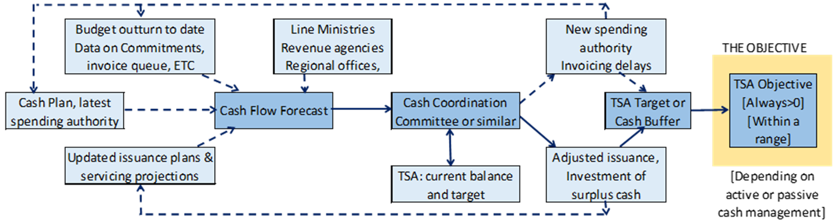
Process Summary
Building the Plan
Building - and maintaining - the Forecast

Slide 6
Agenda
Cash Flow Forecasting and Cash Planning
International Experience
Building the Forecast
Using the Forecast

Slide 7
Summary: Forecasting is Difficult!
Continuing Challenges in Many Countries
Lack of systematic collection of outturn data
Different budget and accounting classifications
Fragmentation of IT systems – hampering data aggregation
Past cash rationing implies distorted historical spending data
Tax forecasts tend to be more difficult than spending
Not always – capital expenditure very difficult – liaise with PMOs
Problem of end year surge (end-year flexibility or similar mechanism)
Confusion between budget execution and liquidity management
Not enough performance analysis
MDAs must resist the temptation to just divide by 12!
Excel becomes unwieldly and lacks robustness

Slide 8
Developing Cash Flow Forecasts
Must focus on what will happen, not what should happen
Start from budget profiles but systematically revise, collecting latest information
Build independently of budget process
Treasury (or Debt Office) not Budget Department
Avoid game playing by MDAs [a problem or not?]
Objective is to anticipate cash needs
Cash in and out of TSA
May be different from recording of revenue and expenditure
Focus is domestic currency (DX)
It is what matters for the TSA & monetary policy.
Ideally, all FX inflows converted to DX by central bank, which makes FX available to MoF as needed
Modified if shortage of FX or an illiquid local FX/DX market – MoF may need some FX balances => may need to identify FX, donor flows separately

Slide 9
Cash Flow Forecasting: the Horizon
Forecast information is needed for some period ahead
    Timing of future peaks and troughs must be identified to make decisions about financing or seeking other sources of cash
    If cash rationing or withholding of allocations is necessary, it gives time to develop response
        Giving time for MDAs to adjust avoids more damaging unplanned cash delays
Ideally
    Monthly profile for the year, regularly updated, supports budget execution
    But more detailed forecasts looking at least 3 months ahead
        Monthly, then weekly, then daily
    Rolled forward regularly (monthly, then weekly)
    Including over year-end

Slide 10
Forecasting in Practice
Note: the initial plan may be constrained to the Budget; but the forecast can deviate even at the start of the year if the forecasters judge the budget to be unrealistic
Default is past outturn pattern
Adjust for one-offs, impact of weekends, holidays
Known dates for debt service, salaries, transfers to SNGs
Check re Tax payment dates, seasonal payments, large projects
Adjust for new policies, new taxes, one-offs (dividend receipts)
Take out flows that do not impact the TSA (non-tax revenue leakage...)
In year; incorporating outturn to date
Identifying timing changes/new trends; bottom up information from MDAs, RA

Slide 11
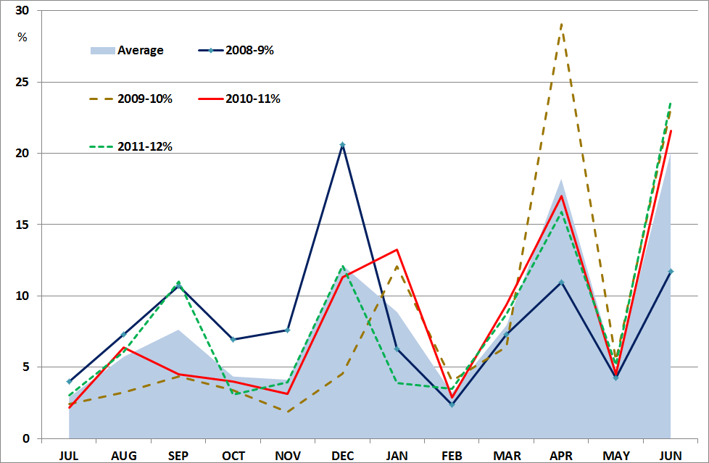
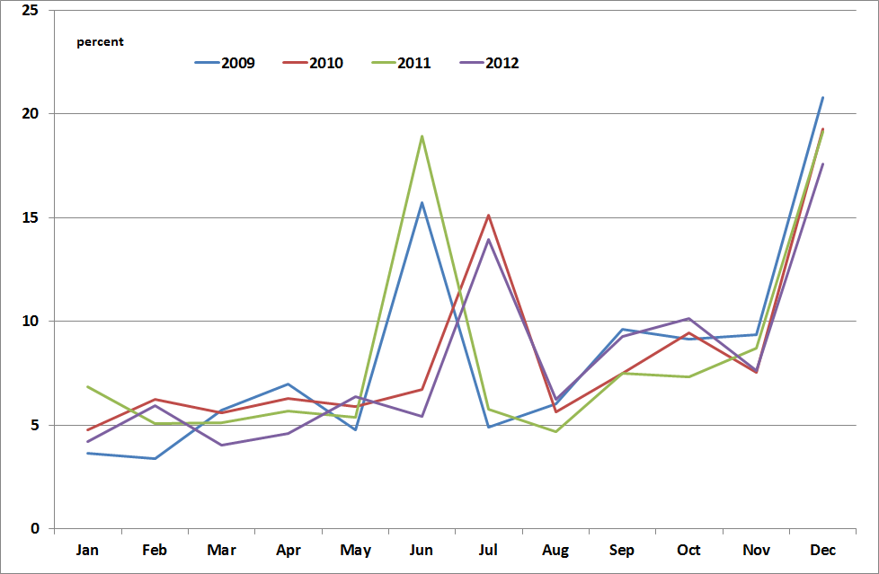
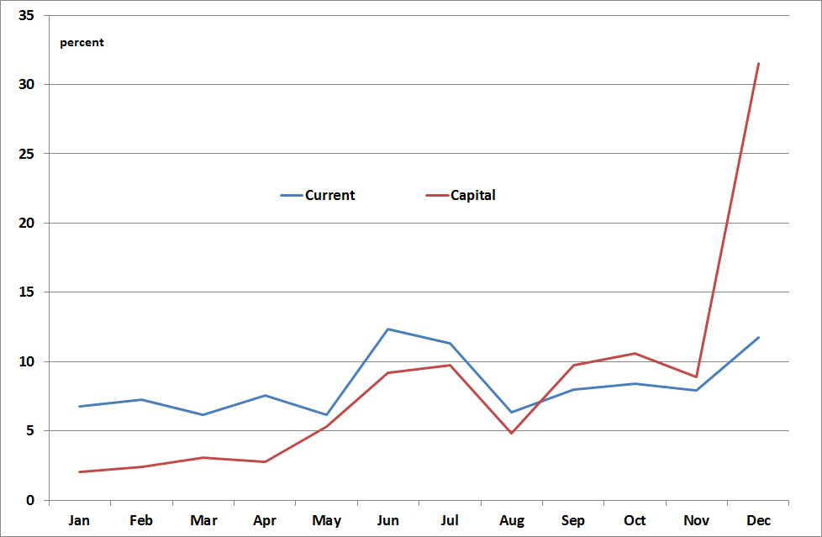
Use Past Patterns – Carefully!
Averaging can overlook some big fluctuations
Timing effects can be significant in different years
The size of the end-year surge can vary

Slide 12
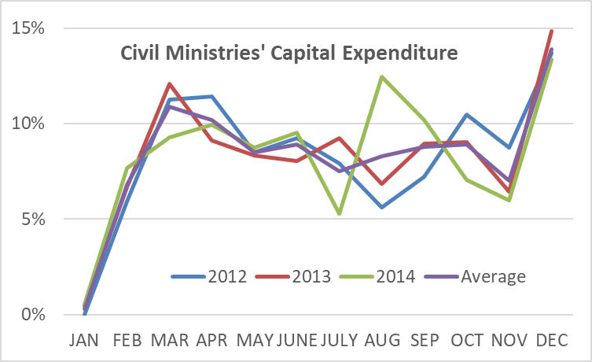
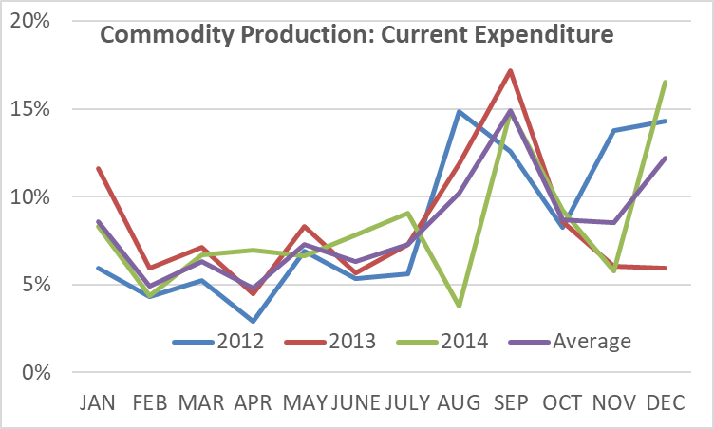
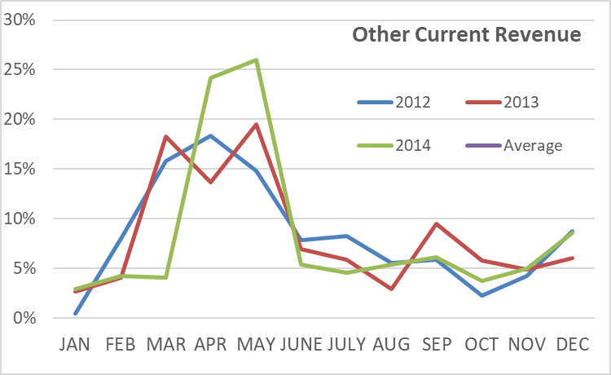
Another Example
Something unusual in 2014!

Slide 13
The Role of Econometrics
Econometric models are important for multi-annual projections & annual budget
    Early warning indicators of macro-economic activity can be useful in-year
    Some expenditures may be linked to macro or other variables (weather & agricultural support)
Difficult to develop models that will generate a monthly or quarterly path
Some other Approaches
Model underlying trend on which is imposed estimated seasonal adjustments; but not always been an improvement on more simple pattern analysis.
Some (e.g. Peru) have explored autoregressive models, relating revenue in one month to revenue in same months in previous years, plus a macro variable and trend factor (and/or tax changes)
MDAs may be better placed to use such models for expenditure series as more familiar with underlying data
There will still be special factors (policy changes, behavioural shifts) to take into account, and changes from year to year in the day on which month ends or key holidays fall.
=> Experience, intelligence networks and pattern analysis usually more productive
  Average past patterns: use for homogenous flows or when there is no better information
  Separate profiles for different streams; be wary of using for capital expenditure
  Identify past outliers, one-offs or deviations from average
  Take account of end of months on a weekend, dates of public holidays, etc

Slide 14
MDAs and Revenue Authorities must Cooperate
Importance of Bottom-up Information
MoF needs forecasts or intelligence about latest information: if necessary, require by legislation
    [and also Planning Ministry, PMOs for investment expenditure]
    MDAs cover non-tax revenues as well as expenditure
    Explore use of Templates
Scope for Carrots and Sticks?
    Cash penalties/incentives, virement flexibility, league tables [examples in Turkey, Hungary, UK]
Build personal contacts
    Avoid requests / information going up hierarchy, across and down
    Contacts with similar technical staff in major MDAs/RA
    New intelligence (early notice of divergences from forecasts or unanticipated flows) as important as regular updates
Source: Cangoz & Secunho (World Bank, 2020)

Slide 15
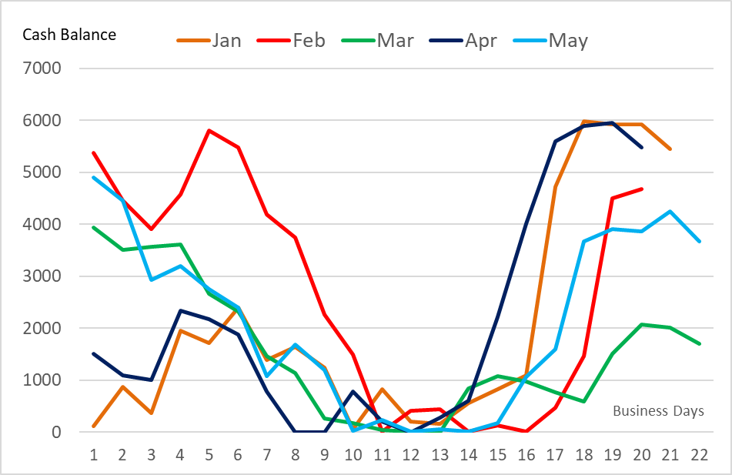
Identifying Maximum Cumulative Outflow within the Month
The example of a country where there is a sharp outflow during the month before any inflow (real country data, normalised to minimum of zero)
Monthly forecasts hide the within-month profile
Meeting the cash requirement for the month may still leave a cash shortage in some weeks
Hence the need for weekly and daily forecasts – or identify maximum outflow during month
MDA flows contribute to this pattern – and may be well placed to offset it
The example of Italy (from Public Debt Report 2014)

Slide 16
Some Other Smoothing Techniques
Scope to link days of outflows to days of inflows?
Payment due dates for new taxes linked to e.g. salary payment dates
Smoothing salary payments across the month
Identify preferred date for privatisation receipts; fix dates of e.g. transfers to local governments
Inflows before outflows within the month
Problems with external flows
Highly uncertain, difficult to forecast, may depend on project progress
Possibly assume project spending and project funding net to zero (but lumpy flows? Or direct payments)
Inflows may also go to separate accounts (donor or FX accounts) not TSA
Requires close interaction with other functions
Avoid bond redemptions on days/weeks of weak cash flow
Agree profile of programme loans

Slide 17
Resources and Data
People
Not many staff required
Data
Commitment Information
Potentially useful, particularly if IFMIS identifies a due date for payment
2-3 in CMU at MoF often enough (although 5-6 is more common)
Supported by others in MDAs
Large volumes to manage
Heavy use of Excel – flexible for scenarios etc
Link to IFMIS for outturn data; or use IFMIS to collect MDA forecasts
But variable lags => commitment information not itself sufficient for cash flow forecasting
See Annex for role of CMU
Accounting quality data not required

Slide 18
Agenda
Cash Flow Forecasting and Cash Planning
International Experience
Building the Forecast
Using the Forecast

Slide 19
Forecasting is a Challenge Worldwide
Only 28% of 80 DeMPA Assessed Countries Reached Minimum DeMPA Requirement (monthly forecasts, scoring C, or above)
Many lower and middle income countries fail to meet minimum requirements
Ability to generate forecasts says nothing about forecast performance
Although ECA better than average
Which is often not studied or is inaccurately reported
Taken from: Cangoz & Secunho (World Bank, 2020)

Slide 20
Some Broad Conclusions: Preparing Forecasts
(A personal perspective based on work in 40 countries, of varying income)
Insufficient understanding of importance of cash forecasts as well a cash plans
Reflects focus of Treasuries on cash adequacy not cash efficiency
Uncertain or confusing boundaries between Treasury and Budget Department
Dominance of cash rationing (especially lower income countries)
Forecasts primarily top down
Failure to use information from MDAs
More willingness to use information from RAs – but often not updated or rolled forward during the year
MDAs/RAs are not asked to build the necessary capabilities
Focus on revenue forecasts (budget often sets unrealistic targets)
Forecasts do not look far enough ahead
Focus on the next month makes it difficult to respond strategically – too much “firefighting”

Slide 21
Some Broad Conclusions: Using Forecasts
Treasury/DMU communication often poor or unstructured
Reflects formation of DMUs in last 20 years as a separate specialism – excellent; but not if they lose touch with the Treasury function
Issuance plan often takes account of redemptions or refinancing requirements – but overlooks the profile of the fiscal deficit
Decision-making lacks strategy or process – puts emphasis on cash adequacy not efficiency
Limited active cash management
Tbills sometimes used to actively manage volatility; although in a cash poor environment seen more as an emergency funding instrument
Countries with some surplus cash do address the best use – but central banks may fail to support

Slide 22
PEMPAL Countries: a Mixed Picture
2021 Survey
But…
Difficult to measure “performance”
Some variations in practice (next slide)
Some confusion between cash forecasting and cash planning
All countries have some forecasting capability

Slide 23
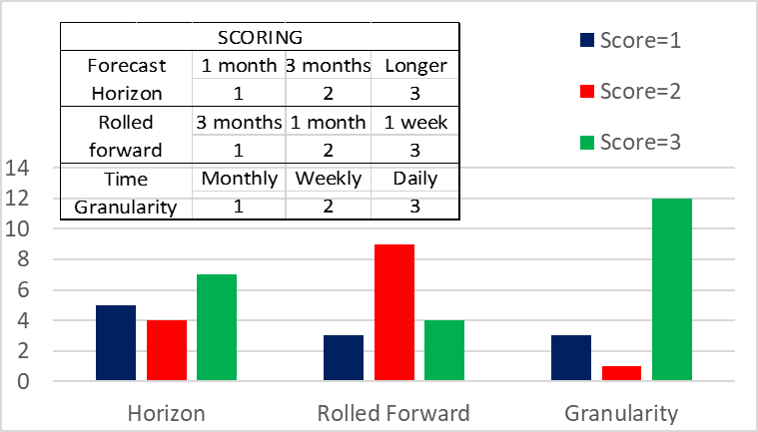
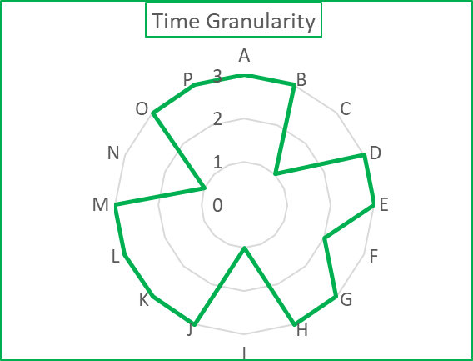
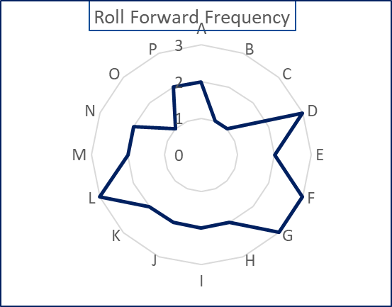
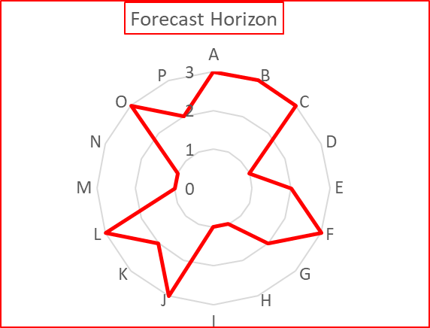
Forecasting Practice
Only I country scores 3 on all 3 dimensions; many score 2

Slide 24
Some National Practices that seem to have worked well…
Revenue
Expenditure
Financing

Slide 25
Revenue Forecasts
The Challenge
Revenue typically the main source of uncertainty
Countries forced to ration cash often have the most focus on revenue, which determines cash releases
The Solution?
Give the RAs formal responsibility (and some resources) for preparing tax revenue forecasts and updating them, which in turn:
Can be supported by information flow from e.g. large taxpayers office or local tax offices
Also supports modelling of impact of tax changes
Risk that revenue plans become targets – or worse unrealistic targets driven by Budget Directorate

Slide 26
Remember the Extra-Budgetary Funds
Social security and similar funds have major implications for cash flow
    Directly on budget
    Demand for debt
    Residual cash balances - to which the government potentially has access whether inside or outside the TSA
Include within processes
    Supplying forecasts
    Regular consultation
    [Potentially membership of CCC]
    Examples: Moldova, N.Macedonia, Turkey, [others?]

Slide 27
Linkage of Inflows and Outflows
Most countries link debt auction dates to redemption dates
But make little effort to otherwise smooth cash flows
Volatility across month reflects difference in timing of tax receipts and salaries
Much more scope to link timings of cash flows
May need legislation to change tax timings
But timing of salaries and other expenditures can be smoothed/coordinated – or directly determined by government (e.g. transfers to SNGs)

Slide 28
Some lessons of the Pandemic for Cash Flow Forecasting
Budget credibility essential
The role of scenarios, sensitivities, what-ifs
Break any link with published budget – focus on what will happen
Ensure systematic coordination structures for debt/cash management
Often become ad hoc during pandemic as response times quicken, and Ministers more involved
Retain technical committee structures
Include MDAs and EBFs within processes; supplying forecasts, regular consultation
EBFs/SoEs sometimes a potential new borrowing source; MDAs cooperate in request to fix or change payment dates
Greater granularity required; weekly not monthly forecasts; daily not weekly

Slide 29
CFAT makes use of this Experience
1. Designed for the Practitioner
2. Supports planning and forecasting
3. Making use of past data, combining top-down and bottom-up information
4. Focus on Cash – and Cash under control of the Treasury/MoF
5. Supports management assessment of policy responses to forecasts (and risks arising)
6. Monthly and weekly forecasts

Slide 30
Agenda
Cash Flow Forecasting and Cash Planning
International Experience
Building the Forecast
Using the Forecast

Slide 31
Putting the forecast to work…
Supporting cash management
Smoothing the TSA; targeting a range of fluctuations
Policy focus on short-term borrowing and investment
Helps monetary policy; but cash flow forecasts still need to be passed to the central bank
Supporting budget execution
Cash flow forecasts identify the cash profile a few months ahead
More realistic than profiles => may be different
Are cash resources adequate to deliver the budget?
May imply delaying release of allocations (or delaying payments)
In the event of cash rationing….
Deciding spending priorities and processing individual payments is separate from decisions about financing – and usually require different people/functions
Decisions should take account of budget priorities – informed by budget department

Slide 32
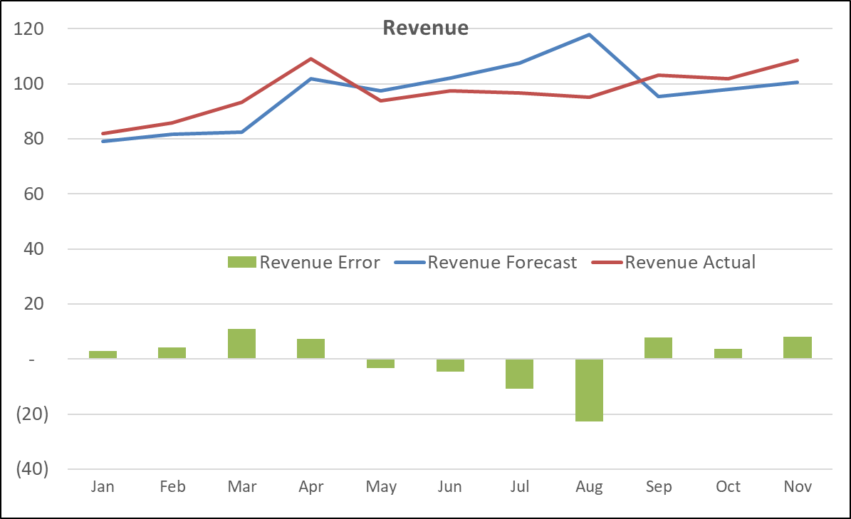
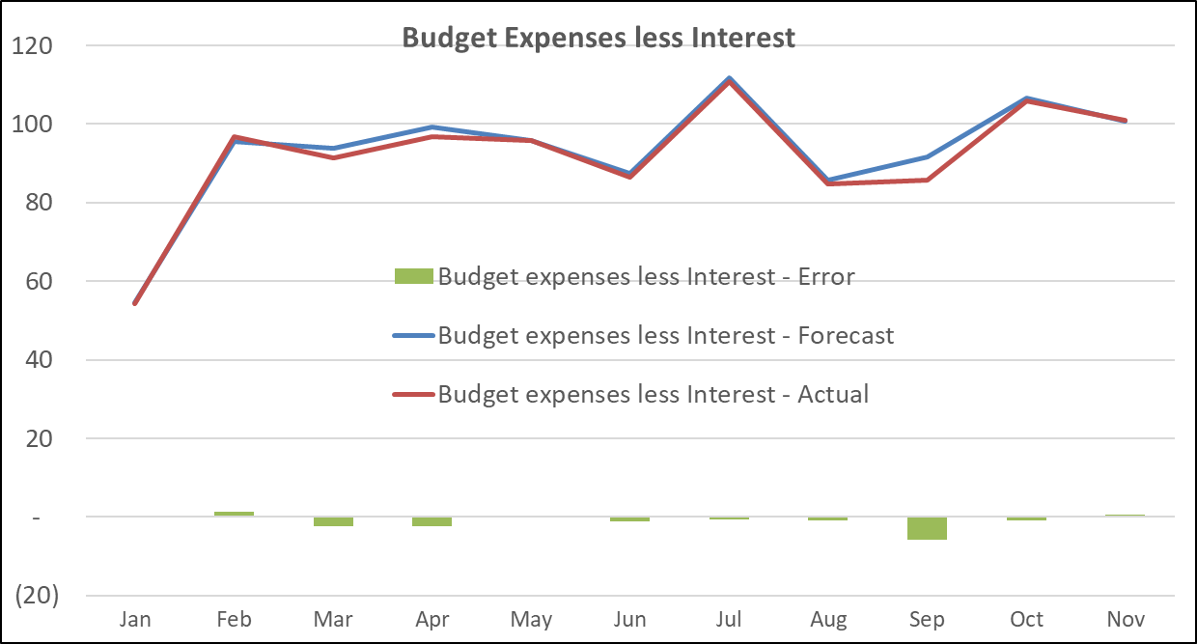
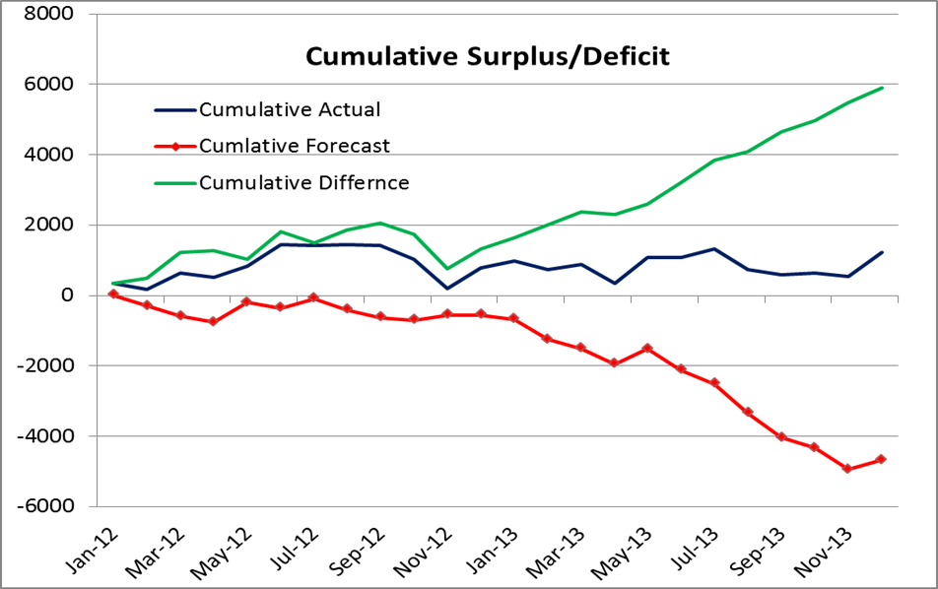
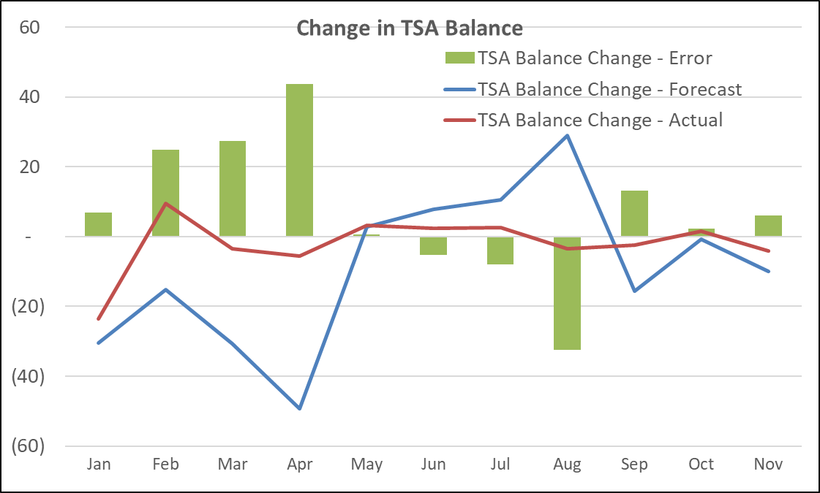
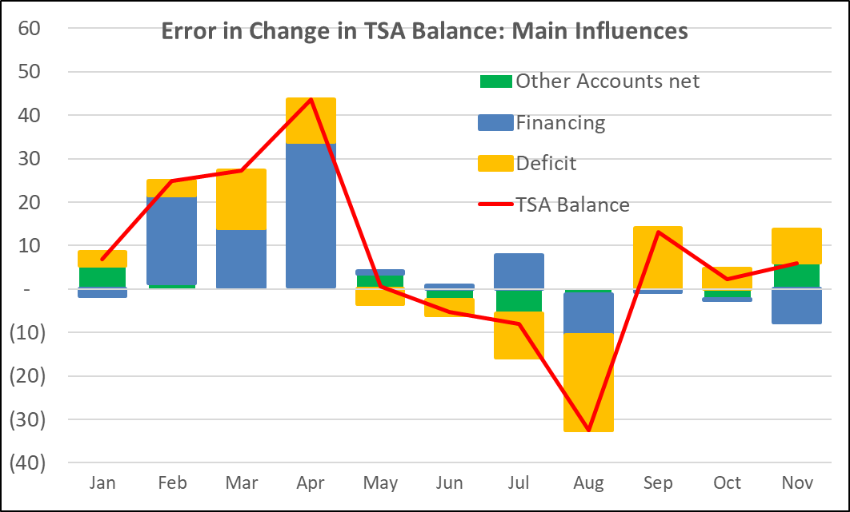
Forecast Performance
Analysing Forecast Performance and Errors is an essential part of the forecasting task:
Planning responses to forecast deviations and learning lessons for the future
Cumulative error is important
[This Forecast seems too pessimistic
  Over-performance does not tell us much about risks
  Forecast should be an unbiased estimate – allowance for caution should be explicit]
Advantages of graphical presentation; has implications for the way in which data are maintained

Slide 33
Managing Deviations from Forecast
Advice to Cash Coordinating Committee on action needed to ensure cash adequacy over the period ahead or cost-effective use of temporary surplus
Deviation
Sustained
More Cash
Less Cash
Timing Change
Vary Tbill issuance
1. Build cash buffer
2. Invest surplus
3. Reduce planned issuance 4. Buy back debt
1. Increase planned issuance 2. Sale of assets, FX to DX 3. Cash rationing
4. Revised budget
Use cash buffer
Safety nets
Credit lines, borrowing from SoEs, central banks in emergency
Is the cash buffer sufficient to cope with extra volatility and market disruption?
Review of Cash Buffer and Safety Nets a key lesson from Covid-19

Slide 34
Presenting the Forecast 1/2

Slide 35
Presenting the Forecast 2/2

Slide 36
Main Messages
Cash flow forecasting is a means to an end: an essential input into modern cash management
Cash flow forecasting is different from cash planning/programming
There are no quick fixes; it is difficult
Past patterns are relevant, but so are experience and information sources
Build intelligence networks – MDAs and RA must cooperate
Develop procedures
Forecasters should prepare advice (with debt managers) on responses to forecasts
Pandemic further adds to uncertainty – requires enhanced tools
Institutional cooperation and coordination are essential
How advice is given, and how decisions are made and executed, all matter
Looking Forward
Forecast must be put to use
Peer learning has a role to play

Slide 37
Annex: Tasks of the Forecasting Unit
Develop a [weekly/monthly] profile of agreed annual budget as a baseline for forecast preparation
Identify sources of information for updating the baseline, and developing forecasts for [3 months] ahead
Design forecast templates for [relevant contributors*]; prepare associated guidelines and instructional materials; and develop protocols for the supply of cash flow forecasts, consulting with [relevant contributors] and others
Make recommendations as necessary for tools (e.g. SharePoint) to receive or share forecasts; and to ensure their accurate aggregation
Ensure the receipt of cash flow forecasts from [chosen contributors] to format and timelines specified, following-up as necessary with responsible officials
Establish and maintain forecast and outturn data to detail specified; identifying any IT requirements, including back-up
Establish the flow of information from [Budget and Macro-fiscal departments] and others as necessary on any changes in expenditure, revenue or financing policies that might have implications for the profile of cash flows
Agree with Central Bank (and others) on: the procedures for movements between DX and FX accounts; and information flows between the Ministry and Central Bank (relating to forecasts and the TSA)
Develop a presentation of forecast data, sensitivities and financing options, that meets decision-makers’ requirements
Analyze divergences between forecast and outturn (and also divergences between plans and outturns) with a view to improving the accuracy of future forecasts
Analyze past expenditure and revenue patterns with a view to enhancing the accuracy of raw forecast data
Prepare a quarterly report for senior management [and members of the relevant committee] reviewing forecast performance and making recommendations for future improvement

Slide 38
Annex: Acronyms
CCC | Cash Coordination Committee
CFAT | Cash Forecasting and Analysis Tool
CMU | Cash Management Unit
DMU | Debt Management Unit
DX/FX | Domestic/Foreign Currency
MDAs | Ministries, Departments and Agencies
PMO | Project Management Office
RA | Revenue Authority
SNG | Sub-National Government

