Slide 1
PFM Digitalization Guidelines: Preliminary Advances
June 7, 2021
PEMPAL – TREASURY COMMUNITY OF PRACTICE
2021 Annual Plenary meeting
Gerardo Uña
Senior Economist
Fiscal Affairs Department

Slide 2
Outline
Evolution in the Design of FMIS
Key FMIS’ Design Challenges
PFM Digitalization Guidelines
High Level Analytical Approach
Main Areas & Processes
Level of Advance of PMF IT Functional Principles
Budget Execution & Controls
Main Conclusions

Slide 3
I. Evolution in the Design of FMIS
The enduring objective of an FMIS is to generate timely, relevant and reliable financial data and reports that support improvements in fiscal discipline, the quality of public spending, and fiscal transparency
FMIS design features, however, have undergone a major transformation during the past 30 years
Fully integrated systems (IFMISs) were once the preferred strategy. But, in general, they have proved less efficient than systems focusing on “core” PFM modules, which are implemented in a sequenced way
These “core” modules include budgeting, accounting, treasury, and reporting. Auxiliary PFM functions – payroll, procurement, PIM, etc. – can be linked through interfaces
Nevertheless, several countries and some development partners continue to promote the adoption of a comprehensive FMIS from scratch

Slide 4
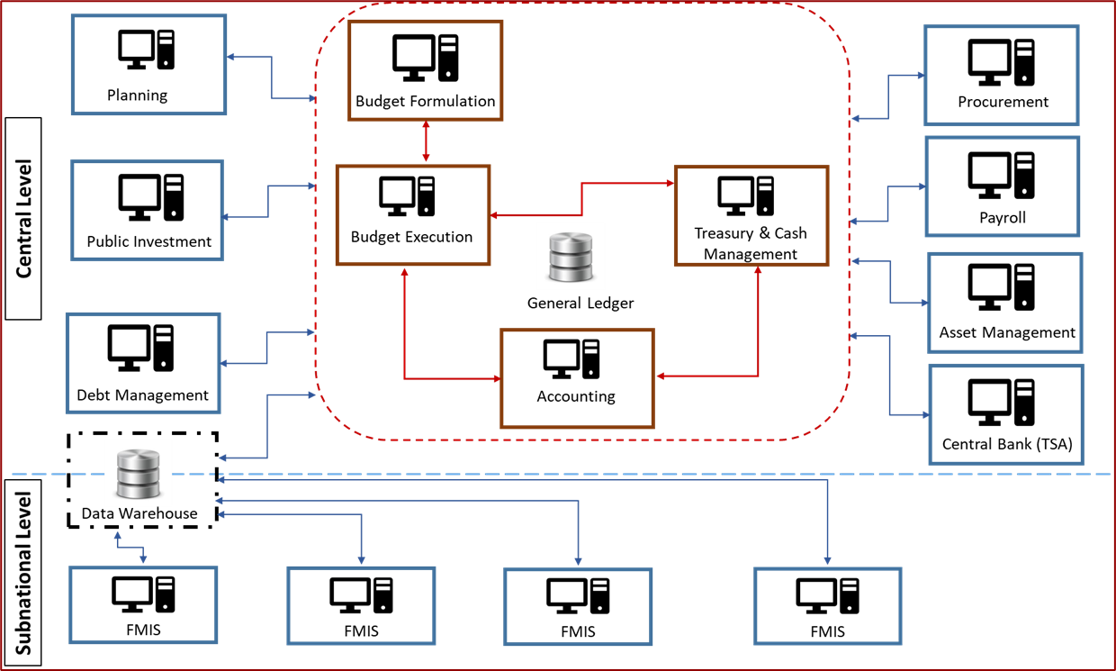
I. Evolution in the Design of FMIS
Figure 1. Schematic Representation of a Comprehensive FMIS in Developing Countries

Slide 5
II. Key FMIS’ Design Challenges
A survey of 46 countries conducted by the FAD in 2019 shows that failures of FMISs in developing countries result from many factors, including:
Failure to carry out an adequate Conceptual Design
Poorly-defined functional requirements
Automation of existing inefficient business processes
Inefficient parameterization of COTS solutions
Short cuts taken to ensure that the FMIS is up and running early
Failure to modernize basic PFM processes (e.g., chart of accounts) in parallel to the FMIS development
Substantial implementation delays and cost overruns
More information available on “How to Design a Financial Management Information System: A Modular Approach” Gerardo Una, Richard Allen, and Nicolas Botton. FAD How to Note 19/02

Slide 6
II. Key FMIS’ Design Challenges
# | Topic | Main Weaknesses of the Core FMIS
1 | Accounting and Fiscal Reporting | 1.1. Problems in the generation of accurate and timely fiscal reports
 |  | 1.2. Failures to integrate the chart of accounts and the budget classification
 |  | 1.3. Absence of a data warehouse or the capacity to drill-down to detailed accounting and budgetary information
2 | Tracking of Cash Flows and Bank Reconciliation | 2.1. Deficiencies related to bank reconciliation and electronic payments
3 | Budget Execution and Internal Controls | 3.1. Weaknesses in supporting the management and control of the budget
4 | Treasury and Cash Management | 4.1. Insufficient support for government banking functions
5 | Institutional Coverage | 5.1. Incomplete coverage of Central Government entities
6 | IT Platform | 6.1. Software licenses expired; limited hardware capacity and/or inadequate database maintenance
 |  | 6.2. Poor or non-existant connectivity in regional or remote locations
7 | Interoperability and data sharing capabilities | 7.1. Absence of shared information with other PFM systems (e.g. revenue collection, debt management, public procurement, payroll, or public investment projects.

Slide 7
III. PFM Digitalization Guidelines – General Overview
Develop PFM Digitalization Guidelines for enhancing public finances outcomes
The PFM Digitalization Guidelines have as an aim support practitioners on how to implement or modernize PFM IT solutions to enhance public financial outcomes, including service delivery to the citizens
The Guidelines will include PFM IT systems functional & technological principles
The Guidelines would allow a more efficient and cost-effective adoption of digital innovations
The guidelines will be developed for a various levels of maturity of PFM IT systems in different countries, which will produce different levels of expected outcomes

Slide 8
III. PFM Digitalization Guidelines – General Overview
General Consulting Group
Bill & Melinda Gates Foundation staff
IMF “Core” Working Group
PFM / IT Community of Practice
Civil Society
Service Delivery to the Citizens
Development Partners
Government Officials
Fiscal Transparency Portals
Cyber Risks
CORE PFM IT SYSTEMS
(Treasury, Budget, Accounting, & Fiscal Reporting)
70% - 80%
Industry
30% - 20%
Digital Innovations
Academia

Slide 9
III. PFM Digitalization Guidelines – General Overview
Figure 1. Stakeholder Map & Core Fiscal Functions
Oversight Entities
Parliament – AD, TD, PD
National Audit Office – CD, AD, PD
Fiscal Council – AD, PD
Anti-Corruption Agency – CD, AD, PD
General Public, NGOs, Academia, Media - AD
External Rating Agencies - AD, TD
Motivation
Scrutinize policies and transactions of government entities
Propose/implement anti-corruption policies
Assess countries’ financial viability
Other Core Government Agencies
Cabinet – AD, TD
Ministry of Planning – CD, AD, TD, PD
Line Ministries – CD, AD, TD, PD
Public Procurement Agency – CD, AD, TD, PD
Motivation
Make decisions on economic/fiscal policy
Support good fiscal policies (CB)
Prepare plans to deliver strategic goals, e.g., infrastructure, SDGs
Deliver public services
Purchase good and services efficiently
Ministry of Finance
Macro-Fiscal Department – CD, AD, PD
Budget Department – CD, AD, TD, PD
Treasury Department – CD, AD, TD, PD
Debt Management Department – CD, AD, TD, PD
Public Investment Department – CD, AD, PD
Fiscal Risk Management Department – CD, AD, PD
Information Technology Department - AD
Revenue Authority – CD, AD, TD, PD
Motivation
Prepare reliable macro-fiscal forecasts
Set fiscal strategy and rules
Prepare/execute credible budgets
Improve cash management and payments processes
Collect tax/customs revenues
Manage public investment
Manage fiscal risks
Issue timely/reliable fiscal reports
Manage fiscal crises (GFC, COVID-19)
Support better service delivery to the citizens by public agencies
Underpin PFM processes with adequate technology and adopt digital innovations
IT Industry & COP
Software & Hardware vendors - TD
PFM IT Community of Practice - TD
Motivation
Sale equipment, applications & software
Provide Technical Assistance y
Other Public Sector Entities
Central Bank – CD, AD, TD, PD
Social Security Agency – CD, AD, TD, PD
Other Extrabudgetary Units – CD, AD, TD, PD
Subnational Government Entities – CD, AD, TD, PD
Public Corporations - CD, AD, TD, PD
National Statistics Office – CD, AD, PD
Motivation
Deliver good public services
Be commercially successful (PCs)
Collect core statistical data (NSO)
External Partners and Private Sector
IMF – AD, TD, PD
World Bank – AD, TD, PD
Regional Development Banks – AD, TD, PD
Bilateral Donors – AD, TD, PD
Private businesses/PPPs – TD, PD
Motivation
Undertake surveillance of member countries
Lend/issue grants and provide CD support
Take investment decisions
Key: CD = collect data; AD = analyze data; TD = take decisions; PD = publish data

Slide 10
IV. High Level Analytical Approach
Identification of the main PFM functions & processes supported by IT systems
1. Fiscal Policy
PFM Diagnostic Tools/Frameworks & Guidelines main aspects related to PFM functions
1. Fiscal Transparency Code/Evaluation
High Level functional requirements for PFM IT systems
Develop Functional Requirements at the Level of a Conceptual Design
PFM IT systems functional & technological principles**
1. Fiscal Policy
2. Budget & Revenue Management
3.Treasury Management
4. Accounting, reporting & audit
5. Other central finance fucntions
2 Budget & Revenue Management
3. Treasury Management
4. Accounting, reporting & audit
5 Other central finance functions
2. Public Investment Management Assessment
3. Public Expenditure and Financial Accountability
4. Open Budget Index*
5. Open Government Partnership*
6. Open Contracting Partnership*
Selected aspects/dimensions as relevant
** Technological principles will be developed in parallel

Slide 11
V. Main Areas & Processes
1. Fiscal Forecasting and Budget Preparation
Preparation of the annual budget;
Budget monitoring (feedback loop); and
Forecasting of tax and non-tax revenues.
2. Public Investment
3. Public Participation in the Budget Process
4. Fiscal Risks Oversight
5. Public Sector Balance Sheet
6. Budget Execution and Controls
7 Collection of Tax and Non-Tax Revenues
8. Accounting and reporting:
Accounting and tracking of financial transactions;
Compilation of in-year financial and budget reports;
Compilation of end-year financial and budget reports; and
Consolidation of main financial reports covering the GG and Public Sector
9. Portal for Dissemination of Fiscal Information and PFM Outcomes
Cash flow forecasting and management;
Debt management operations;
Management of government bank accounts; and
Electronic payment systems.
11. Financial Asset Management
12. Internal Audit
10. Treasury Management

Slide 12
V. Main Areas & Processes
Table 1. PFM IT Systems’ Functional Requirements for Budget Execution and Control
Function/ Process | Objective | Functional Requirements | PFM Assessment Tools Indicators
1. Authorization of expenditure 2. Apportionment by period and spending unit 3. Commitment | Provide reliable information on the availability of funds for commitments based on the approved authorization of expenditure and the supplementary budget | Register and manage reliable budget information. Allow budgetary units to plan and commit expenditure – current and capital - at least XX months in advance, consistent with budgeted appropriations and/or commitment releases. Record expenditure by an administrative, economic, functional, and program classification. Integrate the budget classification in the chart of accounts (COA). | PEFA PI 21.3 FTC Principle 1.3.1 & 2.2.1 PIMA Institution 8.a & 12.a
 | Provide reliable information on the availability of funds for commitments based on updated amounts of authorization of expenditure considering the spending reallocations during the budget year | Register updated budgetary appropriations that take account of any spending reallocations and/or supplementary budgets approved during the budget year. Record any budget updates using the administrative, economic, functional, and program classification and COA noted above. | FTC Principle 1.3.1 & 2.2.1 PIMA Institution 8.b & 12.a
 | Support comprehensive expenditure commitment controls and effectively limit commitments to approved budget allocations and projected cash availability | Exercise the following control – when each transaction generates a new or modified commitment, the amount should be limited to approved budget allocations and/or to projected cash availability. Record that the control has been correctly applied according to the law and regulations. In exercising this control, the administrative, economic, functional, and program classification, as well as COA noted above, should be applied. | PEFA PI 25.2 FTC Principle 1.3.1 & 2.2.1

Slide 13
VI. Level of Advance of PFM IT Functional Principles
Basic
More advanced digital solutions adopted to automatize core and auxiliary PFM functions
Advanced
Intermediate
Automatization of routine / repetitive PFM tasks
Better information to support decision making
Utilization of “cutting-edge” technologies to introduce significant improvements in PFM processes and outputs
Digital transformation of PFM processes
Improving information capture and controls
Improving interoperability
Core PFM Key Functional Dimensions for IT Systems
1. Data Capture | 4. Data Exchange and Interoperability
2. Data Processing & Control | 5. Information to Support Decision-Making
3. Data Storage | 6. Enhanced Information Transparency

Slide 14
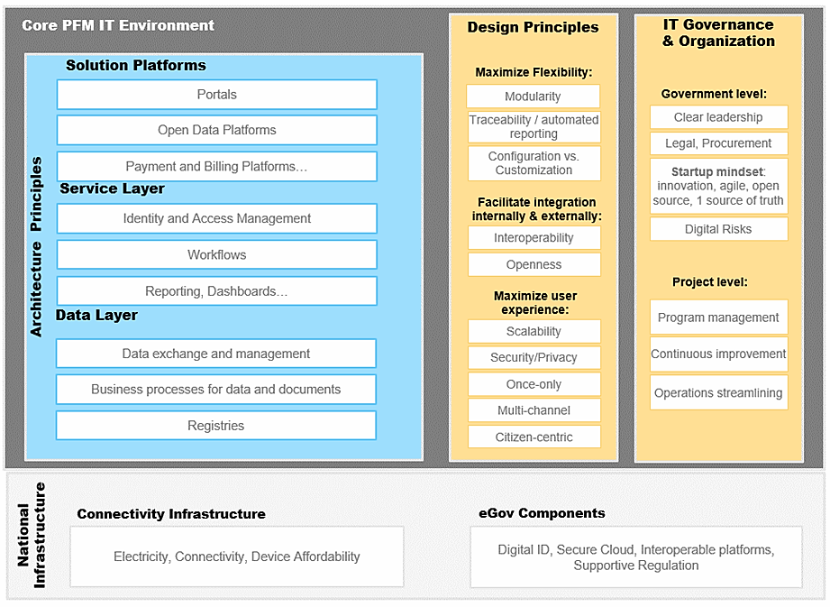
VI. Key Functional Dimensions & IT Principles
# | Core PFM Key Functional Dimensions for IT Systems
1 | Enhanced Information Transparency
2 | Information to support decision making
3 | Data Capture
4 | Data Processing and Control
5 | Data Exchange and Interoperability
6 | Data Storage

Slide 15
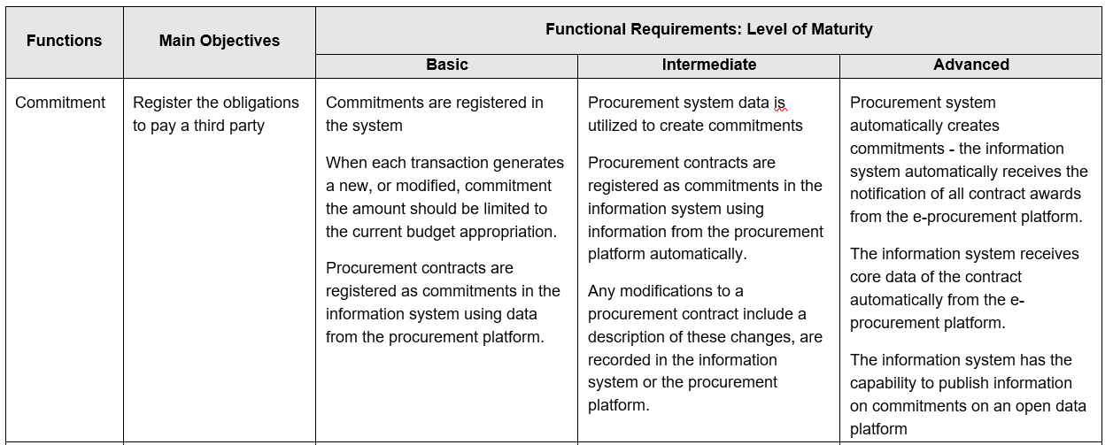
VII. Budget Execution & Controls: Key Functional Requirements by Level of Maturity (1/3)

Slide 16
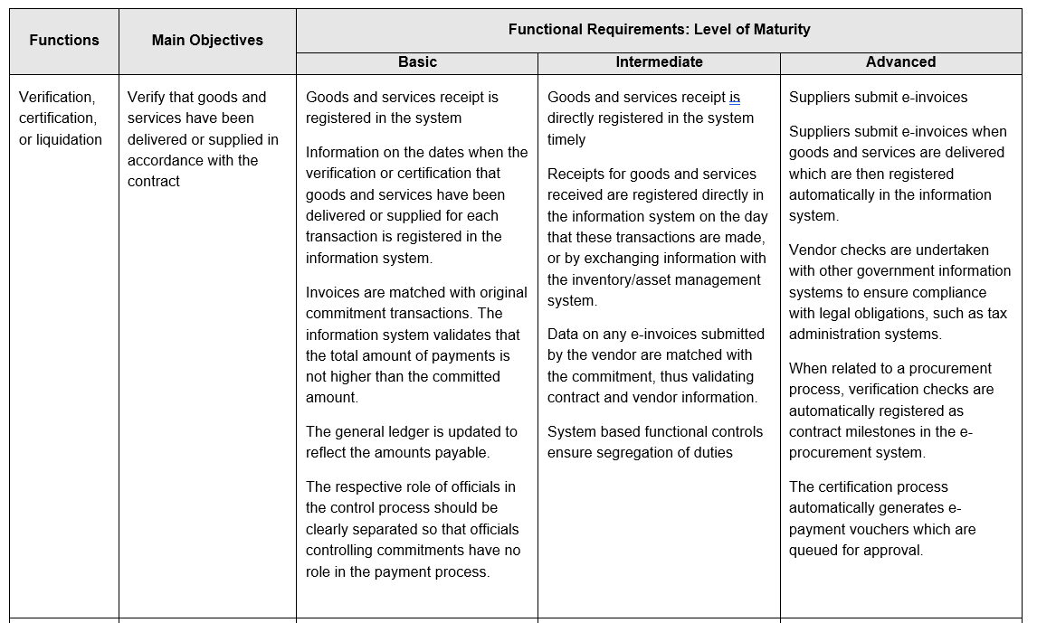
VII. Budget Execution & Controls: Key Functional Requirements by Level of Maturity (2/3)

Slide 17
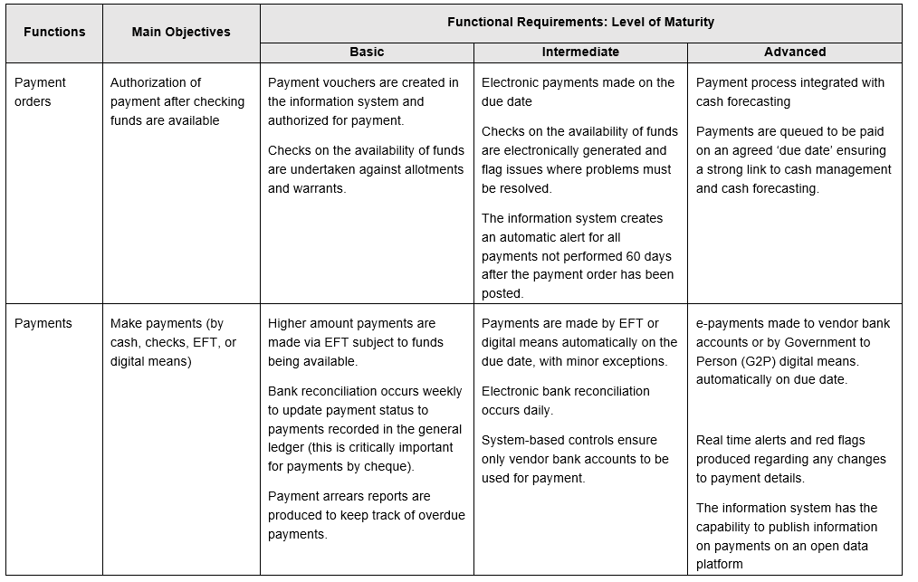
VII. Budget Execution & Controls: Key Functional Requirements by Level of Maturity (3/3)

Slide 18
VIII. Main Conclusions
Many LIDC and EME continue to face severe challenges in modernizing their core FMISs associated with the systems’ core functions, institutional coverage and IT platforms
Replacing a core FMIS with an entirely new system is unlikely to be the optimal strategy in most cases
Despite the large amount of investment in PFM IT systems, a guide with a set of “principles” or good practices has not been developed yet for public sector practitioners. FAD aim is finishing the first draft of this type of Guidelines during 2021.
Solutions should be country-specific. However, implementation of an effective PFM Digital Solutions depends on two critical preconditions: i) political commitment, and ii) the presence of a fundamentally sound PFM system.

Slide 19
PFM Digitalization Guidelines: Preliminary Advances
Gerardo Uña
Senior Economist
Fiscal Affairs Department

