Slide 1
Ministry of Finance North Macedonia IFMIS Developments
07.06.2021

Slide 2
PFM Reform Programme 2018-2021
Implementation of new Integrated financial management information system (IFMIS)
Improved Fiscal Framework
Revenue Mobilization
Planning and Budgeting
Budget Execution
Transparent Government Reporting
Internal Control
External Control and Parliamentary Oversight

Slide 3
New OBL
Preparation of a multi annual forecast and planning of the budget
Establishing a link between the strategies, policies and the budget
Adopting fiscal discipline through a fiscal rule and Fiscal Council
Introduction of the new IFMIS system and its ability to control commitments and other fiscal risks/issues
Improving coverage and quality of the financial reporting
Ensuring transparency and citizens’ access and use of budgetary documents (web portal)
Strengthening the financial management controls and Internal Audit
Broaden the scope of the External Audit
IFMIS Objectives
The main objective of IFMIS development is to improve the efficiency of PFM operations by transitioning from existing fragmented and disconnected systems to a centralized web-based shared platform benefiting from the latest digital technologies.
New IFMIS is expected to support the implementation of new Organic Budget Law (OBL) by broadening the scope of budget execution monitoring and fiscal reporting, covering all stages of the expenditure cycle (from procurement to payment), tracking all budget users, and obtaining a consolidated picture of the public spending on a timely basis

Slide 4
World Bank project - Supporting the Development of Integrated Financial Management Information System
Activity Initiation
Nov 2018
Data Collection Dec 2018
Assessment of Existing PFM Info Systems Feb 2019
Feb 2019 visit
Consultation Workshop on IFMIS Options Apr 2019
Workshop on IFMIS Req (To-Be) & Roadmap Dec 2019
Workshop IFMIS & OBL
Jun 2019
Oct 2019 visit
IFMIS Req update Apr ‘20
IFMIS Req update Jan ’21
WB Pre-Id mission on potential lending for IFMIS & ITIS (Jan 25 – Feb 05, 2021)
Letter to WB on Minister’s Decision to establish IFMIS Unit

Slide 5
Deliverables from the project:
AS-IS report – describes the current business processes in use within public finance sector, individual IT systems and emphasizes the need to establish an integrated public financial management system.
IFMIS Model and Options report - describes the options for an integrated system, as well as the modules that would contain it. The options were: 1. Shared IFMIS platform and web portal; 2. Decentralized IFMIS operations; 3. Hybrid IFMIS platform i.e not procurement of a completely new system, but to maintain the existing basic modules, to upgrade their functionalities and to integrate the processes in the MoF, and to establish a connection of the system with the systems of other relevant institutions).
IFMIS Functional and Technical Requirements - this is technical documentation for the new IFMIS, with a detailed description of all business processes and functionalities of the moduls to be contained in the new IFMIS.

Slide 6
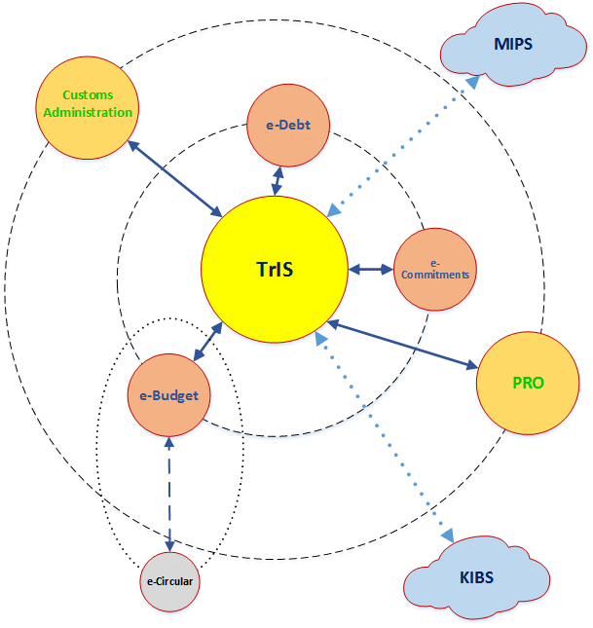
As-Is model in PFM (Fragmented systems)
e-Budget (Budget Planning System (e-Circular), e-Liability and Multi-Year Budget Preparation System (e-Budget)
TRIS-Treasury information system (original registers module, financial plans module, commitments management module, reporting module, payment system module, budget execution and funding allocation module, archive management module (ancillary))
TrIS Interfaces (interface with the National Payment System; Customs Office, Public Revenue Office, Pension Insurance Fund and Health Insurance Fund)
e-Treasury (e-Commitments and e-Payments)
e-Debt (for public debt management, debt projections, debt stock reporting and government securities)
FAMA (Foreign Assistance Management Application)
Other PFM Systems and Interfaces (revenue management, e-Procurement, HRMIS/Payroll, PFM information systems of MDAs (specific systems of Ministries, Departments and Agencies).

Slide 7
IFMIS Model Platform
Preferred Option: Hybrid IFMIS Platform and Web Portal
Hybrid IFMIS platform where core PFM modules can be available via shared IFMIS platform and web portal to the budget users and several other functions can still be decentralized but connected to the shared platform through web portal/interfaces.
Shared IFMIS modules supporting most of the budget users online
IFMIS Scope: 1,360+ Institutions and 6,000 Users from Central and Local Government

Slide 8
IFMIS Modules to Support OBL and PFM Reforms
1. PBM > Planning and Budgeting Module
• BPM > Multi-Year Budget Preparation Replace e-Budget, e-Circular
• PIM > Public Investment / Project Management New
• MPC > Monitoring of Projects and Contracts Enhance FAMA
• REG > Management of registries & budget classifications New
2. BEX > Budget Execution Module
• MBA > Management of budget allocations Replace TrIS
• MEX > Management of expenditures Replace TrIS
• MRE > Management of receipts Replace TrIS
• CCM > Commitment control & management Replace e-Commitments
• CFM > Cash forecasting and management New
• ACC > Accounting / General Ledger New
3. OTH > Other PFM Modules
• PDM > Public Debt Management Replace e-Debt
• FAM > Fixed (& Financial) Asset Management New
4. TGR > Transparent Government Reporting
• OBD > Financial reports/ Open Budget Data (generated from IFMIS) New
• DWH > Data warehouse, BI tools, Web Portal New
5. INT > Interfaces with other PFM Systems New

Slide 9
Proposed IFMIS Model
e-Budget &
e-Circular
IFMIS = B + T + O
Policy Development and Review
Budget Preparation
Public Investments
New and enhanced modules will be combined for a hybrid IFMIS
Audit and Evaluation
Mgmt of Budget Authorizations
DW
Fiscal Reports & Budget Review
Commitment of Funds
IFMIS DB
ESPP
Web Portal / DW
Publish / Monitor
General Ledger
Accounting
TrIS &
e-Commitments
Procurement /
Purchasing
Open Budget Data
Daily Operations
e-Debt
e-Tax & e-Customs
Debt and Aid Management
Payments and Receipts Mgmt
Tax and Customs
Treasury Single Account
Asset / Inventory Mgmt
Cash
Management
Payroll Calcs
HR Mgmt
Market Operations
/ Securities
HRMIS

Slide 10
Implementation of IFMIS will contribute to:
Improve the efficiency of business processes
Preparation of a multi-annual forecast and planning of the budget
Strengthen policy-based fiscal strategy and budgeting
Introduce active cash management
Ability to control commitments and other fiscal risks/issues
Improvement in coverage and quality of financial reporting
Introduce Public investment planning and management
Improve the management of assets and liabilities
Strengthen accounting and reporting
Strengthen the transparency of public finances

Slide 11
Benefits of IFMIS Modules
Transparent Reporting Module
financial reports (Data Warehouse)
user-friendly reports (dashboards)
Connectivity with Other Systems
exchange of data with other systems within the PFM sector and other institutions (PRO, CU, Public Procurement Bureau, MISA and others).
Planning and Budgeting Module
centralized database of registers and classifications
medium term budgeting is strengthened
program budgeting (in principle program, project, activity)
performance indicators
PIM modul (management and monitoring of public investment /project management module)
Budget Execution Module
pre-commitment control
recording of invoices
active cash management
accounting module
Other Modules
sub-module on on-lending
reports related to the public debt
sub-module for guarantees
asset and liability management module

Slide 12
Timeline for IFMIS Activities
Finalizing technical requirements for IFMIS documentation
Change management
Advisory support and monitoring during IFMIS developments
Preparatory activities for tender documentation
March
2021
Jun-July
2021
July-Aug
2021
Q3
2021
November
2021
December
2021
Q1
2022
Q2
2022
Establishing IFMIS WG for coordination of preparatory activities
Adopting OBL
Establishing PIU WB
Establishing IFMIS Unit
Law on borrowing for IFMIS and ITIS
IFMIS tender
IFMIS tender / evaluation / selection of the solution provider
Implementation Phase

Slide 13
Information Systems and Covid 19
IFMIS developments continue during the pandemic (the pandemic affected the timing of the project, but further emphasized the need for digitalization and integration of the PFM processes especially in this circumstances)
PPB adjust the public procurement system with the opportunity to mark public procurements related to the COVID–19
Government create a website koronavirus.gov.mk in order to include data related to the crisis as:
- health statistics, all economic measures, the records of all financial and non-financial donations received as to addressing the COVID–19 crisis, data on all individual payments from the Budget that are made within budget sub-program related to COVID – 19 crisis (connectivity with open. finance portal and PPB system)

Slide 14
Thank you for the attention!

