Slide 1
Practical Experience of the Data Processing Center of the Ministry of Finance in Maintaining the Continuous Operation under COVID-19 Conditions
Viktor Petrenko
Head of the IT Security Department

Slide 2
About the Company
The Data Processing Center of the Ministry of Finance of the Republic of Belarus is a multi-functional IT-company offering a full range of services for information and technical support of the Ministry of Finance, its territorial bodies, local financial bodies, budgetary organizations.
47 years of experience
in more than 100 cities
more than 5000 customers
more than 400 specialists

Slide 3
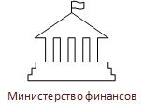
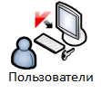
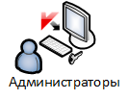
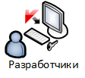
Objectives of the Data Processing Center
Automated System for Financial Settlements (ASFS)
to manage public finance of the Republic of Belarus
Data Processing Center (DMZ)
process automation, development, accompaniment, technical support

Slide 4
Support of Continuity and Recovery of Operations by the Data Processing Center of the Ministry of Finance
The management of continuity of operations by Data Processing Center of the Ministry of Finance means a set of actions aimed at recovery of operations of Data Processing Center of the Ministry of Finance as a results of threats as well as at support of the continuity of performance of works (services) for the benefit of the Ministry of Finance, its territorial and local financial bodies in the following areas:
regular technical maintenance of crucial automation objects (KVOI)
regular technical maintenance of server equipment
regular technical maintenance of telecommunication infrastructure
information security support
information support
accompaniment and support of functioning of
information systems

Slide 5
Threats
technical failures of equipment
cyber attacks on KVOI and public resources
information malfunctions caused by data losses connected with software malfunctions and failures due to malicious attacks
personal health threats (epidemics, pandemics)
transport problems caused by strikes, complicated weather conditions, etc.
natural disasters (flood, hurricanes, tornadoes, and earthquakes)
civil commotions (mass protests)
terrorism (terrorist attack risk)

Slide 6
Secure Remote Access
Actions performed to arrange secure remote access and applicable technologies:
secure publication of web resources of the Data Processing Center using Web application firewall (WAF) technology
connection of remote users using VPN technology
application of Next Generation Firewall (NGFW) technologies
protection of remote workstations (service PCs, Kaspersky endpoint security)
authentication
vulnerability management

Slide 7
Used Online Communication Technologies
Microsoft Teams is a uniform platform for meetings, chats, calls, and joint work.
Skype offers video, voice, and text communication as well as exchange of non-confidential documents.
Google Meet is a service of secured video conferences.
Zoom is a service of video telephony, video conference communications.

Slide 8
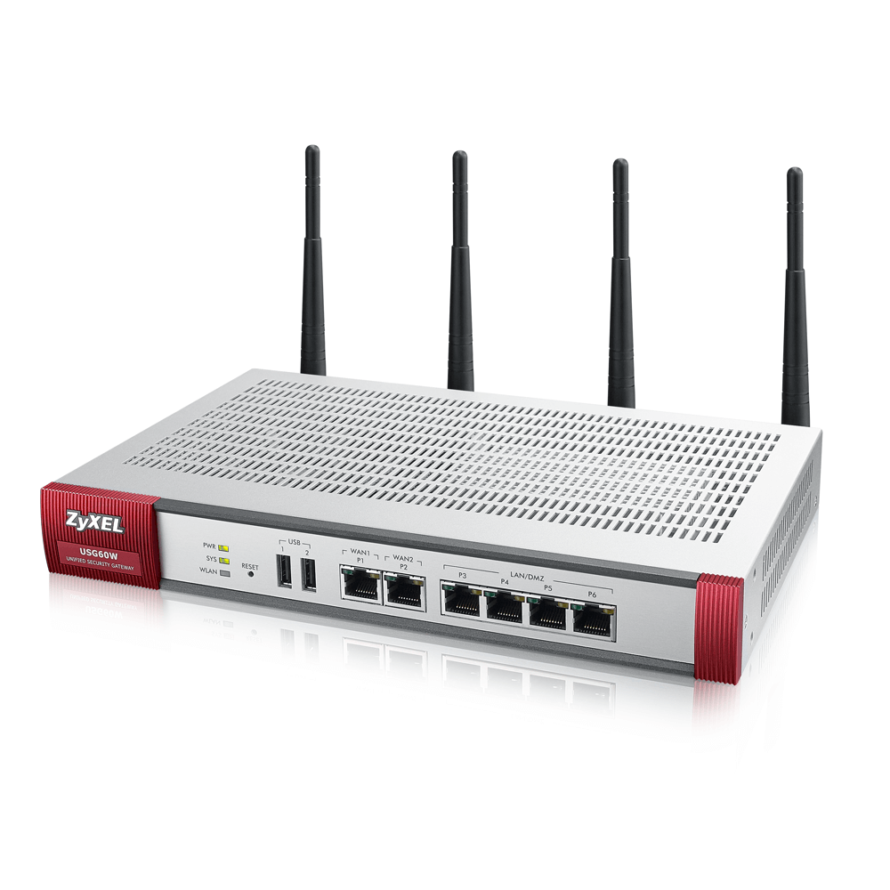
Equipment and Software Purchased with Support of the IBRD Loan
Rapid 7 Nexpose, a vulnerability management system
Kaspersky Endpoint Security, a comprehensive system for protection and control of workplaces
Certified WI-FI connection security gateway
Zyxel USG60W
InfoWatch Traffic Monitor, a system for detection and prevention of confidential information leakages (DLP system)
Ben VPN Gate, a hardware and software suite for information cryptographic protection

Slide 9
Thank you for your attention!
EGOROVA
Ksenia Andreevna,
Project Manager of
the Data Processing Center (UP) of the Ministry of Finance
June 07, 2021

