Slide 1
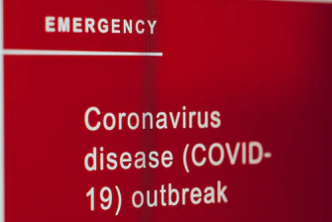
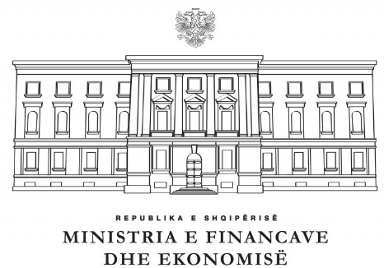


Albanian Treasury response to the COVID-19 challenges
PEMPAL-TCOP
Videoconference meeting
April 29, 2020

Slide 2




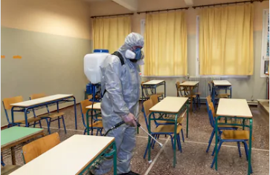
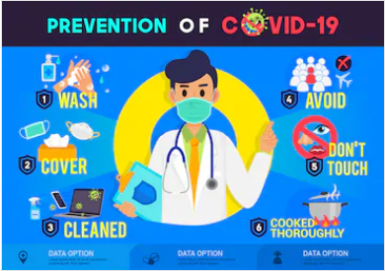
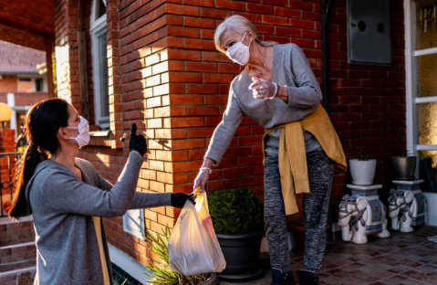
Emergency - extraordinary regime arrangements
We’re in a situation that’s unlike anything we’ve faced before. And even though it may feel like everything has been put on pause, we know that the need to share our stories hasn’t. In fact, it may be more important than ever.
A few months in and “social distancing” is already in the lead for 2020’s word of the year. Or is it words of the year? Anyway, it help fight the spread of illness at the same time.
Measures set by World
Health Organization/Ministry
of Health; we consider the health of our employees and society as a priority.
As someone who works from the office every day, I wanted to highlight other young professionals on the job, collaborating and enjoying the workplace.
Living rooms are the new break rooms, and the electronic equipment have become our coworkers. For the time being, remote work is now just… work. So that’s what we curate—home offices, remote work stations, and video conference calls.
Knowledge is power, and during times like these, more crucial than ever. Hopefully we can flatten the curve sooner rather than later
The youngest help the oldest
Notes:
Izolimi vijon deri ne 21.06.2020
Such regime is introduced in Albania. Of course it has the implications for the treasury operations. It is approved the Council of Ministers Decision for ….
– availability of treasury instructions for operation in emergency situations (or need to develop such instructions), identification of critical business functions, relaxing spending authorization requirements, centralized and simplified procurement procedures, etc.
Masat që janë marrë për frenimin e përhapjes së pandemisë nepermjet karantinimit:
To protect people's health, it is advisable to avoid going to stores or outlets as much as possible, as well as to use digital channels as much as possible. (Për të mbrojtur shëndetin e njerezve eshte këshilluar të evitojne sa më shumë vajtjen në dyqane apo në pikat e shitjes, si edhe të përdorin sa më shumë kanalet digjitale)
Ne kemi bërë të mundur që punonjësit tanë me fëmijë (për sa kohë që shkollat dhe kopshtet janë të mbyllura) dhe ata mbi 50 vjeç, të punojne nga shtepia. Gjithshtu pjesa tjetër e punonjësve tashmë janë duke punuar nga shtëpia me rotacion. Kjo gjë bën të mundur që shërbimi I Thesarit të mos ndërpritet në asnjë çast e nga ana tjetër të krijohet në ambientet e punës distanca e rekomanduar nga OBSH për të mos rrezikuar shëndetin e punonjësve
Të gjitha ambjentet e zyrave si edhe mjetet e transportit të punonjësve janë dezinfektuar dhe vazhdojnë të dezinfektohen rregullisht. Ambjentet e punës janë të pajisura me alkool dhe dezinfektues gjithashtu.
Punonjësit janë udhëzuar dhe inkurajuar për marrjen e masave të sigurisë
Kemi ndaluar të gjitha vizitat nga te interesuarit, takimet dhe organizimet në varësi të progresit të procesit.
Në rast se është e domosdoshme të paraqiten në dyqan, etj., duhet të mbajne distancën prej minimumi 1.5 metra nga njeri-tjetri.

Slide 3

NORMATIVE ACT no. 3, dated 15.03.2020
FOR TAKING SPECIAL ADMINISTRATIVE MEASURES DURING CONTINUANCE OF THE PERIOD OF COVID-19
The Council of Ministers, on the proposal of the Minister of Health and Social Protection and the Minister of the Internal Affairs, decided to fine for violation of the rules, decisions, orders and instructions issued by the competent authorities as following:
Export of medicines and medical equipment from the Republic of Albania, without special authorization of the Minister of Health and Social Protection,
The development of public and non-public activities, such as sports, cultural and conference activities, or mass gatherings indoors or outdoors, such as concerts, rallies and public hearings,
Entry of guardians and/or relatives of patients in the service premises of medical emergency, health care institutions, hospital service facilities where they are receiving inpatient treatment patients, except in cases where such a request comes from the hospital directorate,
Non declared entries of the citizens from the areas affected by COVID-19 infection, declared by the competent local authorities, either foreign or international,
Non closure of the activities of educational institutions, nurseries and kindergartens, public and non-public,
Carrying out activities in the premises of indoor entertainment for children and young people, gyms, sports centers, swimming pools, internet centers, cultural centers,
Non closure of bars, bars, restaurants and clubs,
Allowing development of sports, social, cultural activities, excursions teaching organized by educational, public and private institutions, inside and outside of the country,
Not respecting the ban on the movement of public and private vehicles, including private vehicles, in the areas and schedules set by the competent authorities (revocation of the driving license for a period of three years and by blocking of the vehicle),
Increase the selling price of all food and food products, medicines, medical equipment and services, compared to their price in regular sales, traded in the previous months,
All audiovisual broadcasts with more than two persons in the same television studio,
Failure to provide services by pharmacies, wholesalers of drugs and drug manufacturers, applying the security criteria set by the competent authorities, etc.
Notes:
Financial package of 12 billion ALL (according to the normative act).
• "Anti-COVID-19 social package" has 6.5 billion ALL, in support of employees, including people in need, people who lose their jobs in the community, etc.
• “Anti-COVID Fund” in the amount of 2.5 billion lek, support for the Ministry of Health and hospital structures for the supply of medicines and equipment.
• The reserve fund increases by 1 billion ALL, for expected unforeseen expenses.
• Emergency fund for food security of communities that will be affected by the corona virus, for families with economic assistance, single pensioners in the amount of 2 billion ALL. This fund will also be used for the needs of medical teams, both in civilian and military hospitals.
• Support for the private sector, in the form of a sovereign guarantee of 11 billion lek (100 MUSD), as a guarantee for companies that will have difficulties in paying salaries to employees. The guarantee is for short-term loans, it aims to ensure that every family has enough income to cope with the situation.
The normative act increases the deficit to 68.7 billion lek, or 3.9% of GDP, compared to 2.2% of GDP at the beginning. This will increase public debt to 68.8% of GDP.
MFE has assessed the impact on the economy, mainly the tourism, trade, transport sectors, although the situation is still unclear. It predicts a slowdown in exports and investment. Based on these forecasts, real GDP growth is projected at 2% (economic growth will be subject to review).
============================================
Pakete financiare prej 12 mld leke (sipas aktit normativ).
​​​​“Paketa sociale anti-COVID-19” ka 6,5 mld lek, ne mbeshtetje te punemarresve, perfshire njerezit ne nevoje, personat qe humbasin punen ne komunitet, etj.
“Fond anti-COVID” në masën 2.5 mld lek, mbeshtetje per M.Shendetsise dhe strukturave spitalore per furnizim me medikamente e paisje.
Fondi rezerve rritet me 1 mld leke, per shpenzime te pritshme te paparashikuara.
Fond emergjence per sigurimin me ushqim te komuniteteve qe do rezultojne te prekura nga korona virusi, per familje me ndihme ekonomike, pensioniste te vetmuar ne masen 2 mld leke. Ky fond do perdoret edhe per nevoja te ekipeve mjeksore, si ne spitalet civile dhe ate ushtarak.
Mbeshtetje per sektorin privat, ne formen e garancis sovrane 11 mld lek (100 MUSD), si garanci per kompanit qe do ken veshtiresi per pagat punonjesve. Garancia eshte per kredi afatshkurtera, synon te siguroje qe cdo familje te kete te ardhura te mjaftueshme per perballimin e situates.
Akti normativ rrit deficitin ne 68,7 mld lek, ose 3,9% te PBB, kundrejt 2,2 % te PBB qe ishte ne fillim. Kjo do te rrise borxhin public ne 68,8% te PBB.
MFE ka bere vleresim te impaktit ne ekonomi, kryesisht sektoret e turizmit, tregti, transportit, ndonese situata eshte ende e paqarte. Parashikon ngadalesim te eksporteve dhe investimeve. Ne baze te ketyre parashikimeve, rritja reale e PBB eshte parashikuar 2% (rritja ekonomike do jete subject rishikimesh).

Slide 4
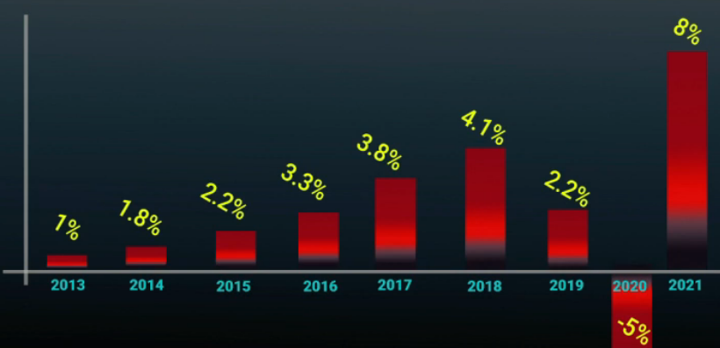


Council of Ministers has approved two financial packages
IMF forecast
for Albania's economic growth
The first package
The second package
Payments for small and large enterprises which are affected from the measures taken for COVID-19 (176,000 persons).
Sovereign Guaranty for the credit of clothing/footwear industry and manufacturing sector, covering of the interest.
Rescheduling of profit tax for the business until in the end
of September.
Rescheduling of profit tax for the clothing & footwear
industry, tourism, call centers and small business until in the end of December, 2020.
Funding for Ministry of Health and Defense.
Sovereign Guaranty for salaries of companies.
Funding for small business and social classes in need.
Reserve Fund for Council of Ministers.
Cancellation of interest on arrears for energy debtors.
Rescheduling of profit tax in the second quarter of this year.
Postponement of the financial statements’ submitting until
June 1, 2020.
The source: The Interview of the Secretariat of the Investment Council with the business
Notes:
First package:
25 millions USD for the Ministry of Health
100 millions USD as the Sovereign Guaranty for salary
65 millions USD for the small business and layers in need
20 millions USD for the Ministry of Defense
10 millions USD as reserve fund for Council of Ministers
Second package:
Payment of 40,000 ALL for small and large enterprises which are affected from the measures taken for COVID-19 (176,000 persons).
Financial aid for 176 persons (workers) who will benefit 40,000 Lek. The categories that will benefit from this measures, are as follows:
10,000 workers in tourism sector
66,000 workers suspended or fired from the large business sector (large enterprises)
100,000 workers from small business (small enterprises)
Sovereign Guaranty for the credit of clothing/footwear industry and manufacturing sector, covering of the interest.
90% of 49.9% of cessation belongs the services sector
The source of information: The Secretariat of Investment Council
Qeveria shqiptare ka hartuar deri më tani 2 paketa financiare, me një vlerë totale prej 570 milionë euro, duke përfshirë këtu edhe dy garancitë sovrane dhe faljen e kamatëvonesave që në vetvete nuk janë shpenzime të zdritshme direkt nga buxheti. Ndërkaq duket se në këtë moment paratë nuk mungojnë, pasi u sigurua borxhi në tregun e brendshëm prej 100 milionë euro; kredia e FMN-së në vlerën e 174 milionë eurove dhe financimet e Bashkimit Europian prej 50.7 milionë euro.

Slide 5




Payment processes
The minister of Ministry of Finance and Economy has approved the instructions no.14, dated on March 24, 2020 “The procedures of the management/monitoring of the budget execution for COVID 19 environment” and prioritized the payments as following:
  Ministry of Health and Debt services payments
  Salaries
  Transfers of social and health care contributions
  Economic assistance and unemployment payment
  Utilities payments (electricity and water)
  Earthquakes
  Economic and financial assistance for COVID 19
  Payments in foreign currency
  Other payments, respecting the chronological order of registration: first in, first out (FIFO)
The other expenses are suspension, so the institutions have to get authorization from the Prime Authorizing Officer, Minister of Finance and Economy and Minister of State for reconstruction. After their approval, Treasury authorizes payments; payment processes is the same, centralized electronically through Albanian Government Financial Information System (AGFIS).
COVID-19 payments are distinguished by economic account of chart of accounts. The ex-ante control is the same, but the electronic archive of justified documents for expenditures does not functions (documents are presented physically to treasury districts offices).
Daily payments by economic operators and beneficiaries are published from IT for transparency.

Slide 6


Liquidity situation
Sweeping funds to Treasury Single Account in total 324.7 millions EUR by following sources:
  International Monetary Fund by Rapid Financing Instrument (SDR currency)
  European Union’ financing
  World Bank budget support
  EURBOND auction in internal monetary market
Thus is used the SWAP instrument between TSA balances in ALL and EUR to pay the expenses of the first and second package for COVID-19
(It is not allow to expense in foreign currency from the foreign financing funds excepted when it approval by mutual agreement).
Currently it is increased the cash buffer level of TSA for unforeseen events (no realization of revenues collection, no realization of securities auction, over expenses, etc.). The level of fiscal deficit is increased twice. Updated daily the realization of cash flows of TSA and rolling out for the next periods.
It is approved the Normative Act for reallocation of expenditures funds and revised the monthly cash flows limits.
It is improved the multi-year commitment control to prevent accumulation of arrears. Analysis daily the fiscal consolidated indicators reports generated by AGFIS for central and local government to respect the approved monthly limits (corrected for the noncash transactions) of cash flows of TSA.
The advances of cash plan to the previous periods are authorized from the Prime Authorizing Officer.
It is improved the bottom up forecasting of cash flows and the institutions are convinced to submit only the necessary expenses to avoid the volatility of liquidity’s needs.
Close coordination between budget execution, debt management and monetary policy implementation to protect expenditures plans from cash flow volatility.
Notes:
International Monetary Fund by Rapid Financing Instrument - 174 millions EUR (139.3 SDR)
World Bank IBRD shuma 2,202,500.00 USD
European Union’ financing 50.7 millions EUR
EURBOND auction in internal monetary market 100 millions EUR

Slide 7


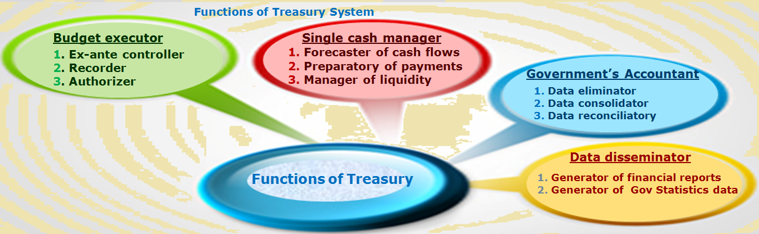


Treasury operations
There is no disruption to core treasury operations.
We are assuring business continuity and applying physical distancing (two employee for office).
Defining of the home based work staff, which has the children under 15 years old and alternating them if it is possible for continuing normally the Treasury operations.
Using of shared drives, online social networks, video calls and video conferencing tools.
Reporting weekly based on the measurable outcomes of each employee according to the approval work plan items/scheduled time to increase the treasury financial services value

Slide 8

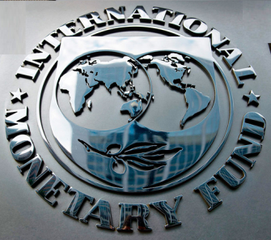
International organizations’ information in response to the crisis
We will keep in mind time by time for the worst situations to implement with the advise of the experts
World Bank
International Monetary Fund
Public Financial Management:
Identify additional budgetary and financial resources
Ensure liquidity, recalibrate debt (whenever possible renegotiate and extend the repayment of the principal) and cash requirements
Ensure timely fund emergency disbursement with adequate accounting, reporting and traceability when possible.
Simplify funding transfer mechanisms for optimal access by those in urgent need and auditing mechanisms
Make auditing of crisis-related expenditures efficient
Simplify and streamline procurement procedures
Establish new fiscal policies to assist the financially most vulnerable segments of population
Prepare fiscal stimulus measures to support the post-crisis resurgence of economic activity
Establish flexibility with the spending rules for the service delivery: from ex-ante to ex-post controls
The challenges are likely to come mainly from:
Estimating and finding additional budgetary and financial resources
Ensuring availability of funds to service delivery units and disbursing them efficiently with due regard to controls
Tracking and accounting for resources deployed in emergency response and reporting it transparently
Ensuring business continuity when faced with large-scale absence of staff.
Notes:
We will keep in mind time by time for the worst situations to implement with the advise of the experts
Pandemic situations represent significant challenge to the operation of the national public financial systems
International organizations provide relevant information that can be used by the authorities in response to the crisis. Below are the links to the webpages of the World Bank (WB) and International Monetary Fund (IMF) where you can find useful reports and policy notes. We also attach to this message the IMF blog and the WB paper which you may find relevant in working on response to COVID-19 challenges in your countries.
https://www.worldbank.org/en/who-we-are/news/coronavirus-covid19
https://www.imf.org/en/Publications/SPROLLs/covid19-special-notes
Health emergencies present a particular challenge to public financial management (PFM) systems due to the need to fund crisis response in a timely and efficient manner, while maintaining accountability and transparency of the use of public funds. PFM systems need rapid adjustments in their processes, procedures, and control mechanisms to ensure rapid disbursement of resources both to the service delivery units and beneficiaries of fiscal stimulus packages directed at affected businesses and households. Ideas for rapid adjustments to the PFM systems are listed below:
Identify additional budgetary and financial resources to develop appropriate macro and micro crisis response packages: In order to meet unforeseen demands in the delivery of emergency health services and purchase supplies, equipment and human resources, finance ministries need to identify and mobilize all emergency response mechanisms available, such as contingency appropriations, supplementary budgets and, where appropriate, external grants. Furthermore, they should identify low priority public spending that could be reduced to create room for priority spending. Public expenditure reviews can help with this exercise.
Ensure liquidity, recalibrate debt and cash requirements: In order to meet its extended obligations, governments will need to ensure liquidity management. This can be achieved by making suitable adjustments to the annual borrowing program and issuance calendar and recalibrating the cash buffer level, if needed, to account for the increased uncertainty. Alternative financing sources should also be explored, such as additional credit lines with banks and arrangements for on call short-term borrowing from cash rich state-owned enterprises and pension funds. A mechanism should be put in place to prioritize payments to the priority sectors/purposes in the event of a temporary cash crunch.
Ensure timely fund emergency disbursement with adequate accounting, reporting and auditing mechanisms: To make resources available to service delivery units in a timely and efficient manner, ministries of finance should create a stream for handling priority items and fast track expenditure authorizations. They should also consider greater delegation of financial authority to frontline ministries, such as the health ministry. Russia has the appropriate institutional, IT and policy infrastructure to handle this issue.
Make auditing of crisis-related expenditures efficient: Government should establish protocols for reorienting or delegating controls. Among others, this can be done by adopting or strengthening a risk-based approach to controls. Supreme Audit Institutions (SAIs) should closely monitor emergency modifications of the PFM system and adjust their auditing approach. SAIs should also consider relying on alternative mechanisms to augment audits and ensure wider coverage of the broad range of new and unusual expenditures. Finally, crisis-specific processes could consider agreeing on audit procedures that are more easily carried out under social distancing e.g. by sharing records and evidence electronically rather than in physical files.
Simplify procurement procedures: For swift supply of the COVID-19 related goods and services, governments should warrant more use of single-source procurement in the case of known and trusted suppliers. Additional guidance should be issued on how to manage this process. To mitigate the risks of fraud, audit trails should be maintained.
Establish new fiscal policies to assist the financially most vulnerable segments of population: To limit health and economic repercussions of the crisis on the most vulnerable social groups, governments should design programs of wage subsidies and cash transfers to impacted households. For the effective disbursement of such benefits adequate systems need to be in place, such as direct deposits in beneficiaries’ bank accounts, or mobile payments and pre-paid cards for those without a bank account. To further simplify funding transfer mechanisms for optimal access by those in urgent need, basic services vouchers can be issues in lieu of cash and existing databases (such as ID records) can be relied on to identify beneficiaries.
Prepare fiscal stimulus measures to support the post-crisis resurgence of economic activity: Once the spread of the virus is halted and social distancing measures lifted, economic activity and employment will need a boost. In order to smoothen fluctuations for the construction-related sectors, governments should explore potentials for accelerating expenditure plans and review the infrastructure pipeline to identify projects that are ready to be implemented or can be accelerated. In the same vein, governments could also consider bringing forward planned construction and maintenance works where appropriate.
++++++++++++++++++++++++++++++++++++++++++++++++++++++++++++++++++++++++++++++++++++++++++++++++++++++++
I. PFM objectives in responding to a pandemic
PFM systems are critical to support the efficacy of the government’s emergency response. Governments around the world are facing the challenges posed by the Covid‑19 outbreak. Unprecedented pressures are likely on healthcare systems—both public and private—and governments may be required to provide fiscal stimulus in response to the crisis. Governments need to ensure that their PFM system is equipped to meet the additional requirements and new challenges in terms of:
Delivery of emergency health services, supporting provision of health care to patients, the purchase of supplies, equipment, and human resources to monitor, contain and mitigate the outbreak of Covid-19;
Ongoing delivery of essential services that may come under stress during an outbreak;
Supporting new fiscal policies to assist sections of population in financial hardship; and
Continued operations despite absence of PFM staff across government.
PFM systems should also be capable of supporting fiscal objectives¾whether that is finding offsetting savings for increased Covid‑19 related spending, or the preparation and delivery of fiscal stimulus packages to support economic activity where appropriate.
II. Immediate considerations: Identify legal framework for additional budget funding
Finance ministries should identify what emergency response mechanisms are at their disposal to meet unforeseen demands. Typically, the main PFM tools to cope with emergency spending are:
Contingency appropriations within the approved budget (or any revolving continency fund). Governments should look to use them judiciously and transparently. Clear prioritization of demands on contingency provisions would be needed to ensure that funds remain unencumbered and available to meet high priority needs.
Emergency spending provisions may be permitted in some jurisdictions. These allow for spending in excess of budgeted amounts when certain circumstances arise, usually under a streamlined approval mechanism (e.g. approval of a head of state).
Expenditure reprioritization through reallocations and virements can create space to accommodate additional requirements. Reprioritization and reallocation would normally be expected to be done transparently within the legal framework for virements.
Supplementary budgets may be needed if new resource requirements cannot be met within the delegated authority of the executive or the available budget envelope.
External grants – sector specific or for emergency response – may be explored.
It would be prudent to determine whether there are any legal or parliamentary constraints on seeking additional funds or reallocating spending that warrant pre-emptive action. This protects against a scenario where it may not be possible to reconvene parliament, or for parliament to meet, when an approval is later needed.
III. Set up institutional PFM mechanisms to meet emergency response
A. Reprioritize spending
Given the additional need to support health and essential services during an outbreak, finance ministries should estimate resource requirements for emergency response, and identify low priority spending that could be reduced to create room for priority spending.
Prepare quick estimates of additional resource requirements. Costing for increased scale of existing services should be relatively easier if cost drivers and price and volume parameters are already available. Require relevant line ministries to provide cost information for any new services under contemplation.
Ask line ministries to provide savings in their respective budgets on a consideration of policy priorities, progress, any available slack, and items that can be postponed to a later period. Experience has shown that across the board cuts do not produce desirable impact.
Care must be taken to ensure that high priority expenditure, including that to support the vulnerable and to meet essential items, such as debt service, should not be adversely impacted. Spending cuts would ideally avoid impacting on sectors already under stress due to Covid-19 impact (e.g. tourism and small business sectors).
Consider the impact of reprioritization on the medium-term budget framework.
B. Ensure liquidity, recalibrate debt and cash requirements
Liquidity management will be critical to enable the government to meet its extended obligations and provide relief to affected population. Even where offsetting savings are available within the budget, a pandemic response will likely require higher disbursement of cash in the near term. Government debt and cash managers should start planning for increased financing and liquidity needs at the earliest opportunity.
Consider any implications for debt—both in terms of its size and composition—and make suitable adjustments to the annual borrowing program and issuance calendar.
Recalibrate the cash buffer level, if needed, to account for the increased uncertainty, as forecasting cashflows becomes more challenging due to sudden and unpredictable cash needs.
Explore alternative financing sources, such as additional credit lines with banks and arrangements for on call short-term borrowing from cash rich state-owned enterprises and pension funds. Opportunities should be explored for tapping any significant pool of government cash outside of the treasury single account system and bringing it under treasury’s control.
Cash managers should closely monitor the government’s cash balance. If necessary, additional protocols for information sharing can be put in place with the central bank and commercial banks providing banking services to the government.
Put in place a mechanism to prioritize payments to the priority sectors/purposes, for use if faced with a temporary cash crunch. Countries with centralized payment systems—through the treasury—should be in a better position to ensure payment prioritization. Decentralized payment systems will have to rely on prioritization at the local level. Clear instructions from the central authorities on prioritization will help.
Financing support from international financial institutions (e.g., the IMF and the World Bank) and other donors could also be explored and readied where needed.
C. Ensure timely fund disbursement
Robust budget execution processes will ensure that resources are made available to service delivery units in a timely and efficient manner to meet their (additional) obligations. Clearly articulated and well understood procedures for priority disbursements would ensure timely budget releases and processing of claims. The idea will be not to bypass established controls but create a stream for handling priority items and fast track expenditure authorizations. There could always be tension between controls and efficiency, and a balanced approach should be taken.
Adopt a risk-based approach to controls. For example, pre-audit can focus only on high-risk payments, while relatively less risky payments may be subjected to post-audit.
Where feasible, consider greater delegation of financial authority—both for reallocation of funds and payment approvals—to frontline ministries, such as the health ministry.
Where possible, use of a real-time gross settlement (RTGS) system would enable moving funds swiftly across the country’s financial system. Such systems may be designed primarily for high-value transactions between financial institutions. Nevertheless, treasury authorities should discuss with the central bank the possibility of using them, if not already in use. RTGS would be particularly useful in transferring resources to subnational governments and frontline public and private agencies in a secure and speedy manner.
Direct deposits through banking channels are likely to be the fastest, secured and most certain way, in case the government decides to extend wage subsidies and cash transfers to large sections of affected population. Account ownership and the ability to receive direct deposits will have critical value for individuals affected by the crisis. For those without a bank account, mobile payments and prepaid cards—with facility to top-up—may be good alternatives. These methods require advance preparation and cannot be used on-the-fly. Early action from the authorities—especially at the local level—will be critical for ensuring the efficacy of such mass disbursement systems.
The biggest challenge will likely be the beneficiary authentication and fraud prevention. Governments will have to devise ways of ensuring timely relief disbursement with an acceptable degree of risk.
Some governments may resort to cash advances to make available resources to service delivery units promptly, especially if the normal disbursement procedures are cumbersome and take time. It will be important to track and account for advances properly and ensure their utilization and prompt settlement. Advances should be approved by a designated authority and recorded in an advance register (preferably automated) at the time of release, clearly identifying the amount, purpose, recipient and the person responsible for its closure. Records should be maintained in such a way that it is possible to carry out an itemized analysis of advances at any time. This will help monitor outstanding advances and their timely settlement.
D. Track and report emergency response expenditure
Tracking, accounting and reporting of expenditure incurred on emergency response is important for ensuring that timely information is available to policymakers for informed decision-making and to the public in general. Good recording will also make it easier to cease temporary spending arrangements once the need is over.
Establish dedicated budget lines to facilitate tracking of funds. Ensure that all budgetary resources deployed for emergency response, including any external grants, flow through these budget lines. Replicate these budget lines in the government chart of accounts, so that fund utilization is recorded and reported in one account in the financial statements.
Create a feedback loop for delivering timely information to policymakers on the utilization on funds.
E. Ensure business continuity
Governments should be ready with their business continuity plans to deal with large scale absence of staff, as more and more people report sick or are required to refrain from attending offices. While proper business continuity plans may take time to develop and implement, simple measures undertaken on urgent basis can make a big difference.
Identify business-critical process (e.g., disbursements) and infrastructure (e.g., financial transaction processing system). The objective will be to ensure that these continue to operate unimpeded.
Assign back-up responsibilities of staff for critical processes and software applications. In the transaction processing system, create suitable roles and grant access rights to the back-up staff.
Test software and communications systems for remote operations.
Organize systematically important documents and information on a protected shared drive to ensure its availability to authorized staff.
Where possible, expose a wider group of staff to critical processes and applications. Prepare flow charts and step-by-step guides for business-critical operations that can be followed and used by even untrained staff should a need arises.
F. Establish effective coordination with lower levels of government
Coordination with subnational governments/entities will be important in understanding the needs at the grassroot level, to provide the necessary funding to enable them to meet the enhanced service delivery requirements, and to improve the quality of response.
Establish, if not already in place, a centralized coordination channel for systematically exchanging information on funding needs of subnational governments, their liquidity position and implementation progress.
IV. Prepare additional policy flexibility
PFM managers should also prepare for the potential need for fiscal stimulus measures to support economic activity. This gives decision makers the policy flexibility to respond quickly to developments. Early work could, for example, include exploring potential for accelerating expenditure plans and reviewing the infrastructure pipeline to identify ‘shovel ready’ projects or projects in delivery that can be accelerated.
[1] Sandeep Saxena and Michelle Stone are Senior Economists in IMF’s Fiscal Affairs Department.
Note: The posts on the IMF PFM Blog should not be reported as representing the views of the IMF. The views expressed are those of the authors and do not necessarily represent those of the IMF or IMF policy.

Slide 9




Treasury response to the COVID-19 challenges
Thank you for your attention
Contact: mimoza.peco@financa.gov.al

