Slide 1
Federal Treasury
PEMPAL-Network
Video Conference, June 24th, 2020

Slide 2
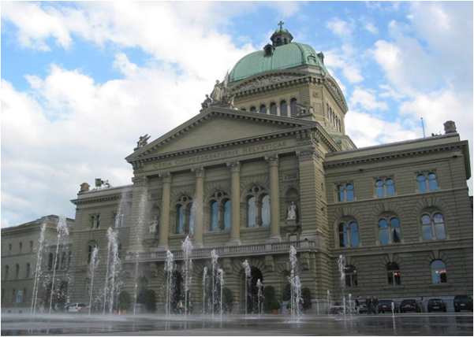
Content
Main responsibilities and organizational structure
Cash forecasting and management
Budgeting: Role of the Treasury
Financial reporting
House of Parliament

Slide 3
Federal Department of Finance
Ministry of Finance
General Secretariat
Federal Tax Administration
Federal Customs Administration
Federal Finance Administration
State Secretariat for International Financial Matters
Federal Office of Personnel
Federal Office of Information Technology, Systems and Telecommunication
Federal Office for Buildings and Logistics
Affiliated to Federal Department of Finance for administrative purposes:
Swiss Federal Audit Office, Swiss Financial Market Supervisory Authority, Federal Pension Fund

Slide 4
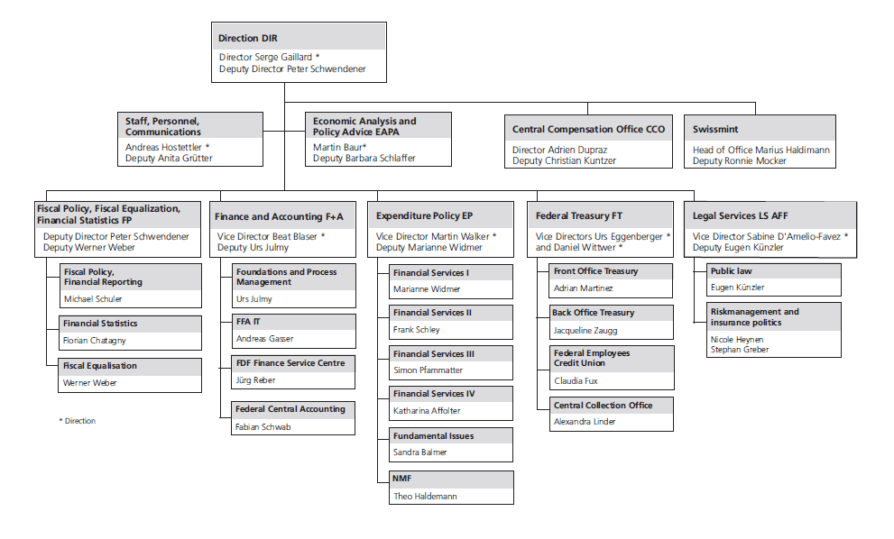
Federal Finance Administration

Slide 5
Federal Finance Administration
provides an overview of the federal government’s finances and ensures its financial stability in the long rung
development of fiscal policy concepts (e.g. fiscal rule “debt brake”)
responsible for budgeting, financial planning and accounting
evaluation of projects of all departments involving expenditures
administers national fiscal equalisation
ensures permanent solvency of the confederation, is responsible for raising funds and investing on money and capital markets, guarantees its privileged position in the markets
supervises Swissmint (Swiss coin production) and the Central Compensation Office for Old Age and Survivors’ insurance
ensures effective and efficient use of financial resources

Slide 6
Federal Treasury – main responsibilities
Money market and capital market funding, cash and fx management
Back office functions (transaction compliance, settlement, financial control)
Risk control functions (market risk and counterparty credit risk management)
Management of tradable equity participations, in accordance with the law
Centralized government receivables recovery management
Management of savings deposits from federal employees

Slide 7
Legal framework
Financial Budget Act (Art. 60-62)
Financial Budget Ordinance (Art. 70-74)
The FFA manages the central treasury operations of the Confederation and its affiliated institutions
The Federal Treasury is responsible for ensuring the ability to fulfill their payment obligations
is allowed raising funds on money and capital markets. The Federal Treasury ensures a permanent, cost-effective access to the money and capital markets
reports on its activities on a yearly basis
invests temporary excess funds based on the criteria security and market equivalent rate of return
only invests in term deposits or fixed income securities, no other asset classes allowed

Slide 8
Legal framework (cont.)
Financial Budget Act (Art. 60-62)
Financial Budget Ordinance (Art. 70-74)
accepts cash deposits from decentralised units and affiliated institutions
is allowed to grant loans to affiliated institutions (e.g. railway)
purchases foreign currency and provides it to the administrative units at the budgeted FX rate, thereby respecting expenditure ceilings defined in CHF
manages saving deposits from federal employees

Slide 9
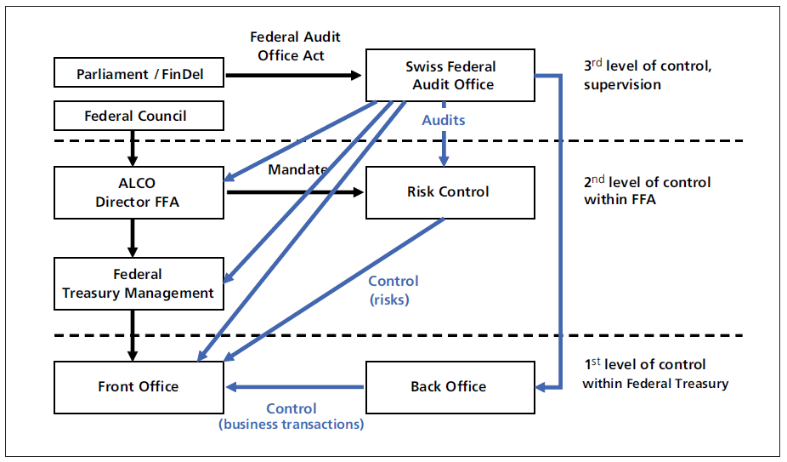
Institutional framework and governance
Front Office
  responsible for cash management, funding and FX management in accordance with ALCO – guidelines
Back Office
  verifies and formally approves the transactions
  responsible for transaction settlement (cash flows)

Slide 10
Institutional framework and governance
Risk Control
  monitors market and counterparty risks
  reports quarterly to the ALCO and ad-hoc to Director FFA
Swiss Federal Audit Office
  conducts audits within the Federal Treasury
Asset and Liability Management Committee (ALCO)
  See following slides

Slide 11
Asset and Liability Management Committee (ALCO)
Members:
  With voting rights: Director FFA (chair), Head of the FFA’s financial policy division, Member of the enlarged governing Board of the SNB, Head of the Federal Treasury
  Without voting rights: members of the front and back offices, member of the FFA’s economic analysis division, Risk Control (coordination)
Frequency of meetings : Once per quarter, additional meetings may be requested by voting members
Agenda:
  Financial accounts and budget of the Confederation
  Economic situation, interest rate and currency forecasts
  Treasury activities
  Risk situation of the treasury

Slide 12
Asset and Liability Management Committee (ALCO)
The ALCO is the strategic steering and supervisory body of the Federal Treasury. The main responsibilities include:
  Definition of the risk strategy, regular review of the strategy
  Adoption of internal risk management guidelines
  Determination of risk limits, especially for interest rate risks, refinancing and liquidity risks, counterparty risks, currency risks
  Approval of the annual issuance strategy, namely issue volumes and issuance dates
  Approval of eligible financial instruments
  Determination of the economic reference values for the preparation of the budget and financial plan

Slide 13
Cooperation with the Swiss National Bank
Federal Treasury has no insight into monetary policy decisions, SNB is independent
But there is cooperation between the two organizations:
  SNB is part of the ALCO
  SNB is mandated to perform and execute auctions on behalf of the Confederation
  Terms and conditions are defined in the treasury agreement between FFA and SNB
  Together with PostFinance the SNB provides the bank account infrastructure for the Confederation, including the master giro account managed by the FT
  Intraday overdraft possibility covered by permanent time deposit of the Confederation at the SNB
  Frequent discussions between staff members

Slide 14

Content
Main responsibilities and organizational structure
Cash forecasting and management
Budgeting: Role of the Treasury
Financial reporting
Federal Department of Finance, Bernerhof

Slide 15
Principles of liquidity management
Main goal: Ensure sufficient liquidity at all times to fulfill payment obligations on time and avoid payment bottlenecks
Key indicator: Ensure the Confederation's permanent ability to pay by providing a "liquidity buffer" (minimum 2 billion CHF)
Maintenance of the liquidity buffer through short-term borrowing and investment (T-Bills, Repo) and long-term financing (bonds)
Investment is possible in principle (e.g. government bonds with a first-class credit rating), subject to risk specifications
Currently all the liquidity on current account with the SNB, Confederation is exempt from negative interest rates
Daily monitoring of liquidity development, including forecasts until the end of the year

Slide 16
Federal Treasury funding instruments
T-Bills
Repo-Market
Money and capital markets
Bonds
Financial institutions
Internal deposits (related institutions/ funds, employees)
Credit market

Slide 17
Federal Treasury funding instruments
Money Market Debt Register Claims (T-Bills)
Swiss Confederation Bonds
discounted paper
weekly auction
price tender, dutch
issuance calendar
new issues; 44x 3 month,
6x 6 month & 2x 12-month T-Bills
secondary market/trading on SIX-Repo-platform
fixed rate (coupon)
monthly auction
price tender, dutch
issuance calendar
new issues and re-issuance of outstanding bonds
secondary market/trading on SIX Swiss Exchange
→ Strive for low interest expenditures in the long run while keeping associated risks at an acceptable level

Slide 18
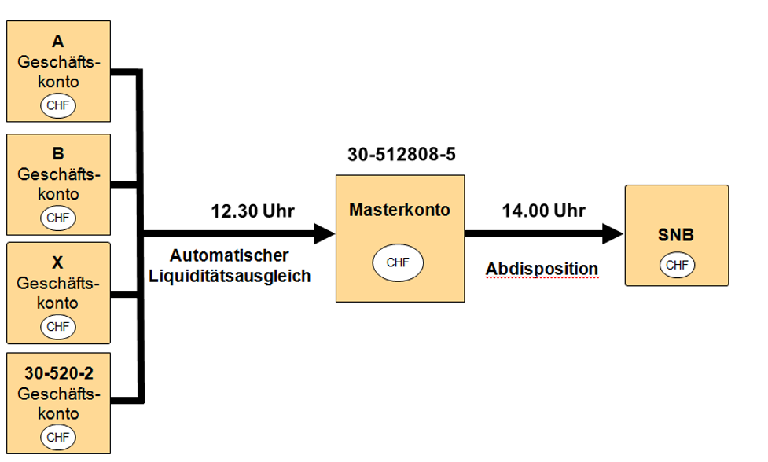
Cash Pooling

Slide 19
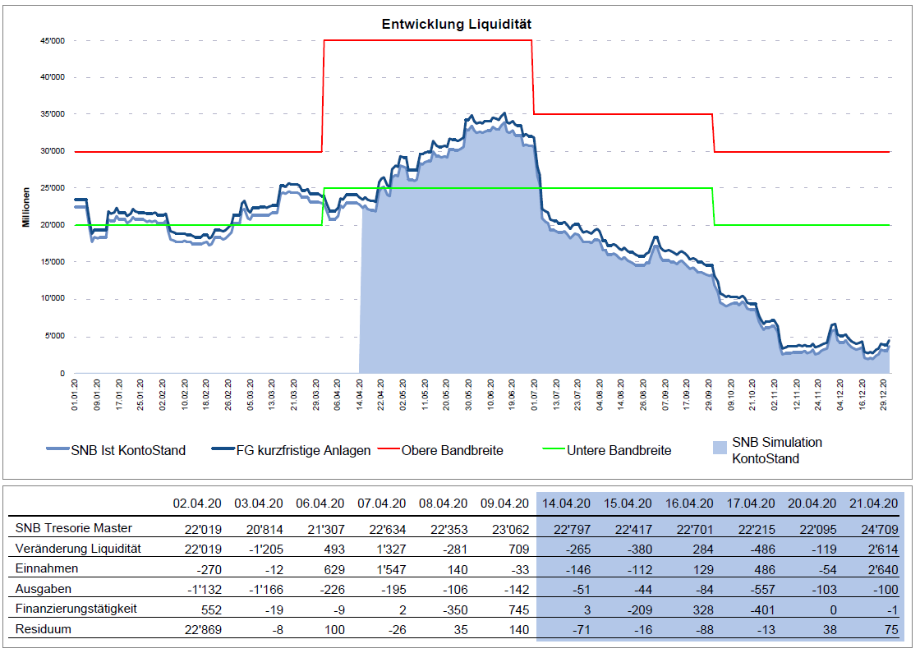
Daily report on liquidity

Slide 20

Content
Main responsibilities and organizational structure
Cash forecasting and management
Budgeting: Role of the Treasury
Financial reporting
Swiss Confederation Govt Bond,
Dec 22,1893
Picture: Pascal Launer, Thomson Reuters

Slide 21
Budgeting Process
Federal Council sets expenditure ceilings conforming to the debt brake: First specifications in February, budget submissions and adjustments by June, Federal Council decision with definitive ceilings in July, Parliament decision in December
The main responsiblity for the budgeting of the Confederation lies with the Fiscal Policy (FP) and Expenditure Policy (EP) divisions of the FFA, the Finance and Accounting division supports the process and maintains the IT systems (SAP)
These divisions coordinate the budget process with the federal administration and its administrative units and are also responsible for the credit control

Slide 22
Role of the Federal Treasury
Interdependence between financial and treasury planning: financial planning influences issuance program, interest expenditures influence financial planning
Ongoing exchange between Treasury and budget divisions is important → fiscal policy division therefore also represented in ALCO
Borrowing through bonds and T-Bills leads to interest expenses → budget position has declined sharply in recent years
Debt brake disciplines fiscal policy: new issues basically limited by maturities
Treasury’s main task during budgeting process: hedging of foreign currencies (leads to planning security and avoidance of supplementary credits)

Slide 23
The Treasury-Plan
Covers the actual year, the upcoming (budget) year and the three following years of the financial plan
Includes the main cash in- and outflows
  fiscal balance outcomes
  extraordinary expenditures and revenues
  internal financial investments (railway, unemployment insurance, etc.)
Is regularly and continuously updated (e.g. to new projections, financial plan or budget)
Reveals the amount of funds available for debt reduction resp. the borrowing requirements (including debt redemptions)
Allocates funds requirements to external (bonds, T-bills) and internal (employees saving deposits, deposits from decentralized units) funding
Based on the T-Plan in November, the issuance program and auction calendar is drawn up and proposed to the ALCO

Slide 24
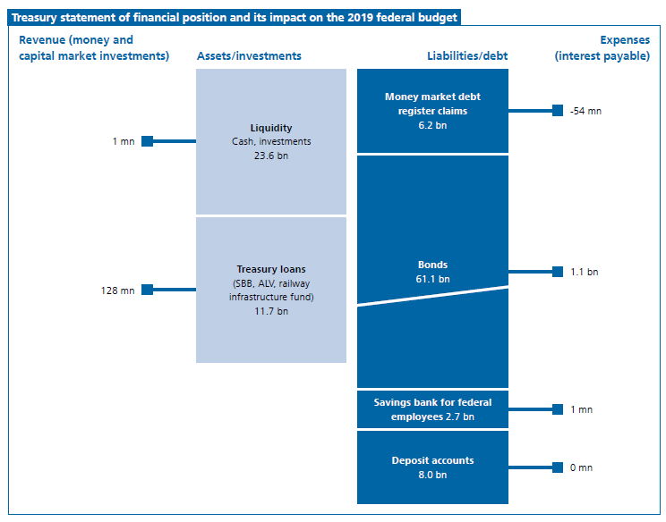
Overview of the Treasury’s “balance sheet” and its budgetary impact

Slide 25
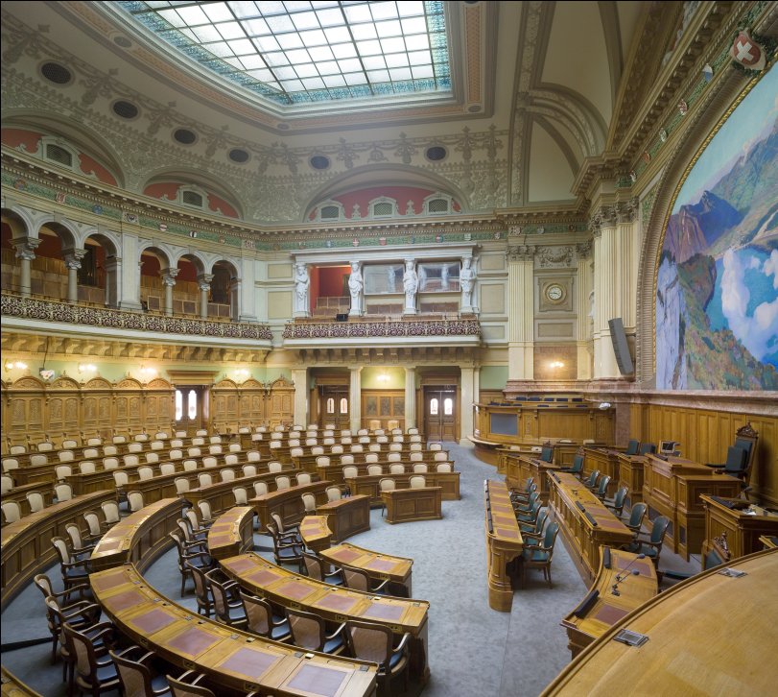
Content
Main responsibilities and organizational structure
Cash forecasting and management
Budgeting: Role of the Treasury
Financial reporting
Chamber of the National Council

Slide 26
Annual reporting
Federal Treasury Activity report (publicly available)
  General information on the functioning of the Federal Treasury, its mandate and the instruments used
  Review of the issuance programme, liquidity management and currency hedging
  Overview of key risk management indicators and reporting on compliance with target values
Financial reporting on the Confederation’s account and budget (publicly available)
  Reporting to the Parliament: debt level, issuance behaviour, special events
  Justification for the development of budget and account items (at credit level)

Slide 27
Annual issuance calender
Issuance calendar for T-Bills and bonds, each with auction dates and planned annual issuance volume, publication in December of the previous year
Market participants can rely on standardized auctions and regular issuance
  Leads to stable participation in the auctions and thus market-driven prices
  ensures permanent and cost-effective access to capita markets
Issuance calendar can be adjusted during the year if financing needs change significantly
Publication via joint media releases of the FFA and the SNB, also sent directly to our regular investors

Slide 28
Announcements and auction results
Before each bond auction: Announcement (including settlement and maturity) one day before the auction via media release, Bloomberg and Reuters. No communication of target volume or price
Directly after the auction: Announcement of results (including volume, price, yield) via media release, Bloomberg and Reuters
Information concerning our issuance program can be found on the FFA’s website (e.g. outstanding bond volumes, issuance results)

Slide 29
Transparency in presentations, media enquiries, OECD etc.
The Federal Treasury acts in an open and transparent manner
  Maintain dialogue with major market participants and investors
  Regular presentations to interested parties within and outside the Federal Administration
  Openness to media enquiries
  Participation in meetings of the OECD and similar organizations
  Willingness to provide information in surveys on debt volume and structure, issuing behaviour etc.

Slide 30
Questions and answers

Slide 31
Additional slides / Appendix

Slide 32
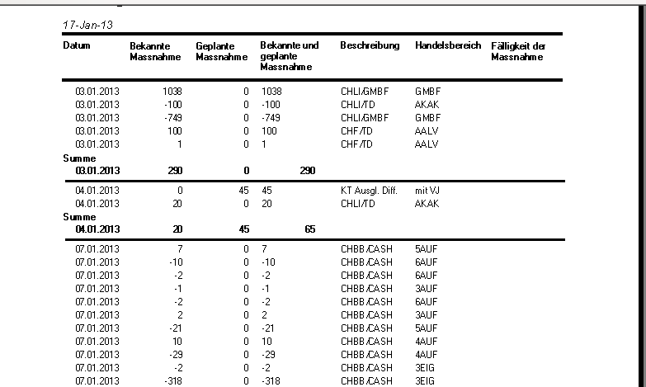
IT-Systems
SIX CO:RE
Swift
(Finastra)
Bloomberg
Reporting
Business Objects
Adaptiv 360
BuRi
Electronic Archiving
(DALA)
Apex
FileZilla
Accounting Data
SAP
Liquidity
Planner
SAP

Slide 33
Current challenge: Covid-19

Slide 34
Current challenge: Covid-19
Up until the beginning of 2020: very high and further increasing liquidity level since the introduction of negative interest rates in 2015
Starting in 2020: Comprehensive measures to cushion the impact of the corona crisis on the economy → high liquidity requirements
High liquidity buffer helps to finance economic measures
Timely adjustment of liquidity planning necessary: Need for additional debt is satisfied by additional T-Bills
Key requirement: Early and transparent information of the markets on additional financing needs

