Slide 1

PEM PAL
IA COP
Audit in Practice Working Group
Public Sector Internal Audit:
Focus on Fraud
Ljerka Crnković
Sochi
29 October 2019

Slide 2
Content
1. Introduction
2. Fraud in Public Sector
3. Responsibilities in respect of fraud within organizations
4. Fraud management: Good practices
5. Conclusion

Slide 3
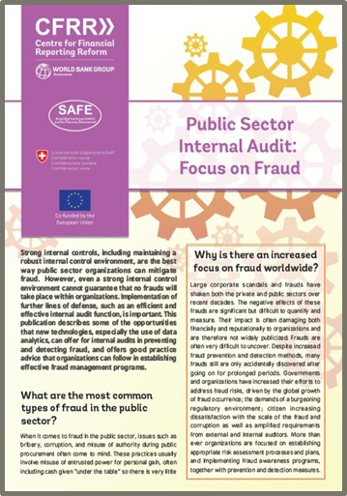
1. Introduction
IA ToT CoP Good Practice Knowledge Resource with focus on fraud, 2018
  A survey of participants covered 22 questions adressing topics focusing on public sector fraud

Slide 4


2. Fraud in Public Sector
FRAUD
The Association of Certified Fraud Examiners
- A Gobal Fraud Survey, 2016
  Government and public sector administration
    the second most represented sector after banking and financial services
    large/small organizations
Incentive or Pressure
FRAUD
Rationalization
or Attitude
Opportunity

Slide 5
2. Fraud in Public Sector
Commom types of fraud in public sector
Asset
misaproppriation
Public
procurement
Accounting
fraud
Other types
misuse of authority
bribery
corruption
accounting and reporting manipuations
theft of assets
misappropriation of intangible assets
money laundering
tax evasion
….

Slide 6
2. Fraud in Public Sector
Red flags
  senior management under intense pressure
  pure IT systems
  legislation, policies and procedures not applied equally
  new programs, programs without effective controls
  centralised decision making
  overriding of controls
  presence of non routine transactions
  high turnover rate, dismissal, lack of expertise ...

Slide 7
3. Responsibilities in respect of fraud within organizations
EXTERNAL AUDITORS
MANAGEMENT AND BOARDS
INTERNAL AUDIT FUNCTION
Applying and maintaining appropiate internal control system
Supervision
Testing internal controls established by management
Performing internal audits based on assessed fraud risk
Aplying technology and data analytics
(- test entire population
- perform continuous analysis
- identify suspicious patterns)
Providing consultancy to management

Slide 8
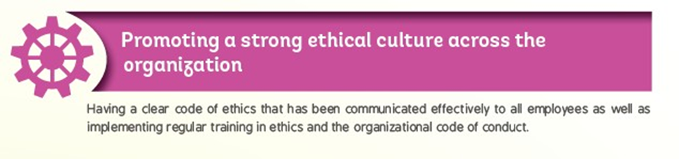
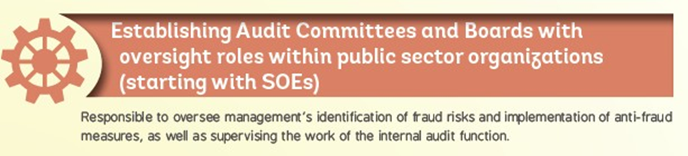
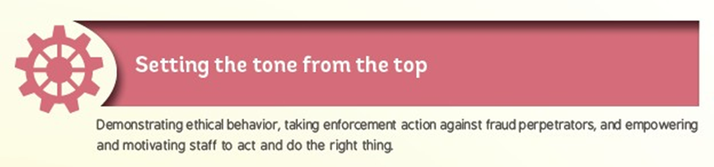
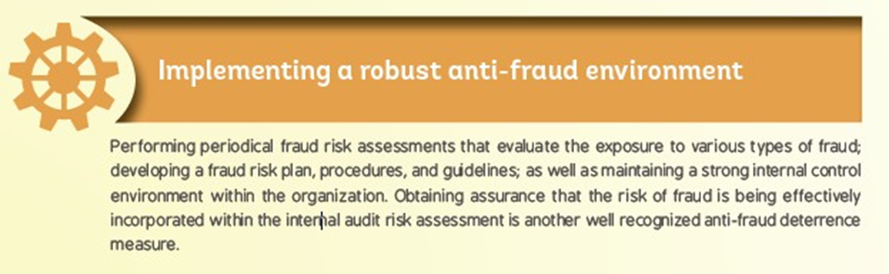
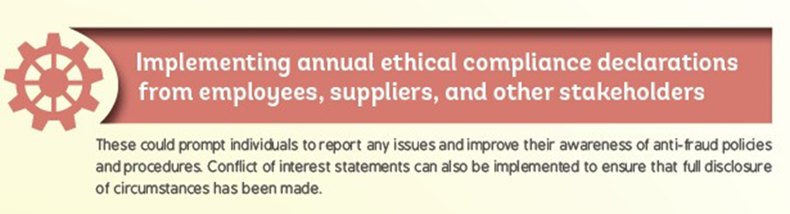
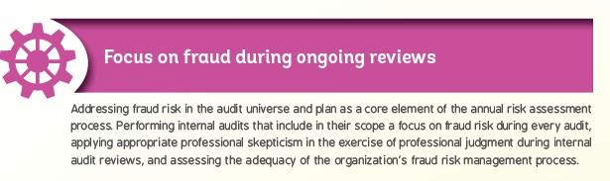
4. Fraud management:
Good practices (1/1)

Slide 9
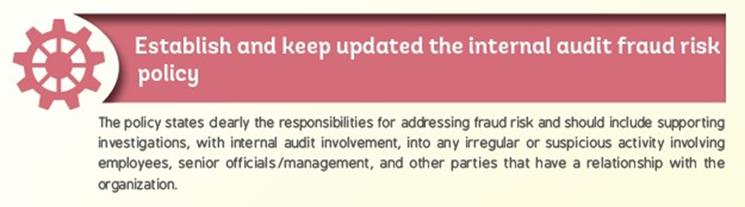
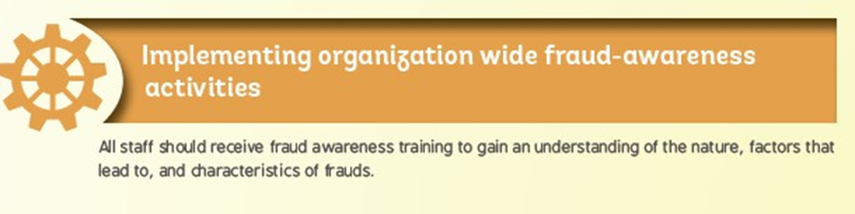
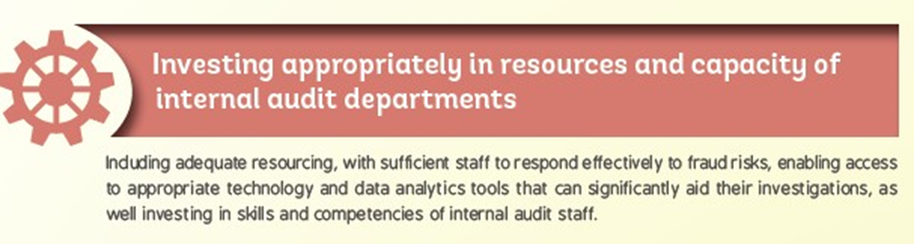
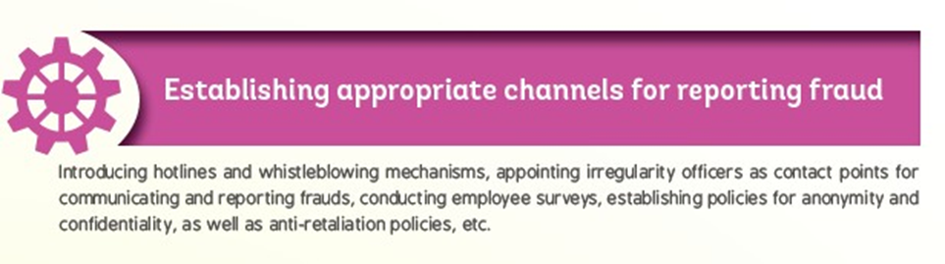
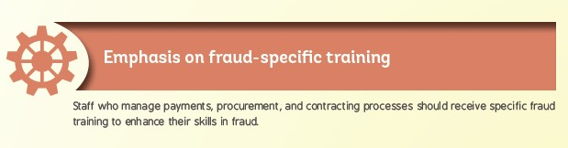
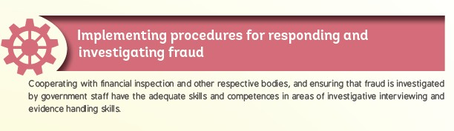
4. Fraud management:
Good practices (1/2)

Slide 10
5. Conclusion
The best way public sector organizations can mitigate fraud
Strong internal controls including robust internal control environment
Use of new technologies
(data analytics)
Establishing effective fraud management programs
Efficient and effective internal audit function

Slide 11
Questions & Answers

