Slide 1
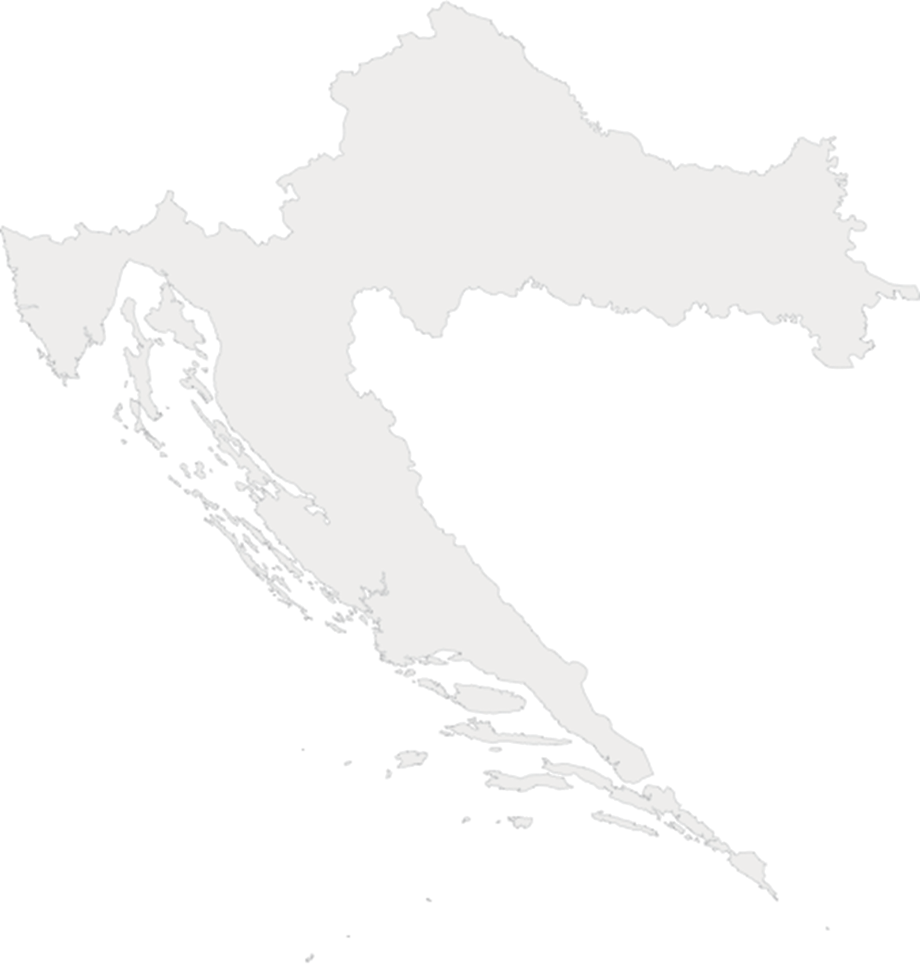

2019 Annual Plenary Meeting of the PEMPAL Budget Community of Practice
Republic of Croatia, Ministry of Finance
Uzbekistan, Tashkent, 18 – 21 March 2019

Slide 2


Innovations in public participation in Croatia
Republic of Croatia, Ministry of Finance
Uzbekistan, Tashkent, 18 – 21 March 2019

Slide 3
Citizen participation in budgeting
Participatory budgeting as a democratic tool enabling citizens to directly participate in the decision-making process concerning the distribution of a part of public resources, upon prior consultation and project elaboration at the state level, as well as at county levels, is not a common practice since a large part of the budget is already predetermined by laws and other regulations.
At these levels, emphasis is placed on enhancing transparency and literacy.
Citizen participation at that level is achieved mostly through the right of access to information, public consultation prior to the adoption of new regulations and general legislation, as well as through public tenders for funds allocation intended for association financing.
Apart from this, there is more room for citizen participation at the local level.

Slide 4
Participatory budgeting – legal framework
The Budget Act does not contain provisions concerning citizen participation in the budgetary decision-making process.
At the local level, provisions of the Act on Local and Regional Self-Government provide for the possibility of “direct citizen participation in the decision-making process concerning local affairs by way of a referendum and local citizen assemblies”, as well as the right to propose the adoption of a certain act to the representative authority.

Slide 5
Right of Access to Information
Constitution of the Republic of Croatia, Art. 38(4)
  Citizens have the right to access information in the possession of the authorities.
Act on the Right of Access to Information, Art. 28
  In order to encourage and facilitate information re-use, the public authorities shall publish information available for re-use and make them readily searchable, along with the metadata, in a machine-readable and open form, in line with open standards.
Citizens are entitled to know how their money is being spent, and
politicians have the obligation to show this in a transparent and easily accessible manner.

Slide 6
Public consultation
Public administration authorities, other public authorities, local and regional self-government units and legal entities with public authority (public authorities) shall consult the public in the adoption of laws and by-laws, and in the adoption of general legislation, i.e. other strategic and planning documents, if these have an impact on the citizens’ and legal entities’ interests.
Public authorities shall publish on their websites in a readily searchable and machine-readable form, among others:
  draft acts and other regulations, as well as general legislation, which are undergoing the process of public consultation,
  public consultation plan for the calendar year no later than at the end of the previous calendar year,
  report on the conducted public consultation.

Slide 7
Association financing
Regulation on the Criteria, Standards and Procedures of Financing and Contracting Programmes and Projects of Interest to the Public Good Implemented by Associations (OG 26/15)
Public sources: state budget, county budgets, city and municipality budgets, as well as public funds, and public companies’ and other public institutions’ revenues, European Union funds and foreign public sources.
Basic standards in planning programme and project financing:
– priority financing areas are established for the budget year based on the needs assessment of a certain area and the measures for achieving goals indicated in the strategic documents which require a responsible financial funds provider,
– financing is carried out by means of a public tender or a public call laying down the conditions for application, criteria for application assessments, the procedure of the authorisation of funds and the procedure of filing a complaint, as well as establishing procedures for the prevention of conflict of interest among persons taking part in the procedure of funds allocation,
– annual plans for calls for tenders are published on the website of the financial funds provider,
– terms of the public tender envisage the indicative number of programmes, or projects, that are to be financed, and the lowest and highest sums that can be granted for financing a programme or a project.

Slide 8
Association of counties – Open Budget project
Counties want to present budget information of all units to citizens in a simple and comprehensible manner, with the intention to inform them about the manner and intended purpose of using budget funds. This has been achieved by the Open Budget project.
https://hrvzz.hr/otvoreni_proracun
Two goals of the project:
  by means of a simple application, all counties should open and visualise county budgets according to all classifications in a completely unified manner,
  county administration should be enabled to compare local and regional budgets on all levels, as well as economic indicators, and thus initiate competitiveness and enhance productivity and efficiency in the work of county administrations
Instructions for the use of the application are provided in the manual Mala škola proračuna (A little lesson in budgeting).

Slide 9
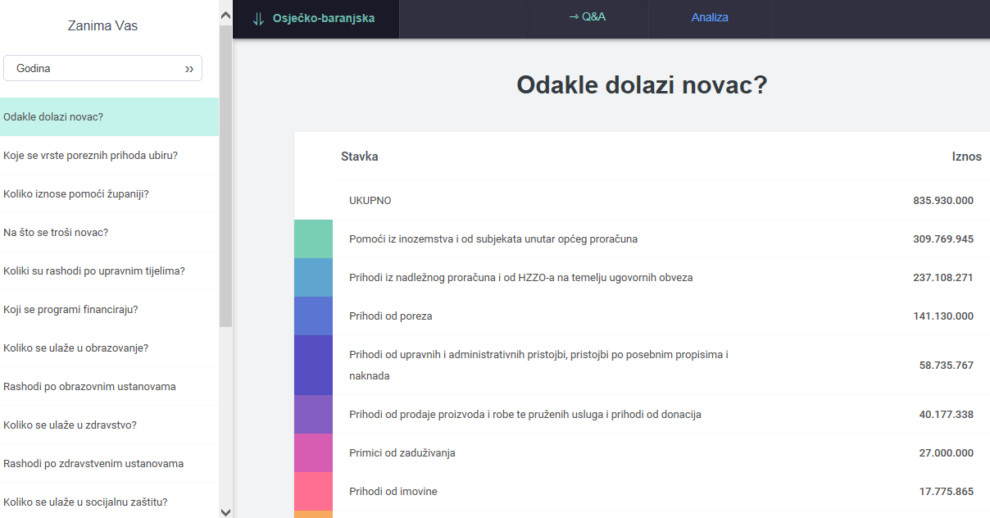
Osijek-Baranja County – Open Budget project

Slide 10
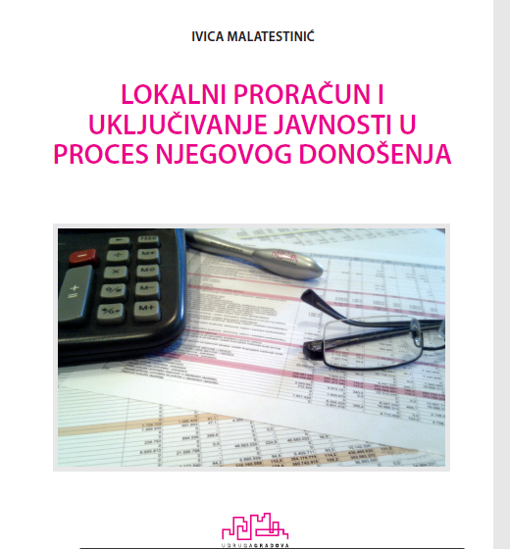
Association of cities – Manual

Slide 11
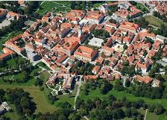
City of Karlovac
Draft budget underwent public consultation, and it was also available to citizens via the website of the City of Karlovac from 25 October to 5 November, with the intention to include everyone through their proposals and opinions. Draft budget was drawn up based on a two-way, continuous and direct communication.
The response was poor, and there were no proposals for the reduction of other expenditures.
The mayor, accompanied by his associates, visited the 38 city districts and local councils, and during the visit citizens expressed their needs ranging from small communal projects to certain greater investment projects.
During these organised meetings with local councils and city districts, which hosted over 1000 participants, there were direct discussions concerning all communal and social needs.

Slide 12
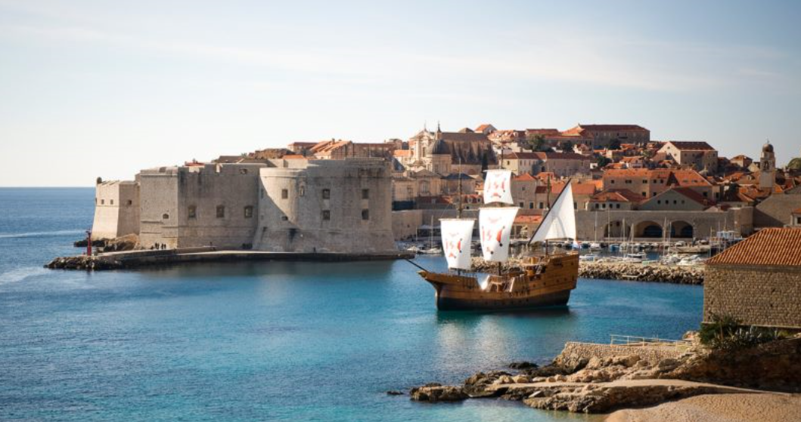
City of Dubrovnik
The City of Dubrovnik initiated the development of its own model in 2018, with the aim to start the implementation with a financial construction for 2020.
The process was divided into three phases:
1 The preparation process started in 2018 by a series of consultations with city districts, city departments and companies, as well as with civil society organisations and citizens, with the aim of collecting information for the development of a model adjusted to the context of the City.
2 The plan is to finalise the work methodology, and form and train a smaller and a bigger team for the implementation of the 2019 pilot process and the 2020 implementation, as well as establish the process evaluation.
3 The 2020 participatory budgeting process will be divided into two parts: the selection process and the project implementation process.

Slide 13

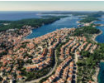
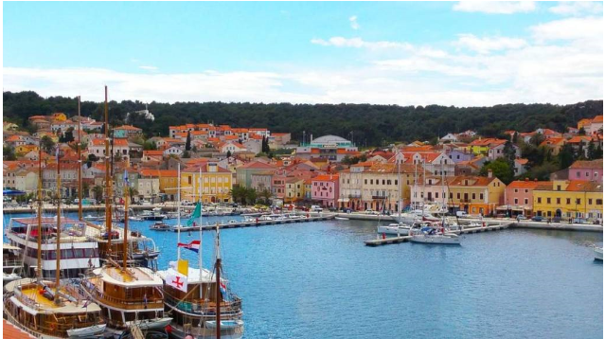
City of Mali Lošinj
The draft budget underwent public consultation, and it was available to citizens via the website of the City of Mali Lošinj from 12 November to 12 December (a certain amount was left for citizen proposals)
After the consultation, the Report on the conducted public consultation was published on the website.
Some proposals were accepted completely or partially, some were rejected because the funds had already been included in the draft budget, and some were advised to respond to the public call for the application of a programme/project aimed at meeting public needs, which would be implemented in early 2019.

Slide 14
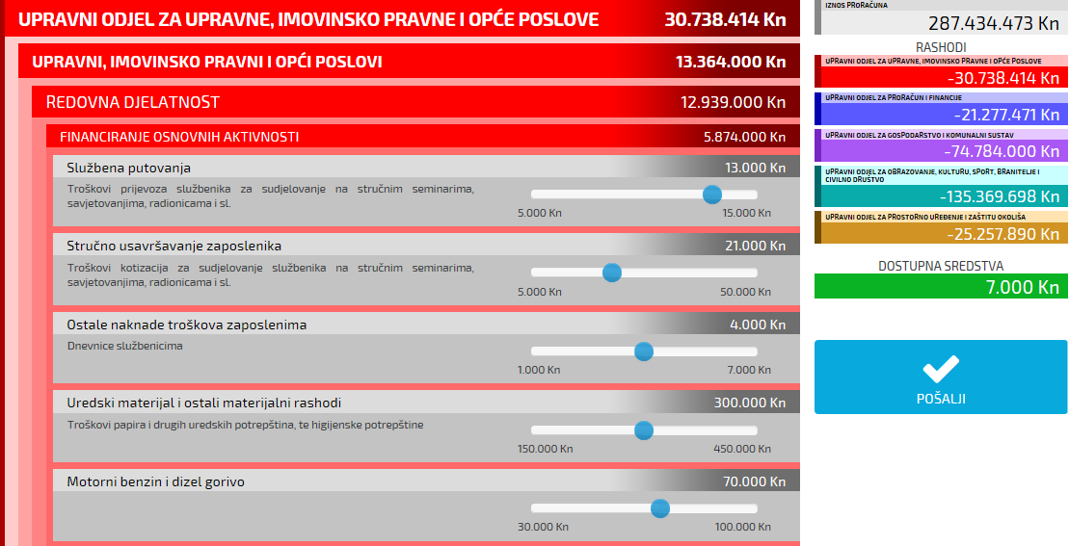
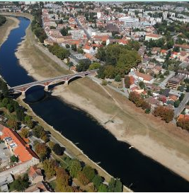
City of Sisak
http://proracun.sisak.hr/moj_proracun.html
Moj gradski proračun (My city budget) application – Get acquainted with the complexity and the scope of the city budget and send your view of priorities

Slide 15
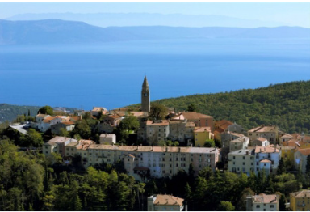
City of Labin
City administration of the City of Labin holds public consultations annually as part of the budgeting process for the following budget year at city councils, via e-mails, and post cards attached to each copy of Proračun u malom (Budget in a nutshell).
Citizens are thus given an opportunity to make proposals for the budget, and prior to its adoption at the City council session, they can give their additional opinions and comments.
Established priorities of local council members and citizens are adjusted to the planned budget of a certain local council, and jointly established projects are implemented in the following budget year.

Slide 16
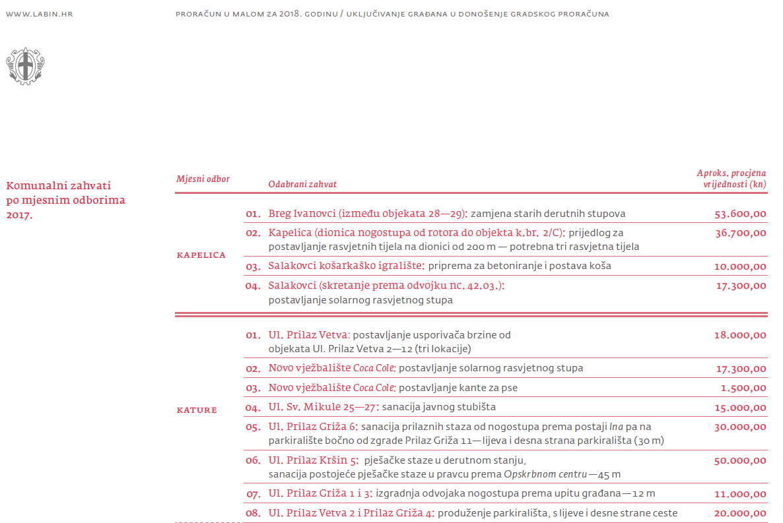
Grad Labin 2018 – Proračun u malom

Slide 17

Town of Pregrada
By applying the participatory model of decision-making and participation, a working group was formed consisting of 10 representatives of youth associations, Youth Council and the town administration which started the development of the town’s Youth Programme.
Based on the results of a survey carried out among the youth, the working group defined five main thematic objectives – areas for which the town’s Youth Programme should be developed in order to make it easier for the youth in Pregrada to engage in the work of the local community.
Town council of the Town of Pregrada issued a Decision on the adoption of the Youth Programme of the Town of Pregrada for a period of five years.

Slide 18
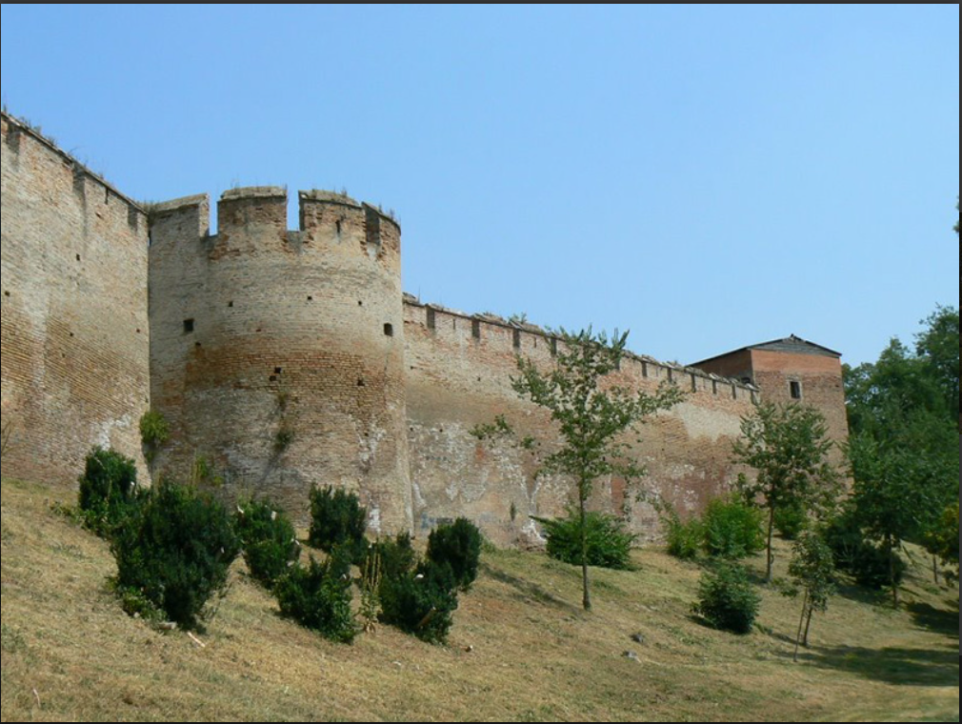
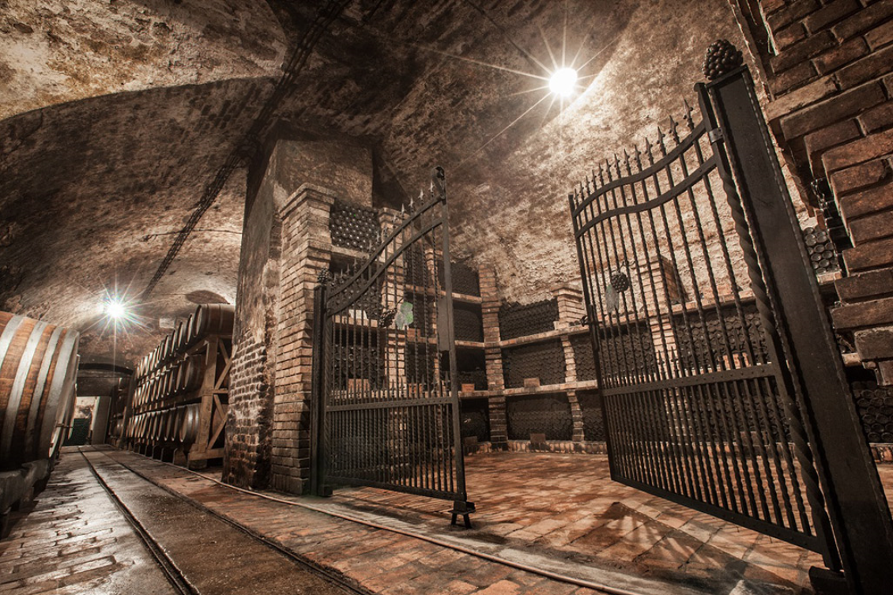
City of Ilok
In the City of Ilok, citizens do not have the opportunity to directly influence the budgeting process, but there have been public hearings which pointed to the problems.
The questions and the relevant answers are published on the city’s website.
Example:
Experts are invited to visit the locations in city parks and by the thoroughfares, and to warn about the dead and dangerous trees which should be removed.
Certain human resources have been commissioned to establish the need for the removal of dead trees and a potential need to plant young trees, and following the collection of all information, a proposal with a cost estimate for the proposed works will be issued.

Slide 19
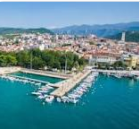
City of Crikvenica
At the public hearing on the 2019 city budget held at the City council on 26 November 2018, the draft budget was presented to the citizens, and after that, the citizens of Crikvenica had the opportunity to ask questions and give their own suggestions.
The greatest issues indicated by the citizens concerned sewage and rainwater drainage, as well as safety on the Adriatic Highway in Dramalj area, and some also believed that insufficient funds were allocated as regards economic stimulation.

Slide 20
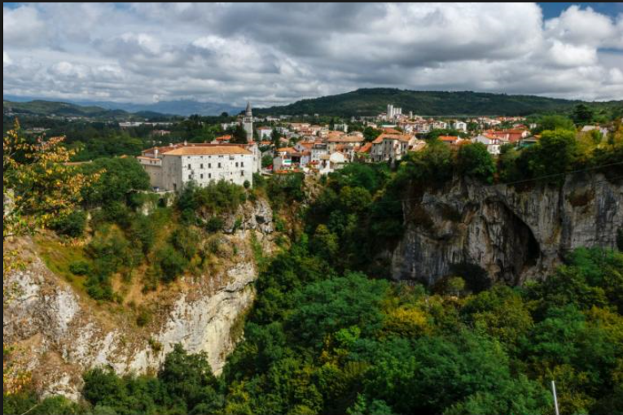
City of Pazin – Pazi(n) proračun! game
Citizens of Pazin are invited to take part in the decision-making process concerning the allocation of funds from the city budget.
Owing to the Pazi(n) proračun! project, during the last four years the citizens have been able to participate in the decision-making process concerning the allocation of funds from the city budget, i.e. to carry out smaller communal actions in their local community.
A total of HRK 600,000 from the budget funds is allocated to the citizens of 6 (of the total 12) local councils in Pazin, which amounts to HRK 100,000 per local council.

Slide 21
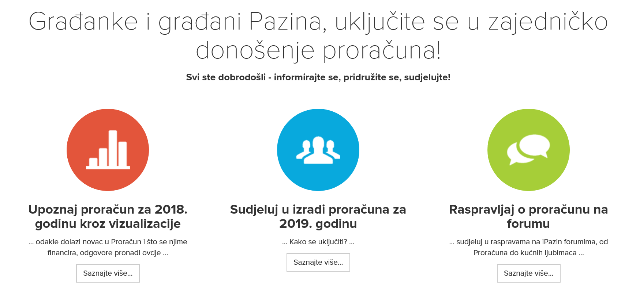
City of Pazin

Slide 22
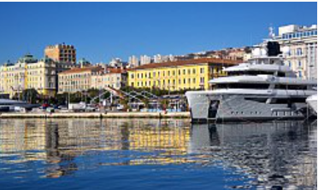
City of Rijeka
Citizen participation in the planning and utilisation of budget funds in the City of Rijeka was enabled through four models:
  small communal actions
  Rijeka's local partnership program
  educational budget game – Proračun(ajme)
  online form for the participation in the planning and execution of budget

Slide 23
City of Rijeka – Small communal actions
Small communal actions or communal priorities include smaller communal works in local councils’ areas, which are carried out according to citizens proposals, with the aim of enhancing the life quality of citizens.
The call for proposals for small communal actions is issued annually in April.
Small communal actions (communal priorities) may be proposed by:
  local community councils,
  citizens,
  authorised representatives of residential-business buildings,
  citizen associations.

Slide 24
City of Rijeka – Rijeka local partnership programme
The programme enables a faster and more cost-effective solution to some of the citizens’ needs by cleaning up smaller public areas (playgrounds, alleys, messy green areas, smaller unregulated landfills...) through direct participation of citizens, associations and local councils in cooperation with the City of Rijeka.
The call for proposals to Rijeka local partnership programme is published annually in Novi list (daily press) and on the website of the City of Rijeka in October/November for the projects which will be implemented in the following year, in line with the planned programmes and financial resources from the budget.
Forms for project proposal applications and the reports on implemented projects are available in the Word document and they are submitted to the Local government directorate.
In October 2018, 14 proposals were submitted, out of which the committee selected 9 proposals for which HRK 200,000 from the budget was ensured (approx. USD 33,000).

Slide 25
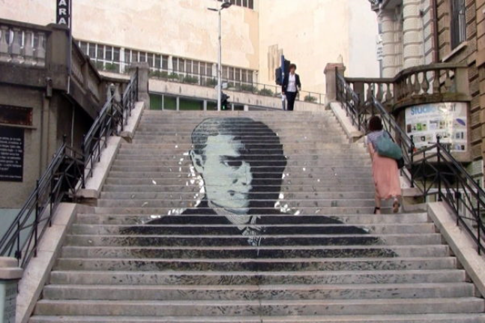
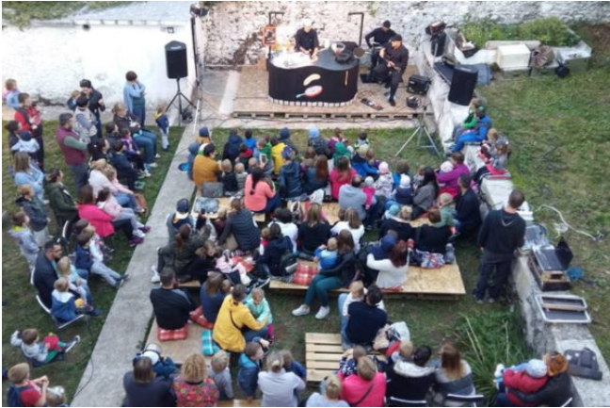
City of Rijeka – Rijeka local partnership programme
Project by the citizen group Kortil uživo – illustration of the stairway connecting two streets.
Project by the association Bez granica – adaptation of the courtyard and the surroundings of Drenova regional museum, and creating the conditions for a safer and quality performance of leisure activities and programmes of all age groups in the museum’s area.

Slide 26
City of Rijeka – Educational online budget game Proračun(ajme)
https://www.vojko-obersnel.com/hr/proracunaj-me/2019
Proračun(ajme) is an educational budget game where citizens, apart from getting familiarised with the items of the current budget, can choose projects which they wish to see implementes and which do not exist in the current budget.
At the end of the game, they can add a project that they would like to see implemented but which was not offered.
The statistical data from the chosen projects and the offered new ones is used during the planning phase of the budget for the following year.

Slide 27
City of Rijeka – Educational online budget game Proračun(ajme)
The game is educational and it provides insight into all items of budget expenditures in 2019, their structures and details about particular items. A simplified overview provides a list and description of various areas and activities financed by the budget of the City of Rijeka.
From the list of projects which are not included in the 2019 budget, or included therein only partially with smaller amounts, in the first step of the game, the citizens may select those projects they find the most important (up to HRK 60 million).
For each selected project funds have to be ensured in the budget for its implementation. The funds can be acquired, i.e. saved, by increasing public utility charges or by reallocation of the sums between the existing budget items, or by combining those two.

Slide 28
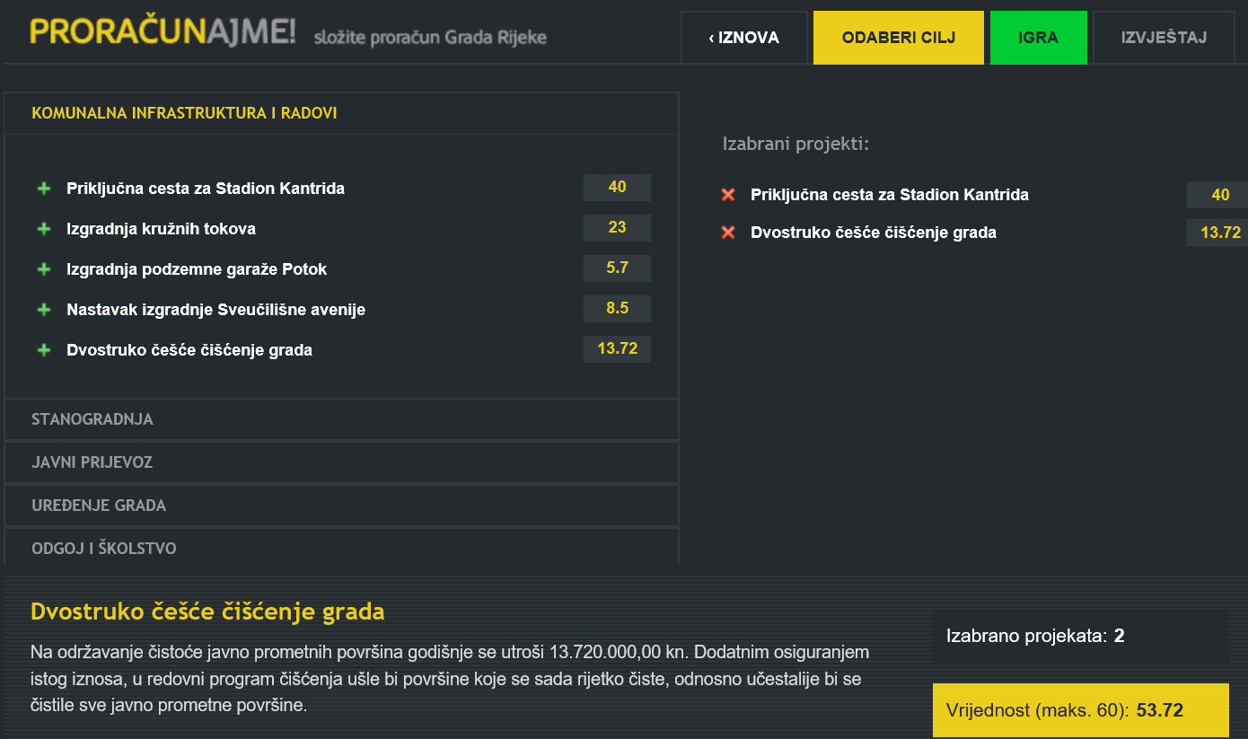
City of Rijeka – Educational online budget game Proračun(ajme)

Slide 29
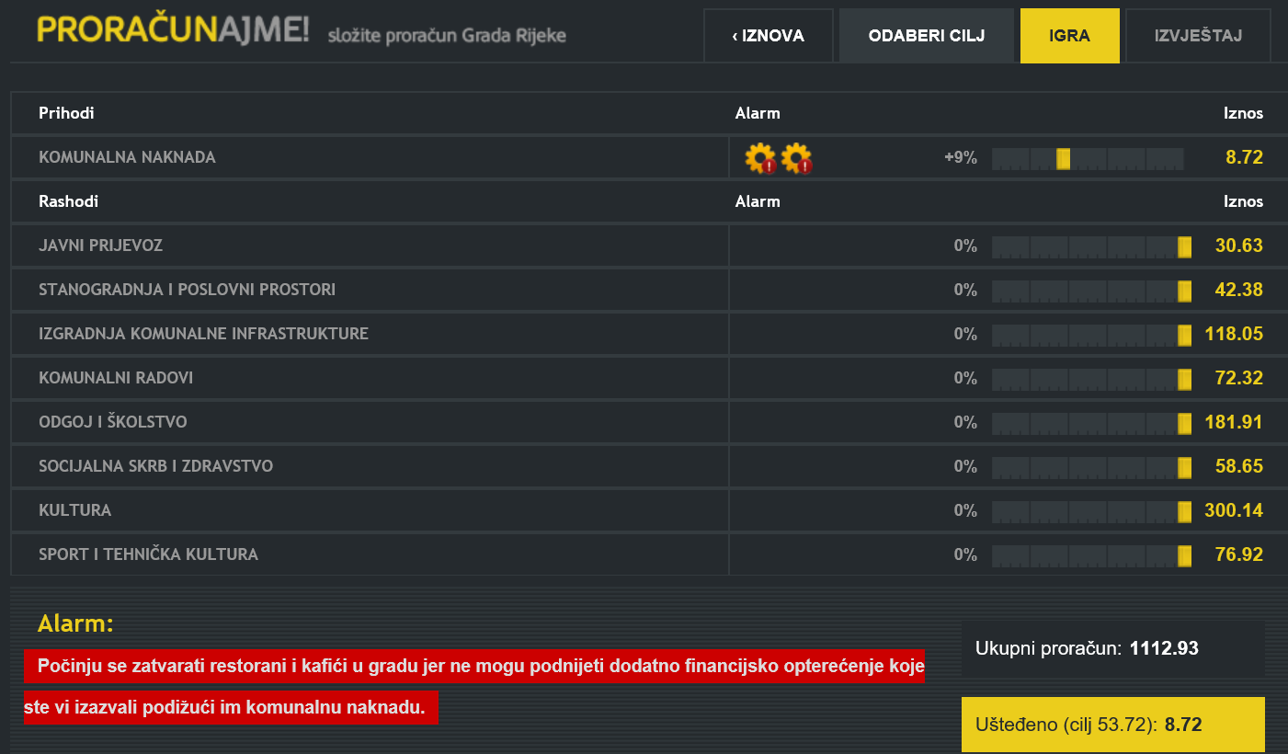
City of Rijeka – Educational online budget game Proračun(ajme)

Slide 30

City of Bjelovar
https://www.bjelovar.hr/gradani-imaju-pravo-znati-jednim-klikom-bjelovarcani-mogu-saznati-se-trosi-novac/
Within a simple application available at https://proracun.bjelovar.hr/ the citizens are only a few clicks away from the details of the budget and its history, presented in a comprehensible manner even to those who are not financial experts.
The emphasis is on its interactive character and its simple visual overview which make it easy to search through all budget items, as well as their trends over the years.
In the next phase of the project, the citizens will be able to have insight into each expenditure within the city administration ranging from HRK 1 to HRK 1 million.
  Issue: Is personal data protection more important than the citizens’ right to know what their money is being spent on?

Slide 31
City of Bjelovar
GAME DESCRIPTION
Get to know the budget structure
You have to adjust the revenues and expenditures for three years in advance (make a budget plan)
Get to know the budget adoption process
Every move can be both good and bad for the budget (if you make too many cuts the quality of public service will drop, people will be dissatisfied; if you allocate too much you will have problems with the debt and deficit)
The goal is not to incur a deficit which needs to be covered with borrowing
START PLAYING
You are playing the role of the mayor who is planing the budget for their mandate
*This is a simple budgeting scenario suitable for the game but it still gives a realistic idea of what it is like to run a town
Play more than once and explore all the possibilites with the budget
* The town and the budget game description are fictional, but the city of Bjelovar served as inspiration for the numbers, demographic statistics etc.

Slide 32
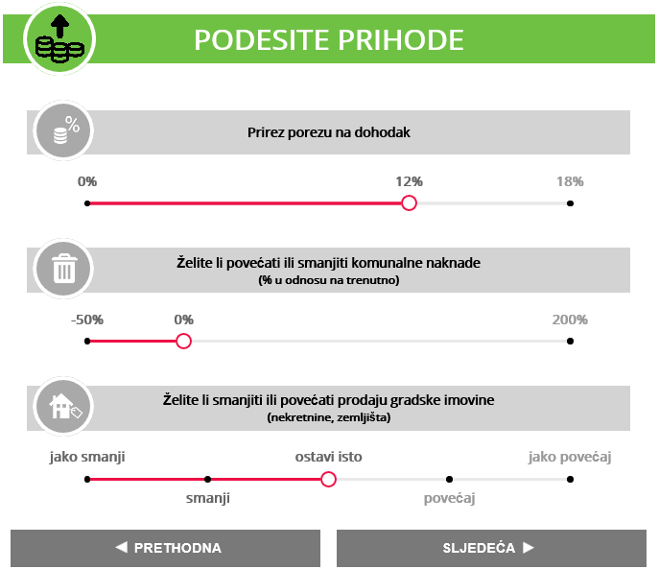
Revenue adjustment

Slide 33
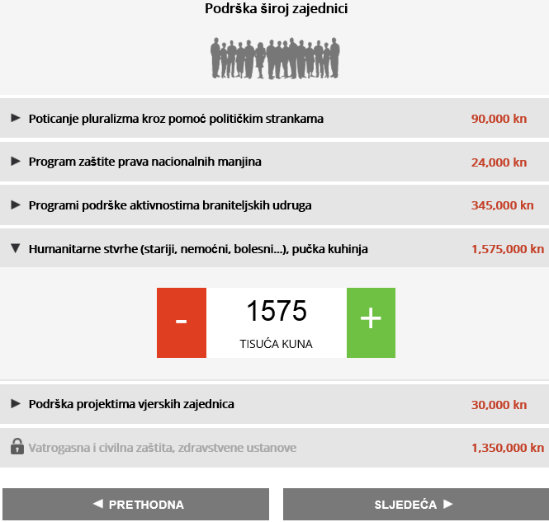
Expenditure adjustment

Slide 34

Thank you!
Questions?

