Slide 1
Infrastructure Prioritization Framework: A tool to support the infrastructure planning process
Darwin Marcelo
Sr. Infrastructure economist,
Infrastructure, PPPs and Guarantees Group
The World Bank
March 2019

Slide 2
INFRASTRUCTURE PRIORITIZATION CHALLENGE (1/1)
Infrastructure gap and demands on governments
Investment needs in all sectors
Limited public resources and fiscal restrictions
Strengthening fiscal transparency and accountability
How to optimize public resources in line with country strategic priorities?
How to compare different investment options?
→ Need for an objective system to prioritize infrastructure investments

Slide 3
INFRASTRUCTURE PRIORITIZATION CHALLENGE (1/2)
Technical Capacity and Measurement
Limited / inconsistent project data availability & quality
Limited technical and institutional capacity
High costs and extensive time to run SCBA across large sets of projects
For CBAs-based analyses capturing key policy goals (e.g. culture heritage, climate resilience, job creation, poverty reduction) is more difficult.
Public investments produce benefits that cannot be monetized
→ Need for an objective system to prioritize infrastructure investments

Slide 4
INFRASTRUCTURE PRIORITIZATION framework
IPF, a Multi-Criteria Decision Tool
Can be adapted to account for policy goals*
Combines social-environmental and financial-economic information
Accommodates to data and resource limitations
Includes the sector budget constraint
Displays information in a simple visual interface
Improves data collection processes*

Slide 5
IPF as a stepping stone
Selection informed
by full SCBA
High technical and institutional capacity
Detailed project-level information available
Requires monetized social, environmental, financial and economic effects
Selection based on NPV comparison
Selection by IPF
Limited institutional and/or technical capacity
Assumes partial project-level information available
Including information on social, environmental, other economic effects
Decisions based on minimum relevant information
Ad-Hoc project selection
Limited project-level information available
Inconsistent use of information
Decisions frequently based on non-technical or political considerations
Subjective project selection
5

Slide 6
THE IPF PROCESS
I. Define Criteria
Consensus between decision makers, experts, and key stakeholders
Feedback
II. Prepare Data
Project-level database (including CBA elements when available)
III. Calculate Composite Indicators
Includes statistical / mathematical methods to combine criteria into two composite indicators
Combine SEI, FEI, and budget constraint to visualize relative project performance
IV. IPF Matrix
V. Project Selection
Based on informed deliberation

Slide 7
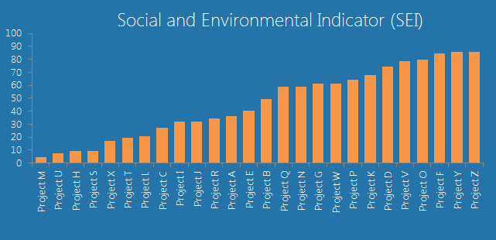
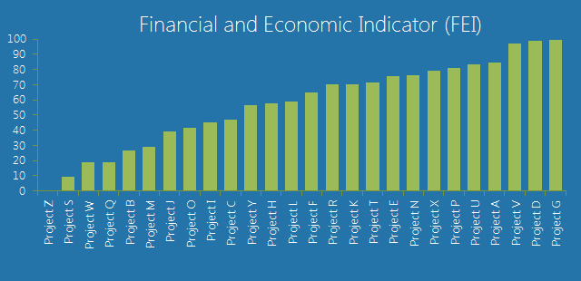
Two-dimensional structure
Social-Environmental Indicator (SEI)
(example)
Beneficiaries*
Affected population*
Environmental effects*
Poverty levels*
Financial-Economic Indicator (FEI)
(example)
Benefit-cost ratio*
Multiplier effects*
Externalities*
Implementation risks*
Fundable projects given the budget constraint
Fundable projects given the budget constraint
7

Slide 8
project prioritization matrix
High Priority Projects
Social-Environmental Priority Projects
Fundable projects given budget constraint
SEI
Financial-Economic Priority Projects
Lower Priority Projects
FEI
Fundable projects given budget constraint
8

Slide 9
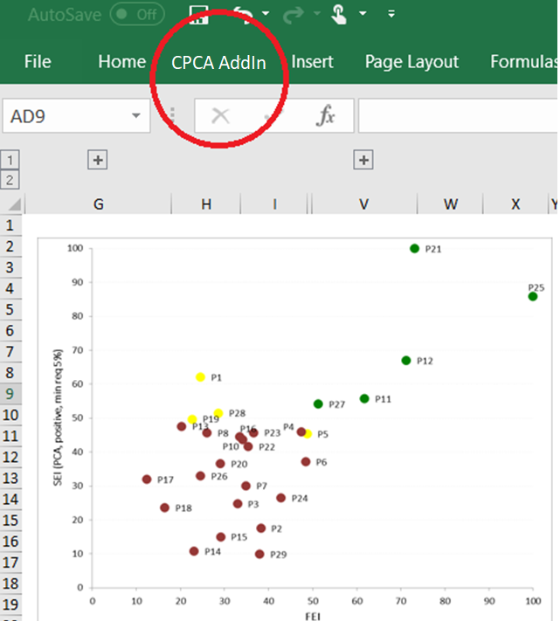
IPF excel Add-in
User-friendly
Easy to input data and to use
Flexible criteria adjustment
multiple scenarios depending on policy objectives

Slide 10
IPF Evolution
Belarus
Chile
Launching of the IPF Excel Add-In that automates the analytical process
Sri Lanka
Argentina
Comparison with CBA-based system to assess IPF suitability
Panama
Additional scenario based on pre-ordered criteria weights
Qualitative data untransformed
Novel constrained PCA (CPCA) approach
Measure of efficiency to compare weighting scenarios
Vietnam
only one stage in a five-steps systematic process
Sensitivity analysis on weights
Two-stages process
All qualitative criteria transformed into quantitative scales
PCA-based criteria’s weights

Slide 11
infrastructure planning cycle and implementation of the IPF

Slide 12
infrastructure planning process cycle
National/
Regional/Sector/
Investment Plan
Investment Needs
Phase I
Project Preparation
Phase II
Information
Consolidation
Phase III
Project Screening and Prioritization
Phase IV
Maximizing Finance for
Development
Identification of minimally relevant criteria
Template for project applications
Information System
Identifying high priority infrastructure projects:
Using cost-benefit or multi-criteria analysis (such as the IPF)
Identifying optimal financing solutions for implementation:
PPPs, ODA, Public Funds, SOEs, etc.
In practice, national infrastructure planning processes tend to be more complex depending on the country regulation and institutional framework

Slide 13
IPF as a Public Investment management TOOL
IPF TOOL
Guidance
Appraisal
Independent
Review
Selection
Implementation
Adjustment
Operation
Evaluation
Project appraisal and selection
Support in decision-making for planning and allocation
Coordination on data collection and project selection criteria
1 2 3 4 5 6 7 8
Link to development strategy
Consistency in project preparation
Key to credible selection
Authority to screen and reject proposals
An effective budget and procurement process to support implementation and operation
Maintain, asset register, operate and maintain asset
Evaluation to improve guidance
Source: Power of Public Investment Management (Rajaram et al., 2014)

Slide 14
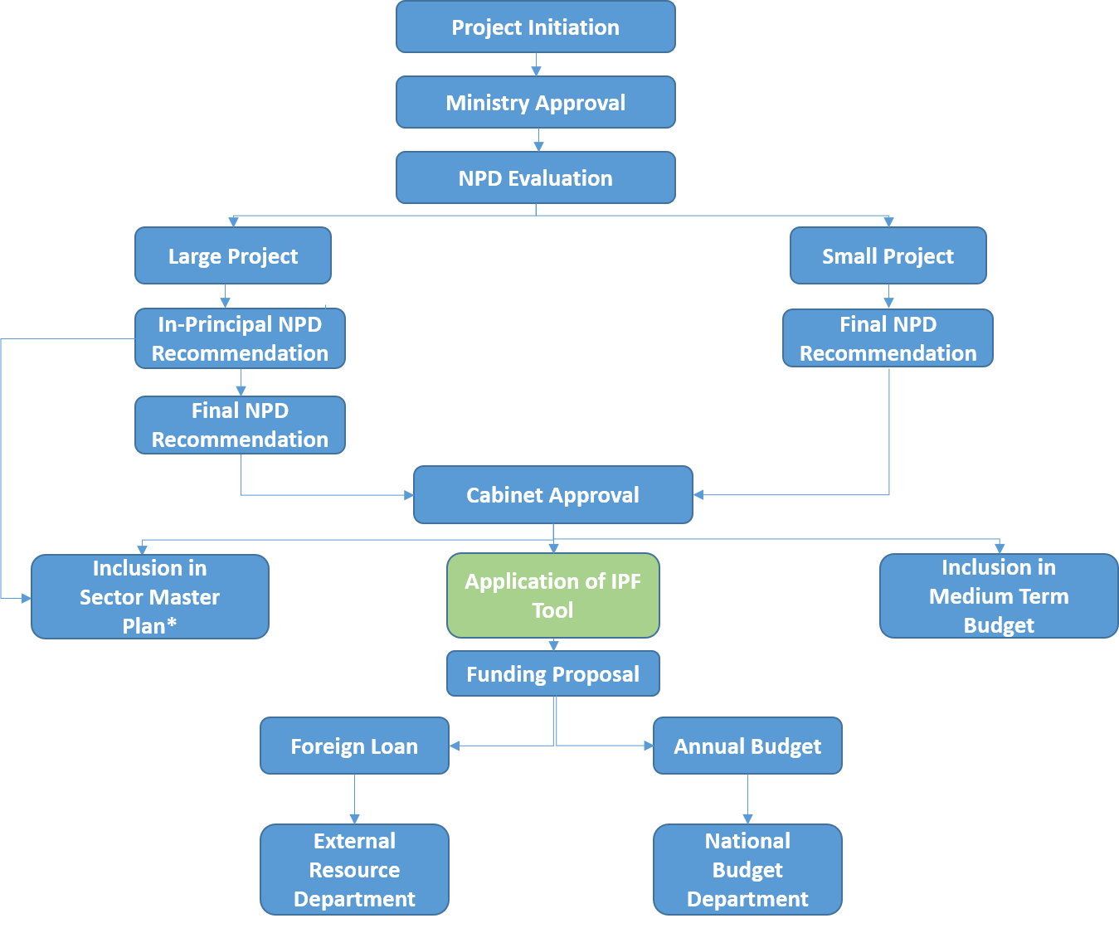
IPF and the infra planning cycle: the case of Sri Lanka
Infrastructure Investment Planning Process in Sri Lanka
IPF bridges the gap between project appraisal and allocation of funds by identifying high priority projects from the selected project list

Slide 15
IPF and the infra planning cycle: the case of CHILE
Infrastructure Investment Planning Process in Chile
Sector Line Ministry
(Proponent)
Prepares initial list of projects
Submits projects using the SNI (National System of Investments) online platform
Ministry of Social Development
(Evaluator)
CBA is only used to filter out projects with ERR < 6%
Sector Line Ministry
(Selector)
Assesses initial list of projects
Filters out projects following a CBA-based approach
Prioritizes filtered projects
Submits prioritized projects for funding
Ministry of Finance
(Financier)
Potential role for IPF
Issues a decree including the sector budget allocation for project implementation

Slide 16
IPF pilots
Country | Year | Sector | Stakeholders involved
Vietnam | 2013-2014 | Transport Irrigation Urban | Ministry for Planning and Investment
Panama | 2014-2014 | Water Supply and Sanitation Transport | Ministry of Economics and Finance
Argentina | 2015-2017 | Irrigation | Ministry of the Interior, Public Works and Housing United Nations Organization for Food and Agriculture (FAO)
Sri Lanka | 2016-2017 | Water Supply and Drainage | National Planning Department National Water Supply and Drainage Board
Chile | 2015-2017 | Interurban Roads, Small Water Reservoirs | Ministry of Social Development Ministry of Finance
Belarus | 2018-2019 | Water Supply Sanitation | Ministry of Economy Ministry of Housing and Utilities
16

Slide 17
IPF implementation support
IPF Value Added
Advice on project selection indicators
Template design for data collection
IPF excel add-in for easy implementation
Training on IPF methodology
Access to global best practices

Slide 18
Data Requirements, Opportunities and Challenges in Implementation

Slide 19
Improving data Collection: template for Investment proposals In Indonesia
Template sample
(word doc + excel sheet for NPVs, IRRs and etc.)
Structure of the template
Basic information
Information for pre-screening and the implementing authority's experience, capacity and commitment
Background of the project
Expected benefits and impacts
contains information for infra screening
Justification for PPP participation
contains information for PPP screening
Annexes

Slide 20
IPF DATA REQUIREMENTS: example of water sector in Sri LANKA
Social-Environmental Indicator (SEI)
Beneficiaries/users per $ invested
Jobs created (direct) per $ invested
Poverty level (in area of intervention)
Bacterial quality of existing water
Water-borne diseases
Continuity of supply
Existing safe water coverage
Financial-Economic Indicator (FEI)
Benefit-cost ratio
Existing water resource yield
Non-revenue water (%)

Slide 21
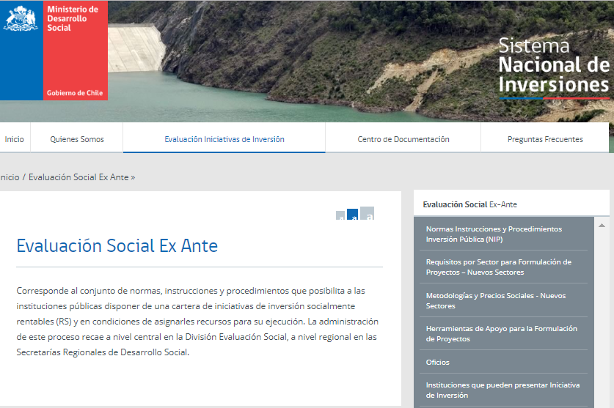
IPF as a tool for Improving data collection and management
Benchmark: SNI (National System of Investments) - investment appraisal system/platform in Chile:
Consolidated project proposal data collection;
Policy filters;
Project appraisal.

Slide 22
Questions and discussion
Thank you!

Slide 23
KEY LESSONS From Previous Pilots
1. IPF can help improve project data availability and comparability
Significant improvement in quality of data can be achieved with little effort
Criteria discussion as catalyst to improve information levels
Standards and guidelines for feasibility studies
2. Methods and safeguards must be considered to manage potential bias
Inherent bias
Methodological manipulation
Safeguards (transparency requirements and independent auditing)
3. Effective IPF implementation requires building capacity
Sufficient technical knowledge to specify and calculate variables, weights and composite indices
Policy knowledge and political authority
Training on CBA basics
Familiarizing with MCA methodology
4. IPF works best if integrated in the infrastructure planning process
Potential sequencing conflicts
Role of central government to oversee and provide guidance
Integration with country infra planning

Slide 24
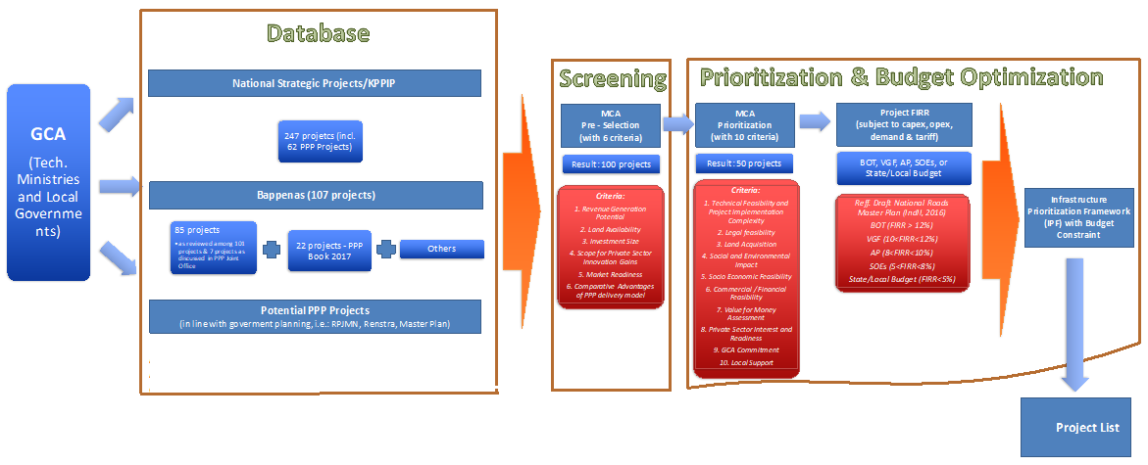
Integration with the infrastructure planning framework –The case of InDonesia

Slide 25
Policy Priorities and Managing biases
IPF accounts for policy priorities through:
selection of criteria/indicators for input variables (i.e. kidney disease in Sri Lanka water sector)
(re) allocation of weights and setting minimum/maximum thresholds for certain criteria
flexibility in consideration of the projects, identified as medium-priority
Importance of independent review (i.e. expert review of input indicators)

