Slide 1
Session 8: Capital Budgeting
15th Annual Meeting of
OECD-CESEE Senior Budget Officials
4-5 July 2019
Minsk, Belarus
Andrew Blazey and Ana Maria Ruiz
Public Governance Directorate
Budgeting and Public Expenditure Division
Public Governance Directorate

Slide 2

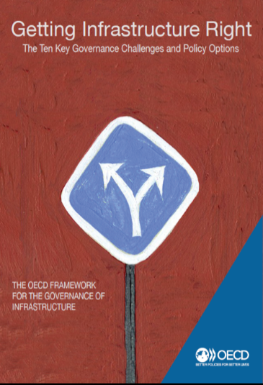



12 years of expertise of the OECD Network of Senior PPP and Infrastructure Officials
Notes:
12 Annual Meetings
OECD (2012), Principles for Public Governance of PPPs Implementation report, adherence of non-OECD countries
5 PPP country Reviews (+ Forthcoming: Kazakhstan)
OECD (2017), Framework for Infrastructure Governance
4 Infrastructure Governance Forums, 2 Country Reviews (+ Forthcoming: Argentina and Spain)
Regional roundtables in collaboration with WB (Cape Town 2017, Abidjan 2018, Korea, 2019)
G20, Guidance note on Infrastructure Governance (collaboration with IMF), G20 Quality of Infrastructure Principles
Four work streams on capital budgeting, investment management, infrastructure and public-private partnerships. These are:
Advisory leadership – Core business – strong demand for OECD reviews. Confirmed reviews are: Suez Canal (March), Argentina (May), Spain (July). Likely reviews include: Greece, Ireland and Peru.
Relationship leadership –Forum and Network Meetings, co-ordination with the GI Hub; co-operation with the IMF is increasing; the next collaboration with the World is on an Asian regional roundtable. Within the OECD, horizontal collaboration is increasing, notably with DAF.
Multilateral leadership – Contributing to G20 has increased our profile on investment management and infrastructure in the multilateral world. Further work is needed to define what success looks like for us.
Development – enhancing our comparative advantage –develop indicators on infrastructure governance and elevate the infrastructure framework to a legal instrument.
Arguably, soon we should think about a fifth stream, transition, to anticipate structural change in GOV to manage business risk.

Slide 3
The role of capital budgeting and infrastructure
  The Ministry of Finance has a key role in dealing with:
    Capital budgeting: the planning and allocation of capital expenditure by governments
    Investment management systems: the processes of prioritising, appraising, selecting, implementing and reviewing capital investment proposals
    Infrastructure development: an asset class that refers to the reticulated supply of roads, energy, telecommunications, and water/waste-water
    Commercial transactions, specifically public-private partnerships.
1
2
3
4
Ministries of Finance
Specialised agencies/units
Private-sector involvement

Slide 4
What are we seeing in practice?
Capital budgeting and infrastructure
Long-term infrastructure planning
Alignment to fiscal plans
Integration between capital and current expenditure
Managing government and commercial expertise

Slide 5
Improved strategic long-term planning of infrastructure
Source: OECD (2018), Survey on Capital Budgeting and Infrastructure Governance
Notes:
Strategic long-term planning is a key element for successful infrastructure development. However, infrastructure investment can involve multiple institutions, jurisdictions, and levels of government, which can make it difficult to design a clear and coherent strategic vision.
More than half of OECD countries reported to have an overall long-term strategic infrastructure vision that cuts across all sectors. This is a new practice in some countries such as Luxembourg and Norway. Likewise, the Slovak Republic reported that the office of the Prime Minister is currently preparing a national infrastructure plan. Thirty-seven percent of surveyed countries reported to have both an overall infrastructure plan as well as long-term plans at the sector level. Co-ordination between these instruments is essential to ensure a clear strategic vision for infrastructure. The same amount of the surveyed countries reported to have only infrastructure plans at the sector level. Most of these countries only have long-term plans for certain sectors (e.g. roads, railways, energy, housing, health). Only Estonia and Sweden reported not having any type of long-term strategic plan (Figure 8.3).

Slide 6
2. Only 50% of countries have a long-term infrastructure aligned to a medium-term fiscal plan
Source: OECD (2018), Survey on Capital Budgeting and Infrastructure Governance
Notes:
9.b. Are the infrastructure strategic plans aligne with existing planning instruments?_Medium term fiscal plan of the government_ 14 yes of 2
55% c of the government

Slide 7
3. Most OECD countries have some integration between current and capital budgets
Notes:
The way capital expenditure is integrated in the overall budget process has different advantages and disadvantages. While full integration between current and capital expenditure can improve planning, facilitate coordination and increase flexibility, separated budgets can ensure that mandatory items such as entitlements do not crowd out discretionary items such as capital investment (Posner, 2009_{[1]}). Governments need to be aware of the inherent challenges of their system in order to ensure that proper mechanisms are in place to face them. If a government decides to submit capital and current budgets separately, it will need to strengthen the selection mechanisms of capital projects to ensure that line ministries better integrate their capital and current expenditure decisions. If it decides for a unified budget, it should ensure that it is also accompanied by guidelines or fiscal rules as well as the political will to limit government borrowing that finances current expenditure (Burger and Hawkesworth, 2013_{[2]}).

Slide 8
4. PPPs remain a small proportion of overall public sector infrastructure investment
Percentage of public sector infrastructure investment (value) through PPPs in the recent 3 years
Source: OECD (2018), OECD Survey of Capital Budgeting and Infrastructure Governance, Question 58, OECD, Paris.

Slide 9
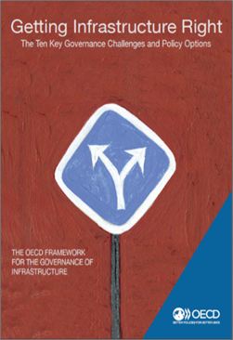
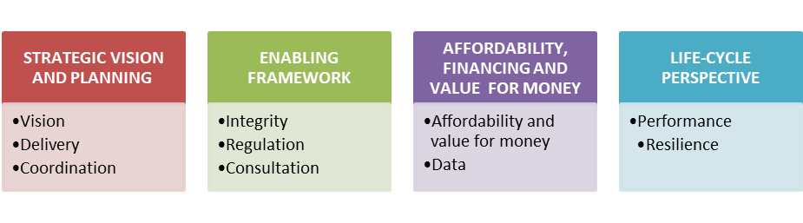
OECD Framework for the Governance of Infrastructure: Getting Infrastructure Right
Ten dimensions or “success factors”
Policy options to identify an enabling environment
Building on several OECD instruments (public procurement, integrity, budgeting)
Notes:
Please see detailed slides per each pillar at the end of the presentation

Slide 10
The OECD Infrastructure Governance Indicators Project
  Objectives
  Map OECD countries’ infrastructure governance practices, identifying strengths and weaknesses
  Provide tools for countries to assess performance in each of the infrastructure governance dimensions
  Contribute to the discussion on the relationship between infrastructure governance and outcomes
  Provide a comprehensive view of the components of the infrastructure governance framework
  Draw attention to each dimension, and the performance data available to measure infrastructure governance

Slide 11
The OECD Infrastructure Governance Indicators Project: a useful diagnosis tool for countries
At first a country would have an outlook of its development status relative to the OECD average
Note: Hypothetical example

Slide 12
Multiple levels of analysis to inform decisions
Zooming in into each pillar:
Deeper understanding of a country’s strengths and weaknesses
Identify priorities to inform decision-making
Note: Hypothetical example
Notes:
Stablish priorities of reform

Slide 13
Thank you
Andrew Blazey
Andrew.BLAZEY@oecd.org
Ana Maria Ruiz Rivadeneira
AnaMaria.Ruiz@oecd.org
Budgeting and Public Expenditure
Public Governance Directorate, OECD

