Slide 1
Internal audit
Community of practice
IACOP: Developments, Achievements, and the Way Forward

Slide 2
Our Mission
IACOP offers support to its member countries
in establishing modern and effective Internal Audit system that
meets international standards and best practices and
is a key for good governance and accountability in the public sector
Our Core Values
Professionalism, dedication to reforms, commitment to sharing knowledge
and experience with the community (as professional family of peers),
trust, unity and respect to diversity of 23 member countries
IACOP Motto
unityINdiversity

Slide 3
Balanced Scorecard
Internal Processes
To maintain and develop a
volunteer network of internal audit professionals through ‘peer’ learning,
knowledge management
with range of activities
Customer
To serve our
governments
Financial
Accomplish donors’ and contributing countries’ needs and make best value for money of PEMPAL with the help of Secretariat
Learning and Growth
Develop the volunteering, Executive Committee leadership, self sustainability
of IACOP, its Working Groups, coordination with partner organizations Steering Committee and other COPs

Slide 4
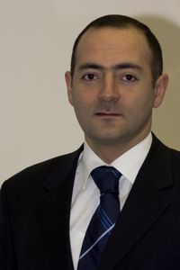
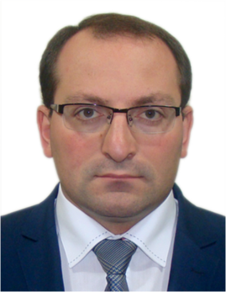
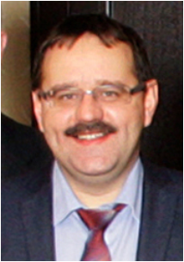
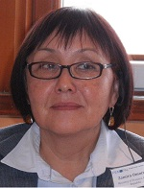
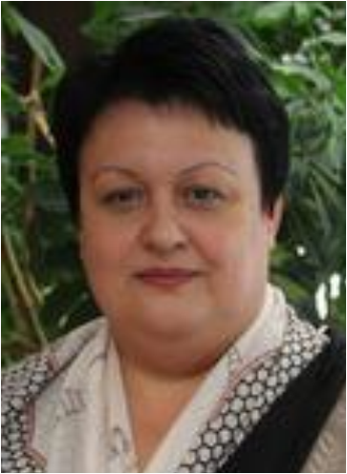
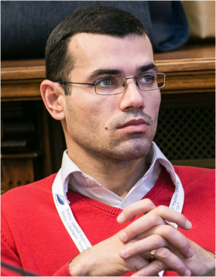
Strong Leadership Team- IACOP ExCom
Diana
Grosu–Axenti
Resource team
member
Arman Vatyan
WB, Lead
Edgar Mkrtchyan
Chair
Armenia
Amela Muftić
Vice Chair
Bosnia and Herzegovina
Edit Nemeth
Vice Chair
Hungary
Zamira
Omorova
the Kyrgyz
Republic
Stanislav
Bychkov
Russian Federation
Mioara Diaconescu
Romania
Petru Babuci
Moldova
Ljerka Crnković
Croatia
Olimjon Mirzoev
Tajikistan

Slide 5
Commonly shared platform – IACOP on Wikispaces.com
KNOWLEDGE PRODUCTS
Ready for share, download and use
EVENTS
Available info before, during and after event
Each and every doc or material produced and further improved
LEADERSHIP and WORKING GROUPS
Plans
Strategies
Composition
COUNTRIES and MEMBERS
State of affairs
Legal framework
Contact details
REGULAR UPDATE and INVOLVEMENT
Each member’s contribution

Slide 6
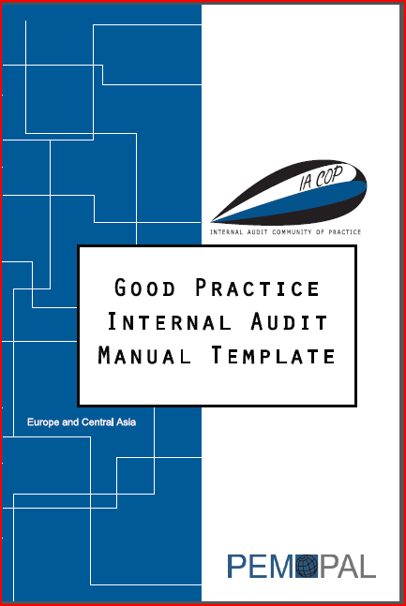
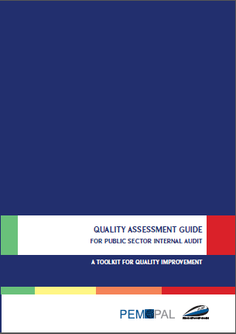
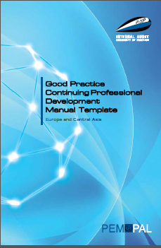
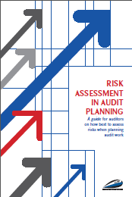
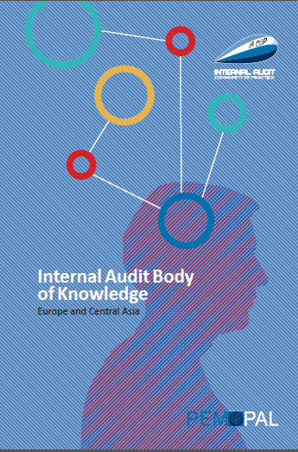
Good Practice Products
Good Practice IA Manual Template
Good Practice CPD Manual Template
Internal Audit Body of Knowledge
Risk Assessment in Audit Planning
Concept Note on RIFIX (Relationship of Internal Audit with Financial Inspection and External Audit)
Quality Assessment Guide
Newsletters, Communiqués and 100+ other knowledge products

Slide 7
Internal Quality Assessment Performed by the Internal Audit Unit
1.1. Ongoing monitoring
1.2. Periodic self-assessment by the internal audit unit
1.3. Audited entity survey
External Quality Assessment Performed by the Central Harmonization Unit
Internal Quality Assessment of the Central Harmonization Unit
Independent External Quality Assessment Performed by an External, Independent Party

Slide 8
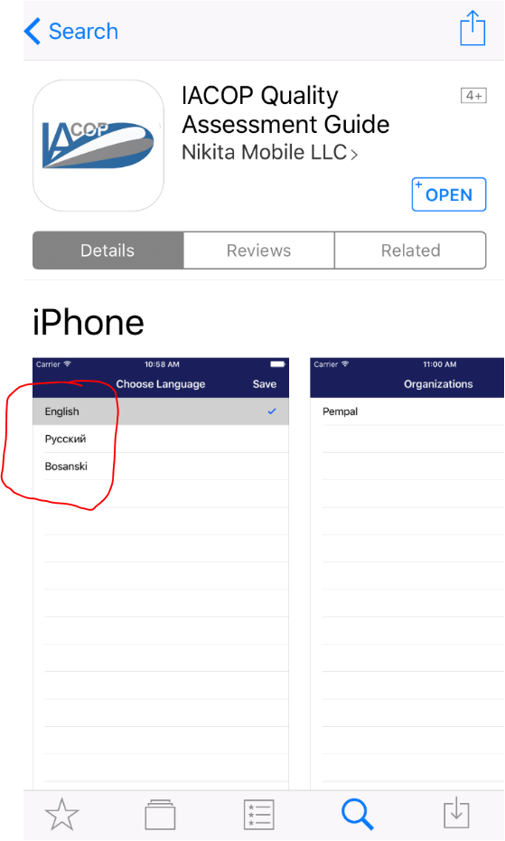
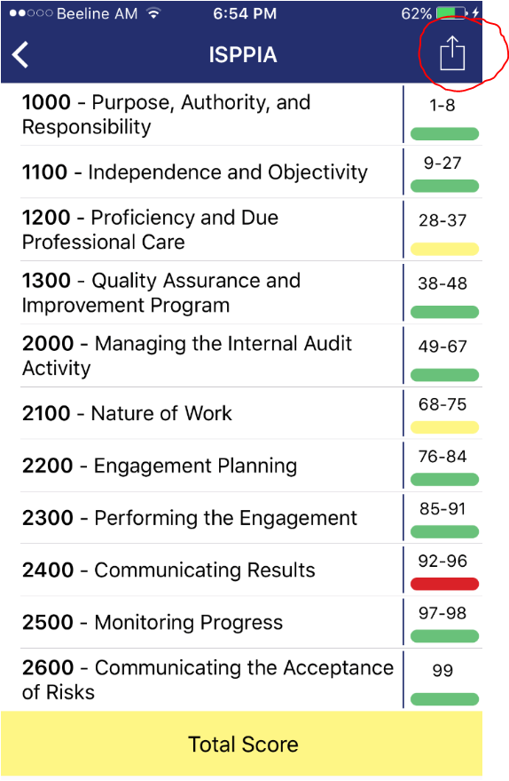
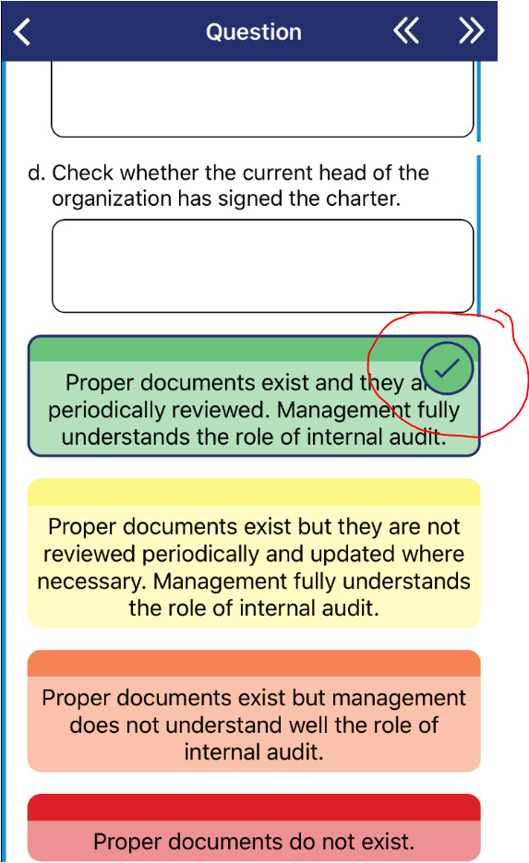
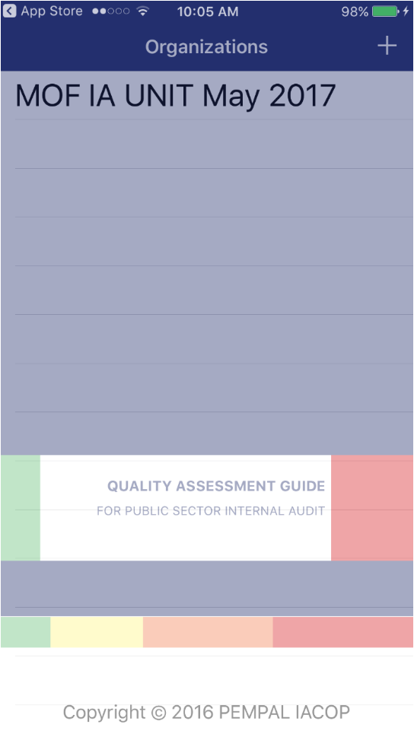
Our Free Quality Assessment App

Slide 9
Relationship of Internal Audit with Financial Inspection and External Audit
Work done
St. Petersburg, September 2013: Study of RIFIX practices in different countries,
Moscow, May 2014: Development of common terminology, definition of principles, drafting of the Concept Paper on RIFIX,.
Astana, September 2014: Finalization of the Concept Paper on RIFIX.
Yerevan, 2015: Draft model of RIFIX cooperation agreement, Discussion of issues regarding to the implementation of the Concept Paper
March 2016: Final draft of the Concept Paper on RIFIX, Prague,
Moscow, Oct. 2016
Approval of the Concept Paper,
2017: Editing, formatting of the e-version and printing of the Concept Paper
Achievements
Coherent terminology
Concentration of the best internationally acceptable practice in this field
Understanding the differences and similarities of the these 3 functions, as well as the benefits of a mutually beneficial partnership
Concept Paper on Relationship of Internal Audit with Financial Inspection and External Audit (RIFIX)
The model of cooperation agreement
Mechanisms for the implementation of RIFIX docs in the member countries

Slide 10
AUDIT IN PRACTICE WORKING GROUP
Budapest – Hungary (March 2017)
Tashkent – Uzbekistan (October 2017)
Brussels – Belgium (March 2018)
Review the complete audit cycle
Learned on Case study
Planning Guidance

Slide 11
INTERNAL CONTROL WORKING GROUP
(including Cross COP topic: accountability)
Outputs:
Knowledge on basics: IC terminology, COSO Framework, The three line of defense
Public sector specifics in internal control systems, how to apply standards and good practices
Clear understanding the EU approach to PIC
Accountability – concept and implementation
Shared country experiences
Draft glossary – future knowledge product
Role of IA and CHU in establishment of sound accountability
PEMPAL IACOP criteria for assessment of managerial accountability – future knowledge product
Events:
Prague, Czech Republic – 2016 March
Moscow, Russia – 2016 October
Budapest, Hungary – 2017 March
Brussels, 2018 February

Slide 13
The Impact of IACOP (2)

Slide 14
The Way Forward
Priority IACOP themes for the FY 2019-2022 are as follows:
Improved value and impact of internal audit
Practical implementation of audit cycle, different types and operational models of audits, including IT solutions (Audit in Practice Working Group)
The role of CHU in public sector reform coordination
CHU’s challenges and functions at different stages of the reform
Public Internal Control - the role of Central Harmonization Units (CHU) and internal auditors (Internal Control Working Group)
Synergy: Public Internal Control with emphasis on integrity management and anti-corruption
Promotion of IACOP and dissemination of its knowledge products and experience gained in ongoing and previous working groups: RIFIX, T&C, CPD, RA, QA, IC, AiP
The format of events proposed:
Plenary, working groups, thematic meetings, ex com members and leaders’ meeting, study visits
Promotion activities, including distribution of existing knowledge products (participation at national and international events)
IACOP peers’ advisory missions and reverse study visit (types of thematic meeting)
Videoconferences, webinars (specifically for thematic meetings)

Slide 15
Thank you!

