Slide 1
PEMPAL Internal Control Working Group– 45th IACOP Meeting
Audit of Internal Control System – Criteria for Audit
Dr. Manfred Kraff Director-General of the Internal Audit Service
Internal Auditor of the European Commission

Slide 2
Assurance and Accountability Chain
ACCOUNTABILITY
AOD/Director-General (management responsibility)
College
(political responsibility)
AMPR
EP and Council
AAR
Art. 99.5 Report
APC
AAR quality
Reports significant issues;
Art. 99.3 Report Overall Opinion
Units + Directorates
(management controls)
Guidance
Central services
3 lines of defence
Director
(risk management and internal control)
Assurance
IAS
Assurance and consultancy
IAS
(internal audit)

Slide 3
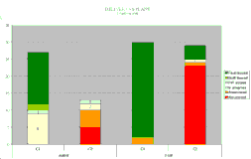
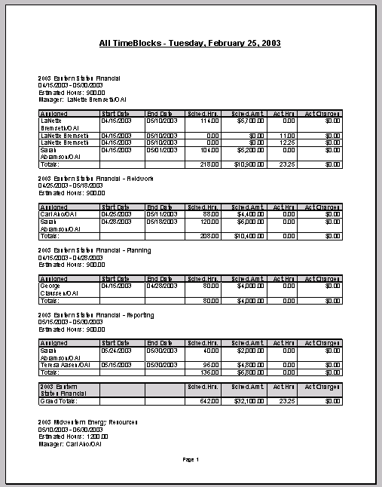
Audit Universe of the IAS
Grants
IT
Financial statements
HR
Monitoring EU law
Financial processes
Non-financial processes
Ethics
Pre-financing
220 auditable entities representing:
~€150bn (commitments) ~€140bn (payments)
Procurement
Accountability, including management disclosure
Communication
385 auditable entities
Payroll
Risk assessment
Risk
factors
REPORTING
IAS Strategic Audit Plan
15% Financial/Compliance
45% Performance
36% Comprehensive
4% Other
Audit Results
Performance Indicators
Financial Reports

Slide 4
Overview on Management Disclosures in AARs
The DG in brief Executive Summary
Section 1
Key results and progress towards the achievements of
general and specific objectives
(including key performance indicators)
Section 2.1
Financial management and internal control
2.1.1. Control results
2.1.2. Audit observations and recommendations
2.1.3. Effectiveness of the internal control systems
2.1.4. Conclusions as regards assurance
2.1.5. Declaration of assurance [and, if necessary, reservations]
Section 2.2
Other organisational management dimensions
Annexes
What have we delivered?
How have we delivered?

Slide 5
Management Disclosures within the Audit Process
Annual Management
and Performance Report
Performance reporting by DGs (evaluations, AARs - part 1, specific performance reporting)
Financial statements
and
Financial reporting
Financial and Compliance Reporting by DGs in AARs - part 2
&
Declarations of Assurance by the Authorising Officers by Delegation
Annual Report by Internal Auditor ('99.3 Report')
IAS Overall Opinion
IAS Limited Conclusion on the state of internal control in each DG
Declarations by
Resource Directors

Slide 6
Should Management Disclosures/Audit Opinions Include a Reservation?
4
No
Reservation
No
No
Significant
reputational event?
No
No
1
2
3
Weakness within declaration’s scope?
Significant in qualitative terms?
Exceeds materiality (2%) of the activity, etc.?
Yes
Reputational
Reservation
Yes
Yes
Yes
Financial
Reservation

Slide 7
Performance Audit of EIP
What are the Criteria for Disclosures/Audits on Performance?
Economy: Were the resources made available in due time, in appropriate quantity and quality and at the best price?
Efficiency: Were a minimum of resources employed / were a maximum of results achieved?
Effectiveness: Were the specific objectives attained and the intended results achieved?

Slide 8
Impact of Intervention Logic of EU Budget on Disclosures/Audits concerning Performance
Resources
INPUTS
What we do
ACTIONS
What we deliver
OUTPUTS
Direct effects
RESULTS
Long-term effects on society
IMPACT
EU high
control
EXTERNAL FACTORS
EU low influence

Slide 9
Thank you for your Attention!
Questions?

