Slide 1
Internal audit
Community of practice
Audit-in-Practice (AiP) WG
Recent achivements and the next steps
Brussel, March 2018

Slide 2
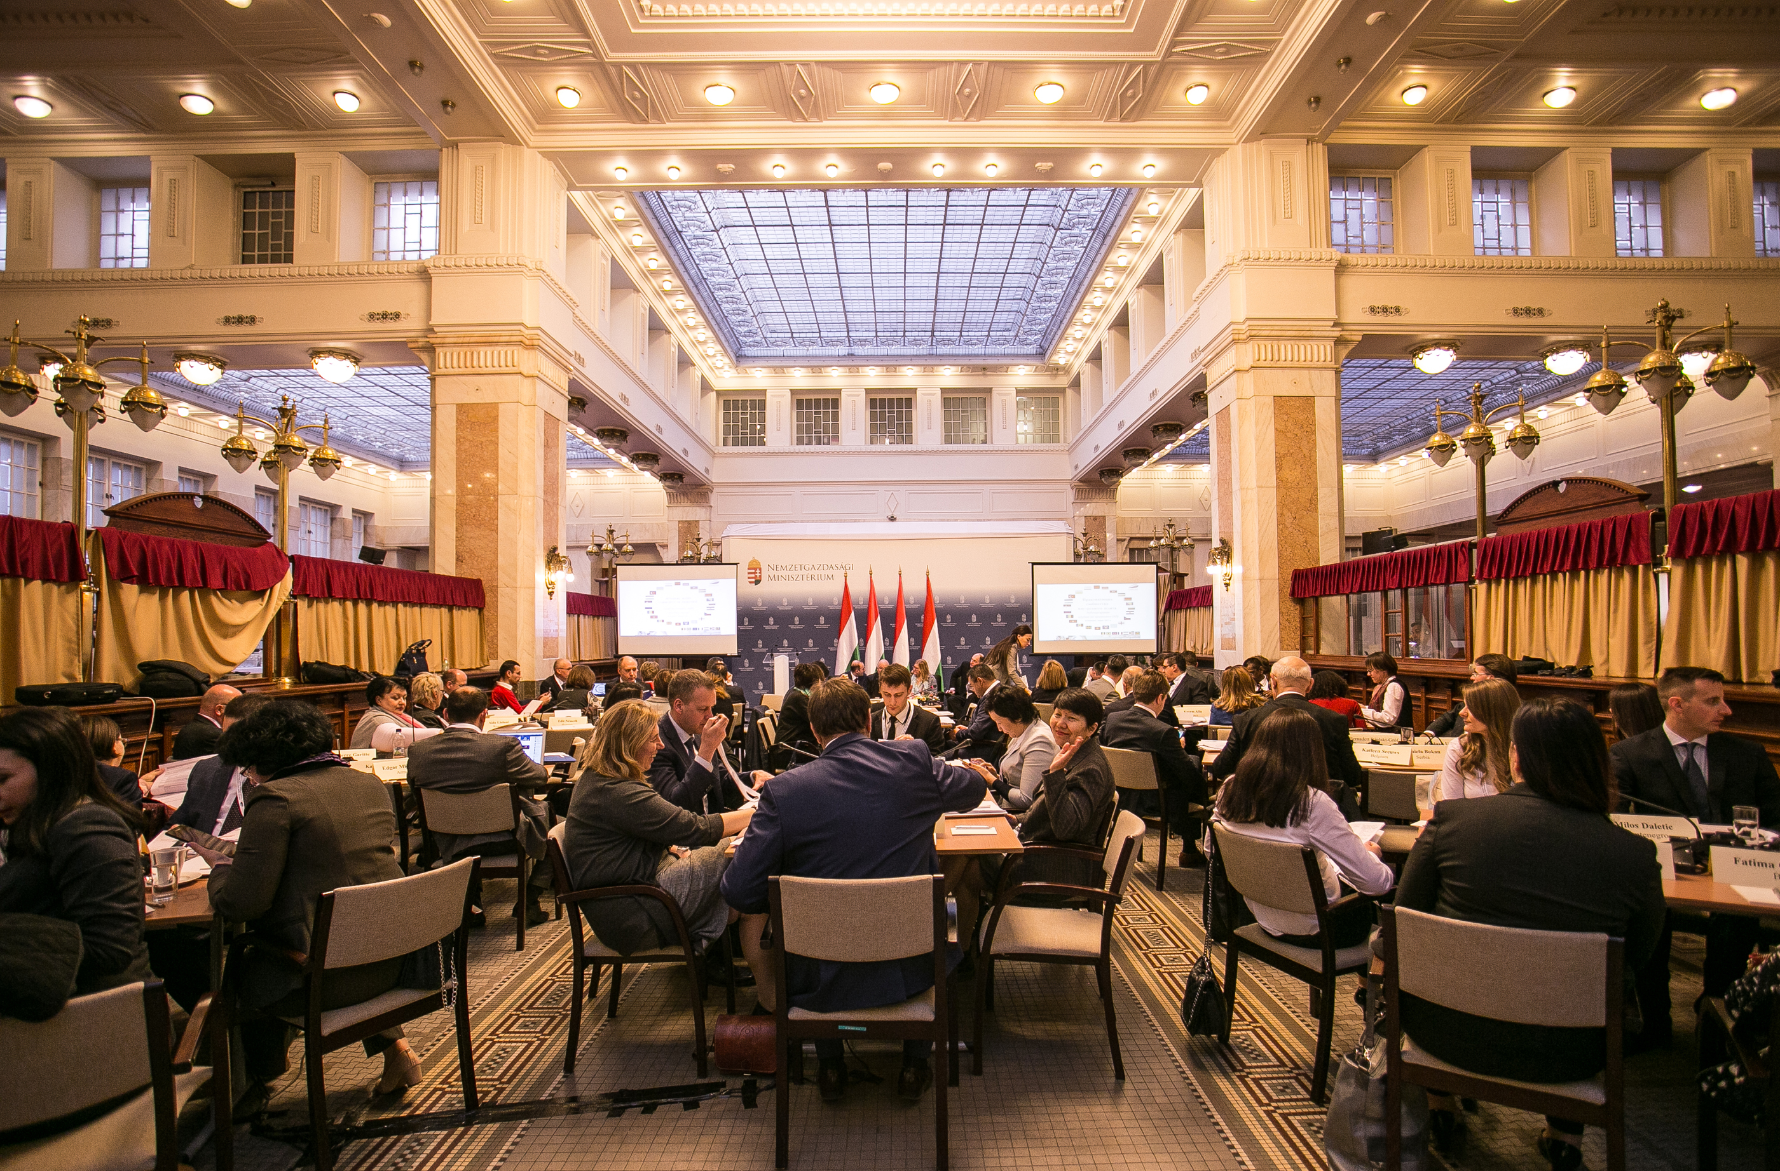
First meeting in Budapest– March 2017

Slide 3
Second meeting – Tashkent – October 2017

Slide 4
Done in Tashkent

Slide 5
Done in Tashkent
3 case studies:
Hospital
HRM
IT
Audit program (template)
https://pempaltc.wikispaces.com/44th+IACOP+meeting+-+Audit+in+Practice+WG+%28Tashkent%2C+October+26-27%2C+2017%29
https://www.pempal.org/events/iacop-pempal-event-plenary-meeting-and-audit-practice-working-group-aip-wg-meeting

Slide 6
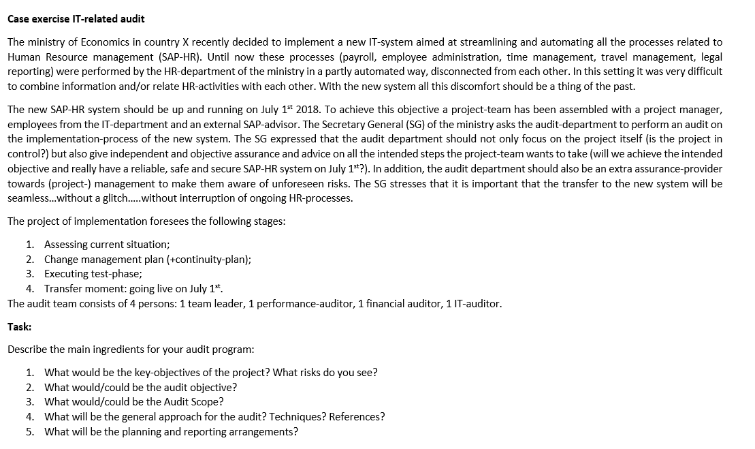

Slide 7
IT Audit (example of one group)
Key point of the project:
Integrated, reliable, safe and a timely system of management of human resources (planning and recruiting of staff, training, billing of salaries and compensations, grading and recording).
Audit scope:
From analyzing to planning of needs for establishment of a new IT system to the beginning of application of the system.
In departments which are included in the process of HR management
Results of SAP testing
Methodology:
Interview,
Testing,
Observation

Slide 8
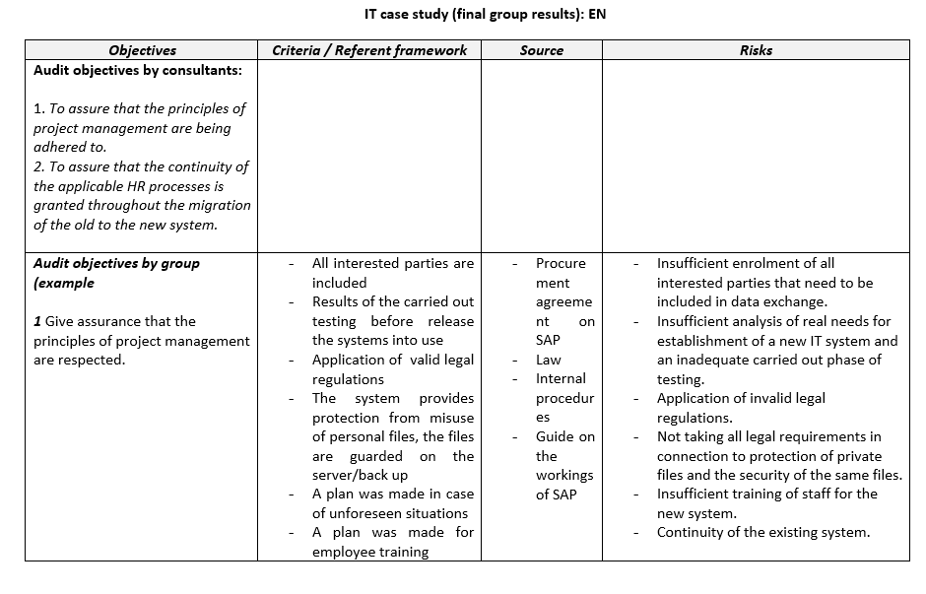

Slide 9
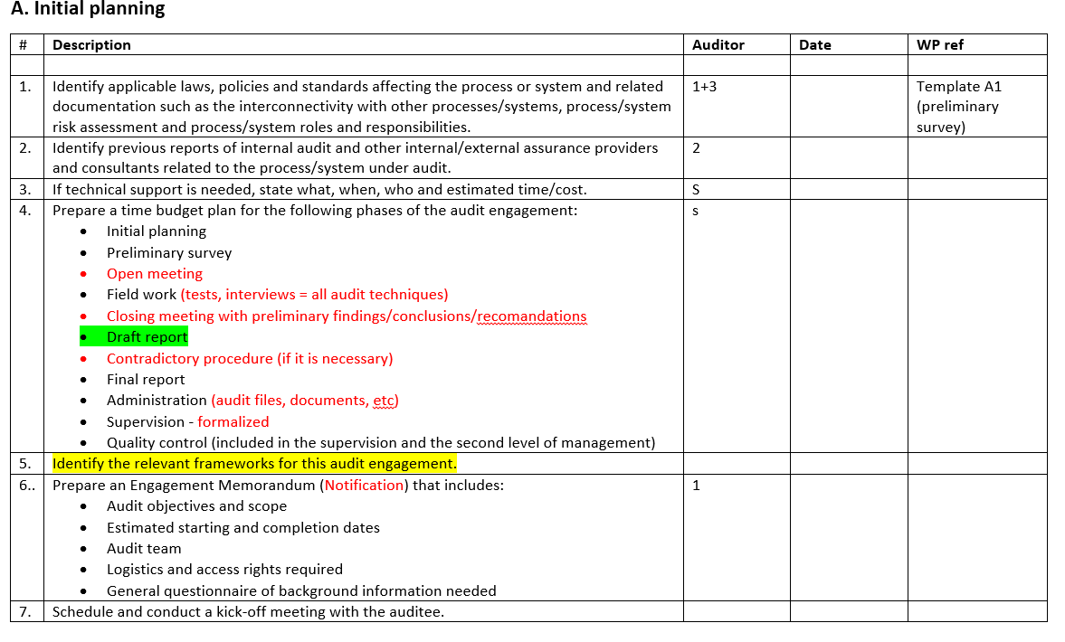

Slide 10
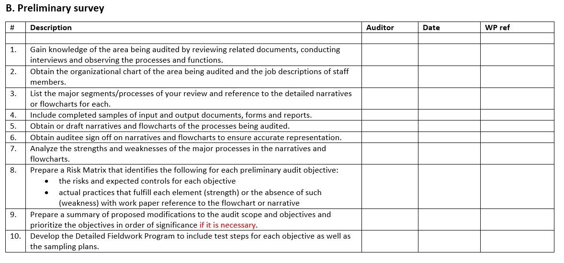

Slide 11
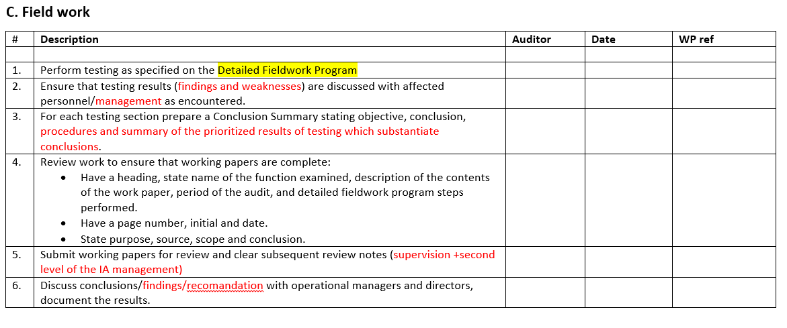

Slide 12
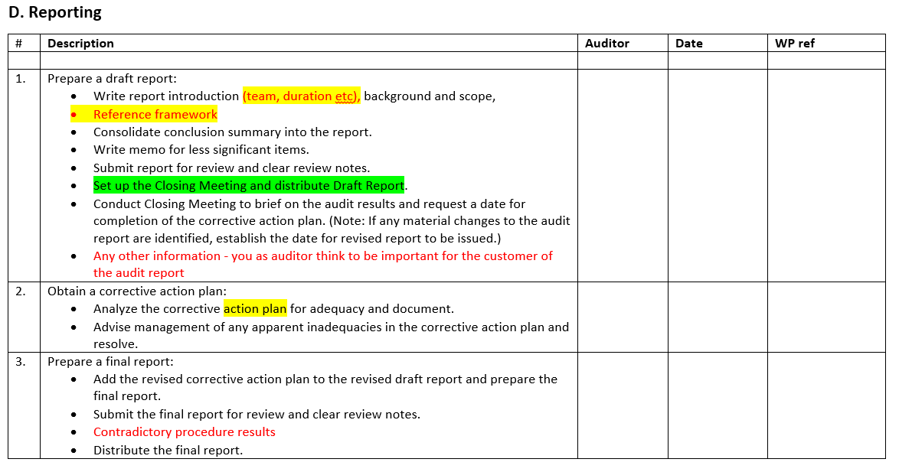

Slide 13
Next steps Objectives and expected outputs and outcomes
Objectives
Learn good practices from the European Commission (EC) and Belgium in organizing internal audit system and performing internal audit engagements
Review the PEMPAL draft audit plan and program template and the work done following the last AiP WG meeting
Understand the linkage between the planning phase (audit program) with the field work of the audit engagements, and review of the related standards (ISPPIA 2310, 2320)
Identify good practices and further develop PEMPAL templates and case studies that can be used by member countries including for training purposes
Expected outputs and outcomes
PEMPAL audit plan and program template and samples of working documents for performing an audit engagement
Practical case studies to be used as a training tool
Knowledge of good practices from EC and Belgium

