Slide 1
Domestic MTBFs and EU fiscal governance: opportunities and challenges from their interplay
Flavio Padrini
Italy’s Parliamentary Budget Office
Secretariat of the IFIs’ MTBF Working Group
2
OECD meeting of the SBOs - CESEE
Zagreb, 24th May 2018
2
This presentation is based on the draft Report: "Medium-term budgetary frameworks: A contribution on definitions and identification of good practices" being prepared by the WG on MTBFs of the Network of EU IFIs. I would like to thank the Chair of the WG, Chiara Goretti, as well as the members of the WG and of its Secretariat that have prepared the Report. The written and oral presentations express my personal view.

Slide 2
Outline
Good practices for effective MTBFs
Domestic MTBFs and EU fiscal governance
IFIs’ role in relation to MTBFs

Slide 3
Good practices for effective MTBFs

Slide 4
Good practices for effective MTBFs
Medium-term budgetary frameworks (MTBF) ➔ set of interrelated systems, rules, and procedures ensuring that annual budgets are set with a medium term perspective (broadly equivalent to “OECD-style” MTEF)
Ultimate objectives ➔ 1) improved allocation of resources in both short- and medium-term; 2) predictability of available resources for public managers; 3) more stability of fiscal targets and compatibility with sustainable public finances

Slide 5
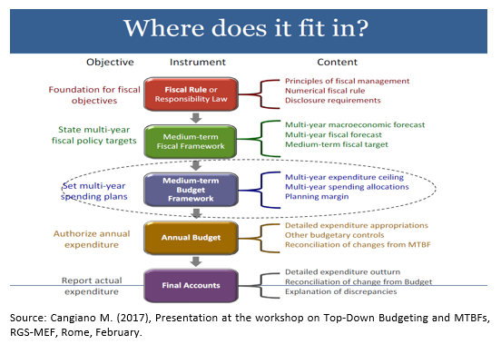
Good practices for effective MTBFs
MTBFs stand between the MTFF (i.e. overall fiscal objectives in the short-to medium term) and annual budgets

Slide 6
Good practices for effective MTBFs
Important warning: no single way to set up or improve MTBFs (instruments and priorities are country-specific)
Political commitment and institutional capacity are key
Existence of an operational expenditure rule to establish binding (not fixed) spending limits in a multi-year setting for each policy area
Overall stability of expenditure targets over the years and reconciliation procedures in place when these targets are changed
Reconciliation among different accounting standards

Slide 7
Good practices for effective MTBFs
Establishment of the MTBF at the beginning of each legislative term with no or limited renegotiation afterwards
Establishing in advance the "rules of the game" among political and institutional actors in specific circumstances
Define a central MTBF also in countries with multilevel expenditure structure because of the impact that the central government envelopes have on the budget of subnational governments

Slide 8
Domestic MTBFs and EU fiscal governance

Slide 9
Domestic MTBFs and EU fiscal governance
The cornerstone of the medium term fiscal coordination, the Stability and Growth Pact, is akin to an (EU) MTFF
For EU countries, need to coordinate their own domestic MTBFs with the EU MTFF
The most effective MTBFs in the EU (e.g. the Netherlands) pre-date the EU MTFF; sometimes contradictions have emerged which are being fixed
Instability of targets and short-term focus of the current EU fiscal framework is a challenge to the implementation of effective MTBFs

Slide 10
Domestic MTBFs and EU fiscal governance
“Budgetary framework directive” (2011) provides for some common pre-requisites and general principles for medium-term budgetary frameworks like to base budgetary projections on realistic macroeconomic forecasts or to introduce country-specific numerical fiscal rules
However, the directive for the relevant parts seems to refer to fiscal (and not budgetary) plans (for example, the Directive asks for general government figures)
Thus, the directive appears to set the requirements and contents of the MTFF (that in many countries coincides with the EU MTFF)
Review of the directive by the end of this year could be an opportunity to focus more on MTBFs as previously defined

Slide 11
Domestic MTBFs and EU fiscal governance
In December 2017 proposal of a Directive laying down provisions for strengthening fiscal responsibility and the medium-term budgetary orientation in the Member States
The Directive requests euro area Member States and other Member States on a voluntary basis to set up a domestic framework of binding and permanent numerical fiscal rules, specific to each country

Slide 12
Domestic MTBFs and EU fiscal governance
The proposed framework must in particular include two rules:
1) a medium-term objective in structural terms ensuring that the public debt ratio does not exceed 60 per cent or, if it is higher than this threshold, approaches it at a satisfactory pace
2) a medium-term growth path of public expenditure net of discretionary revenue measures consistent with the medium-term objective or the adjustment path towards it

Slide 13
Domestic MTBFs and EU fiscal governance
The net expenditure path must be set for the term of the legislature as soon as a new government takes office and must be respected by the annual budgets during the whole period
This could be an opportunity for EU countries to set up a domestic MTFF consistent with the EU MTFF but also consistent with the domestic MTBF (already established or to be improved or to be established)

Slide 14
IFI’s role in relation to MTBFs

Slide 15
IFIs’ role in relation to MTBFs
Directive proposes that IFIs have a stronger role in monitoring the respect and the implementation of the framework
In case of significant observed deviation from the rules, the IFIs should call on the budgetary authorities to activate a correction mechanism thereby measures are implemented to rectify the deviation over a defined period of time
Member States must ensure that budgetary authorities are subject to a “comply-or-justify” procedure vis-à-vis the recommendations issued by the IFIs in the context of their monitoring tasks.

Slide 16
IFIs’ role in relation to MTBFs
But before Directive is approved by Council and implemented by Member States…
IFIs can play an important role in promoting a medium-term approach for the implementation of budgetary policies
As a first step, IFIs could assess the quality of domestic frameworks
IFIs could promote and monitor the implementation of some of the good practices (country specific)

Slide 17
IFIs’ role in relation to MTBFs
Where or when a satisfactory MTBF is in place, IFIs could have a role in assessing whether the medium-term orientation of budgetary policies is indeed followed through by the government in practice and not only in legislation
IFIs could also deliver the main technical parameters needed to establish an MTBF or could provide medium-term projections under no policy change
IFIs could finally have a role in the reconciliation process when an MTBF is being revised
IFIS could assess the consistency of medium-term targets across levels of governments

Slide 18
Thank you for your attention
Flavio Padrini
flavio.padrini@upbilancio.it
www.upbilancio.it

