Slide 1
Performance Indicators in PEMPAL Countries: Trends and Challenges
PEMPAL Budget Community of Practice (BCOP)
Program and Performance Budgeting Working Group (PPBWG)
Naida Carsimamovic
BCOP Resource Team

Slide 2
PRESENTATION OVERVIEW
Rationale for PEMPAL performance indicators (PI) review
Ten criteria based on which performance indicators (PI) were assessed
Summary of PI review based on 10 criteria
Summary review of health and education indicators

Slide 3
Rationale for PEMPAL performance indicators (PI) review

Slide 4
why Focusing ON PERFORMANCE INDICATORS?
Findings of the OECD-PEMPAL Performance Budgeting Survey in 2016 indicated that PEMPAL countries have a common challenge in defining and tracking performance indicators:
Encouraging culture of performance was a high priority for PEMPAL countries in introducing PB (more so than in the OECD countries)
Performance indicators are underused in budget negotiations (similarly to OECD countries)
The second top challenge in PB implementation in PEMPAL countries is unclear policy/program objectives that make it difficult to set performance measures and targets (which is a challenge not identified by OECD countries), while the other top challenges are also related to performance indicators, such as lack of performance culture and lack of accurate/timely data (similarly to OECD countries)
Lack and/or poor quality of performance information/data is identified as top challenge for spending reviews (as is the case in OECD countries)

Slide 5
Pempal PI review: approach
Collected examples/full sets of performance indicators from nine countries in Summer 2017 (Armenia, Belarus, Bulgaria, Bosnia and Herzegovina- the State-level and the FBiH level, Croatia, Kyrgyz Republic, Moldova, Russian Federation, and Serbia).
In September 2017, held a working session and agreed on 10 criteria for review of PIs:
4 from OECD Performance Budgeting Survey
6 additional criteria defined by the PPWG.
PEMPAL PPBWG Resource Team and leadership analyzed the indicators of nine countries based on 10 criteria.
Given differences in scope of PIs set collected, PPBWG decided to focus the review on PIs in health and education.
In October, PPBW further collected health and education PIs from ten countries (those listed above and Turkey).

Slide 6
TEN CRITERIA USED TO ASSESS Pis IN PEMPAL COUNTRIES

Slide 7
10 criteria used to assess pis
Does a PB framework applied uniformly across central government exist?
What are the key elements of PB framework?
Which institutions play an important role in generating PIs?
What are PB challenges identified as high among options within OECD Survey?
At what levels are PIs defined and monitored?
What are the types of PIs?
What is the frequency of tracking PIs?
What is the average number of PIs per program and what is the structure of PB?
What is the estimate of ratio of output to outcome indicators?
What are the main challenges related specifically to PIs?

Slide 8
Summary of PI review based on 10 criteria

Slide 9
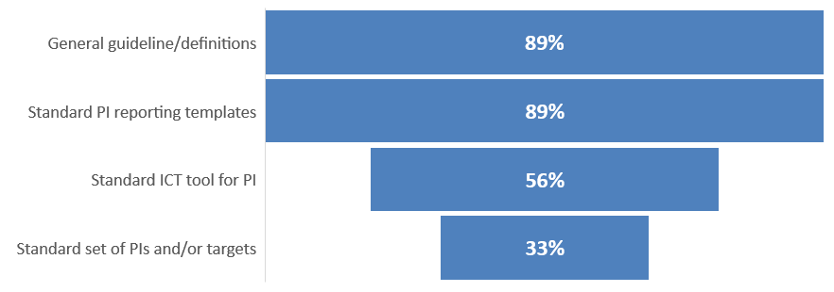
SUMMARY OF pi REVIEW
Criterion 1: Does a PB framework applied uniformly across central government exist?
All countries have compulsory PB framework for both Ministries and Agencies.
Criterion 2: What are the key elements of PB framework?
of countries, the exception is
Armenia
of countries, the exception is
Armenia
of countries, exception is Armenia
of countries, the exception is
Armenia
of countries, the exceptions
are Armenia and Russia
of countries, exception is Armenia
Croatia, BiH,
Serbia &
Moldova
Croatia, BiH, Serbia,
Moldova, and Russia
Croatia, BiH, Serbia,
Moldova, and Russia
Armenia,
Bulgaria,
and Russia
Armenia,
Bulgaria &
Russia

Slide 10
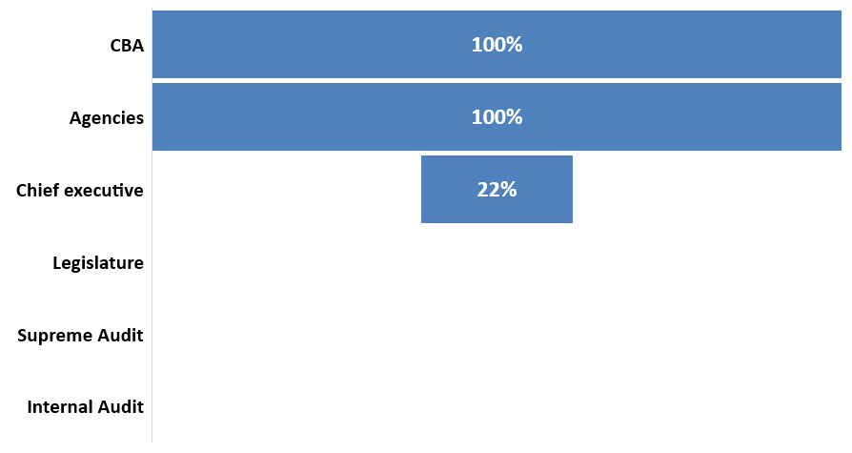
SUMMARY OF pi REVIEW
Criterion 3: Which institutions play an important role in generating PIs?
all countries
of countries, the exception is Belarus
Russia
& KR
Russia
and KR
of countries, the exception is Armenia
NONE
of countries, the exceptions
are Armenia and Russia
NONE
of countries:
Croatia, BiH, Serbia,
and Moldova
NONE
of countries:
Armenia,
Bulgaria, and
Russia

Slide 11
SUMMARY OF Pis REVIEW
Criterion 4: What are PB challenges identified as high or medium high among options within OECD Survey?
Most common are:
Lack of resources (time, staff, operating funds) to devote to performance evaluations;
Unclear policy/program objectives make it difficult to set performance measures/targets;
Lack of capacity/training for staff/civil servants with regards to performance measurement;
Lack of performance culture; and
Lack of accurate/timely data

Slide 12
SUMMARY OF Pis REVIEW
Criterion 5: At what levels are PIs defined and monitored?
In most cased defined by Ministries/Agencies (usually with CBA’s assistance/guidelines);
In Belarus and Russia approved by the Government and consolidated by the Ministry of Economy;
In Balkans countries consolidated by MF; and
In most countries tracked by the Ministries/Agencies and sent to Government/Parliament as additional information only (not for adoption).
Criterion 6: What are the types of PIs?
In around half cases no typology, in other cases usually some combination of output and outcomes (and also efficiency in some cases).
Criterion 7: What is the frequency of tracking PIs?
Annual, except for Armenia where it is quarterly and Serbia where at some levels also semi-annual.

Slide 13
SUMMARY OF Pis REVIEW
Criterion 8. What is the average number of PIs per program and what is the structure of PB?
In most cases there are two levels of results – programs and activities/sub-programs (or policy areas and programs). In KR, three levels – sustainable development level, program level, and activity level.
PIs given in most cases at both result levels, except in BiH where indicators given only at activity level).
Number of PIs varies greatly in most countries, rough averages per country range from 10 to 80 (80 in Russia, 50 in Armenia, 15 in BiH, 30 in Croatia, 30 in Serbia, 10 in Bulgaria, 10 in Moldova, 10 in Kyrgyz R, and 40 in Belarus), however it must be noted that scope of a program varies among countries, from whole sectors (e.g. in Russia) to much smaller scope at a level of one department in one agency/Ministry (e.g. Bosnia and Herzegovina).

Slide 14
SUMMARY OF Pis REVIEW
Criterion 9: What is the rough estimate of ratio of output and outcome indicators in total indicators?
In most cases 2/3 output, 1/3 outcome indicators.
Criterion 10: What are the main challenges related specifically to PIs?
PB still in early stages.
Quality of PIs varies from user to user.
Too many PIs.
Lack of defined standard KNIs/highest-level national strategy with standard PIs.
Connection with overall government strategic planning could be strengthened.
In some cases some PIs not quantifiable.
Weak or non-existent PB at local governance level.
Lack of use of PIs in decision-making.
Challenges for setting and tracking PIs for inter-agency programs.
Difficulties in targeting PI values.
Overall performance-based mindset needs to be strengthened.

Slide 15
Summary review of health and education indicators

Slide 16
NUMBER OF Pis and PROGRAM STRUCTURE
 | EDUCATION |  | HEALTH
 | NUMBER AND STUCTURE OF PROGRAMS | NUMBER OF PIs | NUMBER AND STUCTURE OF PROGRAMS | NUMBER OF PIs
Russian Federation | 1 program with 7 sub-programs | 154 | 1 program with 11 sub-programs | 96
Serbia | 6 programs with 64 activities | 272 | 6 programs with 45 activities | 142
Croatia | 4 programs with 40 activities | 113 | 4 programs with 8 activities | 18
Kyrgyz Republic | 6 programs with 27 activities | 73 | 5 programs with 40 activities | 68
Bulgaria | 9 programs | 123 | 2 programs | 16
Belarus | 1 program with 11 sub-programs | 31 | 1 program with 7 sub-programs | 23
Moldova |  |  | 12 programs | 95
Armenia | 9 programs with 69 sub-programs | 153 | 9 programs with 56 sub-program | 165
Turkey | 7 strategic objectives and 42 performance objectives | 175
AVERAGE |  | 137 |  | 78

Slide 17
Findings from REVIEW oF HEALTH AND EDUCATION PIs: GENERAL CHARACTERISTICS
However, comparison is not entirely applicable, as scope of a program varies among countries, from whole sectors (e.g. in Russia) to much smaller scope at a level of one department in one agency/Ministry (e.g. Serbia).
In majority of cases PIs are properly defined - it is clear what they measure, what the unit of measure is and they are neutral in their name. However, this is not always the case.
In most cases, PIs are in large part outputs, however, outcome-level indicators are also given.
In most cases, low output level PIs are also given (e.g. Number of meetings or Yes/No indicators related to legislation/regulation being developed).
In most cases, highest-level long-term indicators (usually based in internationally comparable measurements) are included – e.g. student PISA scores, population covered by education levels, investment in R&D, life expextancy, mortality related to different disease types, vaccination coverage.

Slide 18
Findings from REVIEW oF EDUCATION PIs: COMMON GROUPING of pis
In education, PIs can generally be grouped as related to:
Access to education (e.g. Share of population covered by education at different levels)
Quality of education (e.g Average scores on state exams, Average scores on PISA, Share of university graduates who are employed)
Number of service beneficiaries (students) and number of service providers (teachers) and their ratio per different education levels
Investment in fixed assets and IT (Share of schools with modern internet and IT services, Share of schools with safety standards, Number of modernized objects that are realized using the IT system, Share of schools with the access to computers for educational purposes)
Gifted students (e.g. Number of awards, Ratio of the number of pupils using student scholarships, Number of secondary school students in international competitions, Number of gifted children and students who were given additional specific forms of support according to their needs, preferences and skills)

Slide 19
Findings from REVIEW oF EDUCATION PIs: COMMON GROUPING of pis
In education, PIs can generally be grouped as related to:
Access of marginalized groups (e.g. Number of pedagogical assistants involved in working with Roma children, Number of students with disabilities, Number of children attending a program of educational work with children on hospital treatment, Increasing the number of supplementary classes for students with learning disabilities)
Support services (e.g. Number of available student dorms, Number of students using accommodation services)
Extracurricular activities (e.g. Percentage of pupils involved in extracurricular activities)
Compliance with standards (e.g. Number of higher education institutions which are aligned with revised European standards, Number of standard documents for student achievement for primary and secondary education)
Research and development (e.g. percentage of GDP expenditures for science and research, Share of funds allocated by universities to development of research work, Share of recent graduates involved in implementation of research and development)
Teachers’ education (e.g. Number of employees in education who received trainings in the area of ​​violence prevention, and Share of teachers participating in advanced vocational training programs)
Legal/regulatory documents (e.g. Administrative acts regulating learning/training process, Laws/bylaws, Preparation of documents on policies (the total number of documents)

Slide 20
Findings from REVIEW oF HEALTH PIs: COMMON GROUPING of pis
In health, PIs can generally be grouped as related to:
Life expectancy
Perceptions of quality of services (e.g. Percent satisfaction of patients provided with health care)
Mortality rates (e.g. Mortality from all causes per 1,000 persons, Infant mortality per 1,000 births, Mortality from cardiovascular diseases, Disease prevalence by type, and Percentage of deaths from malignant tumors)
Prevalence of diseases (e.g. Prevalence of cardiovascular diseases and TB incidence rate)
High-technology health services and investment in fixed assets (e.g. Average age of equipment for radiological diagnostics and air therapy, Number of public health centers equipped with metrologically validated laboratory equipment, Number of e-services implemented, and Per capita capital investment expenditure)
Research and Development (e.g. Percentage of researchers aged through 39 in the overall number of researchers and Number of studies on severely hazardous infections)

Slide 21
Findings from REVIEW oF HEALTH PIs: COMMON GROUPING of pis
In health, PIs can generally be grouped as related to:
Vaccination coverages (e.g. Percentage of fully vaccinated children, Vaccination coverage for children under 2 years of age, and Coverage of women 30-60 years of age in screening Cervical Cancer)
Prevention and preventive health exam coverage (e.g. Percentage of women covered by preventive examinations, Consumption of kitchen salt, Consumption of fruit and vegetables, and Percentage of physically active population)
Health workers’ qualification and training (e.g. Number of health workers who participated in professional training)
Awareness raising (e.g. Developed information materials on prevention of diseases, and Number of awareness-raising campaigns)
Number of health care workers and associated ratios (e.g. Ratio of physicians per 10,000 persons, Number of nursing personnel per 1 physician, Number of doctors specialists per 100,000 inhabitants, Number of medical workers per capita)
Legal/regulatory documents (e.g. Total number of developed draft legal acts and Number of agreements developed, memoranda, protocols, programs and other documents, meetings, discussions and other cooperation activities)

Slide 22
Thank you for your attention!
All BCOP and PPBWG materials can be found in English, Russian and BCS at www.pempal.org

