Slide 1
Objective setting:
application of ISPPIA 2210 in the Netherlands
Manfred van Kesteren
Budapest, March 2017

Slide 2
Steps taken in any type of audit
Intake
(planning and) preliminary research
Fieldwork
Analysis
Report
Evaluation
Follow-up

Slide 3
After intake and preliminary research:
An audit plan in which the ‘why’ and ‘how’ questions for the audit are described. These are the elements of the audit framework (see next slide);
The audit plan is basically the contract between the assigner of the audit and the audit unit (signed by both parties);
A Risk Analysis is always the starting point and usually the trigger of an audit

Slide 4
AUDIT FRAMEWORK
Audit Plan
What?
How?
Audit Context
Audit Strategy
Audit Objective
Organization of the Audit
Key Questions
Analyses
Audit Object and Scope
Planning and Resources
Reference Model
Reporting
Evaluation and Follow-up

Slide 5
Audit objective
Describes what the final result of the audit will be
Describes what management wants to achieve with the audit results
Usually composed of what and why components.
Example: assessment of the quality of the objectives and the proper functioning of the control system within the tendering phase of the procurement process in Ministry X in order to improve this process if necessary.

Slide 6
Key Audit Questions
Key questions are derived from the audit objective
They are the main questions that will be answered by the audit
Can be problem identifying, diagnostic or solution aimed in nature
Example:
Are the objectives set for the tendering phase of the procurement process of good quality?
Is the current system of internal control within the tendering phase of the procurement process functioning in a good way?

Slide 7
Audit object and scope
Object: describes what is going to be examined
Example: the object is process x
Scope: gives clarity about the boundaries of the audit
Example: within process x we look at steps a to c in period y

Slide 8
CONCEPTUAL AUDIT DESIGN (what?)
Reference Model
Conducting an audit means that the actual status of the object (‘ist’- as it is) is compared with a set of norms (‘soll’- should be).
The reference model is used as a tool to make a description of the ideal governance and control framework. It’s the mirror the auditor uses. But the ideal image in the mirror should be formulated by the assigner of the audit (management).

Slide 9
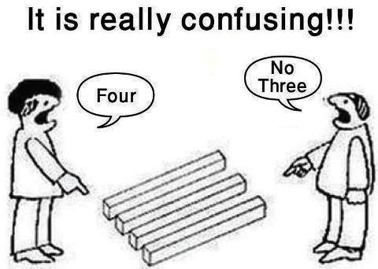
Why do we need reference frameworks?
The auditor needs a measuring tool;
They prevent to some extend disagreements with management about the audit conclusions/opinions;
Clear definitions of the key concepts in the audit prevent misinterpretations.

Slide 10
Position of the reference framework in the audit process
Criteria source 1
Reference framework:
Normative
Framework
(How it should be)
Criteria source 2
Criteria source 3
Gap?
Audit result:
conclusions / opinions
Analysis
Data-collection
(Fieldwork)
Audit-
Object
(How it is)
Notes:
The auditmodel is a schematic view of the auditgoal and the auditview to reach this goal and the auditobject where upon the audit is performed. The auditmodel forms the framework for the auditor.
The auditgoal is already treated in the intakephase. In the auditmodel the goal is repeated and put into a scheme. The auditobject is the subject or item of the audit. It can be a process, but it can also be a theme such as integrity or safety. It is the focuspoint of the auditor. This auditobject is already known in the intakephase, but in the phase of building the auditmodel, this auditobject is definitely determined.
The basis of the framework is the auditview. This auditview are the glasses which clears the sight of the auditor. It determines the way the auditor will examine the auditobject. It forms the basis upon which the auditor draws his conclusions. The auditview is mostly stated in a few general audit questions who are derived from the central audit question or auditgoal. Most of the times the answers to the general audit questions lead to the fullfillment of the auditgoal. Sometimes not only the general audit questions are mentioned but also the aspects or themes to look for during the audit.
A good and explicit auditview is neccesary for an audit. If the auditor has the idea that he cannot completely answer the central auditgoal, he has to work on his references. If needed he can enlarge his preliminary investigation or intake to build a gooed auditmodel. It is also important to mention that it is NOT the auditor who is responsible for the decisionmaking around the auditmodel. It is the auditclient who is responsible for that, but in practice the auditor builds the framework and the auditclient approves it.
Let us now give some examples of references.

Slide 11
Reference frameworks and types of audits
Type of Audit | Characteristics of the reference frameworks | Sources
Compliance Audit | Standardized (usually check lists) | Laws/regulations/procedures
Financial Audit | More or less standardized | Tolerance levels, accounting procedures, reporting requirements
IT-audit | Partly custom made / partly standardized but needs to be tailor made dependable on audit topic | For example: COBIT, internal procedures, ISO27001
Performance Audit | Partly custom made / partly standardized but needs to be tailor made in most cases | Norms/criteria set by management, internal procedures, regulations/laws, theories, best practices

Slide 12
m.Kesteren@minfin.nl

