Slide 1
The Citizens Budget. Open Data. Aidarbek uulu Talas, Budget Policy Division
Ministry of Finance of the Kyrgyz Republic

Slide 2
Budget Transparency Index: Kyrgyz Republic
The Ministry of Finance of the Kyrgyz Republic

Slide 3
The Citizens Budget of the Kyrgyz Republic
First published in 2011 at the KR MoF website
In subsequent years was published as booklets and posters
Format evolution and improvement
The Ministry of Finance of the Kyrgyz Republic

Slide 4
Developing the Citizens Budget in the Kyrgyz Republic
The Citizens Budget based on draft Budget Law submitted to Parliament by the KR Government.
The Citizens Budget based on the approved Budget Law.
Budget process
The Ministry of Finance of the Kyrgyz Republic

Slide 5
Composition of the KR Citizens Budget
Introduction
1. Key macroeconomic indicators
2. Key fiscal indicators
3. Key budget initiatives
Glossary, Information Sources and Contact Information
The Ministry of Finance of the Kyrgyz Republic

Slide 6
Citizens Budget dissemination
Citizens Budget
Publications in the media, paper-based booklets and posters
Publication at the KR MoF official website
The Ministry of Finance of the Kyrgyz Republic

Slide 7
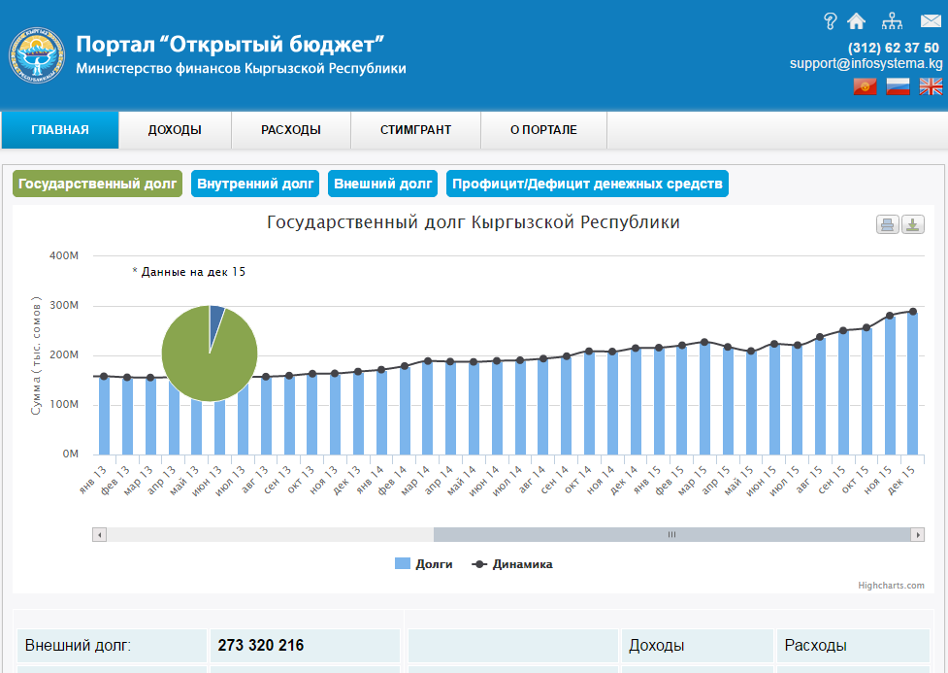
The Open Budget portal

Slide 8
The Open Budget portal
budget.okmot.kg
An automated system to furnish national and local budgets revenue and expenditure data online
Provides detailed and up-to-date state budget execution data in Kyrgyz, Russian and English
The portal is updated online and receives data from the Treasury database with the exception of information for which access is restricted by the KR legislation
The Ministry of Finance of the Kyrgyz Republic

Slide 9
THANK YOU!

