Slide 1
Public Participation in Budgeting: Applying the New GIFT Principles Findings from the 2015 Open Budget Survey and IBP’s Work on Indicators to Measure Public Participation
12th Annual Meeting of CENTRAL, EASTERN & SOUTH-EASTERN SBO
SESSION 8
Anjali Garg, June 29, 2016

Slide 2
Presentation Outline
Public Participation in National Budget Process
Findings from the Open Budget Survey 2015 on Public Participation
Revising the Open Budget Survey Indicators on Public Participation

Slide 3
Public Participation in National Budgeting
Access to budget information is a necessary but insufficient condition to increase the level of accountability for governments to raise and spend public funds efficiently and effectively
For this to happen, transparency needs to be accompanied by meaningful opportunities for the public to participate in the budget process
For this reason, over the last five years, IBP has been working on a set of indicators on public participation for the Open Budget Survey (OBS) that could complement existing indicators on transparency

Slide 4
OBS 2012/2015 Indicators on Public Participation
Indicators on public participation in the national budget process introduced in the OBS 2012 were the first attempt to articulate a set of guidelines on how public participation in the national budget process ought to be structured
Indicators were based on six principles:
Participation should occur throughout the budget process
Participation should occur with all parts of the government
Participation should have a legal basis
The purposes of for public engagement should be publicized in advance
Multiple mechanisms for public engagement should be implemented
The public should be provided with feedback on their inputs
Indicators were implemented in the OBS 2012 and OBS 2015

Slide 5
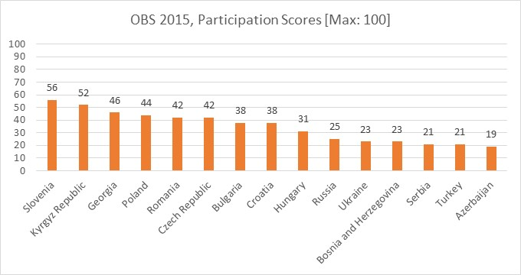
Findings from the OBS 2015 on Public Participation
Most countries do not provide adequate opportunities for public participation. Globally, the average score is only 25 out of 100. Within the region, the results are more encouraging, with an average of 35 out of 100.

Slide 6
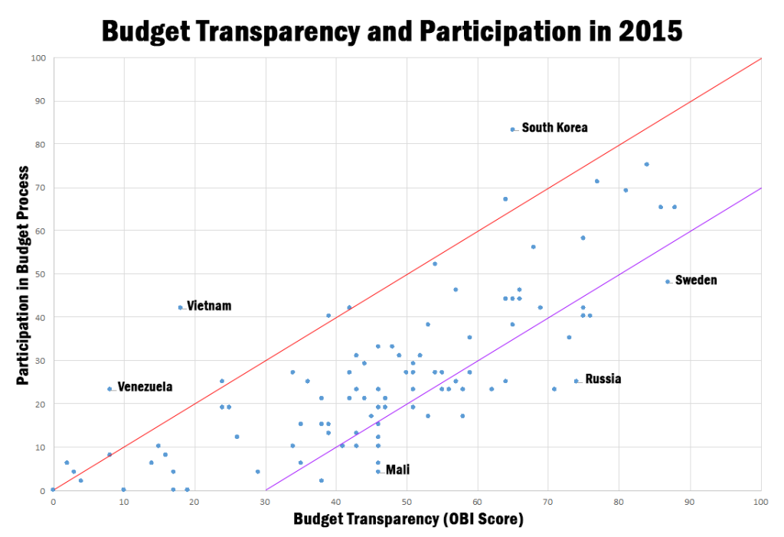
Findings from the OBS 2015 on Public Participation
Transparency is positively correlated with participation, but a participation gap exists.

Slide 7
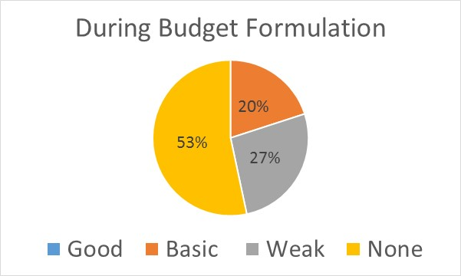
Findings from the OBS 2015 on Public Participation
Opportunities for Public Participation with the Executive

Slide 8
Revising the OBS Indicators on Public Participation
A growing consensus has emerged that public participation is an essential component of a well-functioning, accountable budget system
GIFT’s pioneering work on principles for public participation now serve as a basis for widely accepted norms around what public participation and gives guidance on what should be measured, offering a good moment to revise the OBS indicators on public participation

Slide 9
Indicator 1
Does the executive use participation mechanisms through which the public can provide input during the formulation of the annual budget (prior to the budget being tabled in parliament)?
Yes, the executive uses open participation mechanisms through which members of the public and government officials exchange views on the budget.
Yes, the executive uses open participation mechanisms through which members of the public provide their inputs on the budget.
Yes, the executive uses participation mechanisms during the budget formulation phase, but either these mechanisms capture only some ad-hoc views, or the executive invites specific individuals or groups for budget discussions (participation is not, in practice, opened to everyone).
The requirements for a “c” response or above are not met.

Slide 10
Indicator 2
With regard to the mechanism identified in question 1, does the executive take concrete steps to include vulnerable and under-represented parts of the population in the formulation of the annual budget?
Yes, the executive takes concrete steps to include individuals and/or CSOs representing vulnerable and underrepresented parts of the population in the formulation of the annual budget.
The requirements for an “a” response are not met.

Slide 11
Indicator 3
During the budget formulation stage, which of the following key topics does the executive’s engagement with citizens cover?
For the purpose of this question, key topics are considered to be:
(1) Macroeconomic projections; (2) Revenue forecasts, policies, and administration; (3) Social spending policies; (4) Deficit and debt levels; (5) Public investment projects; (6) Public services
The executive’s engagement with citizens covers all six topics
The executive’s engagement with citizens covers at most five of the above-mentioned topics
The executive’s engagement with citizens cover at most four of the five topics
The requirements for a “c” response or above are not met.

Slide 12
Indicator 7
Do the participation mechanisms identified in the questions above cover portions of the budget related to policies/programs that are intended to benefit directly the country’s most vulnerable and socially excluded parts of the population?
During both budget formulation and implementation phases, participation mechanisms cover expenditures related to all major programs intended to benefit directly the country’s most vulnerable and socially excluded parts of the population.
During either budget formulation or budget implementation, participation mechanisms cover expenditures related to all major programs intended to benefit directly the country’s most vulnerable and socially excluded parts of the population.
During the budget formulation and/or implementation phases, participation mechanisms focus on expenditures intended to benefit directly the country’s most vulnerable and socially excluded parts of the population, but they do not cover all major programs.
The requirements for a “c” response or above are not met.

Slide 13
Indicator 8
When the executive engages with the public, does it provide comprehensive prior information on the process of the engagement, so that the public can participate in an informed manner?
Comprehensive information must include at least three of the following elements: (1) Purpose; (2) Scope; (3) Constraints; (4) Intended outcomes; (5) Process and timeline
Comprehensive information is provided in a timely manner prior to citizens engagement in both budget formulation and implementation phases
Comprehensive information is provided in a timely manner prior to citizens engagement only prior to one of the two phases (formulation OR implementation)
Information is provided in a timely manner in both or one of the two phases, but it is not comprehensive.
The requirements for a “c” response or above are not met.

Slide 14
Indicator 9
Does the executive provide the public with feedback on how citizens’ inputs have been used into the formulation of the annual budget?
Yes, the executive provides a written record which includes both the list of the inputs received and a detailed report of how the inputs were incorporated into the annual budget.
Yes, the executive provides a written record which includes both the list of inputs received and a summary of the how the inputs were incorporated into the annual budget.
Yes, the executive provides a written record which includes either the list of the inputs received or a report or summary on how they were used.
The requirements for a “c” response or above are not met.

Slide 15
Indicator 11
Are participation mechanisms incorporated into the timetable for formulating the Executive’s Budget Proposal?
Yes, the executive incorporates participation into its timetable for formulating the Executive’s Budget Proposal and the timetable is available to the public.
The requirements for an “a” response are not met.

Slide 16
Some Issues for Discussion
Does this assessment seem appropriate?
Are our expectations realistic?
Are we missing any indicators?

Slide 17
Thank you!
For more information, please contact:
agarg@internationalbudget.org
info@internationalbudget.org
And visit: www.internationalbudget.org
International Budget Partnership
820 First Street NE
Washington DC 20002
Tel: +1 202 408 1080

