Slide 1
SPENDING REVIEWS
Presentation of Survey Results
for OECD Countries
OECD SBO CESEE meeting, 24 June 2021
Axel Mathot, OECD Secretariat

Slide 2
Presentation Overview
SR Evolution and objectives
Institutionalization of SR
Organizational structures
Coverage and scope of SR
SR impact
Challenges
Concluding remarks

Slide 3
1. SR Evolution and objectives

Slide 4
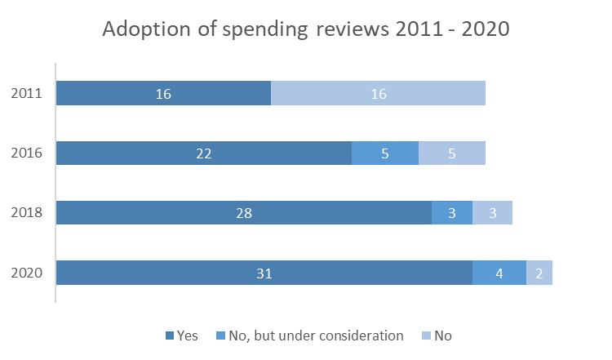
1. The evolution of SR in OECD countries
The number of OECD countries conducting SRs has increased over the past decade

Slide 5
1. Main objectives of SR in OECD countries
Control of the level of total expenditures has been an important objective since the beginning
Improving effectiveness became a more important objective over the years
This can change again due to the Covid-19 crisis - too early to say, but…
Over 70% of OECD countries state SR will become more important as a consequence of the COVID-19 crisis

Slide 6
2. SR INSTITUTIONALIZATION

Slide 7
2. Institutionalisation of SRs: legal and methodological basis in OECD countries
A majority of OECD countries rely on provisions in the basic/organic budget, subsidiary legislation or ministerial orders as a legal basis
Over 2/3 of the OECD countries implementing SR have standing methodologies or guidelines on SR
# of Countries

Slide 8
3. SR ORGANIZATIONAL STRUCTURE

Slide 9
3. Key actors in the SR process in OECD countries
Government
Gives political commitment
External experts
May participate in the review
Ministry of Finance
Line Ministries
Parliament
Cooperate with the Ministry of Finance
Takes the initiative to start the review in cooperation with line ministries
Takes the review findings into account when approving the budget
Coordinates the review process
Participate in the review
Implement the SR results
Cooperate with the Ministry of Finance
Approves the main elements of the review

Slide 10
3. Organisational arrangements of SR: actors responsible for decision-making in OECD countries
# of Countries
In most OECD countries, the Cabinet and a set of leading ministers play the most active roles in decision-making in the SR process
In some countries, the Minister of Finance autonomously decides on crucial decisions
In other countries, the Steering Group or Spending Review Unit make these decisions

Slide 11
3. Organisational arrangements of SR: technical level in OECD countries
20 countries have Steering / Working groups
Steering group involves mostly high level officials
Working group mostly organised around MoF and LM (7 including experts)

Slide 12
4. SR COVERAGE AND SCOPE

Slide 13
4. Scope of SRs: different sizes of SRs in OECD countries
% of OECD countries with narrow/medium/large scope of SRs in indicated year
# of Spending Reviews in OECD countries
More or less equal shares in large, medium and small SR
Large SRs became relatively less important
Number of spending reviews have been relatively stable over the last 5 years

Slide 14
5. SR IMPACT

Slide 15
5. How do SR results feed back into the budget process in OECD countries?
In a majority of OECD countries, SR results are considered and closely linked with the budget process
In most cases, direct linkages are mostly for selective cases only
# of Countries

Slide 16
5. SR impact (self-assessment) in OECD countries
# of Countries

Slide 17
6. SR Challenges

Slide 18
6. Challenges in OECD countries

Slide 19
7. CONCLUDING REMARKS

Slide 20
Key potential issues of interest going forward
SRs have been widely introduced and practiced in OECD countries but still growing in importance in PEMPAL countries
SRs are a flexible tool where the main objectives can vary according to necessities
Options exist for developing standing legal and methodological bases, while also ensuring flexibility
There is a need to balance roles of civil servants and political level in SR organizational arrangement
Advantages exist in creating an SR Unit with options for its composition and responsibilities
The SR process should be closely aligned with the regular budget process
Assessment mechanisms for SR impact should be fostered, ensuring that SR objectives are met, including reallocation stemming from alignment to government priorities
Use of performance information in SRs is important

Slide 21
Thank you ! Axel.mathot@oecd.org

