Slide 1
Open Budget Survey 2019:
Developments in Public Participation and Paths Forward

Slide 2
The enduring case for open budgets
Budgets are key to the actual implementation of a government’s stated policies, particularly for underserved communities.
States are responding to the COVID outbreak and its economic fallout with unprecedented fiscal decisions.
During crises as well as in periods of stability, open budgets are crucial: they support more efficient resource allocation, improve service delivery, and contribute to better governance.
Especially during a crisis, transparency, public engagement, and strong oversight are critical for earning public trust.

Slide 3
The Open Budget Survey
Measures three aspects of open budgets:
transparency of how public resources are raised and spent,
opportunities for participation in budget policy decisions, and
oversight by independent legislatures and audit institutions.

Slide 4
PEMPAL members evaluated in OBS 2019
Albania
Azerbaijan
Bosnia and Herzegovina
Bulgaria
Croatia
Czech Republic
Georgia
Hungary
Kazakhstan
Kyrgyz Republic
Moldova
North Macedonia
Romania
Russia
Serbia
Tajikistan
Turkey
Ukraine

Slide 5
Despite gains, current levels of transparency remain limited (global / PEMPAL)
45 / 54
Average budget transparency score
74% / 61%
Percent of countries that fail to provide sufficient levels of budget information.
1 in 3 / 1 in 6
Key budget documents are not made available to the public.

Slide 6
Measuring levels of public participation
The OBS assesses public participation on the basis of GIFT’s Principles of Public Participation in Fiscal Policies.
Researchers evaluate the formal participation opportunities available to individuals and organizations to directly engage with their country’s executive, legislative, and audit institutions during the budget process.
Scores are calculated via a simple average of 18 questions covering seven different mechanisms in three government bodies.

Slide 7
Room for innovation
Few countries currently provide meaningful opportunities for the public to participate in the budget process, which undermines the public’s ability to effectively use budget information. However, emerging and innovative practices in some countries – among them, PEMPAL members – demonstrate how governments can initiate and strengthen public engagement mechanisms.

Slide 8
2019 public participation scores: PEMPAL members

Slide 9
Participation mechanisms are most common during budget formulation and approval

Slide 10
Participation findings across PEMPAL members Echoing the global trend, more opportunities are available during formulation & approval than execution

Slide 11
A majority of survey countries have no more than two mechanisms

Slide 12
Similarly, 10 of 18 evaluated PEMPAL members provide 2 mechanisms or fewer

Slide 13
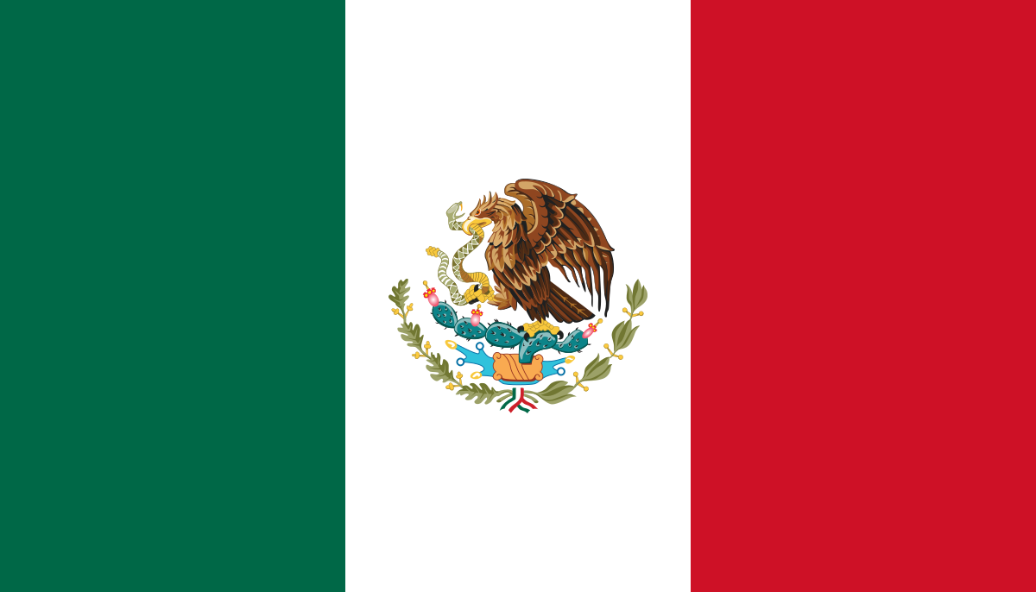
Public participation in the budget process takes many different forms across a diverse set of countries
In the Kyrgyz Republic, the Ministry of Finance publishes materials in advance of open public hearings.
In Mexico, the government established a mechanism called Social Comptrollers: social programs are monitored by committees of beneficiaries.
Pre-Budget hearings are held by New Zealand’s Parliament, which solicits written submissions and oral testimony from members of the public.
In Ukraine, a ‘public expertise’ mechanism within the Ministry of Economy & Trade allows members of civil society to provide feedback to, and exchange views with, ministry officials.

Slide 14
Recommendations for future improvements in public participation
Continue to institutionalize newly-introduced mechanisms to avoid volatility and regression.
Focus on implementing more opportunities to participate in the legislature’s review of the Audit Report, and to contribute to investigations by the SAI.
Make greater outreach efforts to include vulnerable and/or under-represented members of the public (e.g. individuals living in poverty, and religious or ethnic minorities).
Continue to document new and innovative practices emerging from the ECA region through tools such as the BLTWG knowledge product.

Slide 15
Considerations on the BLTWG knowledge product
Compared to the revisions made to the participation section of the OBS from 2015-2017, the questions included in the 2019 Survey are essentially unchanged from 2017, and remain based on GIFT principles; references in the KP to OBS participation methodology can therefore remain as-is.
For the first time since the introduction of the current participation questions in OBS 2017, two countries provide adequate (>61/100) opportunities for participation throughout the budget cycle: South Korea and the United Kingdom.
PEMPAL members outperform the global average on transparency, but have much room for improvement on public participation, particularly in providing more opportunities to under-represented populations, covering more topics during engagement with citizens, and providing feedback on how the public’s input has been used.

Slide 16
A new Call to Action
Within the next five years, we call on governments to:
Provide sufficient levels of budget transparency (achieve a score of 61 and above)
Increase public participation in the budget (achieve a score of 41 and above)
Strengthen monitoring and oversight of budget execution
Sustain and institutionalize improvements in open budgeting

Slide 17
Thank you!
We look forward to your questions during the Q&A session.

