Slide 1
World Bank Public Expenditure Reviews
Ivor Beazley
Paris, November 6, 2019
PEMPAL BUDGET COP

Slide 2
Presentation Outline
PER basics, objectives, types etc.
Scope and focus areas – macro, sectors, themes
Process and analytical methods
Good practices and limitations
Comparison with Spending Reviews in OECD.

Slide 3
PER Basics
PER is a core WB diagnostic tool whose purpose is to evaluate the effectiveness of public finances and inform future government spending decisions.
PER analyzes government expenditures over a period of years to assess consistency with policy priorities and the results achieved.
PER is a highly flexible tool which responds to the government concerns and priorities in respect of both public spending and revenues.

Slide 4
Core areas typically covered by PER
Macro-fiscal Framework
Sector Spending
Institutions for Public Expenditure Management
Impact – Growth, Poverty, Equity
Efficiency
Effectiveness

Slide 5
PER Use across regions
The ECA region appeared to be the largest host of fiscally centered reports, while EAP delivered more than half of the total sector reviews (mainly for Indonesia).
Within the sector selection, the lion's share of the reports were attributed to social sectors
education or/and health care (38%)
followed by social protection (30%) and agriculture (20%)
Breakdown of PERs by region and sector

Slide 6
PER process and methods
Government – WB Dialogue
Scope definition
Data sharing and analysis of options
Report recommendations
Implementation

Slide 7
Programmatic PER - Belarus
PER 1, 2011. Fiscal reform options across 3 priority areas of the budget
A sustainable pension system
Better targeted social assistance
Rationalization of energy and agricultural subsidies.
PER 2, 2013. Reforms to enhance the quality of key public services in a fiscally constrained environment
Intergovernmental fiscal relations
Spending in the education and health sectors

Slide 8
Programmatic PER - Tajikistan
2013 Tajikistan PPER
Government Expenditures: Size, Composition and Trends,
Health expenditures
Education expenditures
2014 Tajikistan PPER
Key Issues in Public Finance Management
Fiscal Risks from State-Owned Enterprises
Capital Expenditures
Public Investment Management.

Slide 9
PER Indicative Costs

Slide 10
PER focus: Macro-fiscal issues
Macroeconomic trends and context
Analysis of fiscal stance (revenue, debt, expenditures)
Analysis of fiscal risks
Review of fiscal rules
Areas to increase or decrease spending in order to boost growth and reduce inequality.

Slide 11
Example: Armenia 2013
Fiscally focused PER incorporating fiscal policy review, covering both revenue and expenditures, including recommendations on:
increasing government spending overall and higher taxation
reforming the tax regime for the mining sector,
changes in customs regime (e.g. presumptive to ad-valorem)
reform of SME taxation.
tax administration reforms, including risk based audit of corporate tax returns
measures to improve efficiency and effectiveness of spending on health and education
increased spending on infrastructure

Slide 12
Armenia: public expenditure

Slide 13
Sector focus
Economic sectors - stand alone PER or part of multi-sector PER
Focus on spending efficiency, effectiveness with a focus on poverty and equity in service provision
Recommendations mostly relate to changes in policy, operations, and strategic shifts in resource allocation, rather than quantification of changes in allocations
Example: Moldova Education PER (2018)

Slide 14
Moldova: Education PER (2018)
Examples of recommendations:
Reform the financing mechanisms for vocational and higher education, to increase transparency
Introduce per capita based financing for pre-school education
Move the mandate for pre-school provision from municipalities to raions
Review HRM processes to address bottlenecks in recruitment, retention, and performance.

Slide 15
Institutional frameworks
Budget institutions and PFM reform
Public investment management
Revenue administration
Debt management
Control of quasi-fiscal activities and contingent liabilities
Inter-governmental fiscal relations and decentralization

Slide 16
PER focus: Poverty and inequality
Incidence analysis of public spending (esp. education and health), often combined with analysis of private expenditures (e.g. in health and education)
Incidence analysis of taxes
Geographical equity i.e. comparing budget per capita across local government, rural/urban
Access to and affordability of basic services (e.g. education and health, power and water)
Analysis of efficiency/effectiveness of social transfer programs and consumer subsidies
Gender aspects of inequality

Slide 17
Poverty and inequality: Belarus

Slide 18
Analytical Methods - examples
Benchmarking of costs, spending, efficiency and effectiveness
Regression analysis using budget and survey data
Computable General Equilibrium (CGE) models, assess the impact of fiscal reforms on growth, poverty, inequality.
Data envelope analysis (DEA), e.g. to assess efficiency of education spending in relation to educational outcomes data
Public expenditure tracking surveys (PETS)

Slide 19
Example: Benchmarking of healthcare provision in Belarus

Slide 20
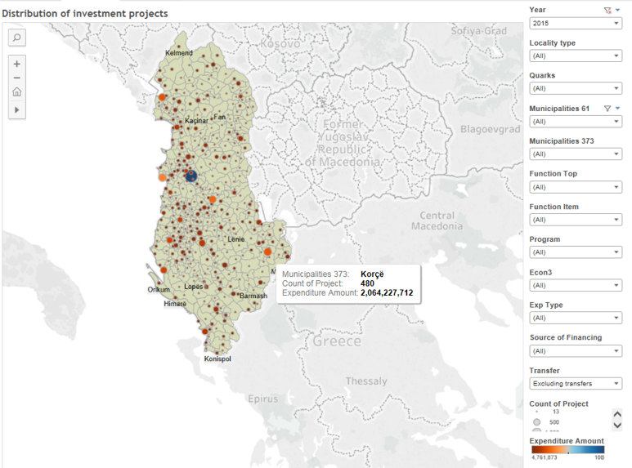
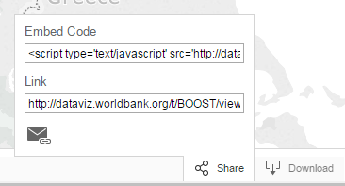
Example: Variation in investment projects across Albania
The current visualization takes the entire population of investment projects (~15’000) and displays it on the country map following the exact GEO location of sub-national jurisdiction
Break this information by sectors, sub-sectors, programs, etc…
Share your budget stories …
Source: Albania GEO-BOOST government expenditure database.

Slide 21
Example: Use of regression analysis in education (Moldova)

Slide 22
Example: DEA Analysis of social protection spending in Georgia

Slide 23
Integration of poverty and budget data analysis
Interesting findings often come from integration of budget data and household survey data.
Show effects of policy and spending changes on inequality:
E.g. Georgia, poverty reduction effects of public pension
E.g. Uruguay, 13: impact of social spending on inequality (Gini) and poverty (Headcount Ratio)
Jordan, 13: Distributional Impact of electricity tariff and consumer subsidy reforms

Slide 24
Integration with business survey data
Integrate budget data and private sector survey data:
Belarus: Effectiveness of state support to agriculture - effects of subsidies on firms’ performance/productivity
Armenia: regression analysis of the data on the largest taxpayers to estimate unevenness in VAT compliance
Azerbaijan: Impact of subsidies to farmers on productivity in agriculture

Slide 25
Other innovative/advanced technique for expenditure efficiency
Use of Geographical Information System (GIS) for analysis of school location, which then was utilized to assess efficiency of educational investments
Rasch analysis technique to assess impact of School Based Management implementation
Estimates of economic return of public expenditures, NPV-based in agriculture (rural roads, irrigation, and extension)
Regression analysis to estimate the economy of scale in public spending (across local governments) e.g. Belarus (2013)

Slide 26
Assessment of fiscal impact
Scenario analysis: modelling policy options
Fiscal impact of specific government reform proposals
E.g. Serbia 2015
Armenia, 2012: assessing fiscal impact of the new gov’s pay initiatives

Slide 27
Serbia 2015 PER: estimated fiscal impact of PER recommendations

Slide 28
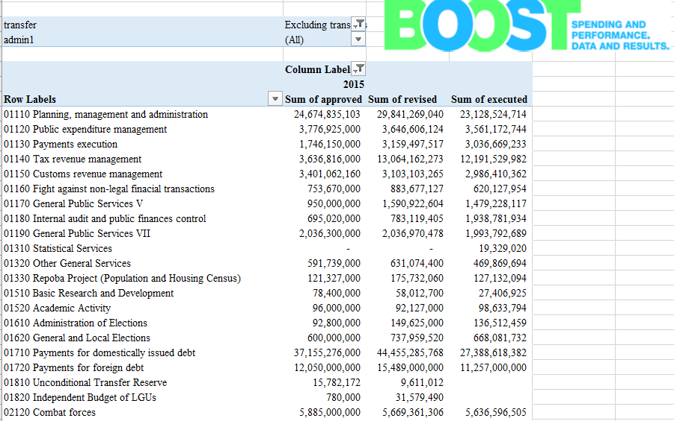
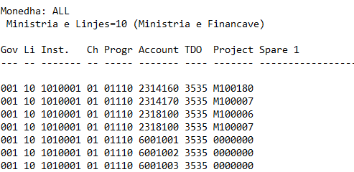
BOOST - Tool for expenditure analysis
A typical BOOST is a repository of public expenditure/revenue data at the most detailed level of disaggregation available in the country’s Treasury System
The BOOST framework draws on a line-item budget representation and exhausts all budgeting dimension as envisaged in the CoAs/national budget classification
BOOST operates through a PivotTable interface that permits practitioners to easily manipulate large amounts of data for high-quality multi-dimensional public expenditure analysis
As a result, technical and non-technical experts are empowered to make evidence-based decisions that ultimately promote transparency and openness in development..
Input Treasury Data
Process
Resulting BOOST interface

Slide 29
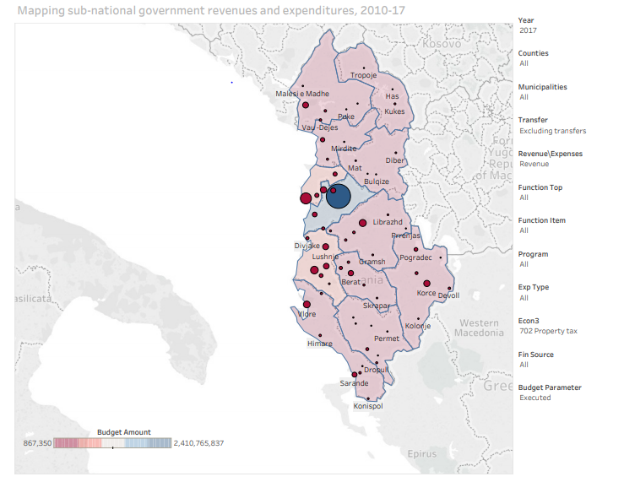
GEO-BOOST Platform in Action: How does your municipality fair in terms of property tax collections?
Property tax collections averaged ~24% in overall locally derived own source revenue of municipalities, according to 2017 revenue budget execution data via BOOST.
3 out 61 municipalities accounted for more than 50% of the overall property tax collections.
With the municipality of Tirana being responsible for 42.22% of all property tax collections.

Slide 30
Comparing SRs and PERs - Objectives
 | Improve expenditure efficiency | Economy - short term budget cuts | Policy and operational improvements | Realign spending with government priorities
WB PER
OECD Spending Review

Slide 31
Comparing SR and PERs - Scope
 | Comprehensive – all sectors | Sectors | Macro fiscal | Budget institutions and processes | Efficiency | Effectiveness | Economy | Poverty and equity impact
PER
SR

Slide 32
Trends in good practice
Poverty/inequality focus using data integration
Programmatic approach - context driven focus,
Coverage of both national and subnational government,
Focus on variability in spending and performance across local governments,
Geo-spatial comparisons, and benchmarking
Use of BOOST for rapid analysis

Slide 33
Typical limitations
Availability of good survey data – e.g. household data – to support analysis of spending efficiency and effectiveness
Implementation of recommendations depends on government (may inform DPO triggers).
Political economy – incentives and obstacles to change.
Timeliness in relation to the budget decision making process.

