Slide 1

Public Investment Management: Trends and Challenges in PEMPAL Countries
This Photo by Unknown Author is licensed under CC BY-NC-SA
Iryna Shcherbyna
Public Sector Specialist, World Bank - Governance

Slide 2
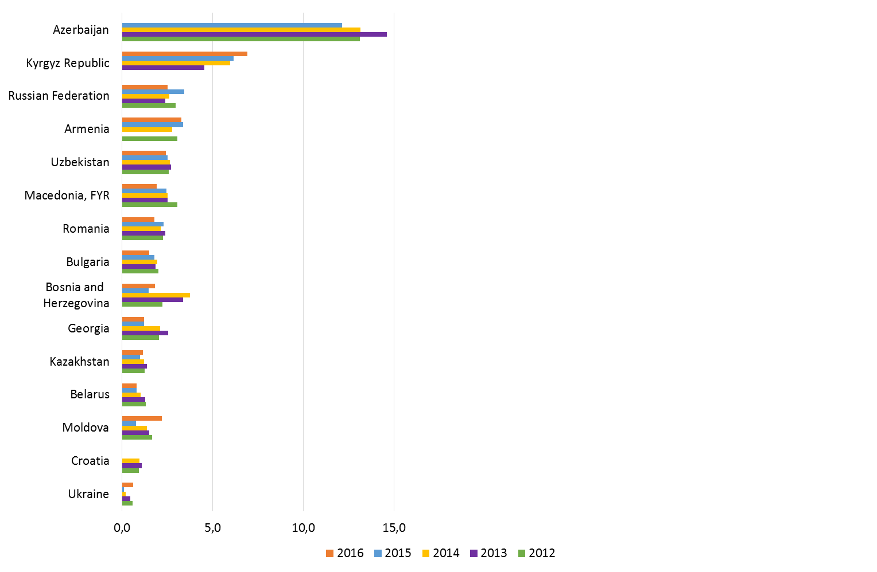
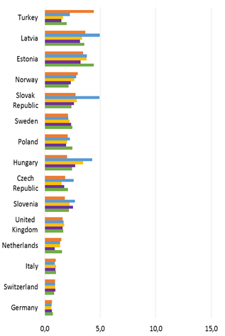

THE POWER OF INVESTMENT POLICY BASICALLY IS SIMILAR ACROSS COUNTRIES
Net investment in nonfinancial assets (% of GDP)
in PEMPAL countries
in EU area countries
Source: World Development Indicators

Slide 3
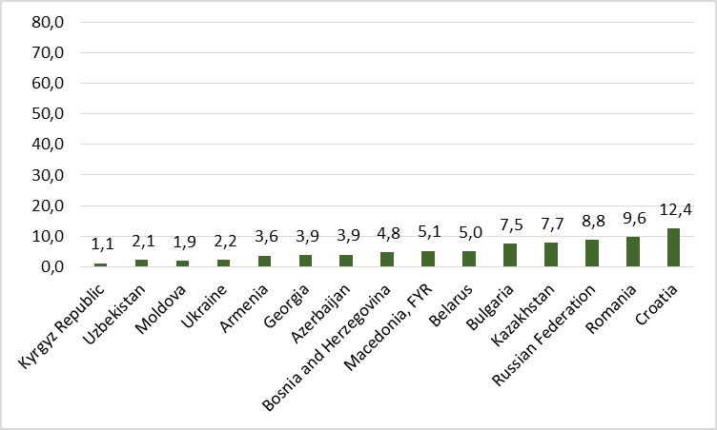
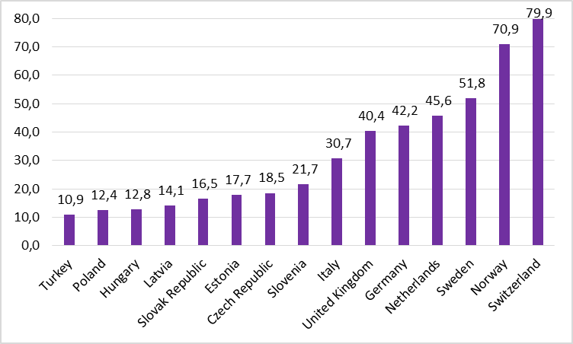
BUT THE POWER to produce GDP IS DIFFERENT ACROSS COUNTRIES
GDP per capita (thousands of dollars) in 2016
in PEMPAL countries
in EU area countries
Source: World Development Indicators

Slide 4
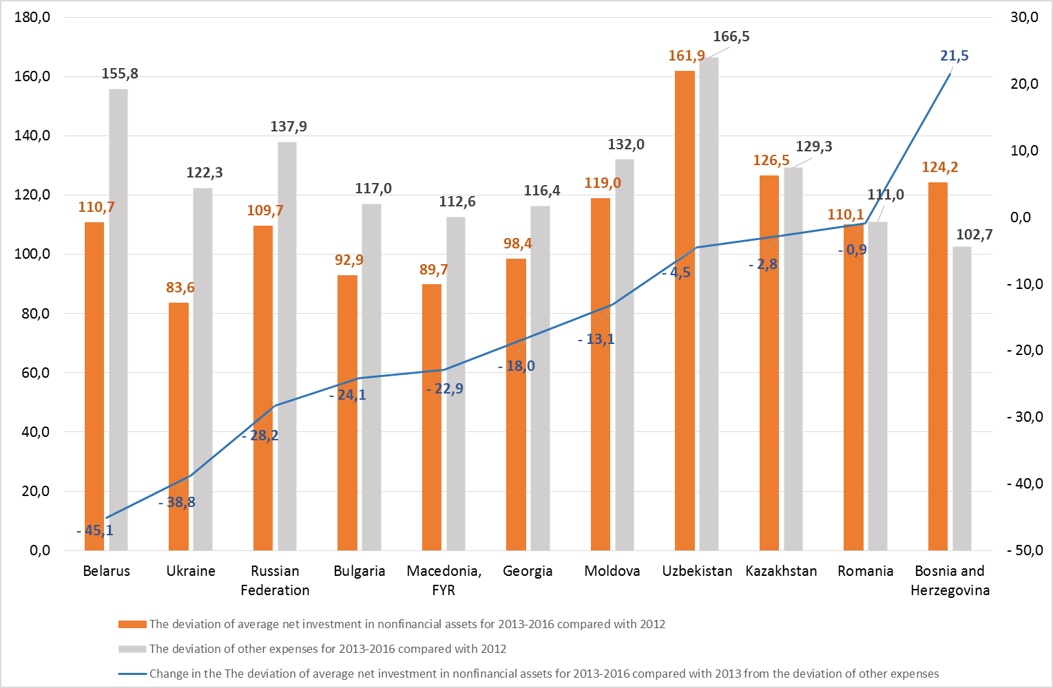
In general, investment changed insignificantly over 2012-2016, while other expenses increased more.
The deviation of average net investment in nonfinancial assets and other expenses for 2013-2016 compared to 2012 (%)
Source: WB World Development Indicators

Slide 5
The argument to increase public investment spending is often weakened by evidence of its low efficiency in a number of dimensions, including the following
Political influence in project selection, often leading to wasteful “white elephant” projects with little economic or social value.
Delays in design and completion of projects.
Corrupt procurement practices.
Cost overruns.
Incomplete projects.
Poor quality of completed infrastructure.
Failure to effectively operate and maintain assets.

Slide 6
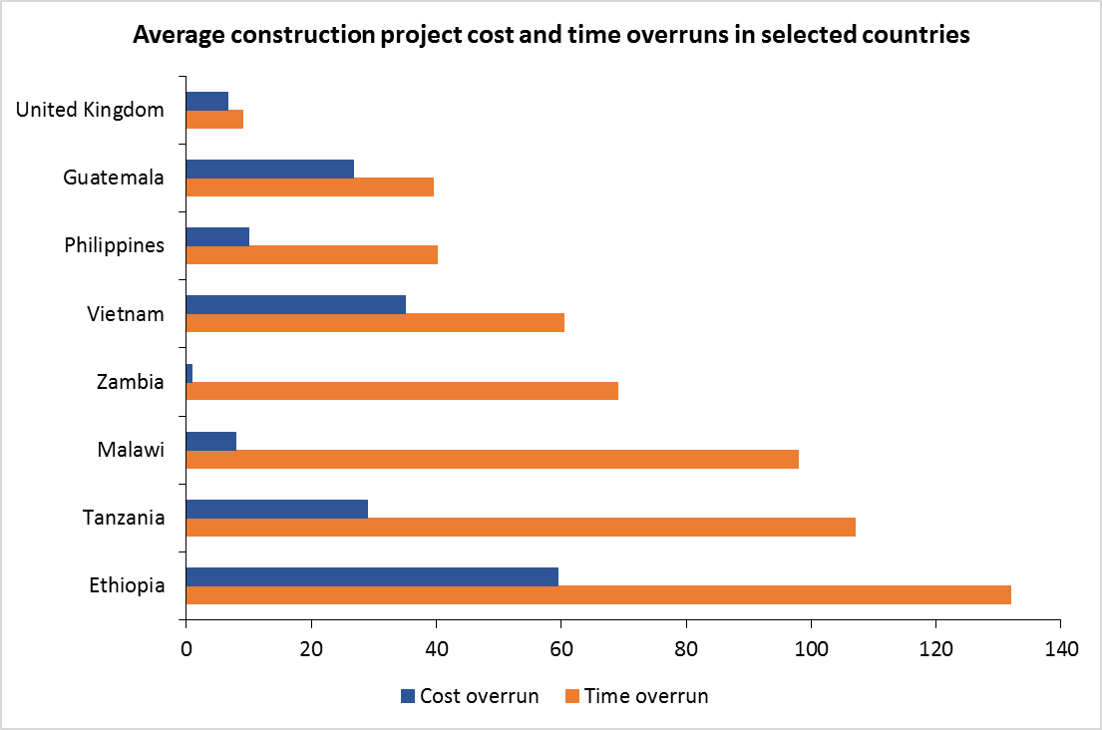
an advanced modern economy can better ensure value for money by minimizing the cost and time overruns more effectively than the typical developing country
Source: CoST 2011.

Slide 7
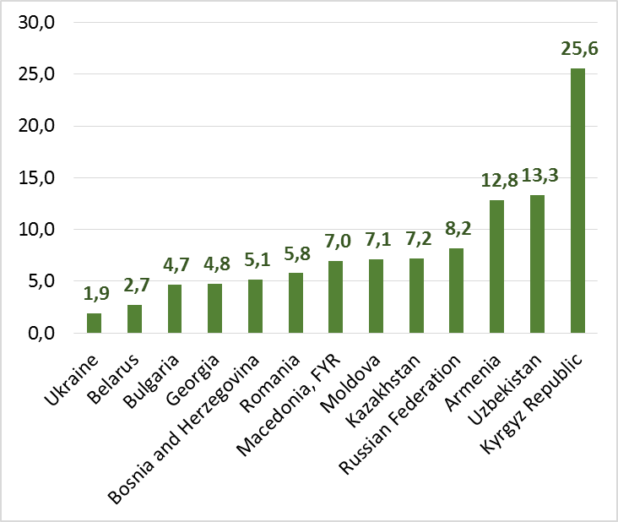
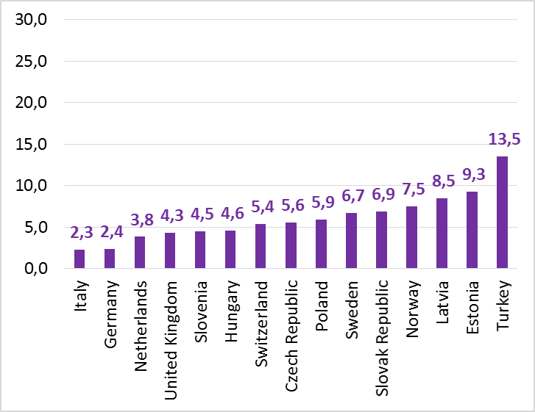
Development countries with the good PIM invest effectively less part of all expenses
Share of Net investment in nonfinancial assets in Expense (%) in 2016
in PEMPAL countries (average 8,2%)
in EU area countries (average 6,1%)
Source: World Development Indicators

Slide 8
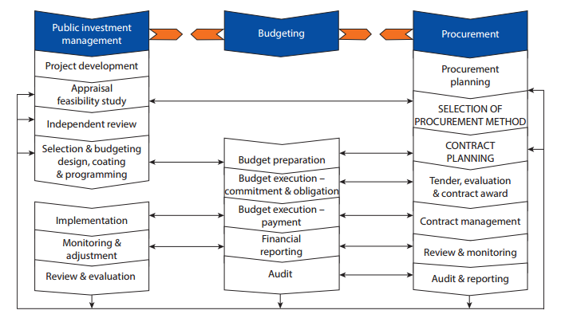
Well managed each of following stages and linkages could lower costs and speed up project implementation
PIM system linkages
Source: Adapted from Biletska and Fozzard 2012.

Slide 9
For all participants, The definition is important step to establish common rules.
Is there terminology in the existing legislation which separately identified capital expenditures and public investments?
Which type of budget classifications reflects capital expenditures and public investments?
Country | Terminology in the existing legislation for |  | Type of budget classifications reflects capital expenditures and public investments
 | Capital expenditures | Public investments | Economic | Program
Armenia | No | No | no answer
Belarus | Yes | No | x | Partially
Bosna i Hercegovina | Yes | Yes | x | x
Croatia | Yes | Yes | x | x
Georgia | Yes | No | x | x
Kazakhstan | Yes | Yes | x | x
Kosovo | No | No | x | x
Macedonia | No | No | x | Partially
Moldova | Yes | Yes | x | x
Montenegro | Yes | Yes | x | x
Russia | Yes | No | x | -
Serbia | No | No | x | x

Slide 10
PIM Legal Framework
Which law has a primary role for public investment management?
Country | Organic Law on Public finances | Organic Law on investments | There is no legislation | Other
Armenia | x
Belarus | x | x |  | x
BiH |  |  |  | x
Croatia | x | x |  | x
Georgia | x |  |  | x
Kazakhstan | x
Kosovo | x
Macedonia |  |  |  | x
Moldova | x
Montenegro | x
Russia |  |  |  | x
Serbia |  |  | x
Total | 8 | 2 | 1 | 6
Decrees of the President of the Republic of Belarus that approve the government investment program
There is no single legislation which regulates public investment management, but there are separate laws that regulates different areas of public investments (roads, railways, etc)
Federal Law of February 25, 1999 No. 39-FZ "On Investment Activity in the Russian Federation Pursued in the Form of Capital Investments"
Notes:
PIM is effective if a law that regulates the general provisions of the budget process also has a primary role for PIM

Slide 11
Institutional Framework
Ministry/agency is responsible for the decision-making in following areas:
 | Review and analyzing of public investment project proposals | Assessment of possible fiscal risks | Assessment of the potential contribution of investments to development | Selection of projects for financing | Regular monitoring of project implementation | Regular monitoring of public investment project implementation | Evaluation of completed projects | Maintaining a unified data about all public investment projects
Ministry of Finance | BIH, GEO, KOSOVO, MDA, MNE, SRB | BIH, GEO, KOSOVO, MDA, MNE, SRB | BIH, KOSOVO | GEO, KAZ, KOSOVO, MDA | BLR, BIH, KAZ, KOSOVO | KAZ, KOSOVO |  | BIH, GEO, KOSOVO
Ministry of Economy (or Planning) | BLR, KAZ, RUS | BLR, KAZ, RUS | BLR, KAZ, RUS | BLR, RUS | RUS | BLR, RUS | BLR, RUS | BLR, KAZ, RUS
Ministry/State Agency of Regional Development
Line ministries | ARM | ARM, MCD | ARM, GEO, KAZ, MCD, MDA, MNE, SRB | ARM | ARM, GEO, MDA, MNE, SRB | ARM, GEO, MCD, MDA | ARM, GEO, KOSOVO, MCD, MDA, MNE, SRB
Accounting Chamber (State Audit Institution) |  |  |  |  |  |  | KAZ
Other | HRV, MCD | HRV | HRV | BIH, HRV, GEO, MCD, MNE, SRB | HRV, MCD | BIH, HRV, MNE, SRB | BIH, HRV | HRV, MDA, MNE, SRB

Slide 12
The Sustainable Investment Strategy is key to the effective public investments within limited Funds.
Country | A clear and authoritative statement of public investment priorities at national and regional levels? |  | A clear mandatory request to reflect the national development goals in subnational (regional) investment plans?
 | Yes/No | Yes. Please explain: | Yes/No | Yes. Please explain:
Armenia | No |  | No
Belarus | Yes | Provision of quality and affordable housing in the course of implementing the Government Program “Housing Construction” for 2016-2020 | No
BiH | No |  | No
Bulgaria | Yes | Medium-term budget forecast | Yes | The regional development plans contain goals which are reflected in subnational investment plans.
Croatia | No |  | Yes | Plan documents of the regional development policy include the Regional Development Strategy of the Republic of Croatia, the county development strategy, i.e. the development strategy of the City of Zagreb and the urban development strategy
Georgia | Yes | Government Strategy clearly defines Infrastructure as key priority for the Government | Yes | Government Program Priorities are used as umbrella for any strategy and plan
Kazakhstan | Yes | Government programs, national-level sectoral programs. Subnational-level territorial development programs | Yes | Goals of the Kazakhstan Development Strategy are aligned with government programs objectives. The programs goals must be cascaded down
Kosovo | Yes | Yes, government priority | Yes | Yes, government priority
Macedonia | No |  | No
Moldova | No |  | No
Montenegro | Yes | A Priority List of Projects has been defined. | Yes | Projects are eligible to compete if they are in accordance with the Development Plan adopted by the Government and/or the Assembly
Russia | Yes | Action Plan on accelerating the growth rate of investments in fixed assets and increasing their share in GDP to 25% | No
Serbia | No |  | Yes | Strategic relevance is one of the basic criteria for selecting capital projects.
Notes:
Availability of a clear and authoritative statement of public investment priorities at national and regional levels and a clear mandatory request to reflect the national development goals in subnational (regional) investment plan

Slide 13
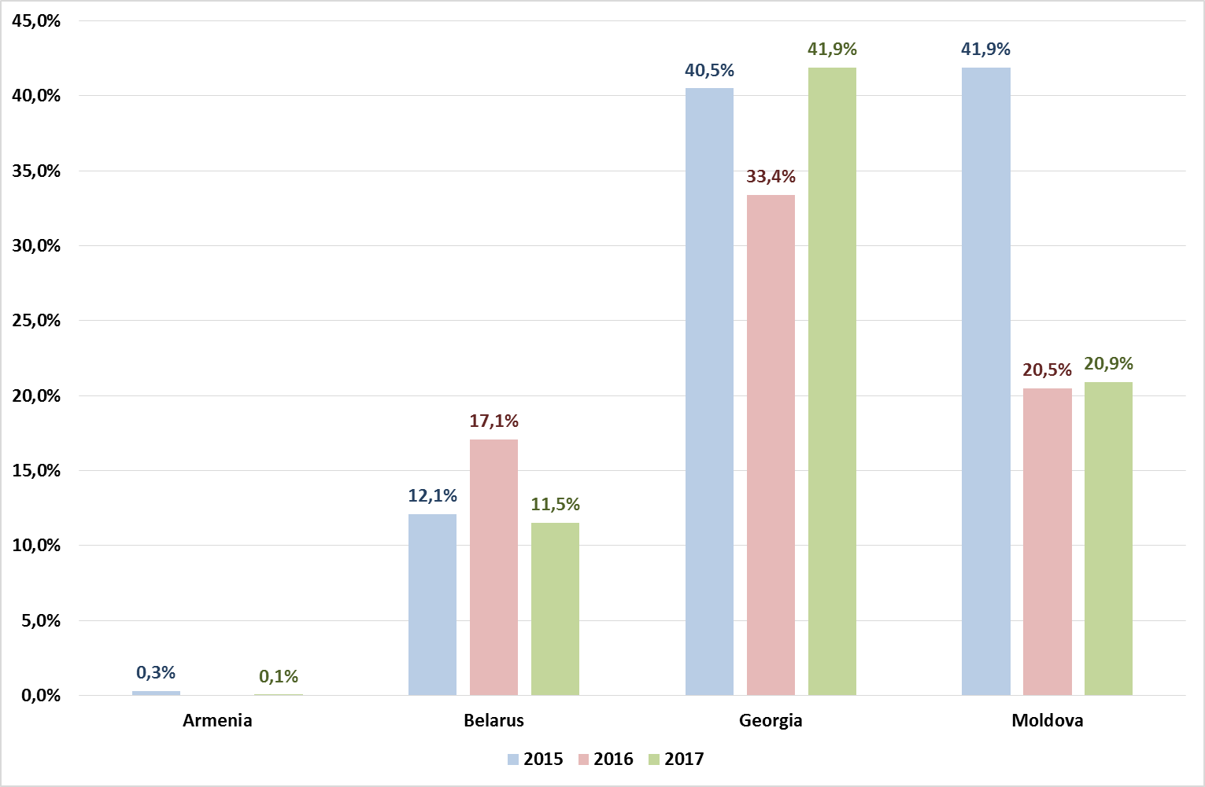
clear RULES are needed To regulate inter-budgetary capital transfers.
Is there a formula-based approach or clearly and legally established criteria to calculate capital inter-budgetary transfers?
Share of inter-budgetary capital transfers in total capital expenditures of subnational budgets in 2015-2017
Armenia | No
Belarus | No
BiH | No
Croatia | No
Georgia | Yes
Kazakhstan | Yes
Kosovo | No
Macedonia | No
Moldova | No
Montenegro | No
Russia | No
Serbia | No

Slide 14
Public Investment will be improved through the Improved Transparency.
The budgetary information regarding public investments that is available publicly to stakeholders at all levels of government in a timely and user-friendly format
Country | Yes/No
Belarus | Yes | On a quarterly basis the Ministry of Finance publishes budget execution information on its website; information on budget capital expenditures can be found there as well.
BiH | No
Croatia | Yes | Investments are planned in a special section of the budget, and the budget is published in the Official Gazette and online.
Georgia | Yes | Capital Budget Annex of the State budget is a publicly available document; Investment projects of local governments are public as part of the budget; All the investment projects implemented by the Municipalities through capital transfers of central government is decided by Government decrees and they are public.
Kazakhstan | Yes | Articles 153-154 of the Budget Code. Article 67-1 “Citizens’ Budget” of the Budget Code
Kosovo | Yes | Budget low with tables are published every year in the web of MoF
Macedonia | No
Moldova | Yes | The IT system is in place and every budget authority/institution have access to the needed information, according to its role in the budget process. More than, there is a reporting system in place and every budget beneficiary has to present implementation reports according to the time frame set. The list of capital investments projects is an annex to the annual budget law
Montenegro | No
Russia | No
Serbia | Yes | Information in the Budget Act

Slide 15
The key challenges in planning and executing capital expenditures, including public investments
Key challenges | Belarus | Bosnia and Hercegovina | Georgia | Kazakhstan | Kosovo | Macedonia | Moldova | Montenegro | Russia | Serbia
Related to selection criteria, evaluation, preparation, and prioritization of capital projects | * | * |  |  |  | * |  |  |  | *
IT support |  | * | * |  |  | * |  | *
Methodology support | * | * | * |  |  | * |  | *
Lack of clear definition of the Public investments (capital investments, capital expenditures) |  | * |  |  |  |  | *
Capacity of institutions |  |  | *
Achieving direct and ultimate outcomes vis-a-vis budget resources allocated to quasi-public sector entities |  |  |  | *
Weak planning for the budget execution, key point procurement procedures |  |  |  |  | *
Complex administrative procedures |  |  |  |  |  |  |  |  | *
Institutionalization |  |  |  |  |  |  | *
Ad-hoc decisions of investment projects makes it a very time consuming exercise |  |  | *
Need for full scale training for large number of stakeholders |  |  | *
Notes:
Methodology for each phase of pim and it support the main challenges

Slide 16

SOME Key decisions TO BE TAKEN FOR CREATE GOOD pim
Interagency coordination processes;
No (reduce) the political considerations on the promoting projects;
Annual and medium term budget management capacity and consistency of the PIM with the budget process;
Acquisition and resettlement issues, environmental safeguards, and complex procurement challenges.

Slide 17

Thank you
Questions?
Please refer to:
Iryna Shcherbyna (WB, Governance)
ishcherbyna@worldbank.org
Maya Gusarova (WB, Governance)
mgusarova@worldbank.org

