Slide 1

  PEMPAL – Facilitating Practical Solutions in PFM across ECA
Maya Gusarova, Sr. Public Sector Specialist, BCOP Resource Team Coordinator, World Bank

Slide 2
WHAT IS PEMPAL?
Public Expenditure Management Peer Assisted Learning network
PEMPAL aims to promote and facilitate:
efficient and effective use of public monies resulting from applying good PFM practices
through supporting a peer learning and knowledge exchange platform for practitioners to connect within three ‘Communities of Practice’ of budget, treasury and internal audit.

Slide 3
WHAT ARE WE AIMING TO ACHIEVE?
PEMPAL Strategy 2017-2022
Outcome: A well functioning professional peer learning platform through which public finance practitioners from the member countries are networked to strengthen their capacities and to enable them to create and share knowledge and benchmarking.
DEPTH AND RELEVANCE
QUALITY
IMPACT
Result 1: PFM reform priorities of member countries in the functional areas of budget, treasury and internal audit/internal control, including cross-functional priorities, are addressed by the network platform.
Result 3: PEMPAL is a viable network which is supported by committed PFM professionals, member countries, and a range of development partners, who see the value and benefit in the network as a tool to improve member country PFM performance.
Result 2: High quality and relevant network services and resources are developed and delivered to support the PFM practices and reform needs of members.

Slide 4
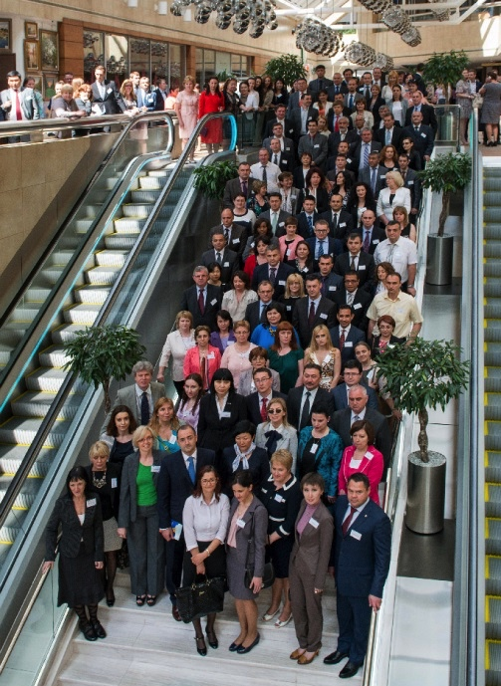
WHO ARE PEMPAL?
Target practitioners: Middle level managers and technical specialists
from Ministries of Finance/Treasuries and central coordinating agencies
in the Europe and Central Asia region

Slide 5

PEMPAL DEVELOPMENT TRENDS
2006-2011 COPs are established, but function around events only with
inconsistent membership and absence of Strategy
2011-2012 Development of PEMPAL Strategy 2012-2017
2012-2017 COPs activities are guided by PEMPAL Strategy 2012-2017
2017-2022 COPs activities are guided by PEMPAL Strategy 2017-2022
Note: High participation in 2014 is due to a large meeting that brought all three COPs together. PEMPAL only has such meetings periodically.

Slide 6
PEMPAL INSTITUTIONAL STRUCTURE
STEERING COMMITTEE
–
STRATEGIC OVERSIGHT AND DIRECTION
BCOP Resource Team
-
T
COP Resource Team
BCOP
TCOP
-
COP facilitation
+
COP facilitat
i
o
n
led by
led by
+
technical content support
8 Exec Comm
8 Exec Comm
technical
content support
WB
members
22 ECA
members
WB
member
countrie
s
s
IACOP
led by 8
Executive Committee
members
IACOP Resource Team
COP facilitation + technical content support
WB
SECRETARIAT
-
LOGISTICAL AND ADMINISTRATIVE SUPPORT
Secretariat support is provided by the World Bank

Slide 7
IMPORTANT DESIGN ELEMENTS
Agreed strategy and results framework
Member driven action plans – linked to country priorities
Strong governance structure
Monitoring, reporting and evaluation framework - annual and quarterly reports, post-event surveys, periodic in-depth evaluations
Support for work program implementation - technical donor funded resource teams (PFM experts)
Support for logistical and administrative needs - Secretariat
Language barrier removed- three official languages – expert translation team
Knowledge managed – website, wiki, reports, products, minutes

Slide 8
TYPES OF COP ACTIVITIES
Full COP plenary meetings (1-2 per year)
Small thematic group meetings (face-to-face)
Study visits
Small group thematic projects (e.g., IA manual development)
COP surveys (web based, using survey monkey)
VCs and web meetings (thematic)
Executive Committee meetings in different formats (face-to-face, audio, video, web)
Virtual communication through web based forum (wiki page )

Slide 9
PFM AREAS OF FOCUS - LAST 7 YEARS
Information technology solutions in Treasury systems
Integrated budget classification and chart of accounts
Cash management
International accounting standards and reporting
Capital budgeting
Program budgeting
Budget reporting formats
Monitoring & evaluation of PFM systems
Developing role and function of internal audit
Training and development of internal auditors
Fiscal rules
Fiscal risks
Interbudgetary fiscal relations
Budget transparency and literacy

Slide 10
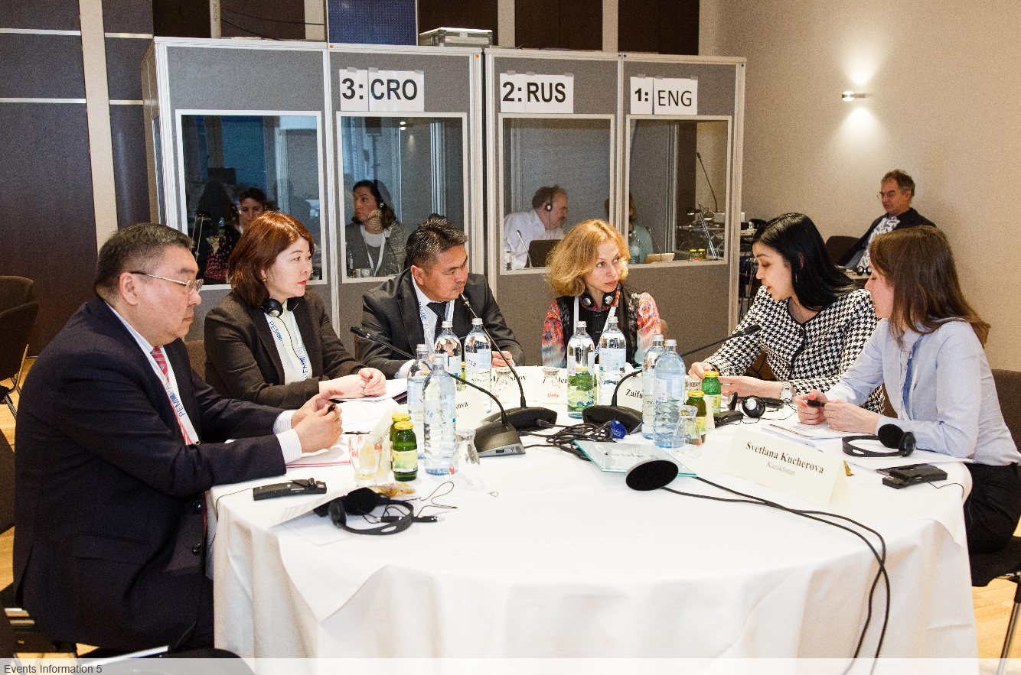
BUDGET COMMUNITY OF PRACTICE

Slide 11
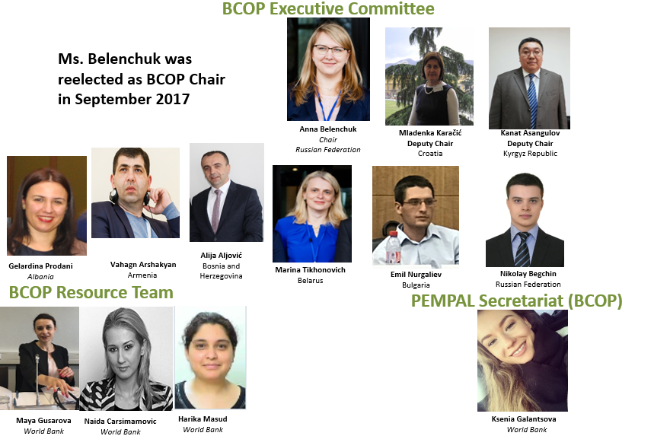
BCOP LEADERSHIP AND MANGEMENT

Slide 12
BCOP SUCCESS FACTORS
Sub-working groups meet regularly via videoconference to address common reform issues. Annual meeting to update all members. Share common problems and discuss solutions together.
A strong member country Executive Committee and technical resource team drive process.
Annual plenary meeting gathers all members once a year since 2012.
‘Knowledge products’ are identified or developed to assist in reforms.
  Identification of member country challenges and solutions through peer/international advice (e.g. Breaking Challenges in Citizen Budget, Public Participation in Budget Process)
  benchmarking studies to ascertain status of reforms to facilitate discussions and measure progress (including joint work with OECD on budget related surveys);
  translations of available government guidelines and international advice (eg laws, budget documents, studies).

Slide 13

EVOLUTION OF PEER LEARNING IN RECENT YEARS
From meetings only between PEMPAL countries to joining the annual OECD SBO meeting for CESEE region on regular basis
From short discussions during plenary meetings to working groups on concrete challenges of each PEMPAL country with international experts
From study visit reports and the results of surveys organized by the resource team to development of a specific knowledge products by the participants themselves
One way of further evolution is inviting PEMPAL countries into inside country dialogues:
  Moscow Finance Forum (Moscow, September 2018);
  International Conference "Open Budget: Public Policy and Ideology on civic engagement“ (Moscow, spring 2017).

Slide 14
BCOP IMPACT ON REFORMS

Slide 16
THANK YOU
Questions?
Maya Gusarova, Coordinator of BCOP Resource Team
mgusarova@worldbank.org
Ksenia Galantsova, PEMPAL Secretariat
kgalantsova@worldbank.org
www.pempal.org

