Slide 1
Draft OECD Best Practices for Performance Budgeting
PEMPAL
Vienna, March 2018

Slide 2
Performance budgeting definitions
Performance budgeting can be defined as the process of linking budget allocation and reporting to the achievement of results
OECD identifies 4 types of performance budgeting:
  Presentational PB
  Performance informed budgeting
  Managerial performance budgeting
  Direct/formula based PB
Notes:
Presentational approach
Performance information is presented with budgeting documents or other government documents but is included as background information for
the purposes of accountability and dialogue with legislators and citizens on public policy issues and government direction. Performance information does not play a
significant role in decision making on allocations nor is it intended to do so.
Performance-Informed approach.
Performance information plays a role in spending decisions; however, resources are related either to proposed future performance or to performance results in an indirect manner. There is no automatic linkage between performance and funding levels. The weight given to performance information depends on
particular circumstances.
Managerial Performance Approach - Using the system of performance information developed in the context of the budget process primarily as a tool of performance
management and accountability at an organisational and management level, rather than primarily as a tool of resource allocation.
Direct performance budgeting - There are explicit links between budget allocations to units of performance (e.g. outputs). Funding is directly based on results achieved.
Appropriations can thus be based on a formula/contract with specific performance or activity indicators.

Slide 3
Big picture
Notes:
Widespread adoption amongst OECD countries, Decades of accumulated experience and research
Accelerating trend towards PB in MICs and LICs
OECD Performance and Results Network

Slide 4

Persistence despite disappointment
Notes:
The story is generally one of early problems with the design, leading to difficulties in implementation and a fair amount of disappointment with the early results of the reforms – at least as compared with the original expectations,
But, in almost all cases, countries have remained convinced by the logic of linking budget more closely to performance through:
Adopting a Program structure
Identifying program objectives
Using performance indicators to measure performance
Over time they have revised their approaches and tried to improve them. Even so, we have found no examples of countries that believe they have got the process exactly right.

Slide 5
Best Practices - Objectives
Distil experience using research evidence and case studies
Offer advice and options to countries updating their approaches, or newly adopting PB.
Notes:
Looking backwards – to distill OECD’s countries’ experience of PB implementation
Looking forwards – to offer advice and options to countries reworking their approaches, or starting from scratch

Slide 6
1. Defining Clear Objectives for the Performance Budgeting Systems
.
The rationale, objectives and approach to performance budgeting are set out in the organic budget law, in other regulations or in an official code of budgetary practice.
The role and interests of important stakeholders in the policy cycle – including the centre of government, the legislature, the central budget authority, line ministries and the supreme audit institution – are reflected in the design of the performance budgeting system.
The approach and scope of the performance budgeting system are adapted to national circumstances and practical constraints including staff skills, the availability of performance data and the stage of development of the performance culture in government.
Notes:
The chances of implementing an effective performance budgeting system are increased if the government is ;
clear about the rationale for introducing the reform,
establishes a clear set of objectives and
takes account of implementation constraints.
Because performance budgeting is a malleable concept, it is important that policymakers take the time to define their goals and expectations. And the interests of different stakeholders are taken into account
The government’s intentions can be given force through a separate law, an amendment to the organic budget law regulations or a budget code .
Examples include: Frances LOLF, United States GPRMA, Austria’s organic budget Law and constitutional amendments.
You also need to work out what it’s realistic to achieve over what timescales, given constraints. Analytical skills, availability of quality performance data and above all the time and effort required to change mind-sets are often critical constraints.

Slide 7
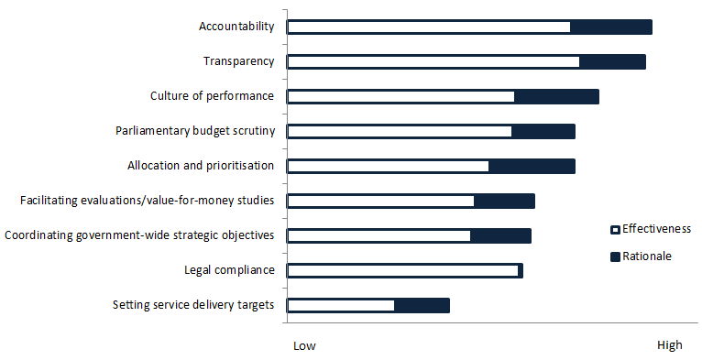
Ranking of Different Rationales for Introducing Performance Budgeting and Their Effectiveness in Practice
Notes:
Looking at the OECD survey data it’s clear that PB has generally proved more useful as a tool for increasing accountability and transparency, including parliamentary scrutiny. IT has also helped to introduce a performance culture.
It has generally proved less useful as a tool for budget allocation and prioritisation, and for setting specific targets for service delivery.

Slide 8
2. Linking the Performance Budget to the Strategic Goals of Government
Performance budgets are closely aligned to national performance frameworks, including strategic policy goals, developmental plans and sector strategies.
Medium term expenditure frameworks provide realistic parameters within which strategic plans are prepared, resourced and implemented.
Evidence based analysis of spending is used in conjunction with performance budgeting to improve the alignment of resources with policy priorities.
The centre of government works closely with the central budget authority to monitor adherence to priority policy goals, to coordinate actions across government agencies and to address constraints.
Notes:
A commonly reason for introducing PB is to strengthen the alignment between the budget and the government’s policy priorities. These may be expressed in government election pledges, set out in national development plans or developed in policies and strategies.
In practice few OECD countries have a comprehensive national performance framework and PB often exposes lack of clarity in respect of priorities, overlapping or inconsistent plans, and poorly formulated indicators and targets.
To make the performance budgeting system work effectively, government’s often need to improve the quality of planning and the links between planning and budgeting ( e.g fully costed development plans ). Example UK Single Departmental Plans.
The MTEF process should relate expenditure allocations to policy priorities and form the basis for strategic re-allocation of resources. The MTEF may therefore be seen as the first stage of the performance budgeting process.
Evidence based analysis spending includes ex-ante policy analysis (e.g RIA), spending reviews and ex-post evaluations.
Strong central guidance helps ministries make the right links between national and sector strategies and the performance budget. Without top down, central strategic direction, performance budgets will tend to reflect the ongoing activities of government departments rather than government’s strategic policy priorities.

Slide 9
3. Adapting Performance Budgeting to the Complex, Varying Needs of Policy-making
The performance budgeting methodology includes in-built flexibility to handle the varied nature of government business, and to recognise the differing relationships between inputs and outcomes.
Programme structures are aligned with the service delivery functions and responsibilities of ministries and agencies.
Complex, persistent and multi-dimensional social problems (so-called “wicked” issues) are addressed through coordination mechanisms and high level government support.
Control frameworks are revised and adapted to support effective budget execution.
Notes:
Performance budgeting methodology needs to incorporate flexibility to deal with the varied and complex relationships between financial resources and performance.
Where government is directly responsible for delivering public services, e.g. issuing passports or constructing roads, it makes sense to link budget resources closely (if not directly) to the achievement of specific outcomes.
Where government’s role is more indirect, for example as a regulator or policy maker, the relationship between budget funding and the outcomes of government policy is indirect and clear attribution problems arise if you try to link funding closely to success or failure to achieve policy outcomes.
Performance budgeting works better when program are aligned with service delivery functions and responsibilities of ministries and agencies, rather than outcomes that are complex and cross cutting goals.. These are best addressed through coordination mechanisms which highlights the need for top level leadership and coordination.
Programmatic classification does not mean that governments need to abandon the traditional economic, administrative and functional classifications. However classification may need to be simplified to retaining or increase flexibility in budget execution.

Slide 10
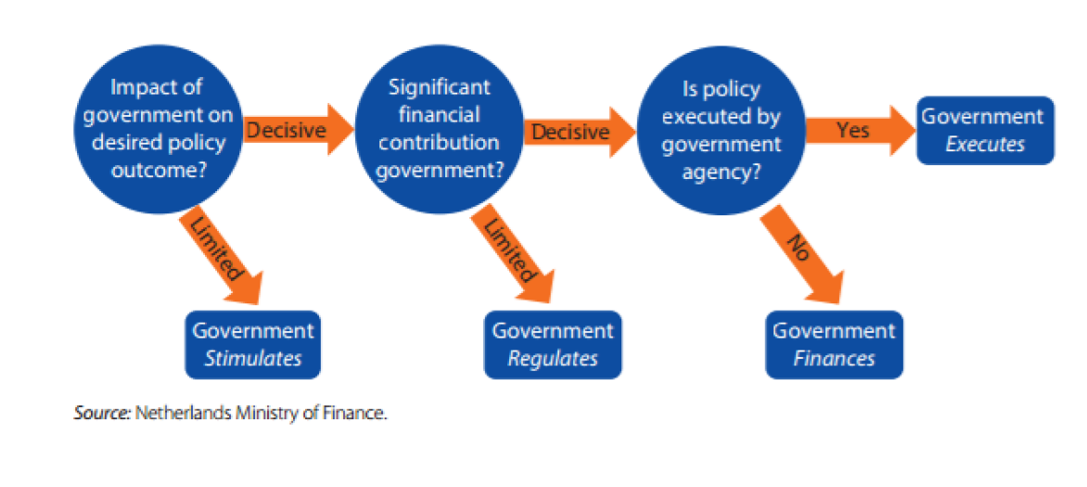
Analysing Relationships between Budget and Performance
Notes:
Netherlands has developed an interesting approach categorizing programs on the basis of the role of the government and the relationship between inputs and outcomes.

Slide 11

Avoiding system overload
Notes:
A common complaint is that performance budgeting systems are too complex. Creating and architecture of thousands of programs and performance indicators absorbs so much time and energy that the main goal is lost sight of. PB can easily turn into just another bureaucratic routine – at worst and additional set of forms that have to be filled out.
WHAT ARE THE BEST IDEAS FOR AVOIDING THIS FATE
Priority Goals - USA (GPRMA) limited number of Agency Priority Goals
Regular structured discussions to review financial and operational performance through the year. (USA GPRMA)
CBA manages the number of programs and performance indicators to manage data volumes. (France and other countries have progressively simplified their systems)
Reporting system (ICT) filters and channel information to meet the needs of different users. (e.g. dashboards for policy makers/senior officials) - more detailed info for program managers
Subsidiary systems to manage complex programs (e.g. health or transport infrastructure), interface with the PB system. Need investment in ICT, changes in SNA and National Statistics

Slide 12
4. Managing Performance Information
The Central Budget Authority guides the production and use of performance information, promoting quality over quantity.
Performance indicators, milestones and targets are consistent with those identified in national policy and strategy documents.
Ministries use outcome and output indicators, together with other indicators that are useful in measuring progress towards achieving policy objectives.
Performance indicators facilitate comparison between similar entities, within the same country or internationally, whenever practical and consistent with government policy objectives.
The SAI has a role in reviewing and validating the achievement of performance targets, and in assessing the quality of performance frameworks more broadly, including programme-logic models and indicators.
Notes:
CBA has an important role to play in guiding the selection and use of performance indicators, encouraging selectivity and quality, rather than allowing for the proliferation of indicators.
The quality of performance information also depends on its relevance for policy and decision making purposes. Therefore, an important quality dimension of performance information, is the ability to track the priorities of government.
Experience shows that outcome indicators may not always be the best measure of performance . The emphasis needs to be on utility.
Public disclosure of performance information can have a powerful motivating effect. When it enables comparisons to be made between regions, countries, ministries etc. this creates peer pressure, and competition to improve performance.

Slide 13
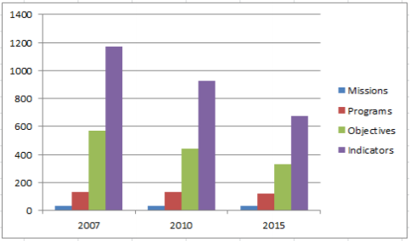
France: Progressive Simplification

Slide 14
5. Creating the Infrastructure Needed to Support Performance Budgeting
Performance budgeting is supported by a core team of specialists, within each ministry and in the central budget authority.
The performance budgeting methodology is supported by detailed guidelines and training of budget analysts.
Financial management information systems integrate non-financial performance data to generate reports that meet the varied needs of different users.
The oversight role and capabilities of the legislature and the supreme audit institution are sufficiently developed in respect of performance budgeting.
Notes:
5th set of best practices relates to the challenge of putting in place the capacity and infrastructure needed to operate a PB system.
Evidence shows that Governments have often underestimated the level of investment required to bring about the change, (even a flat budget).
What’s seems to be needed
Set up a central support unit, to serve as a centre of advice and expertise. CBA is normally the place to put this – supporting other line ministries.
Often needs a re-skilling of staff.
Information systems are a critical tool to manage the volumes of data and support analysis of performance.
To play their oversight role effectively legislators, the secretariats that support parliamentary committees, and the supreme audit institution also need to acquire new knowledge and skills

Slide 15
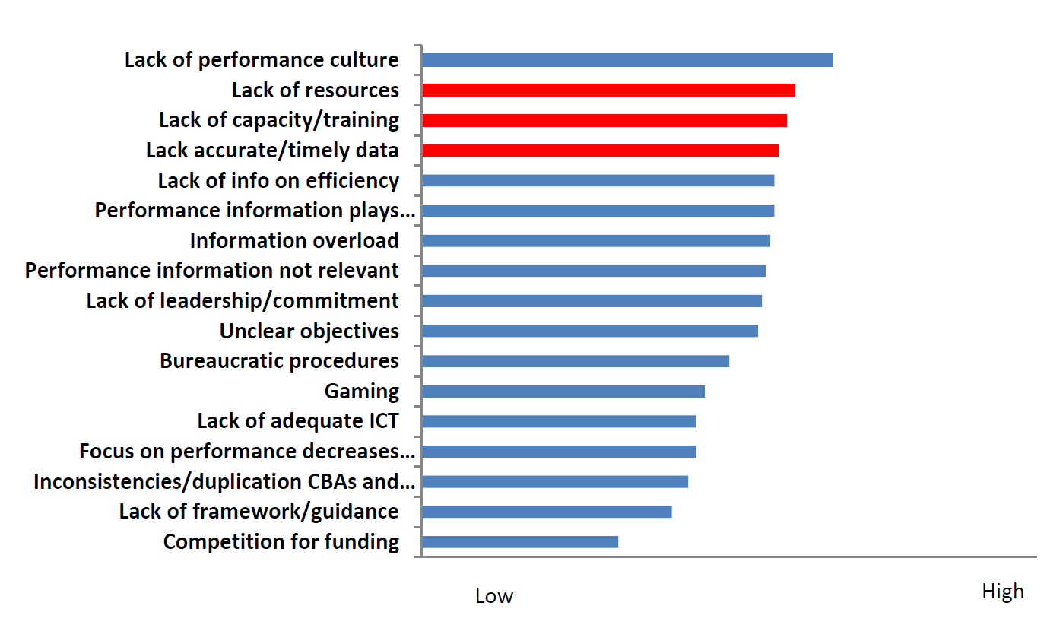
Ranking of Constraints
Notes:
This chart ranks the main constraints, as experienced by OECD countries.
Lack of a performance culture is the No.1 obstacle, followed by resources, training and data.

Slide 16
6. Ensuring Systematic Evaluation and Oversight of Performance
Senior management within line ministries, and programme managers, organize structured discussions to review financial and operational performance regularly throughout the year.
Evaluations of the performance of all major spending programmes are carried out on a rolling basis and the findings are considered as part of the budget preparation process.
Performance targets set out in the annual budget are the subject of corresponding annual reporting on performance.
The supreme audit institution carries out performance audits of important or high risk programmes and tests the relevance, accuracy and reliability of performance data.
The budget and accounts committees of the legislature regularly reviews performance based budget statements and annual performance reports.
Committees overseeing the activities of sector ministries conduct public hearings based on performance reports provided by government and performance audit reports and hold ministers and senior public managers accountable in the event of poor performance or misrepresentation.
Notes:
8th area of best practices looks at the processes of evaluation and oversight
In most OECD countries the feedback loop is a weak element in current practices , patchy evaluation, unclear responsibilities , lack of interest from legislators
Responsibility for evaluating performance is typically split across different agencies
Evaluations are on a separate timeline to the annual budget process, complicating the link,
The roles of the SAI and the parliament are generally under-developed in respect of PB.
What seem to be best practices?
Evaluation of all major spending programs covering policy, program design and implementation aspects
Combined technical and financial expertise
SAI role, especially in validating perforrmance data .

Slide 17
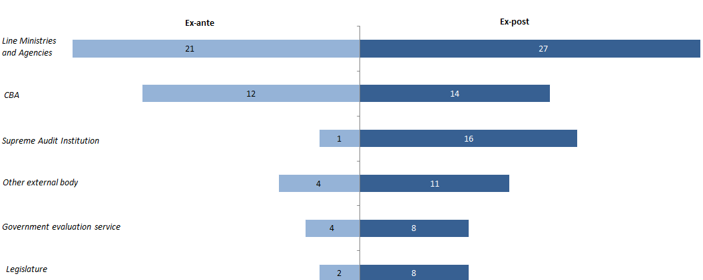
Program Evaluation - Actors

Slide 18
7. Incentivizing Performance-oriented Behaviour and Learning
Identified individuals and teams are responsible and accountable for the achievement of performance goals.
Responses to programme performance emphasise recognition of successes, learning and problem solving in respect of under-achievement, rather than automatic financial rewards or budget cuts.
The centre of government promotes a broader performance management culture that supports performance budgeting.
Notes:
The 7th area of good practices addresses the issue of using performance budgeting to change behaviour and introduce more performance orientation.
It is also important to acknowledge that responses to under-performance are almost universally weak. (see next slide) so there is a lot to be done
Evidence from OECD country case studies shows that countries with experience of performance budgeting, don’t attempts to directly link performance to increases or cuts in the budget or to individual rewards and sanctions.
They rely only “soft” (management) tools to motivate individuals and teams to be more performance oriented. Approaches that seem to be more effective include:
GO TO SLIDE BULLETS
Identified individuals
Emphasis on learning and problem solving
Role for centre of government in promoting performance oriented behaviour (
Individual and team recognition of performance
Interest from sectoral committees in performance budget reports

Slide 19
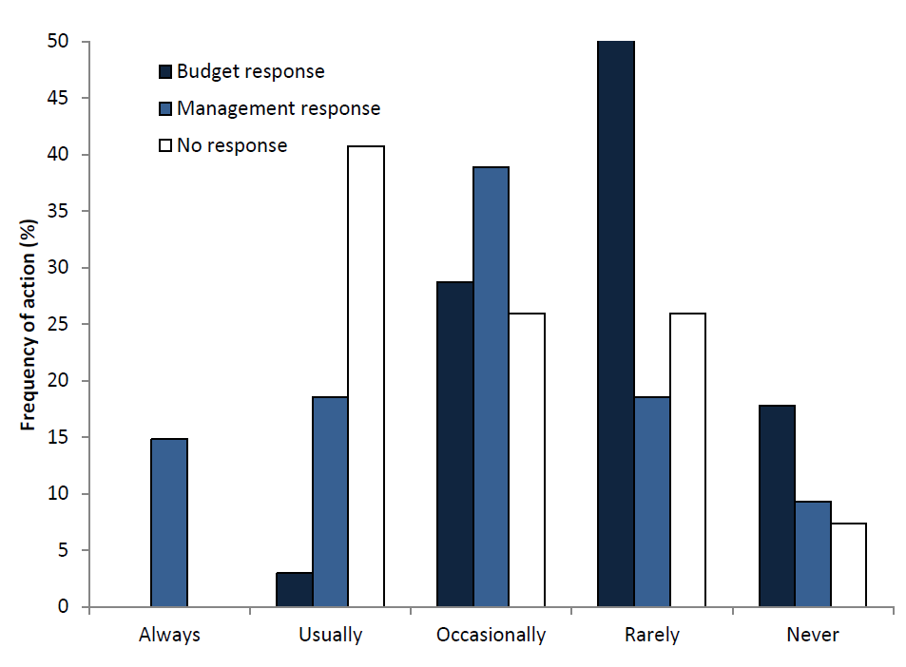
Responses to Under-performance
Notes:
This chart shows that the most common response to under-performance is “no response”. Where government’s do respond the predominate response is managerial. Budgetary responses are comparatively rare.

Slide 20
Thank you
Contact ivor.beazley@oecd.org

