Slide 1

Performance Management and Impact Assessments
at the federal level of government in Austria
Roland Schneider
Vienna, March 13th 2018

Slide 2
Federal Ministry for the Civil Service and Sport
Established January 8th, 2018
DG III “Civil Service and Administrative Innovation” mission is to ensure up-to-date HR management and development for federal employees, public sector innovation and performance management:
  HR Management: Drafting of laws governing the work, pension, equal treatment, employee protection, social welfare, staff representation, remuneration and service contracts of Federal employees
  HR Development: Promoting mobility (between institutions in Austria, EU, OECD, etc.) as well enhancing public sector education and skill-enhancement programs through the Federal School of Administration
  Public Sector Innovation through innovation prizes, trainings, development of new collaboration techniques
  Performance Orientation within the public sector through the “Federal Performance Management Office” with a special focus on Gender Equality
Notes:
KH
Good Morning! First of all, I have to apologize for our Director General, Angelika Flatz, who can‘t be here today. She asked me to send her apologies and welcome you here at the Federal Chancellery. My name is Klaus Hartman and I am the deputy Director-General. I will give you a very quick overview about our DG before I hand over to my colleagues from the Federal Performance Management Office, which is a part of our DG.
The Austrian Federal Chancellery basically consists of Six Directorate Generals.
We are part of DG III, which is responsible for „Civil Service and Administrative Innovation”. This includes, among other things:
HR Management for all Federal Employees
HR Development for all Federal Employees, especially through the Austrian Federal School of Administration
Public Sector Innovation and….
Performance Orientation … which will be the focus of today’s meeting

Slide 3
The Federal Performance Management Office
Part of DG III
Responsible for performance orientation in the federal budget and impact assessments
Regularly reports to Parliament about ex-post evaluations
Main mission
  Improving quality and functioning of the overall system (concept development)
  Establishing close cooperation with other stakeholders (MoF, PBO, DG Gender Equality of the Ministry of Health and Women's Affairs.)
  Visualizing of data and progress reporting for the Austrian Parliament and the public
  Coordinating horizontal dimensions (Gender Equality) with other ministries
  Pushing for openness, transparency, efficiency and effectiveness of the system
Notes:
KH
As I said, the Federal Performance Management Office is a unit in our DG. They are responsible, among other things, for the performance orientation system in the federal budget and for accompanying impact assessment scheme. The FPMO, through the State Secretary, reports to Parliament twice a year about the progress of the implementation of performance orientation. Within that system their main mission includes:
Improving quality and functioning of the overall system
Establish close cooperation with other stakeholders (MoF, PBO, DG Gender Equality of the Ministry of Health and Women's Affairs.)
Inform the Austrian Parliament and the public about progress
Coordinate horizontal dimensions (Gender Equality) with other ministries
Push for openness, transparency, efficiency and effectiveness of the system

Slide 4
The Thing About Change
DG III is involved in various change processes, from updating civil service labor laws, to modernizing HR development and implementing performance management as a guiding principle in public administration
Guiding Principles
  Focus on equal opportunities for women and men
  Keep talking and keep everybody involved
  Be transparent about the results
  Be patient, big change processes take time before they show tangible results
Notes:
KH
So you see, the main mission of this Director-General is to modernize the Austrian Federal Civil Service. From the modernization of the laws that govern how we work, to the skills we need for that work and the way we communicate our results, we are involved in various long-term change processes. And although you could lose sight of this overall mission when working on the nitty-gritty details of new proposals and implementation schemes, there are nevertheless some guiding principles that hold true for all our work:
Focus on equal opportunities for women and men
In all our work we aim at equal opportunities for women and me, from designing laws that not only make this a legal principle, but also by designing a labor code that proactively tackles this issue. In a similar way, we provide support and training programs that enables women to rise to high level positions. And finally, in performance orientation, we support all ministries in setting and measuring goals and activities to this end.
Keep talking and keep everybody involved
This also means, that we have to be constantly in touch with all stakeholders to be aware of arising issues and argue for the necessity of this modernization schemes.
Be transparent about the results
Being in touch with stakeholders also entails to be transparent about our goals and results, to be able to engage in a frank and fact-based discussion.
Be patient, big change processes take time before they show tangible results
And finally, we are aware that the big a chance processes we are engaged in, will take time. Our target group, federal employees, is a large and diverse group of over 100.000 people. We are aware that we cannot change processes and minds overnight and there is no single program that fits everybody. Nevertheless we are confident that if we keep making our case for a modern civil administration and if we systematically coordinate and organize our programs and acitivties, we can unleash substantial change.
My colleagues will now provide more details about one of these change processes, performance orientation, and explain how this ties into our overall ambition of gender equality.

Slide 5
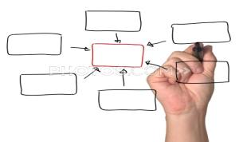




The Federal Performance Management Office
Mission
conceptual framework
consultancy & training
quality assurance
ICT planning
performance reporting
Notes:
Before we start we would like to give a short overview of the Federal Performance Management Office.
It is a unit in the Chancellery (the Chancellery is the Austrian equivalent to Cabinet Office/ Prime Minister’s department and responsible for coordinating general governmental policies)
The work of the FPMO is based on four pillars:
First of all we are responsible for the conceptual design and development of the performance management framework.
Secondly we assist line ministries and agencies in the uniform and consistent implementation of the performance management framework by means of consultancy and training
We provide quality assurance with a view to promoting the uniform quality of objectives and indicators
As of 2014 the FPMO will also be responsible for reporting performance to Parliament.
As you see now, in Austria the competencies regarding performance budgeting/management are split between the Ministry of Finance and the Federal Chancellery. The Ministry of Finance focuses on budget management issues, whereas the Chancellery is dealing with all performance aspects of the management process. As the Ministry of Finance pays its attention mainly to inputs, it can be quite useful to have another ministry or department that keeps an eye on outcomes and outputs.
14 Persons

Slide 6
Performance Management in Austria
Strategic Goals in the Medium Term Expenditure Framework
Performance Information in the Annual Budget
Impact Assessments for Policy Proposals
Outcome orientation was introduced in 2013 as a budgetary principle in the Austrian constitution
Focus: managing public administration based on its contributions towards achieving outcomes in society
Information: Outcome statements, outputs and indicators per budgeting chapter and for new regulation
Key Pillars
Performance management (outcome orientation)
Outcome oriented impact assessment
Notes:
RS
Our response to those challenges in Austria has been outcome orientation.
Now, the basic idea of outcome orientation is to manage public administration based on its contribution towards achieving certain outcomes in society – for example, related to social issues, environmental protection or gender equality.
Key pillars are the new budget framework and a new system of impact assessment:
2013, for the very first time, the budget shows the political goals and objectives aimed at, by Ministries and other public bodies.
As well as the measures and activities, indicators also show how progress will be measured.
Another key element, is a new system of impact assessment, integrating outcome orientation in the process of planning new regulations and major programs.
And finally, outcome orientation has also been laid down as a budgetary principle in our constitution. Being a fundamental, large scale reform, it came into force in two stages, in 2009 and 2013.

Slide 7
Performance management

Slide 8
Performance Information in the Budget
Strategic Goals in the Medium Term Expenditure Framework
Performance Information in the Annual Budget
Impact Assessments for Policy Proposals
Provides intended outcomes and outputs for all budget chapters
Includes indicators and milestones to assess progress
Reduced to max. five outcomes per budget chapter to focus on key issues
Ministries (and Supreme Organs) have to provide information about goals, activities and key data for their policy fields

Slide 9
Budget and performance structure
Budget structure
Performance structure
MTEF,
Strategy Report
5 headings
Annual Budget
mission, strategy, outcome statement
32 budget chapters
global budgets
output statement
Supplements to Annual Budget
performance contracts
detail budgets
Notes:
This chart illustrates how we link the budget structure with the performance structure.
The total budget is divided into five headings and the headings again are divided further into 32 budget chapters. A budget chapter corresponds with the budget of a line ministry, however there are ministries who are responsible for two or three budget chapters. Examples of budget chapters are ”Interior”, Justice”, ”Social Security”.
A budget chapter is subdivided into one to four global budgets. Global budgets are a kind of program budgets. One example is the ”Police”. At operational level we have detail budgets. These are budgets of authorities and agencies. One example is “Police department in the region x”.
Each element of the budget structure has a corresponding element on the performance side.
The left hand column shows the planning documents where resources, objectives and indicators are defined. In spring we have the MTEF and the strategy report explaining the fiscal strategy.
In autumn the draft annual budget is submitted to Parliament, containing an outcome statement per budget chapter and an output statement per global budget. The draft annual budget is accompanied by the annual budget supplement. The supplement contains a summary of the objectives set at operational level in the performance contracts.
Rubriken:
Recht und Sicherheit
Arbeit, Soziales, Gesundheit und Familie
Wirtschaft, Infrastruktur und Umwelt
Kassa / Zinsen
9

Slide 10
Outcome oriented Impact AssessmentS

Slide 11
Scope of RIA
Strategic Goals in the Medium Term Expenditure Framework
Performance Information in the Annual Budget
Impact Assessments for Policy Proposals
Impact Assessments mandatory for
  new laws and regulations and
  major projects (procurement activities, infrastructure projects…)
No exceptions, but thresholds for in-depth assessments
Key Features
  Outcomes (incl. indicators)
  Ouputs (incl. Indicators)
  Intended and unintended impacts in other policy fields
  Financial information and connection to budget
Notes:
Let me turn now to the scope of the RIA.
In Austria we have been conducting Impact Assessment for many years – financial impact assessment; impact on environment and so on. But in the past we didn´t implement it in a systematic way, we didn´t conduct quality assurance, there was no obligation to conduct internal evaluation and so on.
The new model provides a much more structured and systematic approach and also links the RIA to the outcome and output statements in the annual budget.
So the new system for RIA was introduced as a part of the budget reform. The new approach is based on the old system and has developed it further.
Since the 1st of January 2013 – one the one hand, all new laws and regulations, but on the other hand, also major projects with substantial financial impacts have to be assessed on the basis of the desired outcomes and the undesired effects.
Examples for such major projects would be procurement activities that are cost-intensive - or infrastructure projects such as road- or tunnel construction.
What does that mean for the scope of RIA? Well in Austria the scope of RIA is very broad. There are no exceptions by law. The same procedure has to be applied on all laws, regulations and major projects.

Slide 12
Thresholds for in-depth assessments
Initially: no exceptions, same procedure for every proposal
Problem: For „small“ proposals no meaningful indicators and evaluations possible. High number of low-quality evaluations expected in coming years
Solution 2014: Thresholds for indepth-assessments and evaluations ➔ RIA Light

Slide 13
RIA Light
Thresholds:
  Less than 20 Mio. Euros
  No substantial connection to output statements (priority measures) in budget
  No substantial impact in impact dimensions (environment, economics, gender, SME…)
  No funding program (grants)
RIA Light
  No need for indicators
  No need for ex-post evaluation
  BUT: Short assessment of problem, measures taken and costs

Slide 14
Parts of Regulatory
Impact Assessment
Problem analysis
Outcome statement
Output statement
Impact assessment incl. Financial impacts
Planning of internal evaluation
Notes:
When doing a RIA the following steps have to be taken:
1. The problem analysis forms the starting point. It describes why there is a need for political action.
2. The desired outcomes are described in the outcome statement.
3. The output statements contain information about the outputs of the law, the regulation or the project.
4. Then the impact assessment is done. The substantial impacts of the law, regulation or project are assessed in several policy areas - so called „impact dimensions“. The aim is - to take also unintended effects of the law into account.
6. The results of the RIA are documented by means of an IT tool.
7. After the maximum of five years an internal evaluation has to be conducted. When doing the RIA you have to plan the time for conducting this evaluation.
The following slides will give you more detailed information about these single steps.

Slide 15
From structure to process

Slide 16
Performance management cycle
1
strategic planning
reporting
7
evaluation &
reporting
2
outcome statement
evaluation of outputs & outcomes
planning
6
3
output statement
implementation
5
4
management by objectives
performance contracts
Notes:
The performance management cycle follows the principle of „plan, do, check and act“.
The basic idea is a learning process. Performance management is not only about achievement of objectives but especially about learning and doing better in the future.
The results of the evaluation are used for future planning and decision making. So the performance management cycle becomes a full circle.

Slide 17
Budget Subcommittee
Discusses all performance information reports (ex-post evaluations of annual budgets, ex-post evaluations of RIA)
Strategic Framework
MTEF
Ministry of Finance
Segmenting expenditure limits
Spec. Budgets for line ministries
Federal Chancellery
HR resources framework
FPMO
Collects evaluation of performance information
Compiles, visualizes and publishes information for public
Reports to parliament
Line Ministry
Budget chapter
Expenditures
HR-resources
Performance information
Line Minsitry
Ex-Post Evaluation of performance information
Court of Audit
Statement of Accounts
Court of Audit
Recommendations for budget chapter.
MOF
Quality Assurance for detail budgets
FPMO
Quality Assurance and Feedback for performance inf.
Line Ministry
Compiles final draft proposal for budget chapter
MoF
Financial controlling
Line Ministry
Implements Budget (chapters)
FC
HR controlling
Parliament
Discussing all elements of budget proposal
Amends and enacts budget
Support by Parliamentary Budget Office
Council of Ministers
Decision on final budget proposal
Notes:
RS
Explaining the full process in detail would take some time, so I will just hightlight some key features:
Key Stakeholders are: FC, MoF, Line Ministries: these three play several roles in this cycle and need to interact closely
Additional Players comment and assess the budget information and in case of parliament enact the budget.
The whole idea is to implmenent a performance cycle from planning, to implmenenting, to evaluation that constantly involves all relevant stakeholder and allows for feedback loops.
I‘d like to hight some phases a little bit in more detail now:

Slide 18
Budget Subcommittee
Discusses all performance information reports (ex-post evaluations of annual budgets, ex-post evaluations of RIA)
Strategic Framework
MTEF
Ministry of Finance
Segmenting expenditure limits
Spec. Budgets for line ministries
Federal Chancellery
HR resources framework
Planning
Implementing
Evaluation
FPMO
Collects evaluation of performance information
Compiles, visualizes and publishes information for public
Reports to parliament
Line Ministry
Budget chapter
Expenditures
HR-resources
Performance information
Line Minsitry
Ex-Post Evaluation of performance information
Court of Audit
Statement of Accounts
Court of Audit
Recommendations for budget chapter.
MOF
Quality Assurance for detail budgets
FPMO
Quality Assurance and Feedback for performance inf.
Line Ministry
Compiles final draft proposal for budget chapter
MoF
Financial controlling
Line Ministry
Implements Budget (chapters)
FC
HR controlling
Parliament
Discussing all elements of budget proposal
Amends and enacts budget
Support by Parliamentary Budget Office
Council of Ministers
Decision on final budget proposal
Notes:
RS
Explaining the full process in detail would take some time, so I will just hightlight some key features:
Key Stakeholders are: FC, MoF, Line Ministries: these three play several roles in this cycle and need to interact closely
Additional Players comment and assess the budget information and in case of parliament enact the budget.
The whole idea is to implmenent a performance cycle from planning, to implmenenting, to evaluation that constantly involves all relevant stakeholder and allows for feedback loops.
I‘d like to hight some phases a little bit in more detail now:

Slide 19
Quality of Indicators and systems

Slide 20
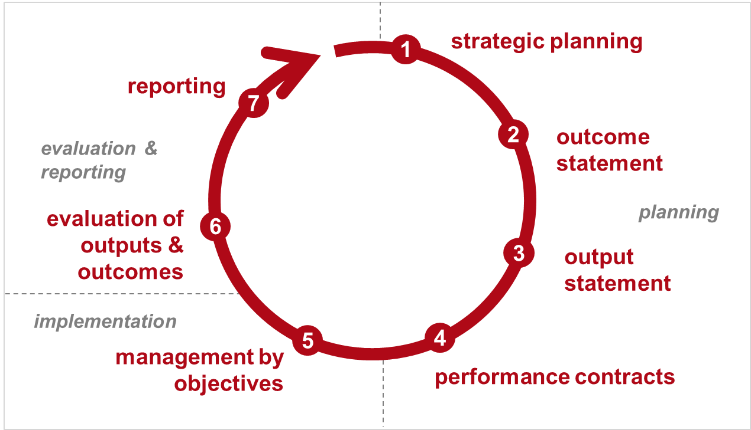
Quality Assurance as part of the Performance management cycle
QA M&E + Reporting
QA Outcome Orientation
QA RIA

Slide 21
Quality Assurance as part of the Performance management cycle
QA M&E + Reporting
QA Outcome Orientation
QA RIA

Slide 22
Quality Assurance Process – PM
Submission of draft outcome and output statements (draft federal budget law) by federal ministries
Ongoing support in the development of outcome and output statements
Quality Assurance by the Federal Performance Management Office and submission of recommendations
Revision of draft outcome and output statements (draft federal budget law) by federal ministries
In case of non-compliance: Mandatory explanation („comply or explain“)
from 2016: Publication of recommendations by the FPMO

Slide 23
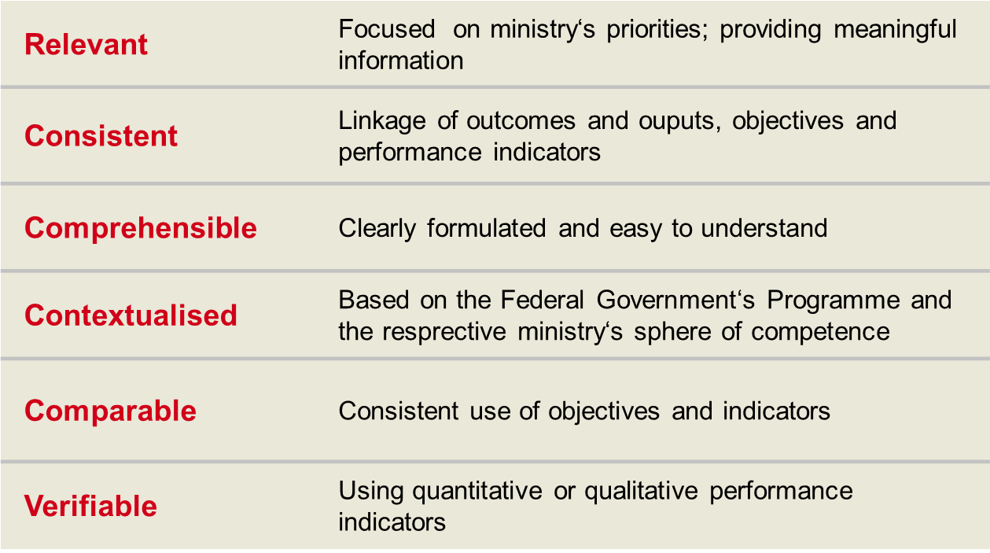
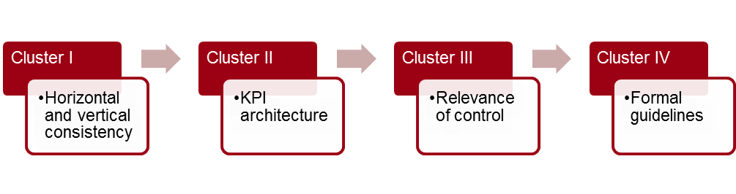
Quality criteria for performance information
Notes:
The Quality assurance is based on certain criteria, laid down in the federal budgeting act.
“Relevant” means that the objectives relate to the core competencies of a ministry. It is not possible to cover all the tasks with the objectives. Ministries shall focus on priorities.
Furthermore performance information should be consistent across all budget management levels. The outputs must contribute to the desired outcomes defined by the ministries. A performance indicator should allow to measure the respective objective.
To make objectives and indicators transparent to Parliament and the interested public, they must be clearly formulated and easy to understand. Ministries are asked to avoid abbreviations and technical terms.
The outcome objectives of a ministry must be well-founded and contextualized. They can be based on the Federal Government‘s Program or the respective ministry‘s sphere of competence. The Annual Budget contains a verbal description of the context, especially an explanation why the respective outcome has been chosen.
Comparable: Ministries should use objectives and indicators consistently, in order to allow comparisons over a certain period of time.
Verifiable: An objective should be specific. In our concept we use quantitative but also qualitative performance indicators.

Slide 24
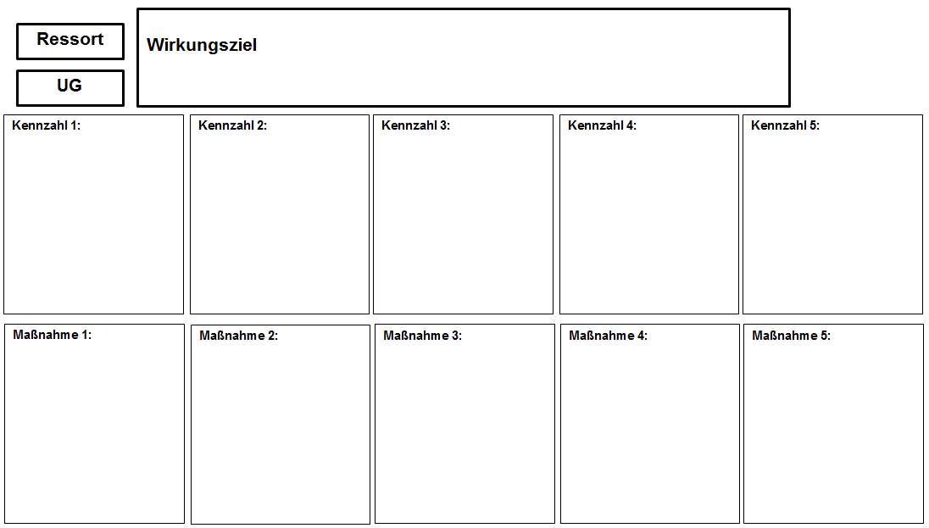

Quality Assurance Clusters - PM
Strategie
QA cluster 1:
Horizontal Consistency
QA cluster 2:
Indicator Architecture
QA cluster 3:
Management relevance
QA cluster 4: Horizontal consistency
Notes:
Vergleich von Theorie und Praxis
Wir holen und Expertinnen und Experten zur Begutachtung und Supervision. Wir lassen unsere Theorie überprüfen -> Vor- Nachteile, Reichweite
Wir bewältigen unsere Herausforderungen selbst

Slide 25
Cluster II – Indicator Architecture
Review of the link between outcome target and indicators
Indicators should allow an observation of the impact on the outcome target
Points of observation:
  Outcome target fulfills quality criteria for performance information
  Indicators provide information ob target achievement
  Indicators consider interdependencies and blind spots
  Quality of Indicators (i.e. CLEVER-Scheme)

Slide 26
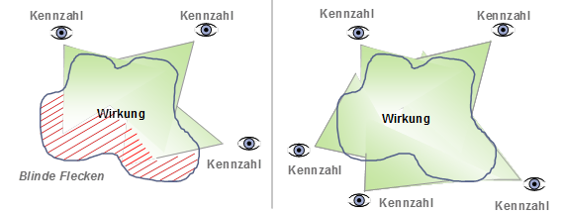
Cluster II – Indicator Architecture
Blind spots
Indicator
Indicator
Indicator
Indicator
Outcome
Outcome
Indicator
Indicator
Blind spots
Indicator
Indicator

Slide 27
Cluster III – Relevance of Control
Review of the structural connection of the target cascade
Points of observation:
  Target cascade and indicator architecture is significant, meanigful and informative
  Indicators are controllable/influencable
  Connection between output measures and development of indicators can be observed
Outcome
target
Output measure
Indicator

Slide 28
Quality Assurance as part of the Performance management cycle
QA M&E + Reporting
QA Outcome Orientation
QA RIA

Slide 29
Quality Assurance in RIA Process
Lead ministry conducts an impact assessment (key objectives, indicators, implementation measures, expected impacts…)
Support and quality assurance by Federal Performance Management Office and
experts for specific impacts from other ministries
RIA additional document for consultation phase and parliamentary discussions
Ex-post evaluation within 5 years
Federal Performance Management Office compiles a report to Parliament
Lead ministry designs new law, regulation or major project
Revision of RIA by lead ministry (In case of non-compliance: Mandatory explanation - „comply or explain“)

Slide 30
Quality criteria for RIA
Notes:
The Quality assurance is based on certain criteria, laid down in the federal budgeting act.
“Relevant” means that the objectives relate to the core competencies of a ministry. It is not possible to cover all the tasks with the objectives. Ministries shall focus on priorities.
Furthermore performance information should be consistent across all budget management levels. The outputs must contribute to the desired outcomes defined by the ministries. A performance indicator should allow to measure the respective objective.
To make objectives and indicators transparent to Parliament and the interested public, they must be clearly formulated and easy to understand. Ministries are asked to avoid abbreviations and technical terms.
The outcome objectives of a ministry must be well-founded and contextualized. They can be based on the Federal Government‘s Program or the respective ministry‘s sphere of competence. The Annual Budget contains a verbal description of the context, especially an explanation why the respective outcome has been chosen.
Comparable: Ministries should use objectives and indicators consistently, in order to allow comparisons over a certain period of time.
Verifiable: An objective should be specific. In our concept we use quantitative but also qualitative performance indicators.

Slide 31
Evaluation & reporting

Slide 32
Why evaluating?
Transparency and legitimacy
  Accountability towards parliament and society
Effectiveness of policies for society
  Ex-Post Evaluations show the implications of the policies funded by the federal government on different demographic groups
  Systematic data collection across all institutions allows horizontal analysis of all policies geared towards certain target groups
Basis for rational management, evidence-based policy making and continuous learning
  continuous development of policy fields
  annual reporting on outcome and output statements
  organizational learning (i.e. external factors, effectiveness and efficiency of measures taken)
  basis for future planning (of outcome and output statements)

Slide 33
Target groups
Parliament
Interested Public/ Lobbies
Ministries
Federal Government
Notes:
Performance orientation can be applied at different levels. Here we have identified three groups of users of performance information.
First of all, the desired outcomes defined by the government are made transparent to Parliament and the interested public (such as the media, interest groups, and citizens). They can discuss the appropriateness and the level of ambition of objectives. They are now in a better position to represent their interests towards government. Citizens gain better inside into Government’s work as well as a better understanding of the machinery of government and what it is responsible for. This will strengthen people’s confidence in public institutions.
Second it is an analytical tool that supports government and ministers. It helps to identify the relevant challenges and to plan actions that tackle societal problems (like unemployment or gender inequality).
And finally, it provides the basis for decentralized management of public bodies. Public administration can also show the range of services it provides for citizens, organized interest groups, politicians and other stakeholders.

Slide 34
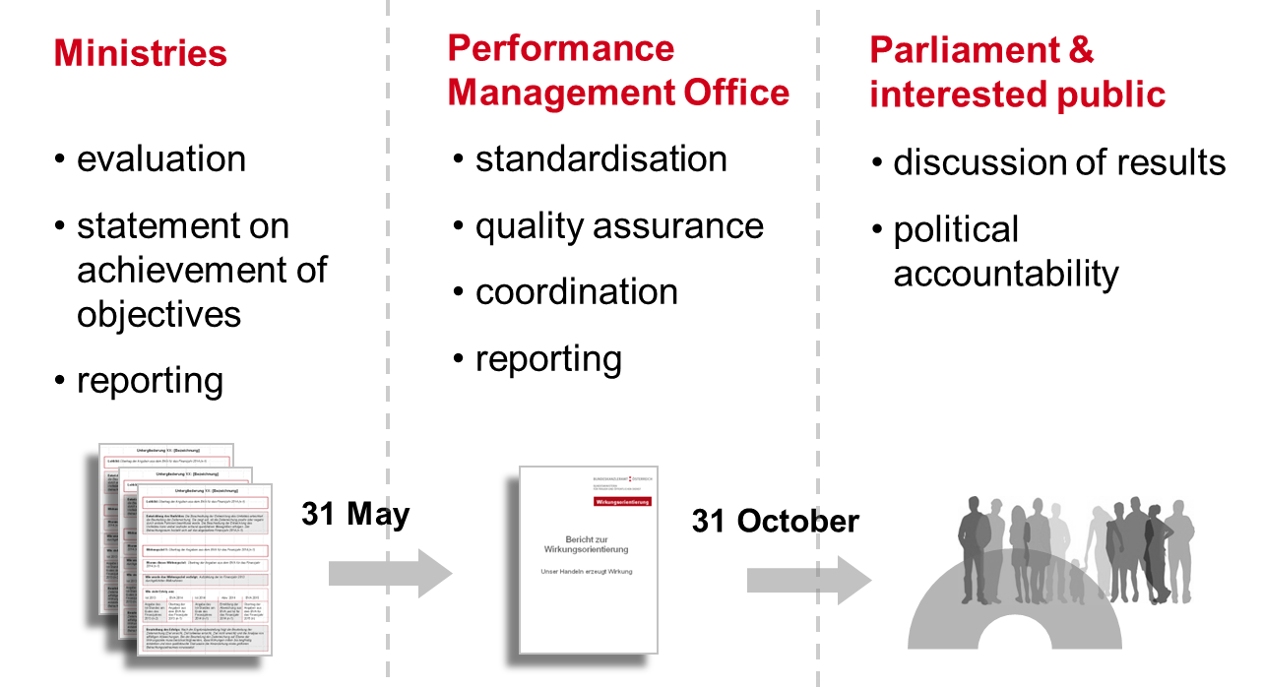

Annual Federal Performance Report (PM)
Notes:
The official Performance Report to Parliament contains information about the achievement of objectives at the level of budget chapters (outcome statement) and global budgets (output statement)
The objectives at operational level are not reported to Parliament.
Line Ministries evaluate achievement of objectives and submit the results to the FPMO by the end of May.
Based on the line ministries’ statements we draw up the Annual Performance Report and submit it to Parliament by the end of October.
The budget debate is normally scheduled to start in October. The aim is to discuss the results in the Annual Report together with the objectives and planned activities of the following fiscal year.

Slide 35
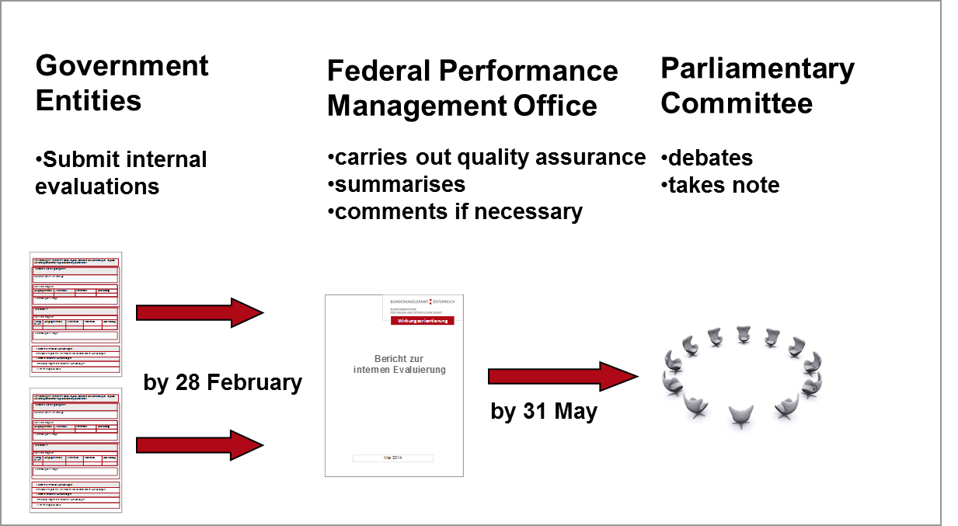

Annual Internal Evaluation Report (RIA)
Notes:
So what happens with these internal evaluations?
Another element - that is new - since this year - is the reporting obligation to Parliament.
Each ministry has to submit a report about it´s internal evaluations in the previous year to the Federal Performance Management Office.
We compile the reports of the ministries, analyze and comment them and submit them as one report to the Parliament.
The goal is to make internal evaluations more transparent to Representatives in Parliament as well as to the interested public:
Impact assessment and internal evaluation should become part of the parliamentary debate and influence the policy making.
Before the parliament decides about the new annual budget and the new outcome and output statement the representatives should discuss the results of the evaluation and look at what has worked and what hasn´t worked in achieving certain political goals.
So impact assessment becomes part of the cycle of planning, implementing and evaluating.

Slide 36
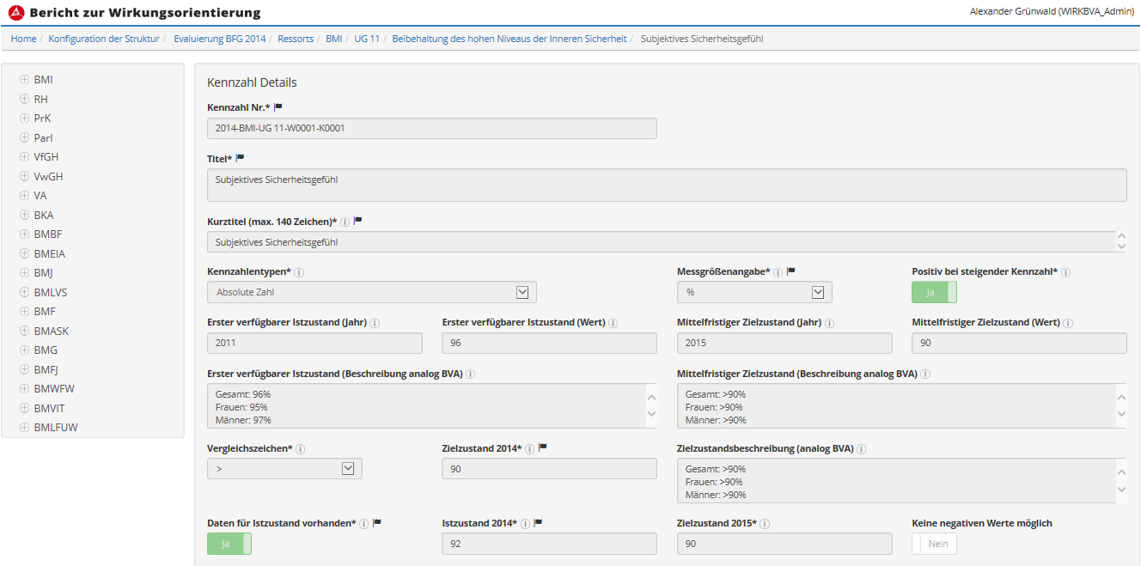
Digital Reporting: Data Input
Database

Slide 37
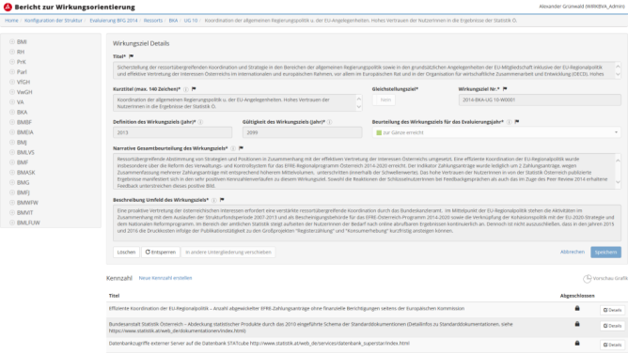


Digital Reporting: Annual Performance Report
Database
www.wirkungsmonitoring.gv.at

Slide 38
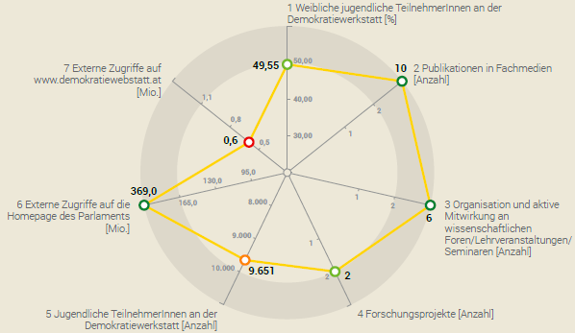
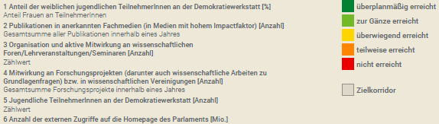
Digital Reporting: Data Output
  + Background Description (environment, international developments, relevant stakeholders)
  + Narrative Overall Assessment of target achievement
  (environment, international developments, relevant stakeholders)

Slide 39

Compiling and visualizing performance information
Notes:
SSch
We really try to get this information to different target groups and through different channels. From classical reports with several hundred paiges…..
Eder PDF herzeigen

Slide 40
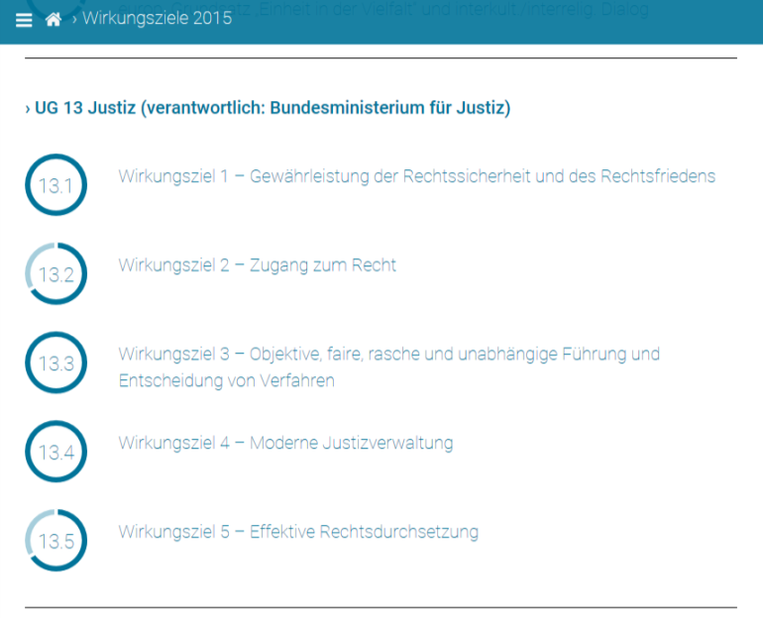
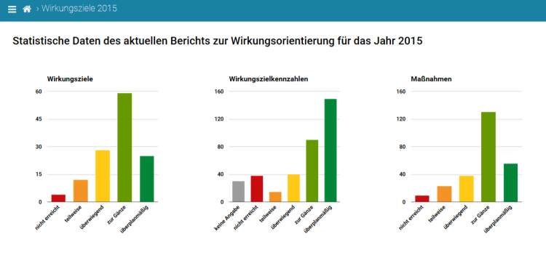
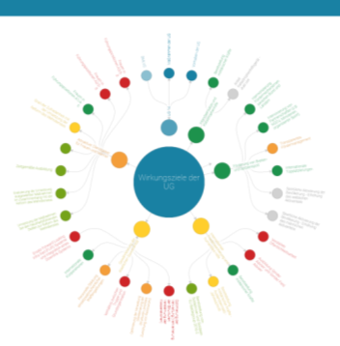
Online Reporting I
www.wirkungsmonitoring.gv.at

Slide 41
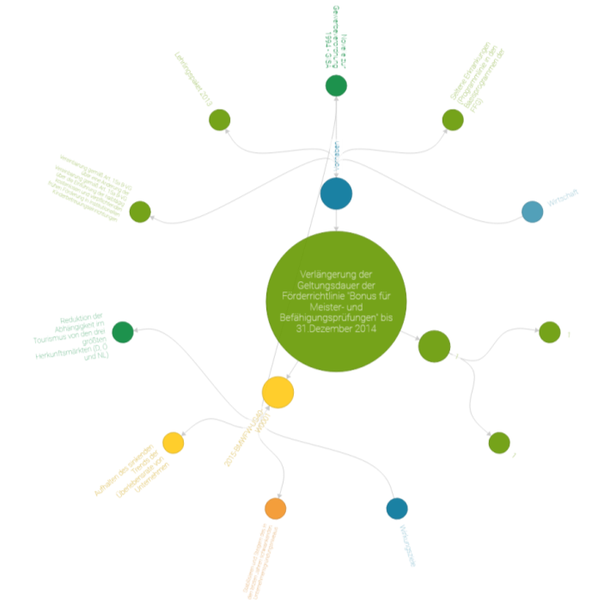
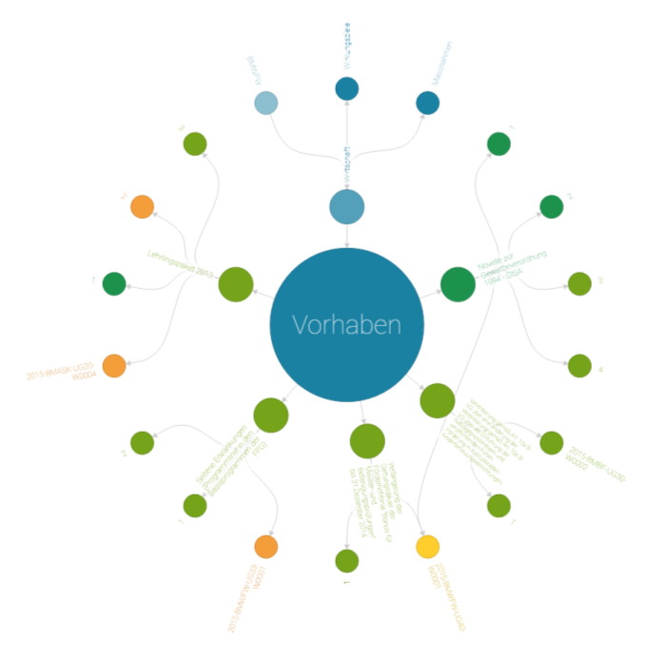
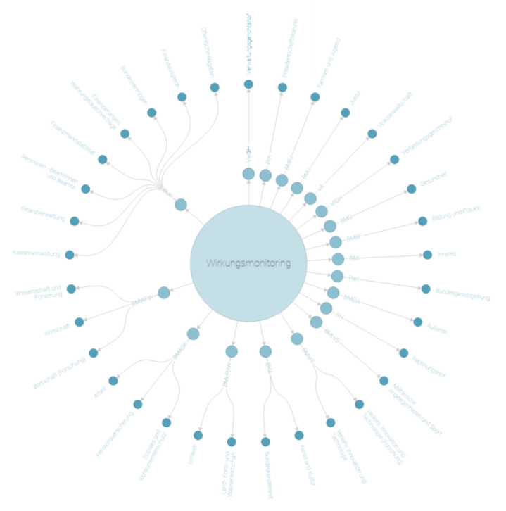
Online Reporting II
Notes:
To new forms of visualizations that allow you to see the full picture of all performance based information and drill down to various levels to specific indicators for measures…

Slide 42
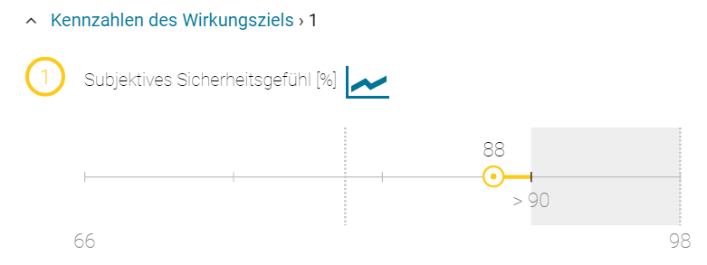
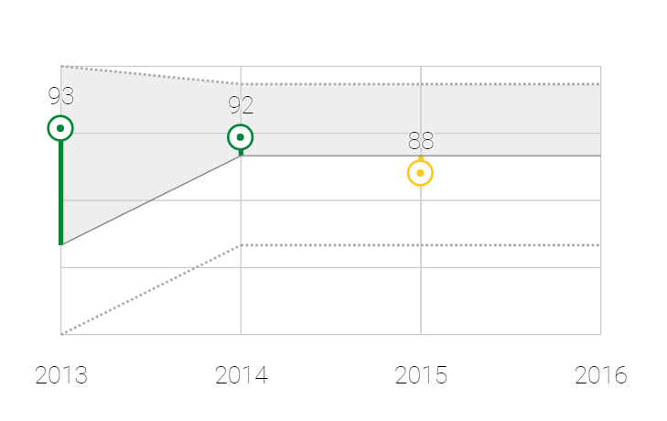
We historize…
Notes:
SSch
Online you can click from the highest structural level to the details. From the holistic view it is possible to go to the basics where users can dip into the past and see the development of indicators – as gender pay gap - up to now; as well as a forcast is being offered of what is the road ahead for this indicator.
GENDERINDIKATOR
also going from the vertical view to a more horizontal or historical view, that show users how a ministry performed againt their target indicators.
So there is a lot of effort in getting all stakeholders to produce, assess and discuss high quality performance information.

Slide 43
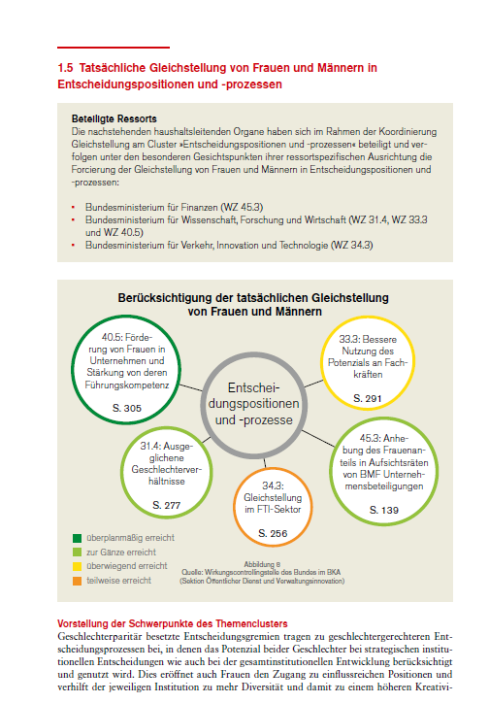
Reporting on Gender Equality I
Annual Reporting on the base of topics
  Familiy and work
  Labour market
  Health
  etc.
I.e.: gender equality in decision-making-positions
Presentation of results and progress
Notes:
SSch

Slide 44
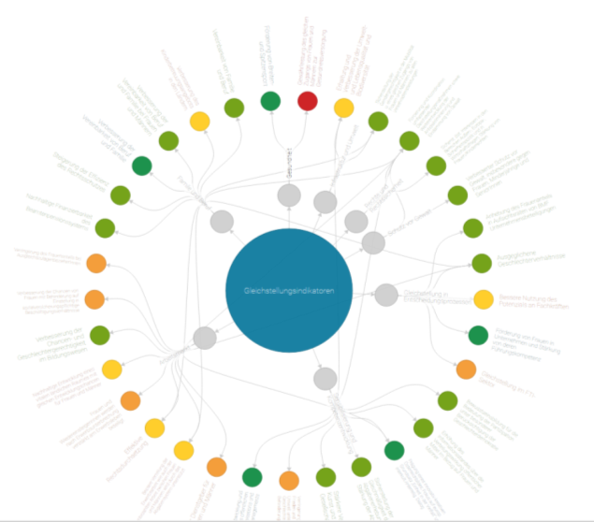
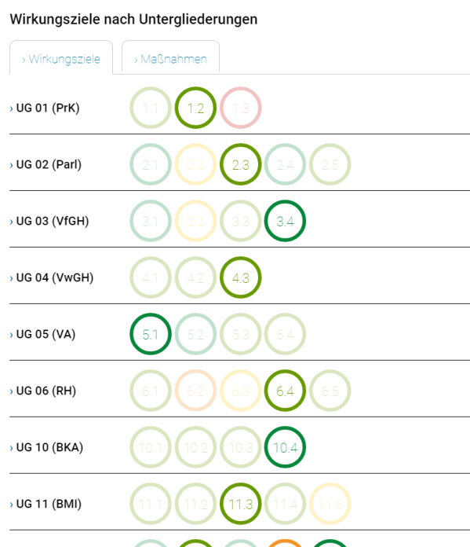
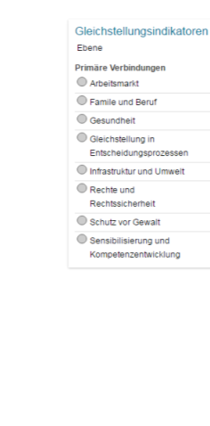
Reporting on Gender Equality II

Slide 45

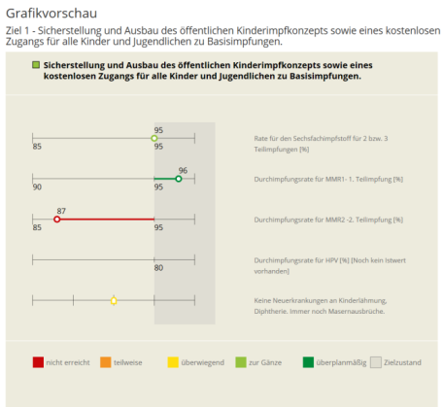
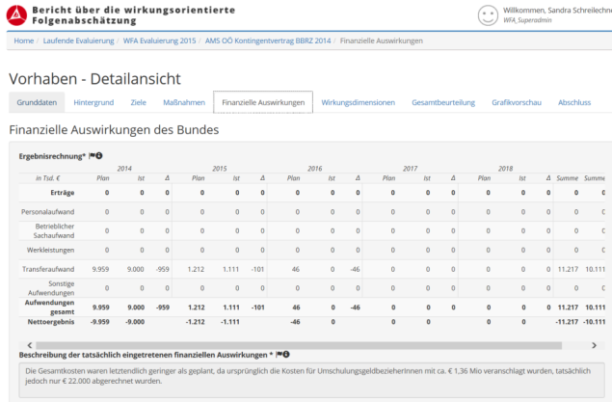

Digital Reporting
Database
www.wirkungsmonitoring.gv.at
Notes:
SK

Slide 46
CHALLENGES, SOLUTIONS AND THE ROAD AHEAD

Slide 47
Challenges
Collecting meaningful data
Designing user-friendly IT-Tools
evaluation and foresight
Increasing accountability and awareness

Slide 48
Collecting meaningful data!
Challenges
  RIA und PM introduced need to formulate goals and indicators throughout central government and measure impacts
  Lack of knowledge in public administration about indicator construction, availability, validity, reliability, timeliness of data…
Solutions
  Introducing proportionality for RIA and reducing the need to „invent“ indicators for minor amendments
  „School of Data Public Service“ workshop series
  Support and Quality Assurance by FPMO
Next steps
  Refining and expanding impact dimensions for RIA

Slide 49
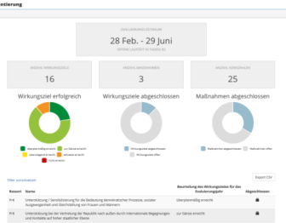
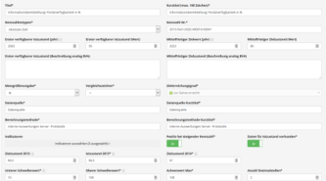
Designing user-friendly IT-Tools
Challenges
  Many public servants involved in conducting and evaluating RIA and PM
  Single input and interoperability between different systems
  Central oversight for FPMO
Solutions
  Web-based tool for evaluating performance goals, indicators etc.
  Provides multi-year database with up-to-date oversight for FPMO and ministries
  Automated evaluation and reporting processes
Next Steps
  Better Integration (same UI) of RIA and PM tools
  Interoperability with other IT-systems
  Enabling internal short-term (less than 1 year) data collection and analysis

Slide 50
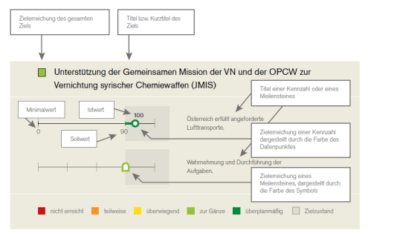
Increasing accountability & awareness
Challenges
  Implementing RIA and PM is strong cultural change
  Raising awareness for the potential both inside and outside the government
Solutions
  Central government body that provides feedback, PR, training, handbooks, quality assurance
  Improving presentation of data and results
  Patience
Next Steps
  Raising public awareness with
  machine-readable open data
  Interactive content visualizations
  Focus on user experience

Slide 51
Evaluation and Foresight
Challenges
  Using the collected data for strategic planning and closing the performance management loop
  Use of (ex-post) evaluations, foresight tools and modes of anticipatory governance vary between policy fields
  Use of indicators and goals for steering and governance of institutions
Future Steps
  Developing data dashboards for high level use
  Providing best-practice examples and support to increase evaluation “know how” throughout the central government

Slide 52

The road ahead
Keep pushing
  Improve skills throughout public administration
  Provide support and a centralized quality assurance
  Support the necessary cultural change, that impacts are made transparent “by default”
Keep publishing
  New ways of visualizing data, reporting and drawing a bigger picture
  Engage with public and parliament
Be patient

Slide 53
Thank you for your interest
Ursula ROSENBICHLER
Head of Department
Roland SCHNEIDER
Federal Ministry of the Public Service and Sports
Department III/9
Federal Performance Management Office
Hohenstaufengasse 3
1010 Vienna
Tel: +43 1 531 15-207461
roland.schneider@bmoeds.gv.at
www.bmoeds.gv.at
www.oeffentlicherdienst.gv.at
Notes:
Ladies and Gentlemen,
We hope, we have been able to give you a basic idea about Outcome Orientation in Austria as well as the steps we are taking to implement this scheme.
If you have any questions, we will be happy to answer them.

