Slide 1

Engaging citizens in the budget process and developing budget literacy in the PEMPAL countries:
Example of Croatia
Mihaela Bronić and Nevenka Brkić
Institute of Public Finance and Ministry of Finance
Moscow, June 22, 2017

Slide 2
The structure of presentation
Basic facts about Croatia
The structure of public administration
Much has been done in increasing BT (publishing CB)
But PP in budget processes is lagging behind on national level
Still good examples on local level
Conclusion: Increased budget literacy/citizens education is needed for improving PP in budget processes

Slide 3
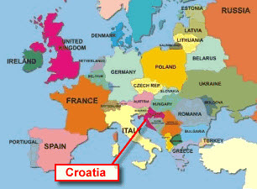
Basic facts about Croatia
Population: 4.3 mil.
Capital (pop.) : Zagreb; 790,017
Area: 56,542 km²
Language: Croatian
Life Expectancy: 77.9
GDP per Capita:
current US$ 11,592 (2015)
Literacy: 99%

Slide 4
Fairy tale Croatia

Slide 5
The structure of public administration in Croatia
Unitary state with two tier subnational government
  Self-government units
  Regional (21 counties
    - incl. the City of Zagreb with the special status)
    Local (127 cities and 428 municipalities)
Notes:
70 percent of regional and local units have fewer than 5,000 inhabitants

Slide 6
Much has been done in increasing BT
(producing CB) - as prerequisites for PP
IPF – since 2000 numerous CB for central and local governments http://www.ijf.hr/eng/publications/guides/1087/
MOF - since 2012 online citizens budgets for almost all key budget documents

Slide 7
But PP in budget processes is lagging behind at national level
Open Budget Survey (OBS)
  the world’s only independent (IBP)
  comparable measure (102 countries) of:
      budget transparency (BT),
      public participation (PP) and
      oversight.
  Biennial (since 2006)
  BT is insufficient for improving governance
      PP in budgeting can maximize the positive outcomes associated with greater BT.
  PP = 16 indicators measuring the degree to which the government provides opportunities for PP in budget processes
Notes:
Such opportunities should be provided throughout the budget cycle by the executive, the legislature, and the supreme audit institution.

Slide 8
Graph 1: OBS 2015 - Public participation scores at national level for PEMPAL countries*
* weak (0-40), limited (41-60), adequate (61-100)
Source: OBS Results by Country

Slide 9
The Government of Croatia is weak in providing the public with opportunities to engage in the budget process on national level
Executive – weak SAI - weak Legislative – adequate
Recommendations:
    Establish credible and effective mechanisms (i.e. public hearings, surveys, focus groups) for capturing a range of public perspectives on budget matters;
    Ensure the public is informed of the purpose of public budget engagements and provided with sufficient information to participate effectively;
    Establish formal mechanisms for the public to assist the SAI to formulate its audit program and participate in audit investigations.
Public Participation in Fiscal Policy and Budget Processes in Croatia (Ott and Bronic, GIFT, 2015)
Notes:
When broken down to branches, only the legislature was providing adequate opportunities, while executive and SAI were providing only weak opportunities for public participation in budget processes.
119. Does the executive make available to the public clear (accessible, nontechnical) definitions of terms used in the budget and other budget-related documents (for instance, in a glossary)?
120. Is the executive formally required to engage with the public during the formulation and execution phases of the budget process?
121. When the executive engages with the public during the budget formulation process, does it articulate what it hopes to achieve from the engagement and provide other information far enough in advance so that the public can participate in an informed manner?
122. When the executive engages with the public during the budget execution process, does it articulate what it hopes to achieve from the engagement and provide other information far enough in advance so that the public can participate in an informed manner?
123. Has the executive established mechanisms to identify the public’s perspective on budget priorities?
124. Has the executive established mechanisms to identify the public’s perspective on budget execution?
125. Does the executive provide formal, detailed feedback to the public on how its inputs have been used to develop budget plans and improve budget execution?
126. Does a legislative committee (or committees) hold public hearings on the macroeconomic and fiscal framework presented in the budget in which testimony from the executive branch and the public is heard?
127. Do legislative committees hold public hearings on the individual budgets of central government administrative units (i.e., ministries, departments, and agencies) in which testimony from the executive branch is heard?
128. Do legislative committees hold public hearings on the individual budgets of central government administrative units (i.e., ministries, departments, and agencies) in which testimony from the public is heard?
129. Do the legislative committees that hold public hearings on the budget release reports to the public on these hearings?
130. Does the Supreme Audit Institution (SAI) maintain formal mechanisms through which the public can assist in formulating its audit program (by identifying the agencies, programs, or projects that should be audited)?
131. Does the Supreme Audit Institution (SAI) maintain formal mechanisms through which the public can participate in audit investigations (as respondents, witnesses, etc.)?
132. Does the Supreme Audit Institution (SAI) maintain any communication with the public regarding its Audit Reports beyond simply making these reports publicly available?
133. Does the Supreme Audit Institution (SAI) provide formal, detailed feedback to the public on how their inputs have been used to determine its audit program or in Audit Reports?

Slide 10
PP is lagging behind - online survey PP in budget process, 2015
Graph 2. Answers of the students who were polled (in %)
Source: Ott and Bronic, 2015. Citizen Participation in Fiscal Policy and Budgetary Processes in Croatia, Newsletter, No. 96.

Slide 11
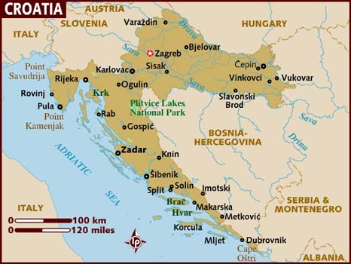
But there are good examples of PP at the loc. level
– 1. City of Rijeka
Total population: 128,384
Population density: 2,926 inhabitants per km²
Surface: 44km²
34 Local Boards
36 budget beneficiaries
The
administrative center of the Primorsko-goranska County
Source: Presentation Mr. Ante Mađerić, Poreč, July, 2015

Slide 12
Participatory Budgeting
in the City Of Rijeka
THREE INITIATIVES
SMALL MUNICIPAL
INTERVETNIONS
– since 2004
LOCAL PARTHNERSHIP
PROGRAMME
– since 2005
ONLINE EDUCATIONAL
BUDGET GAME
– since 2011
Source: Presentation Mr. Ante Mađerić, Poreč, July, 2015
Notes:
Small municipal interventions or municipal priorities include smaller municipal works in the areas of local boards that are carried out in accordance with citizens’ proposals, with the aim of raising the quality of their life.
Through direct participation of citizens, associations and local boards, in cooperation with the City of Rijeka, this programme enables citizens to resolve part of their needs faster and more cost effectively, by putting in order smaller public spaces (children’s playgrounds, tree-lined avenues, flowerbeds, not cultivated green areas, smaller-sized illegal landfills. The competition in respect of which proposals are submitted to the Local partnership programme of Rijeka is published every year in October for projects that will be realised next year, in accordance with planned programmes and financial resources available in the budget. The competition is published in the daily newspaper Novi list, and on the web site of the City of Rijeka. The forms that need to be filled out in order register a project proposal as well as the report on realised projects are available in Word and they should be submitted to the Directorate of local self-government.

Slide 13
Participatory Budgeting in the City Of Rijeka, 2015
City Of Rijeka
(2015 Budget -
around US$ 120m.)
Small Municipal
Interventions
(around
US$ 1.5m.)
Local Partnership
Programme (around
US$ 30,000)
Online Educational
Budget Game
Proracun(ajme)
Citizens
Source: Presentation Mr. Ante Mađerić, Poreč, July, 2015

Slide 14
Online Educational Budget Game
Proracun(ajme)
1. Homepage
  Introductory text about the current budget
  Educational part: keywords are explained (e.g. communal fee)
2. Game
  Citizens choose projects that are not in their current budget
    (Total maximum amount of selected projects: ≈ US$ 10 mil.)
  Reducing items of current budget or raising communal fees citizens provide funds for the implementation of an earlier selected project
      Alarms alert citizens to what happens when an item of current budget decreases or communal fee increases
3. Report:
  Selected projects and how are they funded
  Comparison of citizens' budget to the current budget
Notes:
Početna stranica. Uvodni tekst o općoj slici aktualnog proračuna.
Edukativni dio: linkovi na ključnim riječima koje su u footeru objašnjene, u objašnjenjima linkovi koji vode na zakone, pravilnike i dr. dokumente.
Participativni dio: građani biraju ponuđene projekte kojih nema u aktualnom proračunu. Maksimalni iznos: 60 milijuna. Projekti razvrstani unutar pojednostavljenih proračunskih stavki. U footeru detaljniji opis svakog od ponuđenih projekata. Naveden i iznos potreban za realizaciju.
Informativni dio: stavke i iznosi aktualnog proračuna. Svaka stavka detaljnije razrađena na projekte koji se financiraju kroz aktualni proračun. Projekti pojedinačno opisani u footeru.
Igra: Smanjivanjem stavki aktualnog proračuna ili podizanjem komunalne naknade građani osiguravaju sredstva za realizaciju ranije izabranog projekta. Alarmi upozoravaju što se događa kad se pojedina stavka aktualnog proračuna smanjuje.
Izvještaj je moguće vidjeti nakon osiguranog cijelog iznosa za realizaciju izabranog projekta.

Slide 15
Online Educational Budget Game
Proracun(ajme)
http://www.vojko-obersnel.com/hr/proracunaj-me/2017

Slide 16
But there are good examples of PP at the loc. level
– 2. City of Pazin, 2014.
Total population: 8,638
Population density: 62.89 inhabitants per km²
Surface: 137.22 km²
12 Local Boards
6 budget beneficiaries
The
administrative center of the Istrian County
Source: Presentation Ms. Maja Grah, Ljubljana, May 11, 2017

Slide 17
City of Pazin - organization of administration
City of Pazin has 38 employees and 2 attendants in vocational training
City Mayor has 2 deputies (volunteers)
City Council has 15 members
MAYOR
DEPUTY MAYORS
Internal Audit
City Office
Economy, Finance and Budget D.
Communal System, Physical Planning and Construction D.
Government, Administration and Social Affairs D.
Source: Presentation Ms. Maja Grah, Ljubljana, May 11, 2017

Slide 18
Participatory Budgeting in the City Of Pazin, 2014
1) Preparation phase
II – V, 2014 | Project team meetings Project presentation Preparation of website, forum, brochures, video, billboards...
2) Co-decision on the small communal actions
VI, 2014 | The Mayor invited all citizens to send proposals Presentation of a website with visualizations of the Budget for 2014 and a forum for on-line public debates
VII-VIII, 2014 | Project promotion – brochures, radio announcements and websites Citizens send about 130 proposals (e-mail, mail) Preparation of public hearings (structure; ppt; timeline)
IX, 2014 | Analysis of received proposals Taking photos of locations and financial assessment of each proposal
Source: Presentation Ms. Maja Grah, Ljubljana, May 11, 2017

Slide 19
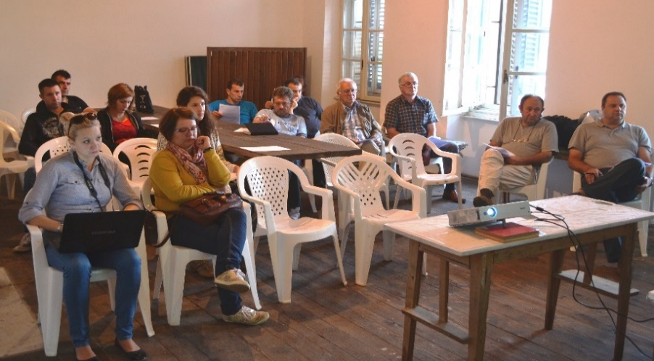
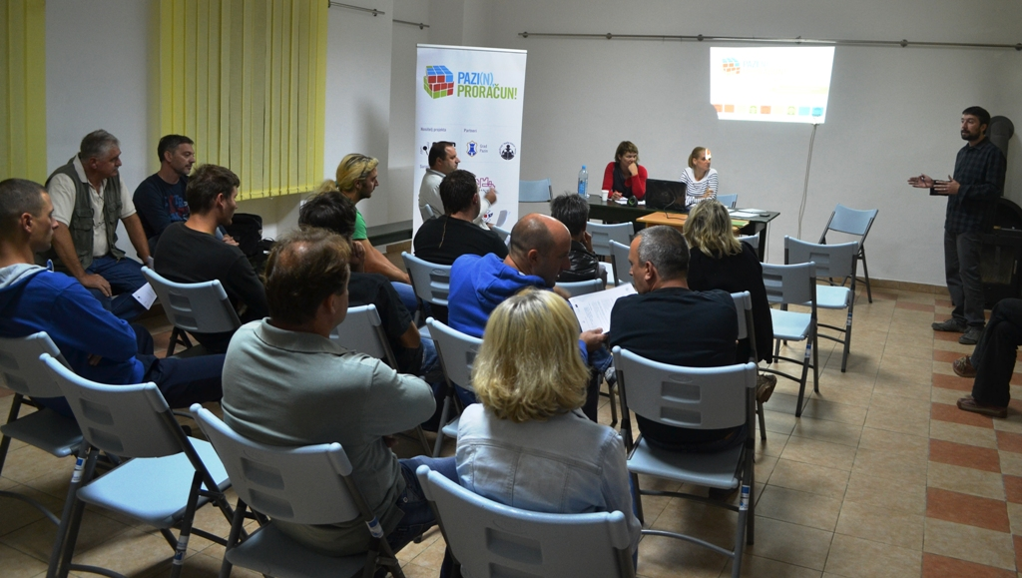
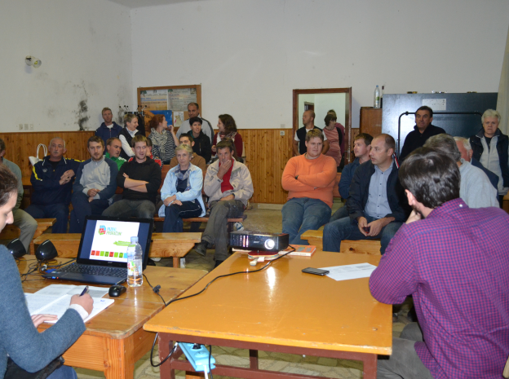
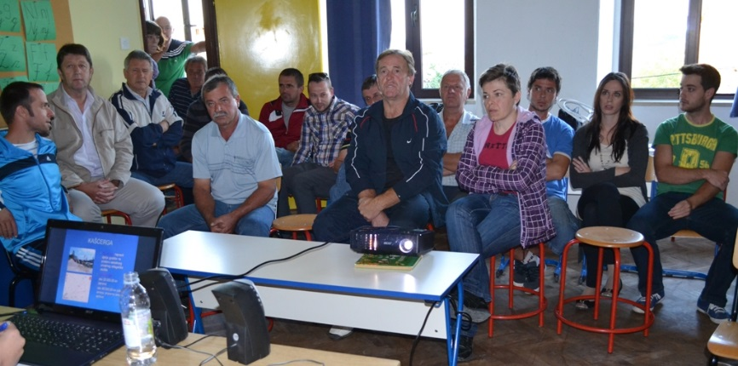
2) Co-decision on the small communal actions (cont.)
IX-X, 2014 | 9 debates on the community level boards: City rep. in an understandable way explained the budget structure and budget adoption process, and elaborated the proposals received Citizens debated and voted on proposals (total ≈ 45,000 US$ - 3% of the budget) The minutes of each public debate published and sent to the Mayor and Councilors
Heki
Zabrežani
Lindar
Kašćerga
Source: Presentation Ms. Maja Grah, Ljubljana, May 11, 2017

Slide 20
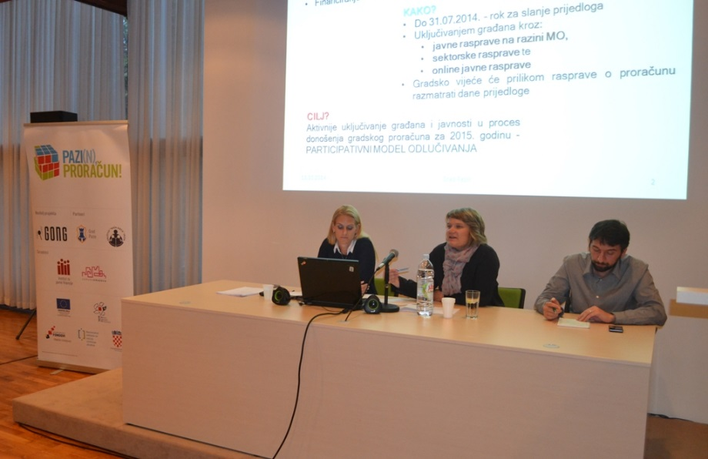
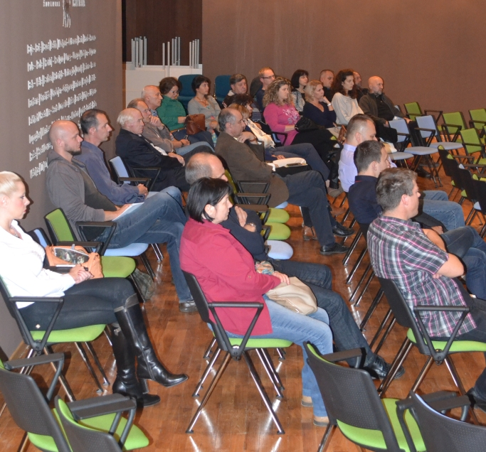
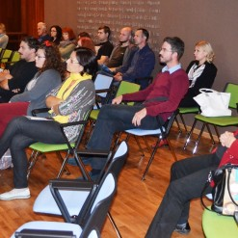
XI-XII, 2014 | 3) Review and adoption of the budget
Source: Presentation Ms. Maja Grah, Ljubljana, May 11, 2017

Slide 21
Chosen small communal actions - included in 2015 Budget
DATE | SETTLEMENT | CHOSEN ACTIONS | VALUE ASSESSMENT IN HRK
16.09. | Stari Pazin | Repairing children playground in Bertoši + bench | 33,000
 |  | Repairing children playground and new swing in Zagreb street | 15,000
18.09. | Heki | New bus station in Ježenj | 20,000
18.09. | Zabrežani | Pedestrian crossing in Zabrežani | 12,000
 |  | Notice board in Drndići | 4,000
23.09. | Kašćerga | Renovating of public area in Kašćerga (parking) | 20,000
23.09. | Trviž | Selective garbage dumpsters (green island) | 2,500
23.09. | Beram | New bus station in Ruhci | 20,000
Source: Presentation Ms. Maja Grah, Ljubljana, May 11, 2017

Slide 22
PP is lagging behind especially on the national level, because obviously producing CB is not enough
Increased budget literacy/citizens education are needed for improving PP in budget processes
  need to motivate citizens for PP
  citizens education is essential!

Slide 23
A way CG could monitor and encourage reforms on the l. level
Graph 3. Level of BT in Croatian LGU, 2016 (%)
Source: Ott, Bronic, Petrusic and Stanic, 2016. Budget transparency in Croatian counties, cities and municipalities (November 2015 – March 2016), Newsletter, No. 107.

Slide 24
A way to increase budget literacy on the national level
1. Since it is hard to reach each citizen individually the best way might be to start with the education of:
  the media
  members of the parliament
  county, city and municipal councilors
  2. Introducing budget literacy courses into school curricula (as a part of civil education at all levels of education)

Slide 25
Thank you ☺
Your comments and suggestions are welcome…

