Slide 1
RISK MANAGEMENT IN RELATION TO CASH MANAGEMENT IN TURKEY
TURKISH TREASURY

Slide 2
Contents
1
General Overview of Treasury Risk Management
2
Cash Management Processes
3
Managing Cash Management Risks
4
Managing Cash Management Performance
5
The Way Forward

Slide 3
GENERAL OVERVIEW OF treasury rIsk management
1

Slide 4
Risk Management at Treasury
ERM
Management of enterprise –wide risks
1. Risk Types
2. Risk Owners
3. Coordination
4. Risk Governance
All kinds of risks incl. strategic, legal reputational etc.
All Treasury units
(Public finance, shareholder executive, foreign economic relations, regulation of insurance system etc.)
Strategy Development Department
Internal control and risk management groups in each unit
Internal Control and Risk Management Coordination Committee
A component of general internal control system of the institution
Public Finance
RM
Management of specific public finance risks
1. Risk Types
2. Risk Owners
3. Coordination
4. Risk Governance
Market Risk
Credit Risk
Operational Risk
Public finance units
(Debt management, cash management, receivables management, accounting etc.)
Middle Office (Market Risk, Credit Risk and Operational Risk Management and Budget Monitoring Departments.)
Debt and Risk Management Committee
Specialized technical risk management function for public finance management

Slide 5
Managing Public Finance Risks
Debt and Risk Management Committee
Composition
Deputy Prime Minister (Chair for critical meetings)
Undersecretary (Chair for ordinary meetings)
Deputy Undersecretaries
DG of Public Finance
DG of Foreign Economic Relations
DG of Economic Research and IT Systems
Duties and Responsibilities
Determining borrowing strategies and risk limits for annually for a 3-year period
Monitoring these strategies and limits
Determining policies for Treasury guarantees and on-lending and receivables
Other
Coordination and Technical Work
Performed by Middle Office
Technical work and analysis for borrowing cost and risks
Presenting analysis, reports and proposals to the Committee
Other
Annual Meetings
Monthly meetings
Evaluation of Macroeconomic Outlook
Core annual strategies and limits
Global economic conditions
Macroeconomic indicators
Financial sector overview
Annual borrowing program
Debt and Risk Issues
Budgetary realizations and projections
Cash realizations and projections
Foreign and domestic borrowing markets
Overview of risks
Guarantee and on-lending limits

Slide 6
Strategic Benchmarks and Indicators
Liquidity Risk
Currency Risk
Keeping certain level of cash reserve
A minimum nominal figure
Borrowing mainly in TL
A nominal ceiling for FX borrowing and FX cash reserves
1
2
Interest Rate Risk
4
3
Refinancing Risk
Using fixed rate TL instruments as the major source of domestic cash borrowing
Decreasing the share of debt which has interest rate refixing period less than 12 months
Increasing the average maturity of domestic cash borrowing taking market conditions into consideration
Decreasing the share of debt maturing within 12 months

Slide 7
CASH MANAGEMENT PROCESSES
2

Slide 8
Cash Management Processes
Core processes
Interacts with other sub-processes and support processes
Annual Cash Planning
Monthly Cash Planning
Daily Cash Planning
Managing Cash Reserves
Short-Term Money Market Operations
Monthly program figures are translated into daily program figures
Daily cash requests are collected via PEPS
Cash reserves of the institutions are gathered
The next day’s cash allocation figures are determined
All TL and FX account balances are remunerated automatically on a daily basis with market rates.
Not a single idle balance left at any Treasury accounts.
Treasury pays transaction fee to CBRT and ZiraatBank for banking operations.
Regulation since 2008.
3 types of instruments
Not utilized so far due to strategic benchmark on holding strong cash reserves
Technical infrastructure is being tested and kept ready
September-October Period
Use budgetary figures as inputs
Annual cash program with daily projections
Revising annual program on a monthly basis
Monthly meetings with agencieas and MoF
Evaluation of cash requests of agencies submitted to CRS
1
2
3
4
5

Slide 9
ManagIng CASH management rISKS
3

Slide 10
Sources of Cash Management Risks
4 Major Sources
Market Risks
Credit Risks
Operational Risks
Budgetary Risks
Macroeconomic outlook
Interest rates
Exchange rates
Guarantees
On-lending
Debt assumption commitments (PPP Projects)
HR risks
IT Risks
Stakeholder Risks
Mostly related with markets risks on the revenue side
Tax cuts and reliefs
Incremental expenditures
1
2
3
4

Slide 11
Managing Market Risks
Liquidity Buffer
FX Reserve Level
The level of cash and other highly liquid assets readily available to cover financing needs
Maximum level for FX reserves
for cash management purposes to control
time differences between cash inflows and outflows
revenue-based deviations
expenditure-based deviations
Redemption profile for FX type payments is considered
for debt management purposes to reduce
re-financing risk
short term bond auction volatilities
If the amount exceeds upper limit+allowance => Convert the excess amount of FX to local currency

Slide 12
Liquidity Buffer
Average Monthly Liquidity Buffer
Historical analysis of the ratio
∑(monthly offers in the auctions) / ∑(monthly redemption)
Determination of the critical periods and their average duration
low demand for the auctions (mean and std. deviation of the above ratio)
Availability of financing sources
Financing from the auctions during critical periods
Other sources (primary surplus, privatization etc.)
Minimum Daily Cash Balance
Daily Available Cash Reserve = Cash Reserve – SDR
DACR / Average Daily Redemption
DACR/ Average Daily Primary Expenditures

Slide 13
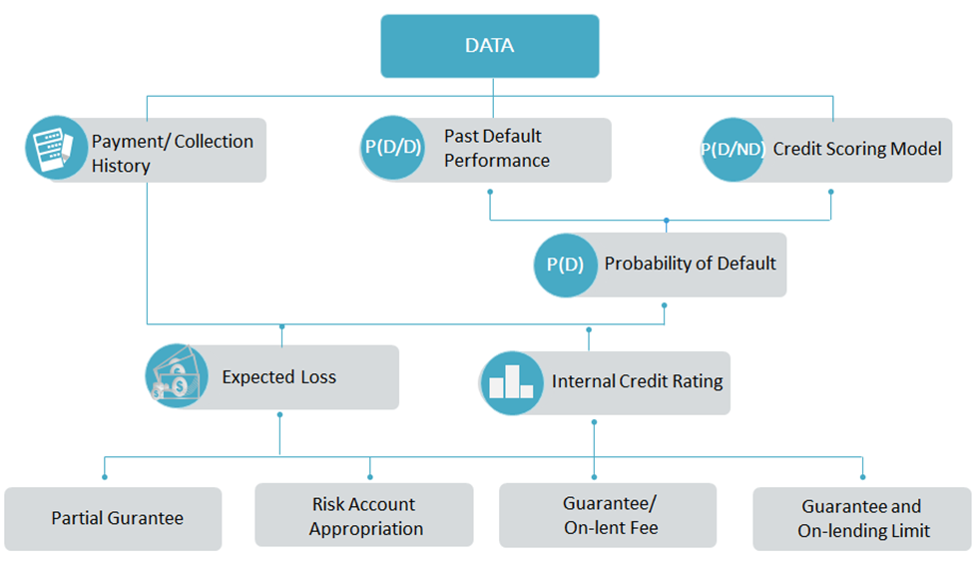
Managing Credit Risks
Credit Rating Model
Guarantee and On-Lending Limits
Risk Account
A guarantee and on-lending limit is imposed on the Treasury guarantees through the Annual Budget Law.
4 USD billion for 2017
Partial guarantee (Up to 95% of the total amount)
Held at Central Bank since 2003
Used for risks arising from contingent liabilities
Prohibited to serve for any other needs.
Revenue sources: Budgetary appropriations, guarantee/on lent fees, collections for undertaken amounts

Slide 14
Managing Operational Risks
COSO Model for Risk Identification, Assessment and Monitoring
Qualitative evaluation of risk magnitude and probabilities
Mapping risks as high, medium and low level risks
Risk submission and reporting
Each operational risk event is reported to OR IT sytem by the relevant personnel
Periodic operational risk reports
Contingencies
Business continuity plan
Periodic emergency drills
Emergency centres in various locations

Slide 15
Managing Operational Risks-Example

Slide 16
ManagIng CASH management performance
4

Slide 17
Key Performance Indicators and Monitoring-I
Cash management KPIs are part of 5-year Strategic Plan and annual performance programs of Treasury since 2009/2010.
Initially set as a single KPI based on deviations from the projected cash surpluses/deficits on a monthly basis.
Since 2014 two separate indicators defined as the average monthly deviation in the total revenues (cash inflows) and expenses (cash outflows) of which the results are reported monthly.
$\frac{\sum_{i=1}^{n}{\frac{[Rai−Rpi]}{Rpi}}}{i}$<BMR ; $\frac{\sum_{i=1}^{n}{\frac{[Eai−Epi]}{Epi}}}{i}$<BME
i: Month i subject to performance measurement
Rai; Eai: Actual revenue and expenses respectively
Rpi; Epi: Programmed revenue and expenses respectively
BMR;BME: Benchmark value (minimum acceptable performance) for revenue and expenses
CMD is subject to Turkish Court of Acccounts’s audits and accountable for these KPIs

Slide 18
Key Performance Indicators and Monitoring-II
Due to relatively less controllability issue the benchmark for the revenue side ise lower.
Benchmark values (the minimum acceptable performance) have been set more stringent year by year.

Slide 19
The way forward
5

Slide 20
Vision I: More Comprenhensive Reserve Benchmarks or Indicators
A more comprehensive liquidity buffer which incorporates high-risk revenue items and obligatory payments.
Identification of revenue items which are one-off and subject to variation.
Assigning a risk factor to relatively stable revenue items
Identification of obligatory payments like payroll and social security contributions.
Examining the difference between stable revenues and obligatory payments for the upcoming 20 days on a daily rolling basis (calculating the largest cumulative deficit for upcoming 20 days)
Arranging the minimum buffer level taking into account the negative differences.
A more conservative reserve target apart from liquidity buffer
A lengthier period considered for revenue-expense differences.
Changing weights assigned to the target calculation depending on the riskiness of the term of the year

Slide 21
Vision II: More Comprenhensive KPIs
A KPI to measure the performance of the daily programming process
Daily deviations are already scrutinized and reported to top-management every day .
A formal indicator would enhance the accountability to a higher level
A KPI to measure the performance of the remuneration system
Since that currently the remuneration is an automatic process based on a single rate with no idle balances at the end of the day, it may not be very effective indicator for performance measurement.
Envisaged to be very instrumental after the accomplishment of the new TSA system and establishment of new remunaration channels
A KPI like,
Remuneration Income/Average Reserve Level
Average Borrowing Cost of Treasury
is worth being considered

Slide 22
Thank You!
TURKISH TREASURY

