Slide 1
RISK MANAGEMENT
Edit Nemeth, Vice Chair of IACOP
Vienna, 31st of May, 2017

Slide 2
Risk assessment vs. Risk management
Risk assessment is a tool – applied in different business areas
SWOT analysis (strengths, weaknesses, opportunities and threats)
Risk management is an operational activity of management
Internal auditors have to make a risk based strategic and annual audit plan

Slide 3
Risk based audit planning vs. Risk management
 | Risk based audit planning | Risk management
Who responsible for it? | Internal auditors (IA) | Management
What is the purpose of it? | To decide on the focus of internal audit activity | To manage risk in order to achieve the objectives
What is the result of it? | Risk based strategic and annual audit plan | Risk inventory, Risk map, Control Self-assessment, Action plan for managing risks
What are the steps? | A – if there is a reliable risk management in place – IA use the information from it, but still use their on professional judgement B – if there is no risk management – with the involvement of management IA should assess the risks by their own in order to establish their audit plans, but this risk assessment cannot be considered as risk management! | Risk identification Risk analysis Risk evaluation Decision on how to manage the identified risk ( Determination of Risk appetite, Control Self-assessment and choosing the applicable strategy for risk mitigation) Action plan Take action to mitigate risks Monitoring of action plan

Slide 4
What we consider as Risk?
Risk: The possibility of an event occurring that will have an impact on the achievement of objectives. Risk is measured in terms of impact and likelihood.​
Risk Management: A process to identify, assess, manage, and control potential events or situations to provide reasonable assurance regarding the achievement of the organization's objectives.​
Inherent Risk: An assessed level of raw or untreated risk; the natural level of risk inherent in a process or activity without doing anything to reduce the likelihood or mitigate the severity of a mishap, or the amount of risk before the application of the risk reduction effects of controls.
Residual Risk: The risk remaining after management takes action to reduce the impact and likelihood of an adverse event, including control activities in responding to a risk.​
INHERENT RISK – CONTROL ACTIVITIES = RESIDUAL RISK

Slide 5
RISK
An event
Occurs in future
Has negative impact on objectives

Slide 6
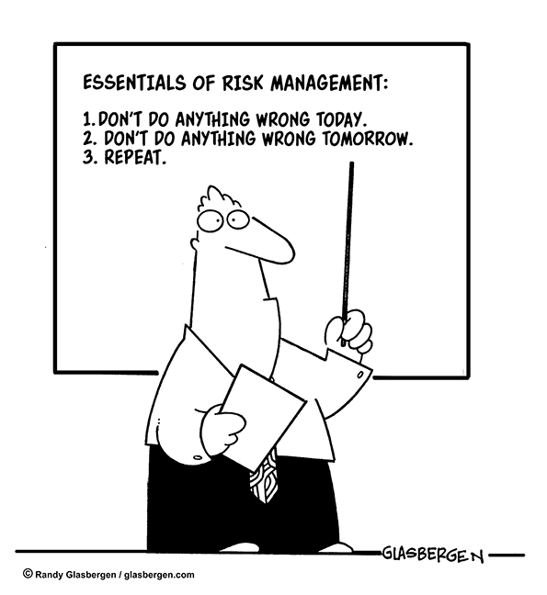
RISK?
Can we consider a problem as a risk?
Is it a risk if we are uncertain in something?
Is it a risk if we are lack of something?

Slide 7
RISK FACTORS
Generate risks
Elevate probability or impact of risks
Eg. Lack of resources, lack of information

Slide 8
Identification of risk
Risk universe (in audit planning – audit universe)
No one can assess risk if objectives are not clear!
What risks we should identify during risk management?
Formulation of risk is essential to have an effective risk management

Slide 9
Evaluation of risk
Risk categories
Risk factors
Risk criteria
Probability * Impact = Risk value

Slide 10
4 options to manage risk

Slide 11
IACOP approach
Our objective was to understand risk management and risk based audit planning
Our countries just started to implement IA and internal controls that’s why most probably the organisation doesn’t have a proper risk management – so IA need to assess risk to establish audit plans according to IIA standards
During the working group meetings we processed a case study – which became also a knowledge product – Moldova and Hungary created a training on RA and RBAP on the basis of this case study
We elaborated a Risk assessment in audit planning guide for public sector internal auditors

Slide 12
Role of internal auditors in risk management
Internal auditors cannot be involved in decision making, but can help the organisation to understand of risks
IIA Standard 2100 – Nature of Work: The internal audit activity must evaluate and contribute to the improvement of the organization’s governance, risk management, and control processes using a systematic, disciplined, and risk-based approach. Internal audit credibility and value are enhanced when auditors are proactive and their evaluations offer new insights and consider future impact. – IA is helping by performing the internal audit activity

Slide 13
THANK YOU FOR YOUR KIND ATTENTION!

