Slide 1
Single Treasury Account (STA): General Policies on Cash Flow Regulation
Yekaterina Semyonova
Head
Department for Federal Budget
Execution Support,
The Russian Treasury
moscow April 2017

Slide 2
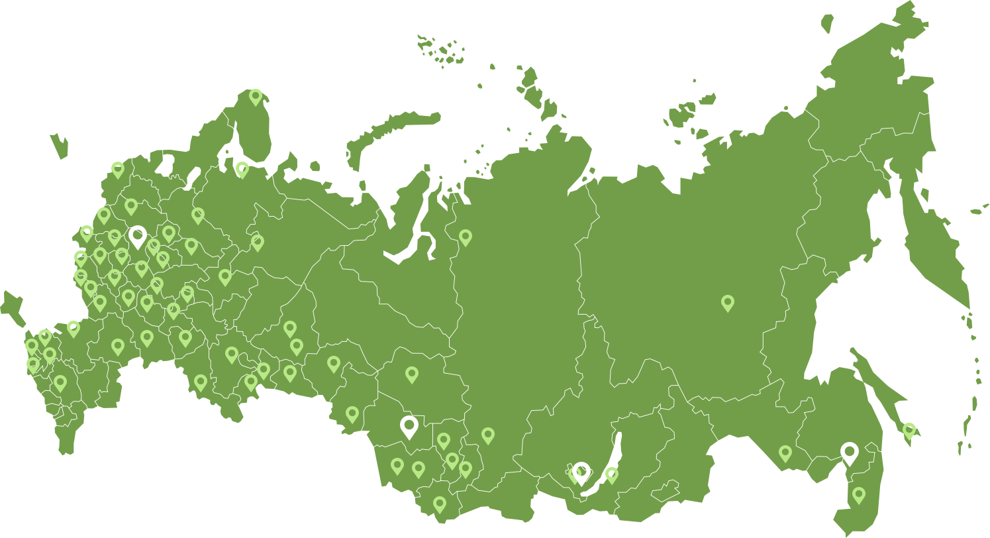
CASH CONCENTRATION –starting point of cash management
85 RF constituents, more than 500 bank accounts
Uniform IT environment – banking electronic speed payment system – BESP
On-line execution of payments (within 1 minute)
Daily backing of Federal Treasury’s accounts for t+1 – in the amount of the next day expenditures
Daily automatic zero balancing of bank accounts based on the day outcomes in acc. with the procedure
Support of payment security

Slide 3
Chronology of funds consolidation on the sta
For reference: as of 01.03.2017
Resources of RF constituents
and municipalities (outlook)
Federal
budget
funds 48%
Resources of territorial offices
of state extra-budgetary funds
Resources of legal entities–
treasury support
Financial institutions resources
Budget users and autonomous entities– 42%
Legal entities – treasury support – 58%
Resources of Central Directorates
of the state extra-budgetary funds
Temporarily administered resources
Temporarily administered resources and
resources of the budget users and autonomous institutions
Federal budget resources
2000
t
2011
2015
2017
2019

Slide 4
Treasury support of the government contracts
Treasury of Russia
Credit institutions
Prime contractor
Public customer
past
co-contractor
co-contractor
co-contractor
Treasury of Russia
Credit institutions
Public customer
present
Prime contractor
Current account of prime/co-contractor
Final settlement
co-contractor
co-contractor
co-contractor
Designated use of funds
Transparency and accountability
Expansion of liquidity
for reference: as of 01.03.2017 – about 210 billion Roubles
impact:
Advance/settlements
Invoice/work completion report

Slide 5
treasury support of subsidies
Treasury of Russia
Treasury of Russia
Main budget spending unit , budget user
past:
Subsidies to the Russian Federation Constituents
notes:
Old delivery mechanism – 25% BA every quarter;
New delivery mechanism – as needed
1. funding in accordance with the terms of agreements
The Russian Federation Constituents
2. Report
Subsidies to budget and autonomous institutions:
For government tasks
For other purposes
Budget and autonomous institutions
present:
1. Need
Subsidies to legal entities (economic entities – recipients of subsidies)
2. Funding
Legal entities (economic entities – recipients of subsidies)
Effects:
Designated use of funds
Minimization of receivables
Expansion of liquidity
for reference: as of 01.03.2017 – about 310 billion Roubles

Slide 6
Planning is the basis for effective cash management
maximum coverage of participants
prerequisites
single IT platform
on-line operation
year broken down by months
Planning horizon:
month broken down by days
benchmark: the longest period of breakdown by days
for long and short terms
Targeting:
use of ‘rough’ and ‘fine’ tuning tools

Slide 7
‘rough’ and ‘fine’ tuning of liquidity
“rough”
“fine”
placement of funds to t+5
deposits to t+5
REPO to t+5, including REPO overnight
placement of funds from t+5*to t+n
deposits from t+5
REPO from t+5
withdrawal from placement
Raising of funds in the capital market to bridge potential temporary cash gaps (in the near future)
Demand deposits (in the near future)
Expenditure funding limits
Use of deadline payment date (in the near future)
*t+5 - near future (currently - t+3)
STA hedging (currently under consideration)

Slide 8
Example of ‘rough’ and ‘fine’ tuning of liquidity
‘rough’ tuning of liquidity
billion Roubles
Establishment of ПОФР – financial reserves limit
Initial liquidity
Development of long-term placement program
Conditional zero
Buffer volume
Jan
Feb
March
April
May
June
July
December
Months
August
……
‘fine’ tuning of liquidity
withdrawal from placement/Fund raising in the capital market
billion Roubles
Conditional zero
Buffer volume
t+30
t+60
t+90
Days

Slide 9
Promising fine-tuning mechanism
Liquidity balancing options:
Result:
Reduction of one-day placement level
Application of a deadline payment date
Withdrawal of placed funds
Intra-day liquidity hedging
Fund raising in the capital market
?
1
It is used after comparative assessment of profit generated by the withdrawal of funds and fund raising in the capital market.
yes
no
2
3
yes
no
4
Notional example:
period
1 work.day
2 work.day
3 work.day
n work.day
cash gap – 100
cash gap – 50
expenses*, roubles
150
200
300
…
+100
+50
Deferral mechanism
Payment carryover by 100
Payment carryover by 50
1 priority order of payments
1 priority order of payments
2 priority order of payments
2 priority order of payments
* Expenses are generated on the basis of billing documents t-4
9

Slide 10
Establishment of an optimal period for execution of payment documents
Prerequisites:
The Federal Treasury authority to make payments within the period t+5
Actual payments within the period t+4
Acceptance of billing documents
Payment execution
t
t+1
t+2
t+3
t+4
t+5
Additional day for just in case payment carryforward
Control (authorization)
For reference:
Government institutions, local authorities (their institutions)
60 days
Other government agencies
State and military health facilities
30 days
50 days
International Experience (e.g., France)
Ссылки на официальные источники:
Ordonnance n°2015-899 du 23 juillet 2015 relative aux marchés publics (Articles 59 et 60 (règlements, avances et acomptes) - Article 61 (garanties));
Décret n°2013-269 du 29 mars 2013 relatif à la lutte contre les retards de paiement dans les contrats de la commande publique;
Décret n°2016-360 du 25 mars 2016 relatif aux marchés publics (Articles 115 à 121 (régime des paiements) - Articles 122 à 126 (garanties) - Article 183 (retard de paiement))
10

Slide 11
«period t+3»- period for strengthened control of risky payments
Risk scale
Expenditure type groups
100 Payroll
200 Procurement
300 Social Security
400 Investments
500 Inter-budgetary transfers
600 Subsidies
700 Debt servicing
800 Other expenditures
Procurement of goods, works and services: 200 «’procurement of goods, works and services for government (municipal) needs’; 323 ‘purchase of goods, works and services for the benefit of the citizens to provide them with social welfare’; Capital investments in the government (municipal) assets: 410 ‘budget investments’; 460 ‘subsidies to budget and autonomous institutions, government agencies for further capital investments to the constructed government (municipal) assets or for purchase of property to be owned by government (municipality).’; Provision of subsidies to the RF constituents’ budgets for co-financing of capital construction assets to be owned by the government (a municipality): 522 ‘subsidies to co-finance capital investments in the assets in the state (municipal) ownership.’; Provision of payments, contributions, gratuitous transfers to the subjects of international law 863 ‘payments to secure implementation of agreements with the governments of foreign states and international organizations’; 880 ‘special expenditures’
Standard documentary control
strengthened control*-field inspection, survey
Control of individual payments (the List of Payments) to be specified by the relevant criteria (Budgetary Classification Code, contract amount, advance payment arrangement and size, etc.). Payments are subjected to risk analysis.
11

Slide 12
Quality improvement of the expenditure projections
For a near-term outlook
E-budget Subsystem
Justification document
Procurement management
Procurement plan
Road map
Expenditure management
Budget commitment
Cash obligation
Expenditure-based cash payment projections
…
Payment deadline date
expenditures
t+1
t+2
t+3
t+4
t+5
t+n
projection completion $≈100\%$
projection completion $>or<100\%$
12

Slide 13
Prioritized execution of payments during the current business day if confronted with a cash gap on the sta
(either the sta balance hedging limit is achieved, or it is absent)
Until the STA liquidity is balanced* payments are made using the actual balance in accordance with one of the following options (to be selected):
Option 1
Option 2
2
priority
Other payments
19:00
Chronology of payments within every priority group
Payments are made depending on the date of submission of payment documents
17:00
payroll payments, social security and sovereign debt servicing
15:00
13:00
1 priority
ВР 100 – payroll;
ВР 300 – social security;
ВР 700 – sovereign debt servicing
11:00
9:00
* Balancing options – withdrawal of funds from placement, raising of funds in the capital market, shifting of payment date
13

Slide 14
Chronology of the sta receipts and outgoings within a business day
Expenditures, outgoings
≈ 90 %
placements
≈ 90 %
Revenues, receipts
Cash flows
≈ 80 - 85%
Withdrawal from placements
≈ 90 %
10:00
11:00
12:00
13:00
14:00
15:00
16:00
17:00
18:00
… 21:00
9:00
Extra-budgetary receipts
100 %
14

Slide 15
Intra-day hedging of the STA balance
Mechanism implementation conditions:
The relevant provisions in the agreement between the Bank of Russia and the Federal Treasury on intra-day STA backup
Daily closing balance should be ≥0
Notional example:
Opening balance: S’t=0; closing balance: S’t=0
Payments (t) = 600 Roubles
Receipts (t) = 1000 Roubles
Placement of funds (t)= 400 Roubles
Chronology of cash flows:
Expenditures: from 9:00 till 11:00 - 90%;
from 10:00 till 18:00 – 10%.
Receipts: from 9:00 till 11:00 – 10%;
from 11:00 till 18:00 – 90%.
Billion Roubles
STA balance dynamics
Placement of funds (overnight)
S’t=0
S’’t=0
Hedging zone
Limit is mutually agreed upon.
Payments
Receipts
-500
9:00
10:00
11:00
12:00
13:00
14:00
15:00
16:00
17:00
18:00
9:00
10:00
day t
day (t+1)
15

Slide 16
Review of the regulatory framework for intra-day hedging mechanism of the sta balance
Russian legislation
International Experience (e.g., France)
Fed.Law N 86-FZ “On the Central Bank of the Russian Federation (Bank of Russia)”, Article 22.
Bank of Russia may not provide credits to the Government of the Russian Federation to finance federal budget deficit, or buy government securities during their primary placement except for the cases foreseen by the federal law on the federal budget.
Bank of Russia may not provide credits to finance budget deficits of the state extra-budgetary funds, constituents of the Russian Federation and local budgets
Daily evening consolidated cash position (as of the end of a business day) shall present a positive balance.
This obligation results from the EU commitments of France – Art. 123 of the Treaty on the Functioning of the European Union (Roman Treaty of 25.03.1957, as amended by Lisboan Treaty of 13.12.2007)
The Bank of France statements shall always show a credit opening balance on the STA
Fed.Law №145-FZ “Budget Code of the Russian Federation”,
Article 94
Credits of the Central Bank of the Russian Federation, as well as purchase of government securities of the Russian Federation by the Central Bank of the Russian Federation, during their placement, may not be the sources of the federal budget deficit financing.
«Il est interdit à la Banque centrale européenne et aux banques centrales des États membres, ci-après dénommées "banques centrales nationales", d'accorder des découverts ou tout autre type de crédit aux institutions, organes ou organismes de l'Union, aux administrations centrales, aux autorités régionales ou locales, aux autres autorités publiques, aux autres organismes ou entreprises publics des États membres; l'acquisition directe, auprès d'eux, par la Banque centrale européenne ou les banques centrales nationales, des instruments de leur dette est également interdite.»
‘The European Central Bank and the central banks of its member countries (hereinafter referred to as the national central banks) are prohibited to credit the accounts or provide any other type of credit to the institutions, bodies, or other agencies of the Union, the central administrations, regional or local authorities, any other public authorities, other public institutions or enterprises of its member countries; similarly, the European Central Bank or the national central banks shall not directly purchase from them their debt instruments.’
New version of the Budget Code of the Russian Federation
Art№, p.№ Temporary cash gap manifests itself in the insufficient amount of funds in the single treasury account or the single budget account to execute the required payments from the account in the process of budget execution;
Art№, p.№ It may be allowed to implement instructions on transfer of money in the Russian Federation currency when a separate bank account of the Federal Treasury does not have enough funds, provided there are sufficient funds on its other accounts in the Russian Federation currency, those accounts being defined by the Federal Treasury, in accordance with the procedure established by the Central Bank of the Russian Federation.
Intra-day backup
Credit

Slide 17
Effective use of cash – a future development benchmark
Effective use of every Rouble
Actual zero on the STA
Tools
Development of the STA balance targeting
Diversification of liquidity management instruments
Establishment of the deadline date for payment execution
Intra-day hedging of the STA balance
Balance reduction
Maximum yields from liquidity management
Minimization of intra-day cash gaps on the sta
More stringent control over risky payments
Higher cash budget quality
Improvement of cash management
17

Slide 18
Thank you for your attention!

