Slide 1
PFM IT System Implementation Experience in Moldova
Elena Saharnean, SOE Fintehinform
Chisinau, June 3, 2016

Slide 2
Public Finance Management Project (PFMP)
The Project’s Goal – reforming the existing public finance management system
Implementation Period – 2006-2013
Public Finance Management Project Structure
Component 1. Budgeting and Execution Methodology
1.A Budgeting Methodology
1.B Budget Execution Methodology
1.C IT-System - PFMITS
Component 2. Internal Financial Control
Component 3. Training Capacity Building and Training
Component 4. Management, Monitoring and Project Review
Notes:
Риски - Взаимосвязанные работы между компонентами – реагирование на изменения Координация во времени проектов из разных компонентов

Slide 3
MoF’s Preparatory and Related Activities
Components 1 А and 1В
Improving Budgeting Methodology;
Improving Budget Execution Methodology;
Developing a new budget classification and a new chart of accounts;
Developing a new Law on Public Finance and Fiscal Accountability.
Component 1С
Improving expertise of the IT personnel;
Developing IT infrastructure;
Preparing premises for the server hardware.
Component 3
Creating a proper training environment for users;
Teaching budgeting and budget execution methodology to trainers/instructors.

Slide 4
PFM IT System Implementation Timeline
2005-2006 – PFMITS TOR development;
March 2007 – announcing a two-stage bidding process in accordance with the World Bank’s procedures;
October 2008 – Identifying the winning bidder;
27 March 2009 – Awarding Contract for the PFMITS supply and implementation;
2009-2013 – Developing PFMITS (Modules BPS, BES/MDM, SAP/BW, CNFD have been designed. The Budget Execution Module is pending development);
2014-2015 – Developing the Budget Execution IT System (MoF entered into contract with Fintehinform for the system development);
March 2015 – Launching PFMITS the 2016 budget preparation;
December 2015 – Launching the budget execution IT system for executing the 2016 budget;
2016 – the integrated IT system covers 100% of the budgetary process.

Slide 5
Project Management Organization, PFMITS Component
Management of the Public Finance Management Project is organized as follows:
Supervisory Committee – established under Government Resolution No 18, dated January 4, 2007.
Coordinators Council, working groups – established under Minister of Finance’s executive order, the Council was headed by a Deputy Minister.
Structure of Component 1 Working Groups:
WG 1 – Budget Development Methodology (includes IT specialists);
WG 2 – Budget Execution Methodology (includes IT specialists);
WG 3 – PFM IT system included the following subgroups:
Subgroup 3.1 – Technical Infrastructure and Networks;
Subgroup 3.2 – Budget Development Module;
Subgroup 3.3 – Budget Execution Module;
Subgroup 3.4 – Accounting and Reporting Module.
PFMITS Testing Working Groups – established under the Minister of Finance’s executive order :
Technical Infrastructure and Hardware Testing Group;
Budget Development Module Testing Group;
Budget Execution Module Testing Group;
Accounting Module Testing Group;
Reporting Module Testing Group;
Integration Processes (external and internal) Testing Group.

Slide 6
PFMITS Implementation Stages and Timeline
Stage | Planned (70 weeks) | Implemented (213 weeks)
Analysis | May 2009 – June 2010 | May 2009 – August 2010
Equipment Installation and Testing (Hardware&LAN) | July 2009 – January 2010 | December 2009 – October 2011
System Installation | June 2010 – July 2010 | June 2010 – August 2013
System and Interface Design | September 2010 – February 2011 | September 2010 – December 2013
System Testing | September 2010 – February 2011 | July 2012 – December 2013
User Training | July 2010 – February 2011 | November – December 2013
PFMITS Commissioning | March 2011 | December 2013
System Start-up | Budget 2012 | Budget 2016

Slide 7
Meeting the PFMITS Implementation Timeline
A detailed timeline is agreed upon immediately after the contract signature
Initial timeline was 18 months; the general project plan was designed to match that period;
Implementation timeline was amended 3 times: it was extended, and it delayed the system start-up for 4 years.
Note: changes to the implementation timeline were caused by multiple delays in the system design process, errors in documentation made at the analysis stage, and amendments introduced into the system infrastructure and intermodular integration processes.

Slide 8
PFMITS Hardware Supply and Installation
Initial specifications for server and network hardware were updated immediately before the bidding process initiation as well as immediately before entering into contract.
Server hardware was delivered in two stages (for the main and back-up server rooms).
Delivery and installation of telecommunication equipment for TT.
Creating LAN at the MOF.
Notes:
Примечание: все подготовительные работы со стороны МФ были выполнены в срок

Slide 9
PFMITS Design and Testing
Supplier shall provide necessary manpower and ensure a high level of interaction among subcontractors
Complex project management structure.
5 project managers assigned by Supplier (lack of continuity of knowledge);
4 subcontractors from different countries using different technologies;
Designers worked remotely.
Supplier to timely provide all conditions for testing
Prepare documentation for testing;
Work out functionalities;
Upload test data.

Slide 10
PFMITS Design and Testing
Tens of thousands of pages are translated from/into English
Primary documentation, specifications, minutes of working meetings, management documents (plans, procedural rules, etc.), test results, general communication messages
The above takes time and it is necessary to ensure high quality of translation as well as hire project specialists with good command of English
MOF created workgroups but their members were also involved in everyday work
For the testing period, MOF allocated specialists who were to the extent possible relieved of their daily routine work.
IT specialists were directly involved in the system testing.
Minimize turnover of MOF and IT personnel involved in the system testing process.
MOF designated a classroom for testing (15 computers) and made it permanently accessible.
Notes:
МФ неоднократно настаивал на увеличение персонала во влеченного в проект, а также их присутствия в МФ.
Были установлены еженедельные встречи по мониторингу проекта.

Slide 11
Supplier-Provided Training for MOF Personnel
Supplier must provide quality training of MOF personnel (including IT personnel)
Training for 35 MOF specialists was organized, based on the training of trainers principle.
IT specialists were trained in administering servers and applications, as well as users.
Supplier must prepare user manuals and ensure
High-quality translation;
Easy-to-understand presentation of material.
MOF delegated specialists trained to apply the new budgeting methodology
Training was organized for IT specialists who are currently providing direct support to users

Slide 12
Public Finance Reform Implementation (2014-2016)
Based on the outcomes of the Public Finance Management Project, the Minister by his Executive Order No 53, dated April 15, 2014, approved a detailed action plan for the promotion/implementation of reforms in the area of public finance for 2014-2016 as follows:
Activities | Period
1. Approval of the regulatory framework | 2014
2. Training of users in applying the new budget classification and budget development, approval and amendment methodologies as well as PFMITS; | 2014-2015
3. Training of users on the new chart of accounts, budget execution, accounting and financial reporting methodologies | 2015
4. Developing/designing the MOF integrated IT system: Preparation for the PFMITS start-up; Budget execution IT system (BES) Design; Designing a new version of the accounting system for budgetary institutions (1С); PFMITS start-up for the development of Budget 2016; BES start-up for executing Budget 2016. Budgetary institutions transfer to the new version of the accounting system for budgetary institutions (1С) | 2014-2016
Notes:
Подготовка к запуску в эксплуатацию ИСУГФ (ввод нормативно справочной информации, подключение пользователей и подготовка специалистов ИТ для поддержки пользователей);
Разработка информационной системы по исполнению бюджета (моратории на изменения ранее оговоренных правил, обеспечение интеграции с уже существующими модулями, привлечение специалистов участвовавших в тестировании ИСУГФ);
Разработка новой версии системы бухгалтерского учета для бюджетных учреждений (1С).

Slide 13
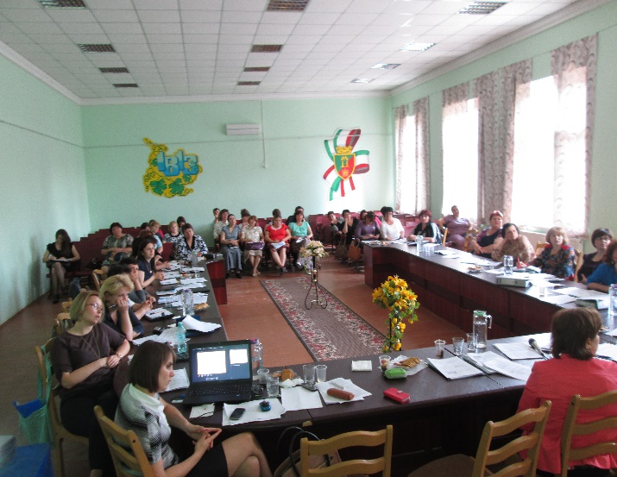
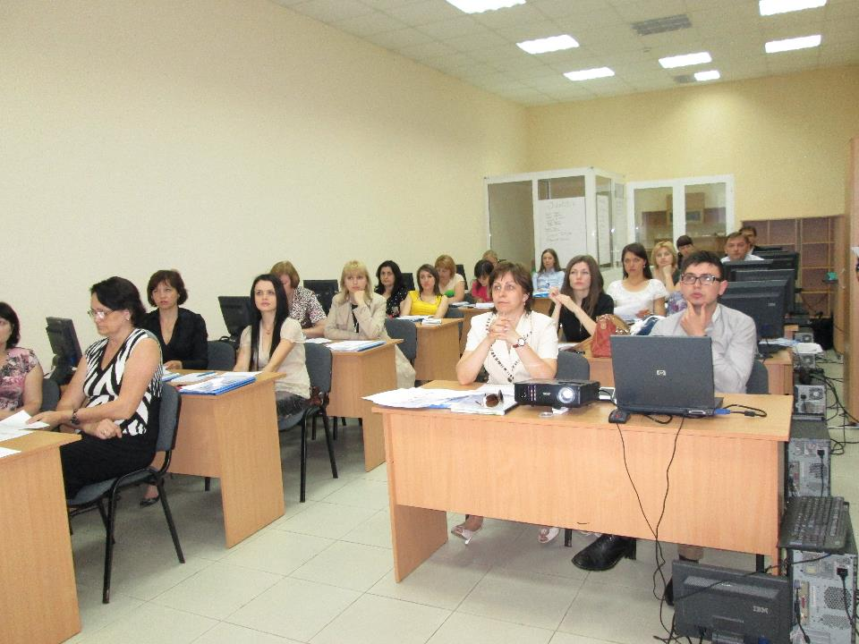
System User Training Strategy (2014-2015)
MOF worked out a training curriculum for financial service specialists
The course included methodology and system application with mandatory hands-on trainings;
More than 200 specialists were trained in the training-of-trainers mode.
MOF provided methodological and technical support for the system user training
A training platform was organized, examples of budgets and users were created, and trainers from financial departments were allocated to train specialists from Primarias.
MOF published all new documents on the web-site
MOF organized outreach training sessions

Slide 14
Risks of Implementing New Processes
Consider changes caused by the introduction of new processes:
Change of work processes in every domain;
Redistribution of functions within and among units;
Need for organizational changes;
Design of new regulations and instructions for the new processes;
Preparing personnel for changes in the processes.

Slide 15
Risks – Legislative Amendments
Amendments to legislation in the course of project implementation may impact the implementation timeline and costs
Amendments should be introduced in a timely manner, at the stage of drafting specifications;
After the system technical specifications have been finalized, a moratorium on amendments to legislation should be introduced;
In the course of the system implementation it is necessary to minimize the number of changes to methodologies and legislation.

Slide 16
Personnel Is the Main Resource
The human resource (personnel) is the only resource appreciating in value with time.
Turnover of IT personnel including main activity specialists during all project phases entails retraining new specialists, delays in implementation and blocking incidents in the course of operation.
Generally positive personnel’s attitude from the very start of the project and their perception of all changes in their activity and introduction of new technologies as steps toward improvement of public finance management processes.

Slide 17
THANK YOU FOR YOUR ATTENTION
Elena.Saharnean@fintehinform.md

