Slide 1
The Evolving Role of Treasury Function Internationally
Treasury Community of Practice
Chisinau, Moldova
1-3 June 2016

Slide 2
Coverage of presentation
Traditional Role of the Treasury
Trends in Treasury Management
Risk Management
Case Study – Evolution in Treasury Management in Australia
Are there core functions for the Treasury?

Slide 3
Typical Treasury Functions
The Treasury comprises an important sub-set of public finance functions that includes:
the preparation of accounts (“book-keeping”),
the setting of accounting standards and policies,
the application of internal controls and the processing of payments on behalf of the government,
the forecasting and management of the government’s cash requirement,
the preparation of annual financial statements, oversight of the government’s bank accounts, and
the management of public assets, liabilities and guarantees
Source: The Evolving Functions and Organization of Finance Ministries, IMF Working Paper

Slide 4
Factors Determining the role of the Treasury
A country’s size, together with its administrative culture and institutional arrangements.
the control framework,
the degree of centralization and decentralization,
whether it is organized as a directorate or department of the finance ministry or as an arms’-length agency with operational independence from the finance ministry (but often subject to its oversight and supervision)
Source: The Evolving Functions and Organization of Finance Ministries, IMF Working Paper

Slide 5
Different Models for the Treasury Function
The British/Irish/Scandinavian system— payment and control functions are decentralized to line ministries but where central policy and oversight functions are located either in the finance ministry or an arms’-length agency
The Francophone system— payment and control functions are heavily centralized in the finance ministry, whose controls extend down even into local governments and state enterprises. Many processing functions have been transferred to line ministries under the modernizing LOLF of 2001, and a specialized agency set up to pay public service salaries.
The Belgian system—a variant of the French model in which the central bank plays and important role, especially for payments. China also has a similar system but using a commercial bank
The Spanish /Portuguese system which includes Mexico— similar to the Francophone model but less centralized; in the case of Spain, an autonomous treasury agency is responsible for the processing of payments and managing the treasury single account (TSA)
Transition Economies (PEMPAL)— powerful centralized Treasury agency sometimes integrated into the the finance ministry sometimes independent. There are also more decentralized versions of this model (eg Bulgaria)
Source: The Evolving Functions and Organization of Finance Ministries, IMF Working Paper

Slide 6
International Examples for the Structure of the Treasury
Source: The Evolving Functions and Organization of Finance Ministries, IMF Working Paper

Slide 7
Rationale for a Traditional Centralized Control Model
Budget execution is king – often this was focussed on line-item budgeting – ensuring every sent was allocated and spent according to the allocations
Information technology is in its early stages of development – continued dependency on manual paper based exchange. May have a central accounting system but no distributed access
Legislative framework may be somewhat dated and prescriptive
focus on detail rather than principles, limited attention to the responsibility of managers to manage
The law may even make the Treasury accountable for payment decisions, or at least be unclear as to who is responsible
Internal controls in MDAs and the internal audit function are still developing - Treasury undertakes an ex-ante control function to ensure everything is correct- BUT how effective can centralised controls be? Who ensures that the expenditure decision was a good use of public money?
Without strong decentralized accountability, people find ways to get around controls

Slide 8
Devolution of Decision Making A major trend in many OECD countries in the 80’s and Beyond
Integrated financial management information systems have been a core driver
Shift in decision making and accountability from the centre to budget entities – balance of authority and responsibility
Needs a strong principle-based legislative framework, which incorporates the concept of public internal financial control
Specific legislative requirements of the financial actors and their role in the budget execution process (PIFC/COSO)
Strong internal audit is important, as is a strong external review functional with parliamentary support and scrutiny
A focus on better decision making – hence the shift from just inputs to results
Ensure that the process is properly planned, that the approval is made up front, and controlled within the FMIS - each step is therefore reviewable
Thus in general, the trend has been that responsibility for controls is also devolved along with the authority, with ex-post review replacing the ex-ante checks!

Slide 9
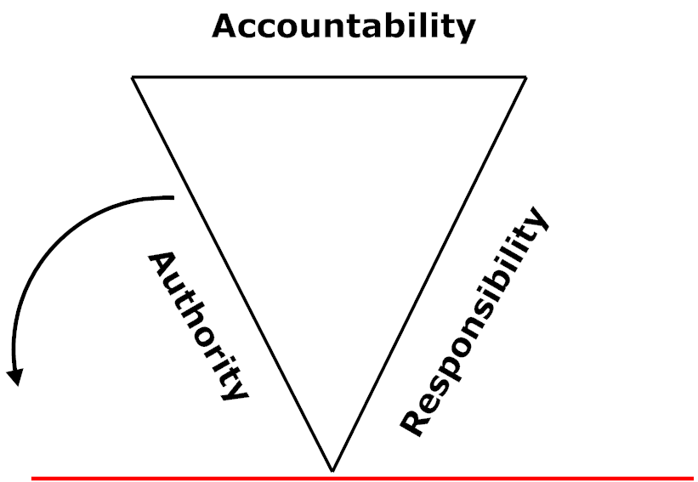
Enhancing accountability and the need to balance authority and responsibility for effective devolution
Diagram by Mark

Slide 10
What is Risk Management?
”risk management is a process… designed to identify potential events that may affect the entity, and manage risk to be within its risk appetite, to provide reasonable assurance regarding the achievement of entity objectives” (COSO www.COSO.org)
Managing and mitigating risks is key
Some examples of risk management strategies
Reduced checks on smaller value transactions - Threshold for reduced or enhanced checks – Dominica
Certification of system based controls for payments
System based controls reduce the need for manual checks (eg procurement linked to payment and accounting)
Centralized system based ex-ante checks – Mexico
Ex-post review – PIFC and Internal Audit/External Audit
Transparency – Georgia
Decisions regarding risk management will directly impact the role of Treasury in budget execution

Slide 11
Evolution of Accounting System in Australian Federal Government – Generation One - Finance Ledger System (FLS)
Cash Based Accounting - Daily
Central unique CoA
Mainframe computer in centre and in 8 regional offices – Accounting Operations Branch
Centralized payroll and payments – payroll and some repetitive payments submitted to banks on magnetic tape – other payments by cheque
Manual input of forms – data-processing pools – over 50% of 300+ staff entirely allocated to this activity
Remaining staff focus is on ensuring payroll and end of month processing achieved
Rudimentary checks regarding forms – eg correct signature
System undertakes checks called “central edits” – these reject simple errors such as erroneous codes, incorrect control totals

Slide 12
Budget Execution
Process within FLS
Stage 1
Decision to Purchase- Pre-commitment
Requisition Stage- Likely to involve tendering processes based on the value of goods and services to be purchased
Stage 2
Purchase Order (legal obligation)
Funds Control/Budget Commitment- Sets aside funds so that money can not be spent for other purposes
Stage 3
Goods or Services Delivered
Liability Recognised- (financial obligation)
Accrual - Accounts payable - Invoice matched to purchase order/commitment
Stage 4
Correctly Rendered Invoice received
Stage 5
Payment Pending in Accounting Systems based on Due date
Stage 6
Payment Made (on the Due Date)
Yes
Payment made on due date recognized both on an accrual and cash basis
No
Stage 7
Budget Arrears
Payments are overdue

Slide 13
Evolution of Accounting System in Australian Federal Government – Generation Two - Finance Information on Resource Management (FIRM)
Advent of MDA FMIS and HRMS –
Central unique high level CoA
Shift to modified accrual in MDAs capturing commitments and accounts payable
Centralized payments and payroll continues but all through electronic payment gateway – bank reconciliation all but eliminated most checks also redundant
Inputs to FIRM and payroll shift to electronic media – initially disc, next through electronic secure “dial-up” access
Small agencies used FIRM but entered forms directly into third-party software
Downsizing as no longer a need for data-processing
New training and education role commenced growing to 50% of staffing over time - partial cost recovery through user charging ($50 per attendee)
Regional Offices becomes the ”eyes and ears” for DoF

Slide 14
Budget Execution
Process within MDAs’ FMIS and FIRM
Stage 1
Decision to Purchase- Pre-commitment
Requisition Stage- Likely to involve tendering processes based on the value of goods and services to be purchased
Stage 2
Purchase Order (legal obligation)
Funds Control/Budget Commitment- Sets aside funds so that money can not be spent for other purposes
Stage 3
Goods or Services Delivered
Liability Recognised- (financial obligation)
Accrual - Accounts payable - Invoice matched to purchase order/commitment
Stage 4
Correctly Rendered Invoice received
Stage 5
Payment Pending in Accounting Systems based on Due date
Stage 6
Payment Made (on the Due Date)
Yes
Payment made on due date recognized both on an accrual and cash basis
No
Stage 7
Budget Arrears
Payments are overdue

Slide 15
Evolution of Accounting System in Australian Federal Government – Generation Three – Accrual Information Management System (AIMS)
All MDAs mandated to acquire a new FMIS – Y2K and accrual the drivers – one system dominants 80% of all selections
MDAs decentralizing internally across Australia using web-based interfaces
Limited central CoA requirements
AIMS - Centralized system to collect daily and monthly accrual information for consolidated reporting – purpose built
Devolved banking arrangements (initially this also involved maintaining cash balances) – no longer centralized payments
Each MDA produces annual report which includes accrual financial statements
Regional offices closed in 1996!

Slide 16
Budget Execution
Process within MDAs’ FMIS and AIMS
Stage 1
Decision to Purchase- Pre-commitment
Requisition Stage- Likely to involve tendering processes based on the value of goods and services to be purchased
Stage 2
Purchase Order (legal obligation)
Funds Control/Budget Commitment- Sets aside funds so that money can not be spent for other purposes
Stage 3
Goods or Services Delivered
Liability Recognised- (financial obligation)
Accrual - Accounts payable - Invoice matched to purchase order/commitment
Stage 4
Correctly Rendered Invoice received
Stage 5
Payment Pending in Accounting Systems based on Due date
Stage 6
Payment Made (on the Due Date)
Yes
Payment made on due date recognized both on an accrual and cash basis
No
Stage 7
Budget Arrears
Payments are overdue

Slide 17
Evolution of Accounting System in Australian Federal Government – Generation Four – Central Budget Management System (CBMS) – latest version
To be implemented in 2017
New system is multipurpose – centralized accrual reporting for manually consolidated General Government and annual consolidated Public Sector
Focus on new program budgeting reporting requirements
Also supports cash management including releases of cash – CBMS creates a derived cashflow statement for each entity – Entities can change this
Creation of a unique CoA enhanced to overcome issues with consolidation – integrates GFSM (Australia) and AASB reporting
Training material centrally produced and released for use

Slide 18
Budget Execution
Process within MDAs’ FMIS and CBMS
Stage 1
Decision to Purchase- Pre-commitment
Requisition Stage- Likely to involve tendering processes based on the value of goods and services to be purchased
Stage 2
Purchase Order (legal obligation)
Funds Control/Budget Commitment- Sets aside funds so that money can not be spent for other purposes
Stage 3
Goods or Services Delivered
Liability Recognised- (financial obligation)
Accrual - Accounts payable - Invoice matched to purchase order/commitment
Stage 4
Correctly Rendered Invoice received
Stage 5
Payment Pending in Accounting Systems based on Due date
Stage 6
Payment Made (on the Due Date)
Yes
Payment made on due date recognized both on an accrual and cash basis
No
Stage 7
Budget Arrears
Payments are overdue

Slide 19
Lessons Learnt from Australian Federal Experience
Accounting reform was not taking place in isolation from other reforms such as enhanced accountability. This was important and did ensure overall improved government operations and decision-making – but were the relationships and the independence of these elements well understood?
One size does not fit all – Australia has a small number of large agencies and a large number of small agencies – small agencies acquired the same systems as a large agency and are also required to report in the same way as a large agency- does this make sense?
If you do not manage for change it may leave you behind – Treasury Regional network did have a role – but this was not managed effectively
Major changes should be driven by a careful analysis of costs and benefits – decentralized processing improved efficiency but did devolved banking and decentralized selection of IFMISs achieve the same results – actually there were large costs to the government. Were these the right decisions?
Generation Five - recent shift back towards shared services– eg centralized processing based on efficiency review (this was the original argument for decentralization too)
Technological capacity has a major influence on how accounting systems evolve – even in OECD countries systems have an end of life.

Slide 20
What are the Core and non-core elements of a Modern Treasury Function?
Oversight of the central accounting system (the general ledger)
Budget Execution Reporting (daily, weekly, monthly quarterly and annually) – enhanced reporting is key to ensuring the Treasury function is valued
Accounting Policy, Instructions and Guidelines – these should be integrated and modernized including accessible on the internet
Consolidated Financial Reporting (annually but eventually more frequently - gradually expand coverage to include all controlled entities, the GGS and eventually the PS
Cash Management and Forecasting - this requires proper use of the GL function, a TSA, quality models and additional timely information from MDAs
Debt Management – strong link to cash management and forecasting. (back office could be in Treasury even if front and middle office are elsewhere)
Training and Education – needs to be strongly linked to the operations, policies and procedures - options exist for it being performed elsewhere
Provision of Treasury services to non-budgetary entities
Provision of other services ( eg storage, disaster management) - these should however not distract from the core services in anyway.
Core
The need
for Strategic Planning
Non-Core
Opportunities

Slide 21
Questions?

Slide 22
Manual Input
M
D
A
S
Finance Payroll System
FLS- Finance Ledger System
(Cash)
Central
Bank
(RBA)
TSA
Vendors (Cheque, Cash or Direct Credit)

Slide 23
Electronic Input
M
D
A
HRMS
I
Finance Payroll System
M
D
A
FMIS
Modified
Accrual
FIRM- Financial Information on Resource Management
(Cash)
Interbank
Clearing
System
vendor bank accounts at commercial banks
Central
Bank
(RBA
TSA
23

Slide 24
MDA
HRMS
I
No Central Govt General Ledger
Reporting Only
AIMS- Accrual Information Management
System – (Accrual)
MDA
FMIS
(Accrual)
Cash Releases
vendor bank accounts at commercial banks
Central
Bank
(RBA)
TSA
24

Slide 25
MDA
HRMS
I
Improved General Ledger
Functionality
Reporting and Cash plans
CBMS- Central Budget Management System (Cash and Accrual)
MDA
And SoE
FMIS
(Accrual)
Cash Releases
vendor bank accounts at commercial banks
Central
Bank
(RBA)
TSA
25

