Slide 1
PEMPAL/IACOP Plenary Meeting March 21-23, 2016 Prague – Czech Republic
Internal Control in Brazil : current situation and prospects
Gustavo Ungaro
São Paulo State General Ombudsman Former President of CONACI - National Council of Internal Control
conaci.org.br ouvidoriageral.sp.gov.br gustavoungaro@sp.gov.br

Slide 2
PUBLIC CONTROL
EXTERNAL CONTROL
INTERNAL CONTROL
Public Prosecution - MP
General Comptroller of the Union - CGU
National Congress
Federal Audit Court - TCU
conaci.org.br ouvidoriageral.sp.gov.br gustavoungaro@sp.gov.br

Slide 3
Federal Constitution
Article 74. The Legislative, Executive and Judicial Powers shall maintain an integrated system internal control for the purpose of:
I - evaluating the attainment of the goals established in the pluriannual plan, the implementation of government programmes and of the budgets of the Union;
II - verifying the lawfulness and evaluating the results, as to effectiveness and efficiency, of budgetary, financial and property management in the agencies and entities of the federal administration, as well as the use of public funds by private legal entities ;
III - exercising control over credit transactions, collateral signatures and guarantees, as well as over the rights and assets of the Union;
IV - supporting external control in the exercise of its institutional mission.
Paragraph 1. the persons responsible for internal control shall, upon learning of any irregularity or illegality, inform the Federal Audit Court about it, subject to joint liability.
Paragraph 2. Any citizen, political party, association or labour union has standing
under the law to denounce irregularities or illegalities to the Federal Audit Court.
Article 70. Control of accounts, finances, budget, operations and property of the Union and of the agencies of the direct and indirect administration, as to lawfulness, legitimacy, economic efficiency, application of subsidies and waiver of revenues, shall be exercised by the National Congress, by means of external control and of the internal control system of each Power.
conaci.org.br ouvidoriageral.sp.gov.br gustavoungaro@sp.gov.br

Slide 4
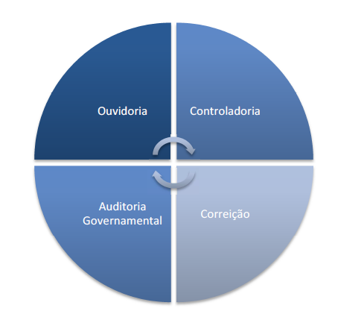
Macrofunctions of the Internal
Control - PEC nº 45/2009
(Proposed Constitutional Amendment)
"Art . 37. ................. XXIII - the activities of
the internal control system , provided for in
art. 74, essential to the functioning of
public administration, behold, especially
ombudsman functions, controlling,
government auditing and correction , and
shall be performed by permanent nature
organs, and carried out by organized into
specific careers, in the form of
supplementary law . “
Current Status : Approved by the Senate CCJ on February 24
Forwarded to the plenary deliberation
conaci.org.br ouvidoriageral.sp.gov.br gustavoungaro@sp.gov.br

Slide 5
The National Council of Internal Control - CONACI is a civil association that brings together the public internal control agencies of the all 26 States of the Brazilian Federation, the Federal District, the Union and 18 State Capitals , totaling 46 members.
Purpose:
The development of an effective performance in the control of public administration , contributing to the prevention and combating corruption and the search for greater integration between the Internal Control Agencies in order to make the exchange of experiences, knowledge and tools , effective means strengthening of its institutions and contributing to the full implementation of the democratic rule of law.
Meetings:
4 2-day technical meeting per year, with one 2-day annual seminar (600 participants).
conaci.org.br ouvidoriageral.sp.gov.br gustavoungaro@sp.gov.br

Slide 6
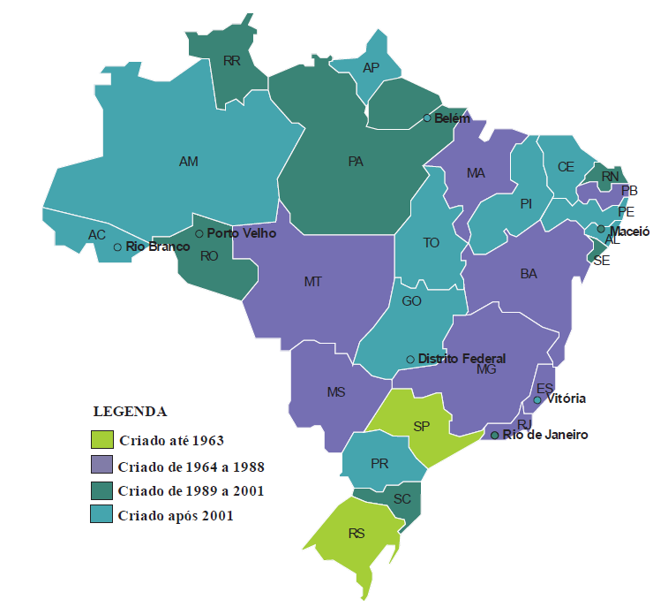
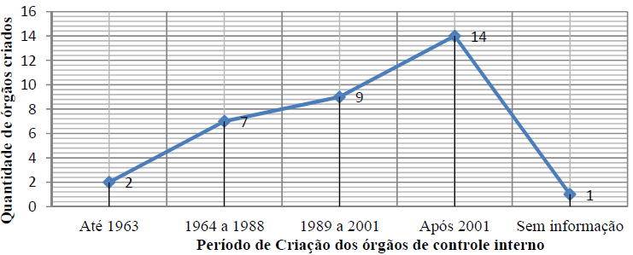
Creation of Internal
Control Organs in time
More than half of the agencies was created after the year 2001, the year of approval of the Fiscal Responsibility Law.
conaci.org.br ouvidoriageral.sp.gov.br gustavoungaro@sp.gov.br

Slide 7
WAYS OF PERFORMING AUDITS
DIRECT
INDIRECT
centralized
decentralized
integrated
shared
outsourced
coordinated by the internal control system with the help of public and private institutions
performed by crowded servers in the central agency
performed exclusively by non-governmental organization
performed by the sectoral bodies servers
performed by the central and sectoral agency servers
conaci.org.br ouvidoriageral.sp.gov.br gustavoungaro@sp.gov.br

