Slide 1


TRANSPARENT BUDGET PROCESS
THE BUDGETARY PROCEDURE IN LOCAL
SELF-GOVERNMENT UNITS
TOWN OF CRIKVENICA BUDGET
ECONOMY, TOURISM AND PROJECTS DEPARTMENT

Slide 2
SOME BASIC INFORMATION ABOUT THE TOWN OF CRIKVENICA
The Town of Crikvenica is situated in the Kvarner Bay, in Primorsko-Goranska County, covering an area of about 28 square kilometres, 36 km away from Rijeka
According to the latest Census (2011), the Town of Crikvenica has 11,122 inhabitants
Mediterranean climate with a substantial number of sunshine hours annually (about 2,500)
Largely tourism-oriented economy
Approximately € 10 million current budget revenues
One of the most transparent towns in the Republic of Croatia
ECONOMY, TOURISM AND PROJECTS DEPARTMENT

Slide 3
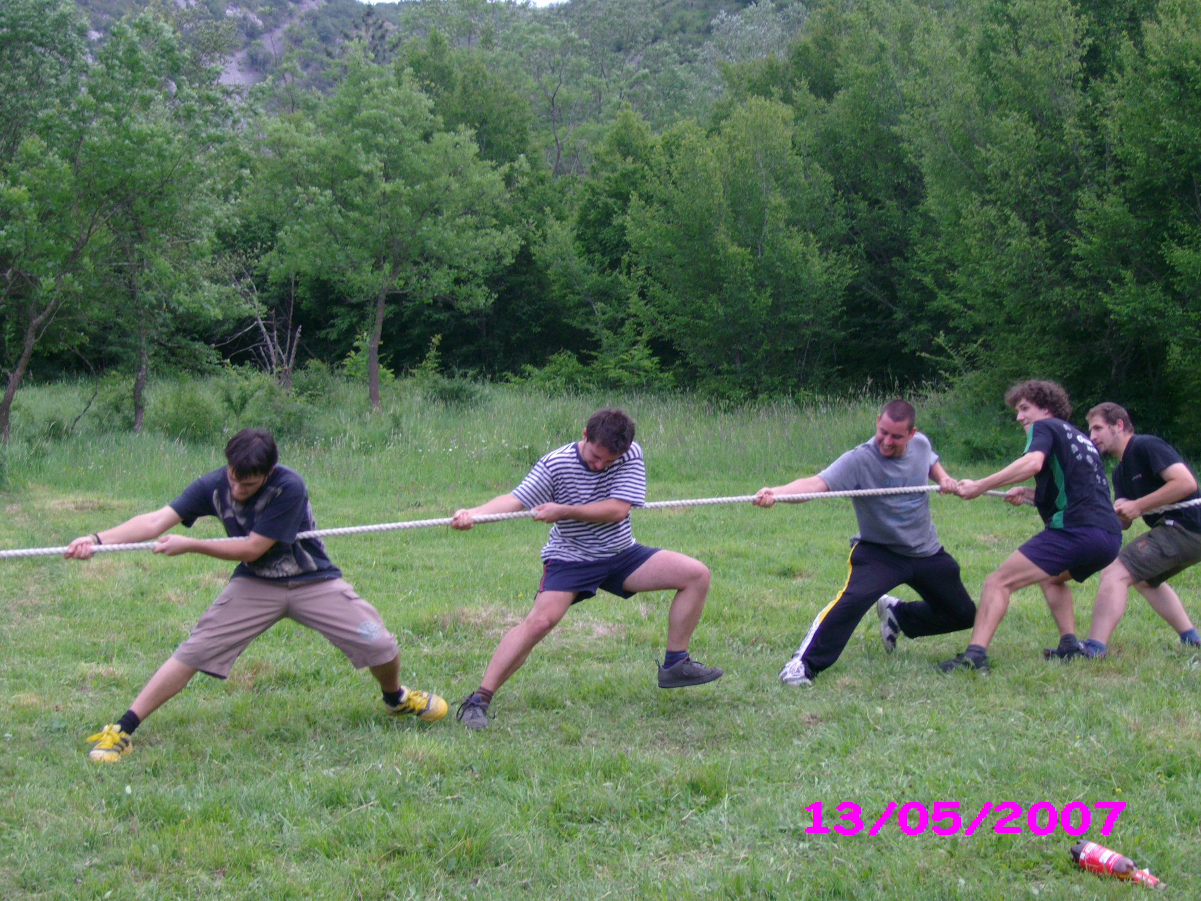

ODSJEK ZA GOSPODARSTVO, TURIZAM I PROJEKTE

Slide 4
BUDGET PROCESS
1. CITIZENS
2. BUDGETARY AND EXTRA-BUDGETARY USERS
3. THE BOARD OF FINANCE
4. TOWN MAYOR
5. TOWN COUNCIL
BUDGET PROCESS – A SET OF RULES ALLOWING DECISION-MAKING THAT LEADS TO BUDGET PREPARATION AND ADOPTION
ECONOMY, TOURISM AND PROJECTS DEPARTMENT

Slide 5
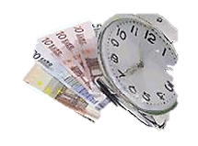
WHO AND WHAT DETERMINES THE FRAMEWORK
_{OF} _{OF} _{THE BUDGETARY PICTURE?}
?
_{LEGISLATION}
_{NATIONAL STRATEGIC DOCUMENTS}
_{COUNTY STRATEGIC DOCUMENTS}
_{TOWN} _{STRATEGIC DOCUMENTS}
_{TOWN BUDGET}
ECONOMIC SITUATION IN THE SURROUNDINGS
_{PROJECTS FROM PREVIOUS YEARS}
BUDGETARY USERS
LOAN-RELATED LIABILITIES
The Town Budget is ultimately reduced to a single number. The final budget amount. However, to obtain such single number, all forces should be taken into account: legislation, national, county and town forces, citizens and other forces determining the final amount in our „town cash-box”. This may not be the most accurate description, but is the most picturesque. The town administration always wants more, faster, better and as soon as possible, while on the other hand, all the foregoing forces have their own rules providing a solid framework to such aspirations. Sometimes it is not easy to cope with all these strategies, priorities, obligations, laws, provisions and restrictions, but such are the rules of the game and they have to be adhered to. Some of them may be influenced or (co-)created, but some, unfortunately, may not.
ECONOMY, TOURISM AND PROJECTS DEPARTMENT

Slide 6
CITIZENS AS PARTICIPANTS IN THE BUDGET PROCESS
Take part in the budgetary hearing during preparation and adoption phase as the budget is made because of and for them
Have a possibility to make proposals concerning allocation of budgetary funds
Monitor whether budget execution complies with priorities
ECONOMY, TOURISM AND PROJECTS DEPARTMENT

Slide 7
CITIZEN PARTICIPATION TECHNIQUES
BUDGETARY ADDRESS
PUBLIC FORA
SURVEYS
CALL-IN SHOWS
POPULAR REPORTING – BUDGET SUMMARY
ECONOMY, TOURISM AND PROJECTS DEPARTMENT

Slide 8
HOW AND WHEN DID WE START INVOLVING THE CITIZENS? – OUR EXPERIENCES
The first public forum concerning the topic of local budget preparation in the Republic of Croatia was organised in 2002 in cooperation with the Urban Institute
The same year, the 2003 Budget in a Nutshell brochure was prepared and distributed
We had no idea what it would mean to us and whether it would bear any fruit, but we are still doing it and haven’t given up
ECONOMY, TOURISM AND PROJECTS DEPARTMENT

Slide 9
WHY A PUBLIC FORUM?
An opportunity to inform the citizens about budgetary issues
Excellent two-way communication model
Gives the citizens an opportunity to express their opinions on the most important issues and matters regarding local self-government directly to the Mayor and expert town departments
One of the ways to obtain support from the citizens for key activities, projects, revenue allocation and expenditure items
Opportunity for town authorities to explain priorities and projects
Demystifies the budget process and builds trust between citizens and local authorities
ECONOMY, TOURISM AND PROJECTS DEPARTMENT

Slide 10
ORGANISATION OF A PUBLIC FORUM
A successful public forum requires:
Good quality of prepared materials
Competent and prepared presenter and facilitator
Adequate and comfortable premises
Topic presentation method
Human resources are most important (officers responsible for forum preparation and presentation, executive head, facilitator)
ECONOMY, TOURISM AND PROJECTS DEPARTMENT

Slide 11
IMPORTANCE OF ATTENDANCE OF THE TOWN COUNCIL MEMBERS
Opportunity to hear opinions, ideas, proposals and complaints directly from the citizens, which helps them represent real interests of their constituency
For better understanding of ideas and arguments put forward by individuals-citizens, which ideas and arguments will be represented or actively lobbied for by such members during decision-making in the representative body
ECONOMY, TOURISM AND PROJECTS DEPARTMENT

Slide 12
PROS AND CONS OF A PUBLIC FORUM
CONS:
Inadequate for decision-making, only adequate for dissemination of information
Inadequate for reaching consensus
Inefficient for presenting complex ideas or overly detailed information
Danger of biased individuals wishing to impose their opinion or dominance
PROS:
Ideal for directly informing a large number of citizens
Allows direct comments and discussion about a specific issue
All sides of the issue can be explained
Direct interaction enables direct explanations or direct resolving of misunderstandings
ECONOMY, TOURISM AND PROJECTS DEPARTMENT

Slide 13
BUDGET IN A NUTSHELL
Budget summary document
User-friendly and easy to read budget presentation
Marketing material for the local self-government
Important way of reaching the public
Educational material
Symbol of local self-government advocating
transparency and civil right to information
ECONOMY, TOURISM AND PROJECTS DEPARTMENT

Slide 14
THE BENEFITS OF CITIZEN PARTICIPATION IN THE BUDGET PROCESS
Improves quality decision-making based on real needs
The public is more ready to accept decisions
Timely information and discussion about different issues and matters
The authorities show their openness and accessibility
Helps to identify and correct budgetary priorities
Increases accountability of the authorities and reduces their (self)isolation
ECONOMY, TOURISM AND PROJECTS DEPARTMENT

Slide 15
A MAN WHO WANTS TO DO SOMETHING WILL FIND A WAY; A MAN WHO DOESN’T WILL FIND AN EXCUSE. ( P. Picasso)
Human resources – expert departments participating in budget preparation, executive power, real interest in taking citizens’ opinion into account
Material resources (costs of graphic design, printing and distribution of Budget in a Nutshell, or the costs of preparation of e-version of Budget in a Nutshell)
Time (insignificantly increased engagement of expert departments who in this phase of budget preparation don’t know whether such proposal will be adopted anyway, i.e. whether the citizens want the planned projects or the money is planned to be spent in some other way (more or less efficiently))
ECONOMY, TOURISM AND PROJECTS DEPARTMENT

Slide 16
IT’S EASY TO BE ON THE TOP.
THE COMPETITION IS WEAKEST THERE.
For 14 years the Town of Crikvenica has bene holding public fora and publishing Budget in a Nutshell, sent to every address and available to all citizens, which enabled us to reach the top of the list of Croatian towns and municipalities.
However, in our opinion, it would be even better for both democratic processes and for the citizens of our country alike if another 14 towns or municipalities had their own first public forum and their Budget in a Nutshell for next year already.
All our experiences and professional support are at your disposal and don’t hesitate to contact us.
ECONOMY, TOURISM AND PROJECTS DEPARTMENT

Slide 17
AND LAST BUT NOT LEAST: WHAT DOES THE BUDGET PROCESS TRANSPARENCY IN LOCAL SELF-GOVERNMENT UNITS DEPEND ON? (INSTITUTE OF PUBLIC FINANCE (IJF) - 2015)
Open relationship between the town administration and its citizens does not require:
Number of inhabitants
Number of employed
Budget revenues / Fiscal capacity
Operation / level of development of the local unit ….
But it does require:
Political willingness of local authorities (www.ijf.hr)
ECONOMY, TOURISM AND PROJECTS DEPARTMENT

Slide 18

BUDGET IN A NUTSHELL
OF THE TOWN OF CRIKVENICA FOR 2015
Town of Crikvenica, January 2015
ECONOMY, TOURISM AND PROJECTS DEPARTMENT

Slide 19
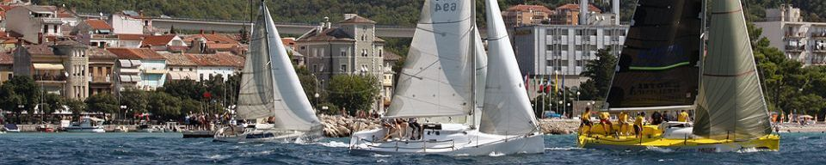
Thank you for your attention!!!

