Slide 1
Local and regional self-government units' budgets
- transparency
Nevenka Brkić, Ministry of Finance
Zagreb, 2 December 2015

Slide 2
Presentation overview
Structure of the Republic of Croatia
Local government of the Republic of Croatia and its self-government jurisdiction
Public funding system in the Republic of Croatia
Local and regional self-government funding structure
Budgeting process at the local and regional level
Transparency principles
Budget guidebook for citizens
Budget transparency

Slide 3
Structure of the Republic of Croatia
The provisions of the Act on the Territories of Counties, Towns and Municipalities in the Republic of Croatia (Official Gazette no. from 86/06 to 110/15) establish the regional structure of the Republic of Croatia and determine the territories of all the counties, towns and municipalities in the Republic of Croatia, their names and seats, the manner of establishing and changing the borders of municipalities and towns, the procedure preceding the change of the regional structure and other issues significant for the regional structure of local self-government units, that is, regional self-government units [hereinafter: LRSGUs]

Slide 4
Local government in the Republic of Croatia
Croatia is established at two government levels: state and local government
Croatia has two types of local government, and these are:
counties [regional self-government units]
towns and municipalities (local self-government units)
There are 20 counties, the City of Zagreb, which enjoys the status of a county and a town, 127 towns and 428 municipalities in Croatia, amounting to 576 LRSGUs
A middle level of government has not been established in Croatia as in some EU countries

Slide 5
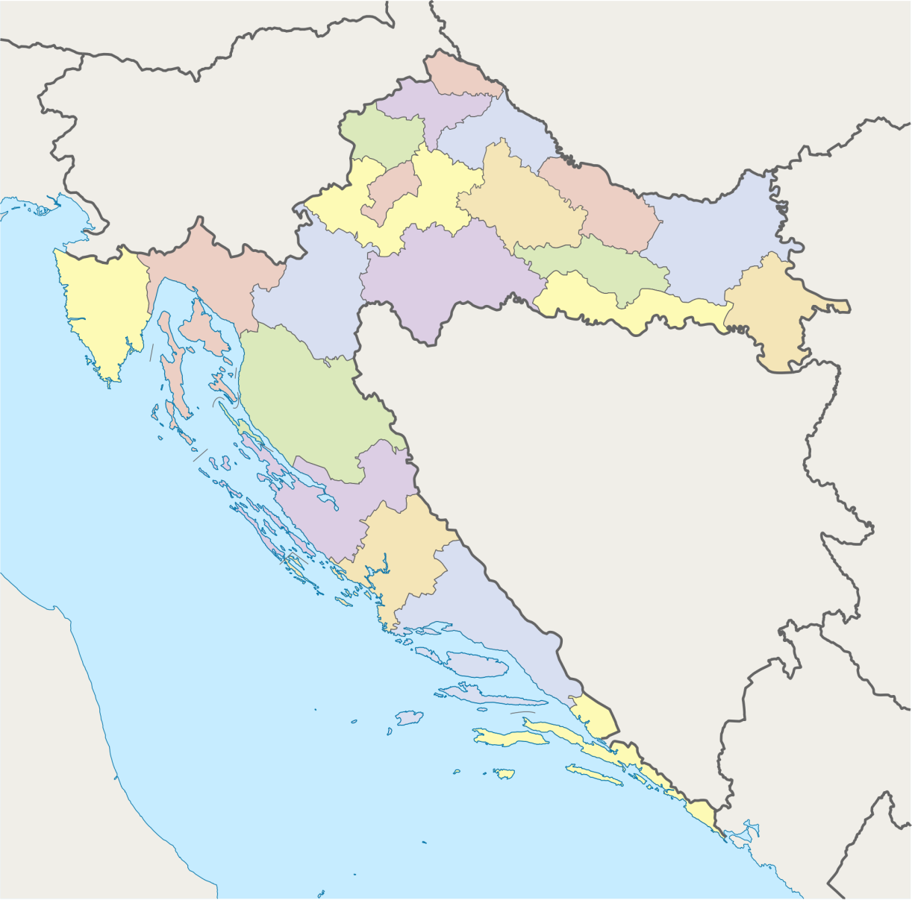
Counties on the territory of Croatia
AUSTRIA
HUNGARY
ITALY
SLOVENIA
SERBIA
BOSNIA & HERCEGOVINA
MONTENEGRO
ITALY
ALB.

Slide 6
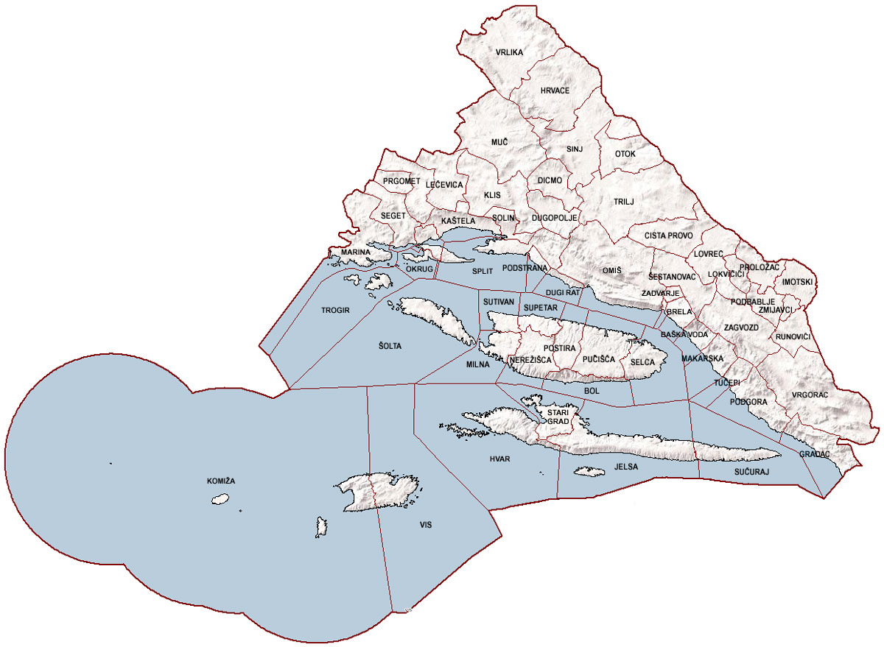
Borders of the Split-Dalmatia County

Slide 7
Self-government jurisdiction of an LRSGU
The provisions of the Act on Local and Regional Self-Government (Official Gazette no. 33/01 to 144/12 and 19/13—consolidated text) prescribe the self-government jurisdiction of municipalities, towns and counties
Municipalities, towns and counties are independent in deciding on the activities from their self-government jurisdiction pursuant to the Constitution of the Republic of Croatia and the stated Act

Slide 8
Self-government jurisdiction of municipalities and towns
In their self-government jurisdiction, towns and municipalities perform activities of local significance which directly meet citizens' needs and which are not assigned to state authorities under the Constitution or law, and especially activities relating to:
- settlement planning and residence,
- spatial and urban planning,
- municipal economy,
- child care,
- social welfare,
- primary health care,
- primary school education,
- culture, physical education and sports,
- consumer protection,
- natural environment protection and enhancement,
- fire and civil protection,
- transport on own territory,
- and other activities pursuant to special laws

Slide 9
The self-government jurisdiction of large towns and county seats
Large towns are local self-government units which are at the same time economic, financial, cultural, health, traffic and scientific centres of development of wider surroundings which have populations of more than 35,000 inhabitants
The self-government jurisdiction of large towns, as well as of county seats, includes not only activities of local significance performed by the abovementioned towns and municipalities, but also activities related to:
- public road maintenance,
- issuing of construction and location permits, other documents related to construction and execution of spatial planning documents

Slide 10
Self-government jurisdiction of counties
In its self-government jurisdiction, a county performs activities of regional significance, and especially those relating to:
- education,
- health care,
- spatial and urban planning,
- economic development,
- transport and transport infrastructure,
- public road maintenance,
- planning and development of the network of educational, health care, social and cultural institutions,
- issuing of construction and location permits, other documents related to construction and execution of spatial planning documents for the county territory outside the territory of a large town,
- and other activities pursuant to special laws

Slide 11
LRSGU in the public funding system in the Republic of Croatia
PUBLIC FUNDING SYSTEM IN THE REPUBLIC OF CROATIA
CENTRAL GOVERNMENT BUDGET
EXTRABUDGETARY FUNDS
LOCAL AND REGIONAL SELF-GOVERNMENT UNITS' BUDGETS
CONSOLIDATED BALANCE SHEET OF THE GENERAL GOVERNMENT
text
CONSOLIDATED BALANCE SHEET OF THE CENTRAL GOVERNMENT

Slide 12
LRSGU funding sources
1. OWN INCOME
Own taxes (including surtax on income tax)
Other own income (income under special regulations—public utility contributions, public utility fees, administrative fees, fees for use of public surfaces, residence tax, income from sales and rental of assets, fines ...)
2. COMMON INCOME
Tax income (income tax and real estate transfer tax)
Other common income (concession fee, income from monument annuity, income from sale of duty stamps, income from games of chance ...)
3. OTHER SOURCES OF INCOME
Grants
Receipts from borrowing (long-term and short-term)

Slide 13
Common taxes LRSGU
Income tax
is divided between the local and the regional self-government
Real estate transfer tax
is divided between the local self-government (80%) and the central state (20%)

Slide 14
Income tax—distribution
Distribution of income from income tax Period | State share | Municipality/town share | County share | Decentralized functions share | Share of the position of the equalization grant for decentralized functions | Share of the position of the grant for projects co-funded from EU funds | Total
01/01/1994 - 31/03/2000 | 70.0% | 25.0% | 5.0% | - | - | - | 100.0%
01/04/2000 -30/06/2001 | 60.0% | 32.0% | 8.0% | - | - | - | 100.0%
01/07/2001 - 31/12/2001 | 29.2% | 32.0% | 8.0% | 9.8% | 21.0% | - | 100.0%
01/01/2002 - 31/12/2002 | 29.6% | 32.0% | 8.0% | 9.4% | 21.0% | - | 100.0%
01/01/2003 - 31/12/2006 | 24.6% | 34.0% | 10.0% | 10.4% | 21.0% | - | 100.0%
01/01/2007 - 30/06/2008 | 0.0% | 52.0% | 15.0% | 12.0% | 21.0% | - | 100.0%
01/07/2008 - 29/02/2012 | 0.0% | 55.0% | 15.5% | 12.0% | 17.5% | - | 100.0%
01/03/2012 - 31/12/2014 | 0.0% | 56.5% | 16.0% | 12.0% | 15.5% | - | 100.0%
01/01/2015 - | 0.0% | 60.0% | 16.5% | 6.0% | 16.0% | 1.5% | 100.0%

Slide 15
LRSGU income structure in 2014

Slide 16
LRSGU tax income structure in 2014

Slide 17
Budgeting process at the local and the regional level
Based on strategical plans, national reform programme and convergence programme and the recommendations of the Council of the EU for the Republic of Croatia Ministry of Finance ... Government of the Republic of Croatia ... | ... prepares draft guidelines for economic and fiscal policies (GUIDELINES) for a three-year period ... adopts the GUIDELINES by conclusion | by the end of July (Article 25 of the Budget Act)
The Ministry of Finance ... | ... based on the guidelines of the Croatian Government, delivers to the ministries and other state authorities the Instructions for Preparing the Proposed State Budget | as of 15 August (Article 26 of the Budget Act)
The Ministry of Finance ... | ..., based on the guidelines of the Croatian Government and the Instructions for Preparing the Proposed State Budget, prepares the Instructions for Preparing the LRSGU Budget | as of 15 August (Article 27 of the Budget Act)
LRSGU budget users... | ... shall deliver a proposal of the financial plan to the competent administrative authority by | 15 September at the latest (Article 32 of the Budget Act)
LRSGU extrabudgetary user | ... shall deliver the proposal of the financial plan to the competent administrative authority by | 15 September at the latest (Article 36 of the Budget Act)

Slide 18
Budgeting process at the local and the regional level
The administrative authority for finance... | ...prepares a draft budget for the budget year and projections for the next two years and delivers them to the head of the LRSGU | by 15 October (Article 37 of the Budget Act)
The head of the LRSGU... | ... determines the proposed budget and the projections, and submits these to the representative body for adoption | by 15 November (Article 37 of the Budget Act)
The representative body of the LRSGU... | ... adopts the budget for the next budget year (at the level of an economic classification sub-group) and the projections for the next two years (at the level of the economic classification group) ... gives consent to the proposal of the financial plan of his extrabudgetary user together with the adoption of the budget | by the end of the year (and that being within a deadline which enables the application of the budget as of 1 January of the year the budget relates to) (Article 39 of the Budget Act)
The head of the LRSGU... | ... shall deliver to the Ministry of Finance the budget and the projections, the decision on budget execution and amendments to the budget | within 15 days from their coming into force (Article 40 of the Budget Act)
Source: the Budget Act (Official Gazette 87/2008, 136/2012 and 15/2015)

Slide 19
Transparency principles at the LRSGU level
At its session held on 5 April 2012, the Government of the Republic of Croatia, accepted the Action Plan for the Implementation of the Open Government Partnership Initiative in the Republic of Croatia for the Period 2012-2013
As one of the priority challenges of the said Action Plan, the strengthening of the transparency principle was stressed as a factor contributing to more efficient management of public resources
Pursuant to the Action Plan, it was proposed to LRSGUs, for the purpose of making the contents of their budgets available to the public, to publish on their web pages:
the budget proposal
the adopted budget with projections
the proposal of a semi-annual and annual report on budget execution

Slide 20
Budget guidebook for citizens
Pursuant to the Action Plan, it was proposed to LRSGUs to publish citizens' guidebooks
The Ministry of Finance gave its recommendation and published on its web pages a Unique format of the citizens' guidebook accompanying local and regional self-governments budgets
The LRSGUs' citizens' guidebook should contain:
A word of introduction which lays out the key objectives intended to be achieved through activities and projects financed from the budget
General notes about the budget and its contents
A short overview of the proposed budget for the budget year and the projections from the next two years
Budget income structure
Key programmes, projects and activities funded from the budget
Important contacts and useful information

Slide 21
Budget transparency
The provisions of Article 12 of the Budget Act (Official Gazette no. 87/08, 136/12 and 15/15) prescribe one of the key budget principles—the transparency principle. The transparency principle is especially important because it makes it available to the public and to all those interested in how budget funds are spent. The said provisions stipulate as follows:
LRSGUs' budget and budget projections, amendments to the budget and the decision on provisional funding shall be published in LRSGUs' official journals

Slide 22
Budget transparency (2)
The provisions of Article 12 of the Budget Act also stipulate that:
the semi-annual and annual report on the execution of the budget, and the semi-annual and annual report on the execution of the financial plan of an extrabudgetary user shall be published on LRSGUs' web pages
the general and special part of the semi-annual and annual report on the execution of the budget and the general and special part of the semi-annual and annual report on the execution of the financial plan of an extrabudgetary user shall be published in LRSGUs' official journals

Slide 23
Budget transparency (3)
LRSGU, budgetary and extrabudgetary users publish annual financial reports on their web pages not later than within eight days from the day of their submission
if a budgetary or extrabudgetary user does not have their own web page, they shall publish their annual financial reports on the web pages of the competent LRSGU within eight days from their submission

Slide 24
Why is LRSGU transparency so important?
Citizens should be encouraged to take part in the adoption and implementation of decisions important for the development of the community they live in
Lack of LRSGUs' initiative to include citizens in the process of adoption of decisions of public interest can make the citizens lose their trust in self-government institutions
Availability of information on income and expenditure, foreseen activities and projects funded from an LRSGU's budget has a strong impact on corruption prevention and greater efficiency in spending budget funds
Coordinated action of all interested parties in the preparation and adoption of an LRSGU's budget raises the level of mutual trust, brings about improvement and development of the LRSGU and supports more efficient spending of budget funds

Slide 25
Published on the web pages of the Ministry of Finance
The Ministry of Finance published the amount and structure of the grant to LRSGUs from the state budget at http://www.mfin.hr/hr/pomoci-jlprs
The Ministry of Finance published the Realization of the LRSGU Budget for the period 2010-2014 at http://www.mfin.hr/hr/ostvarenje-proracuna-jlprs- za-period-2010-2014
The realization of the LRSGU budget is available from the web pages of the Ministry of Finance (archives) starting from 1998

Slide 26
Grants to LRSGUs in 2015 planned in the Croatian state budget, in section 025 - Ministry of Finance
http://www.mfin.hr/hr/pomoci-jlprs in kuna
Activity designation | Local and regional self-government unit's name | Grants to local and regional self-government units based on |  |  |  | Total grant in 2015
 |  | Article 35 (1) of the Act on Realization of the State Budget of the Republic of Croatia for 2015 on account of income tax refund to citizens based on annual tax reports | Article 35(2), (3) of the Act on the Realization of the State Budget of the Republic of Croatia for 2015 on account of profit tax to units enjoying the status of an assisted area | Article 35 (4) of the Act on the Realization of the State Budget of the Republic of Croatia for 2015 in the amount of the grant planned in 2014 | Article 36 of the Act on the Realization of the State Budget of the Republic of Croatia for 2015 (group III 70 %, group IV 45 % and group V 25 % of the amount from 2013 from profit tax and increased share in income tax)
1 | 2 | 3 | 4 | 5 | 6 | 7(3+4+5+6)
 | TOWNS
A557050 | BELI MANASTIR | 7,610,908 | 1,373,581 | 0 | 0 | 8,984,489
A557051 | BELIŠĆE | 1,229,122 | 1,237,703 | 0 | 0 | 2,466,825
A557052 | BENKOVAC | 3,815,623 | 1,653,999 | 1,922,333 | 0 | 7,391,955
A557056 | BUZET | 0 | 0 | 0 | 6,275,389 | 6,275,389
A557059 | ČABAR | 0 | 0 | 0 | 2,160,337 | 2,160,337
A557061 | ČAZMA | 1,120,451 | 472,774 | 0 | 0 | 1,593,225
A557063 | DELNICE | 0 | 0 | 0 | 3,465,186 | 3,465,186
A557066 | DRNIŠ | 4,686,489 | 3,860,639 | 0 | 0 | 8,547,128
A557070 | ĐAKOVO | 3,650,344 | 2,081,273 | 0 | 0 | 5,731,617
A557072 | GAREŠNICA | 1,061,799 | 878,535 | 0 | 0 | 1,940,334
A557073 | GLINA | 3,320,869 | 2,591,801 | 2,757,595 | 0 | 8,670,265
A557074 | GOSPIĆ | 0 | 0 | 0 | 10,408,241 | 10,408,241
A557075 | GRUBIŠNO POLJE | 2,895,740 | 1,766,264 | 538,540 | 0 | 5,200,544
A557076 | HRVATSKA KOSTAJNICA | 1,524,534 | 72,888 | 0 | 0 | 1,597,422
A557078 | ILOK | 3,368,339 | 670,875 | 787,443 | 0 | 4,826,657
A557079 | IMOTSKI | 3,731,813 | 2,579,645 | 0 | 0 | 6,311,458
A557087 | KNIN | 7,001,540 | 669,073 | 748,607 | 0 | 8,419,220

Slide 27
CROATIA TOTAL - BUDGET
Total budgets of counties, towns and municipalities
Account | Item description | Realization in 2012 | Index 2012/11 | Realization in 2013 | Index 2013/12 | Realization in 2014 | Index 2014/13
1 | 2 | 6 | 7 | 8 | 9 | 10 | 11
INCOME AND EXPENDITURE, REVENUES AND EXPENSES ACCORDING TO THE ECONOMIC CLASSIFICATION
6 | OPERATING INCOME (AOP 002+039+047+067+090+107+114+119) | 20,687,119,854 | 102.1 | 22,166,131,483 | 107.1 | 22,109,792,677 | 99.7
61 | Income from taxes (AOP 003+012+018+024+032+035) | 11,938,587,467 | 105.5 | 13,198,733,035 | 110.6 | 12,768,532,804 | 96.7
611 | Income tax and surtax (AOP 004 to 009 - 010 + 011) | 10,703,652,915 | 106.8 | 11,844,649,906 | 110.7 | 11,521,560,315 | 97.3
6111 | Tax and surtax on income from non-independent work | 10,189,335,744 | 105.6 | 10,419,949,980 | 102.3 | 10,507,967,881 | 100.8
6112 | Tax and surtax on income from independent activities | 544,325,805 | 96.7 | 598,696,260 | 110.0 | 612,115,010 | 102.2
6113 | Tax and surtax on income from property and property rights | 128,487,837 | 114.4 | 156,196,418 | 121.6 | 190,720,505 | 122.1
6114 | Tax and surtax on income from capital | 150,689,636 | 348.8 | 284,329,649 | 188.7 | 343,580,395 | 120.8
6115 | Tax and surtax on income based on the annual report | 109,878,683 | 95.0 | 126,539,757 | 115.2 | 138,025,852 | 109.1
6116 | Tax and surtax on income determined in the inspection process for previous years | 18,068,218 | 38.5 | 531,847,321 | 2,943.6 | 11,825,019 | 2.2
6117 | Refund of tax and surtax on income based on the annual report | 253,486,572 | 67.3 | 269,971,926 | 106.5 | 275,994,825 | 102.2
6119 | Refund of surplus realized tax on income for decentralized functions | -180,077,200 | - | 2,937,553 | - | 6,679,522 | 227.4
612 | Profit tax (AOP 013 to 016 - 017) | 957,355 | 39.6 | 0 | 0.0 | 0 | -
6121 | Company profit tax | 758,500 | 31.4 | 0 | 0.0 | 0 | -
6123 | Profit withholding tax on interest, dividends and shares in the profit | 198,855 | >>100 | 0 | 0.0 | 0 | -
613 | Property tax (AOP 019 to 023) | 741,463,239 | 91.6 | 842,122,678 | 113.6 | 744,041,317 | 88.4
6131 | Permanent taxes on immovable property | 155,105,114 | 105.3 | 162,016,787 | 104.5 | 172,532,466 | 106.5
6132 | Tax on inheritance and gifts | 7,950,670 | 97.4 | 8,445,289 | 106.2 | 11,866,017 | 140.5
6133 | Tax on capital and financial transactions | 115,001 | 49.4 | 0 | 0.0 | 0 | -
6134 | Occasional property taxes | 578,192,384 | 88.5 | 671,472,375 | 116.1 | 559,388,569 | 83.3
6135 | Other permanent property taxes | 100,070 | 39.9 | 188,227 | 188.1 | 254,265 | 135.1
614 | Taxes on goods and services (AOP 025 to 031) | 491,673,236 | 103.7 | 510,935,886 | 103.9 | 501,345,443 | 98.1
6141 | Value added tax | 63,475 | 83.6 | 0 | 0.0 | 0 | -
6142 | Sales tax | 95,687,740 | 108.9 | 141,251,055 | 147.6 | 143,577,503 | 101.6

Slide 28
Published on web pages
Based on the data published on the web pages of the Ministry of Finance about the realization of the LRSGU budget, the Institute for Public Funding published an article on its website www.ijf.hr/upload/files/file/newsletter/98.pdf, and based on that article, a map of Croatia appeared on the web page http://brojkemi.xyz/proracun/index.html with all the municipalities and towns with the basic data on the realization of the municipalities' and towns' budgets for 2014
for example:
Rovinj - realization of the budget in 2014
Surplus HRK 28 mil.
Total income HRK 143 mil.
Total expenditure HRK 115 mil.
Surplus per inhabitant HRK 1,960
Income per inhabitant HRK 9,976
Expenditure per inhabitant HRK 8,016

Slide 29
Questions?
Nevenka Brkić Head of the Service for Financing of Local and Regional Self-Government Units in the STATE TREASURY OF THE MINISTRY OF FINANCE e-mail: nevenka.brkic@mfin.hr

