Slide 1
Interaction with Vendors that Support the PFMS:
Experience of Kazakhstan
Treasury Committee of the Ministry of Finance of the Republic of Kazakhstan , 2016
www.kazyna.gov.kz

Slide 2
Treasury Committee
Ministry of Finance of the Republic of Kazakhstan
An IBRD loan helped to finance a system based on Oracle off-the-shelf software. The system is intended to provide centralized cash services for the government budget of the Republic of Kazakhstan.
www.kazyna.gov.kz

Slide 3
Treasury Committee
Ministry of Finance of the Republic of Kazakhstan
Hewlett-Packard servers, in particularSuperDom based on Itanium processor and DA of XP series, were selected as hardware.
www.kazyna.gov.kz

Slide 4
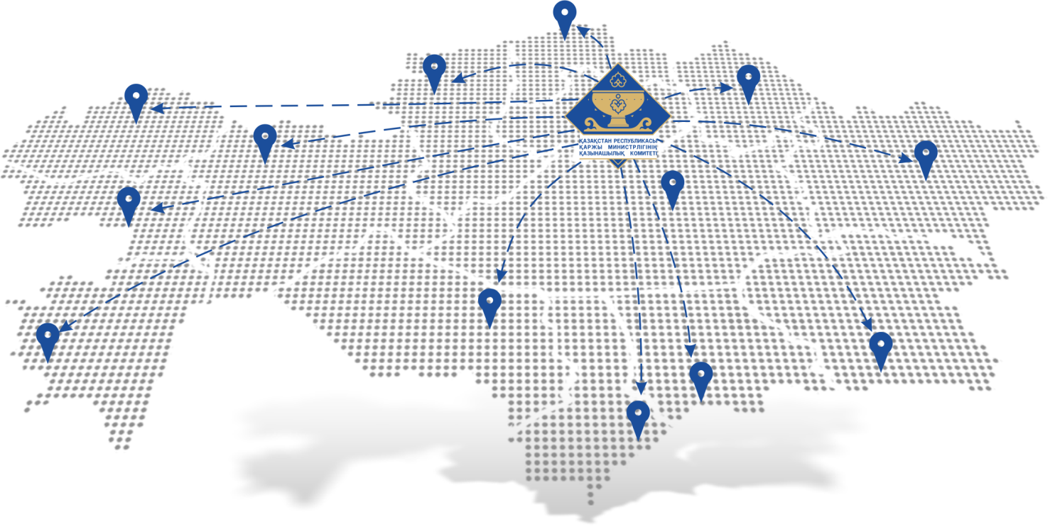
Treasury Committee
Ministry of Finance of the Republic of Kazakhstan
16 regional departments
188 district-level Treasury offices
3,000 Treasury staff
1,000 serviced GB/СКС
45,000 external users (staff of GB/СКС)
www.kazyna.gov.kz

Slide 5
Treasury Committee
Ministry of Finance of the Republic of Kazakhstan
Between 2004 and 2010, contracts for the support of the Treasury information system were established through open tender under public procurement with authorized Oracle partners.
www.kazyna.gov.kz

Slide 6
Treasury Committee
Ministry of Finance of the Republic of Kazakhstan
Tender under public procurement: limitations and risks
Time and labor costs to run tender procedures
Unintended violation of law during the tender under public procurement because there may be excessive requirements to vendors
Risk of corruption: in particular, possible collusion between vendor and client
Information security: impossible to mandate special screening by national security bodies of vendor’s staff
Tender may result in a contract with unfair vendor
Possible disruption of tender procedures which may affect operational continuity of the Committee
The RK legislation on public procurement did not allow to establish a contract with a single vendor to maintain quality: last year’s vendor would have gained experience in supporting the Treasury IS, and replacement might affect quality and speed of service provision.
The need to keep the quality and speed of service provision put the Treasury in a dependent position vis-à-vis its vendor.

Slide 7
Treasury Committee
Ministry of Finance of the Republic of Kazakhstan
Measures taken
The Treasury Information
System
The Treasury Information System was included in to the list of National Information Systems approved by the Decree of the RK Government.
Pursuant to the RK legislation, information resources included in the list must be supported by a Single Operator of the E-Government ICT infrastructure that is 100% state-owned – АО “National Information technologies”
www.kazyna.gov.kz

Slide 8
Treasury Committee
Ministry of Finance of the Republic of Kazakhstan
Contract with a Single Operator: advantages:
The Single Operator staff are screened by the RK national security bodies
The Single Operator poses as the E-Government integrator which has allowed efficient exchange of information with E-Government components
Obtaining services through public procurement without applying provisions o the law “On Public Procurement” allows operational continuity of the client since the support services are in essence a daily need
Under the contract with the Single Operator enhancements are made that do not require changes in the software core.
A technical support schedule is also produced.
No risk of corruption or establishing a contract with unfair vendor
In case of emergencies with IT systems of the Treasury Committee the Single Operator has a cadre of skilled experts.

Slide 9
Treasury Committee
Ministry of Finance of the Republic of Kazakhstan
Changes in the RK legislation related to the procurement of services to ensure operational continuity of government bodies
BEFORE
AFTER
Government bodies set up and maintain server rooms infrastructure on their own.
The Single Operator deploys server equipment in a Government Server Center that meets the TIER-3 standard
Competitive procurement of services to provide communication channels is done by the government body itself
Contracts to provide communication channels for all government bodies are established by the authorized body of the RK in information technologies
No mandatory scanning of government bodies’ information resources for information security vulnerabilities
The RK authorized body in information security monthly scans government bodies’ information resources for information security vulnerabilities and monitors their mandatory elimination

Slide 10
Treasury Committee
Ministry of Finance of the Republic of Kazakhstan
BEFORE
AFTER
Independent certification centers can be used.
Mandatory use of registration certificates issued by the National Certification Center of the RK
No Common Transport Medium for the government bodies (CTM GB) of the Republic of Kazakhstan
Electronic communication is enabled by the CTM GB. The law prohibits integration of the CTM with the internet.
No single internet access gateway (SIAG) for the government bodies
For information security purposes all government bodies must access internet via SIAG. Compliance is regularly monitored by the RK authorized body in information security.
Own ordinance of the government body is sufficient for IS commissioning
Commissioning requires a certificate stating that information security standards of the RK are met, as well as a positive opinion after the standard technical documentation has been evaluated and the RK authorized body in information security has tested the source code.
www.kazyna.gov.kz

Slide 11
СЕРВИСНАЯ МОДЕЛЬ ИНФОРМАТИЗАЦИИ
Treasury Committee
Ministry of Finance of the Republic of Kazakhstan
IT service model
GOVERNMENT BODY (GB)
GB architecture approval
Initiating service development
Service procurement
AUTHORIZED BODY
ICT policy implementation monitoring
Develop and approve methodology for the GB’s IT service model
SERVICE INTEGRATOR
GB architecture development and support
Attracts service providers
Manages the project to develop ICT service
OPERATOR
Provides secure and agile ICT infrastructure for the GB (including communication channels)
Ensures data integrity and security
Provides quality services to GB
NSE “STS”
Testing service products for information security
Monitoring of the Operator’s information security infrastructure
VENDORS
Service development and delivery
Services leased to the Operator
Authorized GB
Monitoring of IT policy implementation
GB architecture development
IS compliance
monitoring
Service
integrator
NSE “STS”
GB
Service
design
Server infrastructure provision
Vendors
Operator
www.kazyna.gov.kz

Slide 12
СЕРВИСНАЯ МОДЕЛЬ ИНФОРМАТИЗАЦИИ
Treasury Committee
Ministry of Finance of the Republic of Kazakhstan
Service Development Model: Selection Criteria
SERVICE SOFTWARE (SS)
PUBLIC-PRIVATE PARTNERSHIP (PPP)
Standard service:
Software helps to automate standard (regulations reference book, standards reference book) and support (accounting, HR, asset management) functions and processes and is available “as is” off-the-shelf without any significant tweaking
Unique service:
Monetization scheme that benefits both IT company and the government is available
Payback period under 3 years
Unique hardware is not needed
Major CAPEX with payback period of over 3 years
Laws or regulations are to be passed/amended for the project to be implemented
Developing software in partnership is more cost-effective for the government than direct public financing
Expensive infrastructure project
Standard Model
IS processing information marked as “CLASSIFIED”
No monetization scheme that would benefit both IT company and the government
www.kazyna.gov.kz

Slide 13
THANK YOU!
Treasury Committee of the Ministry of Finance of the Republic of Kazakhstan , 2016
www.kazyna.gov.kz

