Slide 1




The first workshop of PDMAG on
“Cash Flow Forecasting and Cash Management”
The World Bank Treasury|IBRD-IDA
Public Debt Management Advisory Group (WBT-PDMAG)
TCOP thematic group on
CASH MANAGEMENT & FORECASTING
“News on recent and future improvements”
Participating countries:
Albania
Kosovo
Macedonia
Romania
Serbia
Slovenia
Thailand
FYR of Macedonia Ministry of Finance, Skopje, September 17-21, 2018
Notes:
First and foremost I present my great thanks to the World Bank and I am very grateful for the opportunities offered about the giving of technical assistance on high expertise in areas of public finance management, specially for treasury, its main function of cash management. Also many thanks for Ministry of Finance of Macedonia-host country, for their hospitality and facilities that help to made this event successful. Angela, workshop participant, who is appointed recently in Macedonia Liquidity Management and Forecasting Unit Treasury Department, is present here.
In this news session of the TCOP thematic group’s event I am going to present on the first workshop of Public Debt Management Advisory Group-PDMAG (I will call shortly “Advisory group”) on “Cash Flow Forecasting and Cash Management” organized from World Bank Treasury from September 17th to 21st, 2018, in Skopje of Macedonia, hosted by the Ministry of Finance of Former Yugoslavia Republic Macedonia. This workshop is developed and delivered under the Government Debt and Risk Management (GDRM) Program supported by the State Secretariat for Economic Affairs (SECO) of Switzerland.
One of the areas of expertise of the WBT-PDMAG is to provide advisory and training services for government cash management. The advisory team is dedicated to building human capital among debt and risk management officers across the world.
My presentation will serve as a natural bridge from the country news to the main topic of this TCOP thematic group’s event.

Slide 2
The purpose
One of the areas of expertise of the WBT-PDMAG is to provide advisory and training services for government cash management. Through one-to-one missions, knowledge products, workshops, webinars, seminars and forums, and peer group dialogues, the advisory team is dedicated to building human capital among debt and risk management officers across the world.
The WBT-PDMAG organized its first workshop on “Cash Flow Forecasting and Cash Management”, hosted by the Ministry of Finance of FYR Macedonia from September 17th to 21st, 2018 in Skopje, FYR Macedonia. This workshop is developed and delivered under the Government Debt and Risk Management (GDRM) Program supported by the State Secretariat for Economic Affairs (SECO) of Switzerland.

Slide 3
The purpose
Why it is important the organizing of such workshop?
Public debt is growing apace in emerging markets and developing economies. The normalization of monetary policies is needed for the interest rates to be raised. At the same time, a widening infrastructure gap is forcing governments to find new ways to turn billions into trillions. All this makes debt management even more critical than before and emphasize the preparation of strategies and policies to manage debt, assets, risk, and funding in the new era.
Treasury is constantly keeping abreast of new developments in debt management practices and is also a leader in new thinking on debt management issues.
The workshop aimed to increase the participants’ expertise about the importance of accurate cash flow forecasting and sound cash management practices to ensure that governments meet their financial commitments on time and in a cost-efficient manner.
Notes:
Why it is important the organizing such workshop?
Public debt has increased dramatically in advanced countries, and is growing apace in emerging markets and developing economies. With global growth gathering speed, normalization of monetary policies has begun—and interest rates will rise. At the same time, a widening infrastructure gap is forcing governments to find new ways to turn billions into trillions. All this makes debt management even more critical than before. This year’s Forum will discuss strategies and policies to manage debt, assets, risk, and funding in the new era.
Treasury is constantly keeping abreast of new developments in debt management practices and is also a leader in new thinking on debt management issues.
The workshop aimed to increase the participants’ expertise about the importance of accurate cash flow forecasting and sound cash management practices to ensure that governments meet their financial commitments on time and in a cost-efficient manner.
Government cash management’s importance for debt managers on several occasions:
“Debt managers and fiscal and monetary authorities should share information on the government’s current and future cash flow needs.”
“The legal framework should clarify the authority to borrow and to issue new debt, to hold assets for cash management purposes, and, if applicable, to undertake other transactions on the government’s behalf.”
“There should be cost-effective cash management policies in place to enable the authorities to meet their financial and budgetary obligations as they fall”
“Credit risk should be assessed and managed consistently by debt and cash managers.”
Government cash management can be defined as “having the right amount of money in the right place and time to meet the government’s obligations in the most cost-effective way”. Despite the clarity of this definition and the multiple references in the IMF-WB Guidelines, the exact perimeter of government cash management is not always consensual: “from the perspective of budget policy or management, it is an internal government function - ensuring that cash flows to where it is needed without wastage or idling. But to debt managers and central banks it is about the impact and management of the government’s cash flows in the financial sector”.
Against this background, country experience provides a list of valuable lessons and recommendations for effective government cash management, that includes the following:
Pooling government revenues in a Treasury single account facilitates cash management by ensuring a concentration of funds.
Accurate, timely and realistic forecasts of cash inflows and outflows needs to be developed encompassing all (large) payments and aligning expenditure planning with actual cash spending.
Close coordination between debt and cash management is a crucial but challenging requirement as their objectives can be very different.
Trade-offs need to be clearly evaluated and assumed on minimizing the amount of idle cash and maximizing its return while ensuring timely payment of government’s commitments.
Coordination with the central bank is also essential to avoid adverse implications on monetary policy.
In many OECD countries, there has been a move towards integrating debt and cash management but the choice of any particular institutional arrangement needs to take into account the specificities and history of each economy. In all cases, coordination, transparency and smooth exchange of information are indispensable.
The webinar on government cash management aims to initiate a broad discussion among government debt practitioners and facilitate sharing of experience and key lessons. Given the particularities of cash management across countries, a panel format has been chosen so that speakers will focus on key questions/issues of wide interest for the audience, rather than present the details of their respective systems. They will highlight challenges faced in developing and implementing effective government cash management, its interaction with public debt management and other economic policies. As usual in WB Treasury webinars, participants will have the opportunity to pose specific questions and share their own experiences.

Slide 4
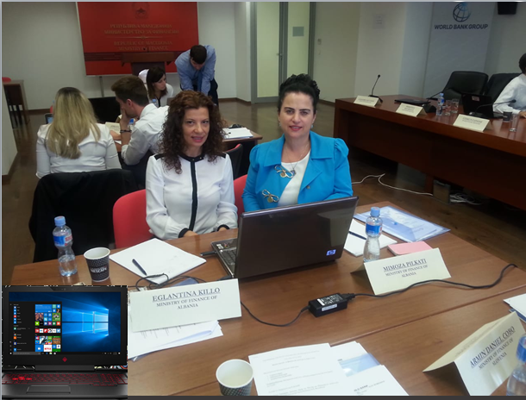
The topics
The intensive workshop, brought together 16 officials from ministries of finance from 7 countries. It consisted in short and practical presentations followed by hands on exercises using an excel-based toolkit specifically designed (slides 8-18).
This five-day workshop focuses on cash flow forecasting and management by central governments. Its goal is to increase awareness of cash and debt managers about the importance of accurate cash flow forecasting and their knowledge on sound cash management practices to ensure that governments meet their financial commitments on time and in a cost-efficient manner.
The workshop covers all the dimensions relevant to its theme, including forecasting of revenue and expenditure, stress testing of projections, coordination between cash and debt management as well as the options to invest excess cash in the market.
Notes:
1. Task: Develop weekly revenue projections for 2018 using historical data for the years 2007-2017 (in the spreadsheet) and the annual revenues for 2018 established by the tax department.
OBJECTIVES:
Historical (realized) data will be used on different ways to define the distribution of the annual revenues set out in the budget law;
Adjustments in projected cash flows will be required to reflect fine-tuning needs and changing environment; and
Possibilities to improve revenue projections will be discussed.
2. Task: Develop weekly expenditures projections for 2018 using historical data for the years 2007-2017 (in the spreadsheet) and the annual projection for 2018 established by the budget department.
OBJECTIVES:
Historical (realized) data will be used to define the distribution of the annual expenditures set out in the budget law;
Adjustments in projected cash flows will be required to reflect fine-tuning needs and changing environment;
Discuss needed adjustment in the comparison of projections with previous years projected and realized data.
3. Simulating shocks to cash flow projections:
Task: Assess the risks around the baseline and generate a stressed baseline.
OBJECTIVES:
Identify intra- and inter-year seasonality of revenues and expenditures; and
Learn about different volatility measures (STANDARD DEVIATIONS) and tools to deal with it.
4. Coordinating debt management with cash management
Task: Establish an annual borrowing plan consistent with cash management’s constraints.
OBJECTIVES:
Incorporate debt service as financial need and debt issuance as short-term funding tool;
Learn how to deal with different but complementary objectives (smooth issuances, market development and predictability/transparency)
5. Determining and testing a cash buffer
Task: Determine the size of the cash buffer based on several scenarios.
OBJECTIVE:
Determine cash buffer optimal levels considering not only risk but cost perspective
Question for Example:As part of the reform of the Central Bank, cash advances to the government are now forbidden and the level of the cash buffer needs to be increased. It is suggested that the cash buffer should not only absorb the volatility of cash flow forecasts (as discussed in Question 2) but also allows the government to face a situation where financial markets are closed for one month, i.e. no T-bills and T-bonds can be issued during one full month.
i) How would you estimate the new cash buffer? Which information would you need?
ii) It was agreed to establish the cash buffer at a level allowing for domestic debt redemptions due in the following month (excluding bank loans). How much should it be (using the baseline for 2018)? How would you respond if the requirement is extended to foreign debt redemptions?

Slide 5
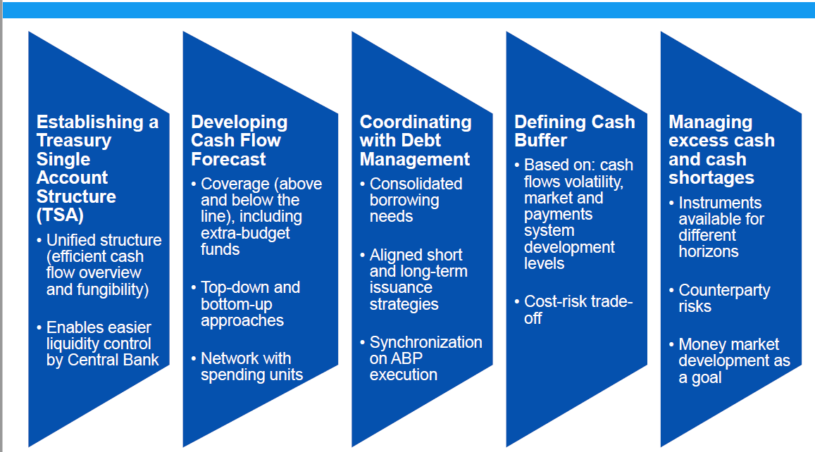
Covered dimensions
dimensions
Notes:
What is cash management?
“having the right amount of money in the right place and time to meet the government’s obligations in the most cost-effective way” Storkey (2003)
“the strategy and associated processes for managing cost-effectively the government’s short-term cash flows and cash balances, both within government, and between government and other sectors”. Williams (2004)

Slide 6
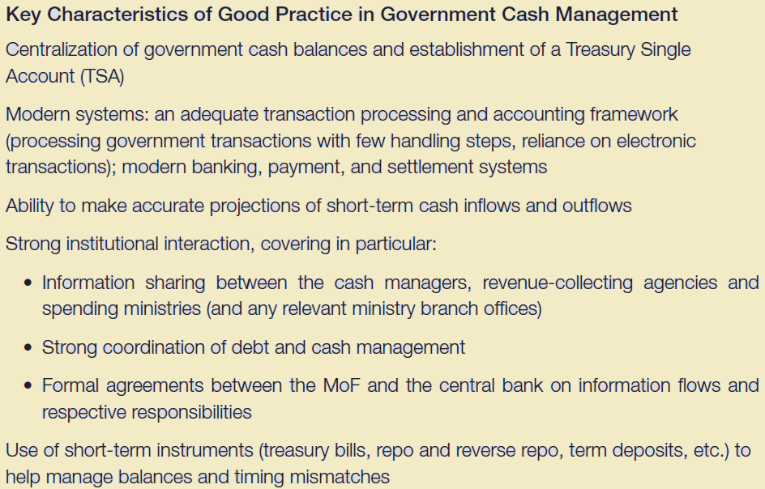

Lessons learned
Notes:
Obstacles to good cash flow management
A.Political Obstacles
•Budget allocation occurs at execution; not at formulation
•Over-reliance on cash controls as disciplinary/reward instrument
•Executive unwilling or unable to make hard budgetary decisions during budget formulation –“Passes the buck to Treasurer or MoF”
B.Opposition by Interest Groups
•Civil servants may resist for technological solutions
•Banking sector may benefit from large floats
C.Institutional & Technical Obstacles
•No TSA or nominal TSA that coexists with multiple other accounts, often with slow or never remittance to treasury
•Low technical capacity
•Lack of data to forecast cashflows
•Weak institutional coordination and information sharing arrangements, as evidenced by irregular or rare cash flow revisions
•Underdeveloped money markets
Results of Poor Cash Flow Management
A. Operational Costs
Service delivery failures
Interrupted construction of public investment projects
B. Financial Costs
Direct cost caused by build-up of payments arrears to suppliers
Opportunity cost of idle cash balances held in non-remunerated accounts
Costs of unnecessary short-term debt issuance
C. Erosion of budget institutions and processes
Disconnect between policy priorities (budget formulation) and policy outcomes (budget execution)
Lower accountability of program managers
Games i.e. hoarding cash
Benefits of good cash flow management
Recognize the time value and the opportunity cost of cash;
Enable line ministries to plan expenditure effectively;
Ensure the cash needs of line ministries has been met as requested
Comprehensive, covering all inflows of cash resources;
Plan liquidation of both short and long term cash liabilities
Ensure that expenditures are smoothly financed during the year, so as to minimize borrowing costs;
Forward looking, anticipating macroeconomic developments while accommodating significant economic changes and minimizing the adverse effects on budget execution;
Enable the initial budget policy targets, especially the surplus or deficit, to be met
Contributes to the smooth implementation of both fiscal and monetary policy
Conclusion
Good government cash management matters. It matters not only from the fiscal and budgetary perspective of cost effectiveness and efficiency, but also because of the benefit it can bring to other financial policies—in particular to debt management, to monetary policy and to the development of the local financial markets.
These wider benefits, however, require well-founded and effective cash flow forecasting arrangements; and strong coordination, both between cash management and debt management, and between the cash managers and the central bank. Coordination is required at policy and operational levels; this has been greatly facilitated in many countries by the integration of debt and cash management functions.

Slide 7
Key takeaways
Budget execution is about ensuring that the budget is managed consistently within agreed financial limits.
Cash management is separate from the budget process
Accurate cash flow projections is essential for efficient management of cash balances
Poor cash flow management have operational and financial costs
Cash flow forecasting provides significant input to decision making process
Cash flow forecast is the first step of cash management
Appropriate institutional framework and network are essential
TSA structure is precondition for cost and risk reduction and higher returns
Building-up active and efficient cash management is a process
Infrastructure and financial market development are key
Cash, debt and monetary policy management must be coordinated
Revenue forecast requires historical data assessment and consistency with budget bill.
Calculation methodologies and models are useful, but do not capture possible pattern and punctual changes

Slide 8
Key takeaways
Network with line entities operational and senior level is required.
Fine-tuning forecast is costly and revenues categories prioritization should be defined, evolving over time.
Error in one period is often compensated in a later period: double error hidden by average methodologies (permanent monitoring required).
Expenditure forecast requires consistency with annual budget and high level of coordination with spending units
Scope of the cash flow forecasts is often larger than the budget bill –include off-budget items
Forecasting of discretionary and non-discretionary expenditures requires different approaches
Two way collaboration with counterparts and daily monitoring is essential
Forecasting errors come from a number of different sources
Historical volatility is useful but presents limitations
Understanding the nature and scope of potential shocks is important
Developing extreme shock scenarios is not an end in itself
Goal is to develop a realistic cash profile and learn from past forecasting errors
Mitigation measures are also important

Slide 9
Key takeaways
Cash, debt and liquidity (CB) management coordination starts on the forecast process (outputs from one process turn inputs for the other).
The more active cash management is the more coordination is required (money market transactions)with debt managers.
CMU and DMU integration is not necessary, but as debt and money market develops and transactions are more frequent and diverse, there are good reasons for it.
Size of cash buffer is a matter of informed judgment, not a formula
There is often a trade off between safety (large cash buffer) and cost (negative carry cost of cash held)
Coordination between cash and debt management is crucial
Structural cash holdings are usually managed separately from cash buffer
Size of the cash buffer can (should) vary with time
Investing excess cash in the market can reduce carry cost
Prior conditions need to be met: robust cash flow forecasts, capacity to assess the size of cash buffer, payment / settlement systems
Coordination with the central bank is crucial in all cases
Counterparty credit risk needs to be calculated and monitored
Choice of instruments should be based on informed decision on risk / return

Slide 10
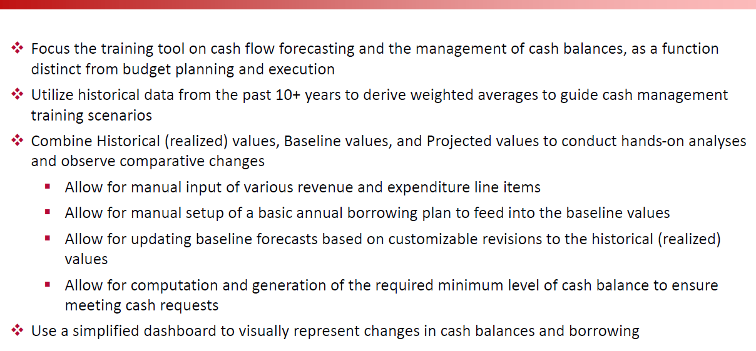
Hands on exercises using an excel-based toolkit
System Architecture
Notes:
Tool Design and Guiding Principles
Focus the training tool on cash flow forecasting and the management of cash balances, as a function distinct from budget planning and execution
Utilize historical data from the past 10+ years to derive weighted averages to guide cash management training scenarios
Combine Historical (realized) values, Baseline values, and Projected values to conduct hands-on analyses and observe comparative changes
▪Allow for manual input of various revenue and expenditure line items
▪Allow for manual setup of a basic annual borrowing plan to feed into the baseline values
▪Allow for updating baseline forecasts based on customizable revisions to the historical (realized) values
▪Allow for computation and generation of the required minimum level of cash balance to ensure meeting cash requests
Use a simplified dashboard to visually represent changes in cash balances and borrowing
Trainees need to be familiar with basic functionality of excel (worksheets, navigation, data entry) to be able to effectively use the tool

Slide 11
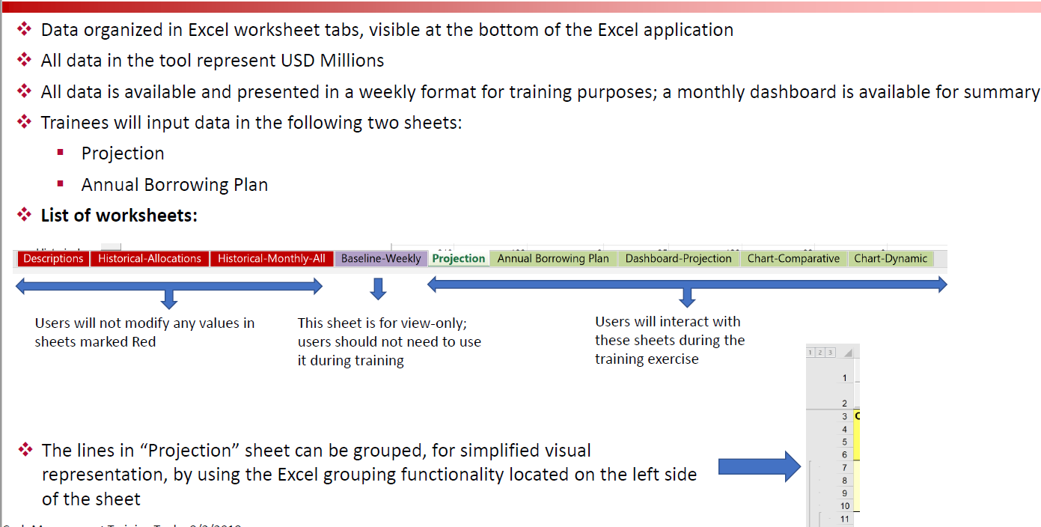
Notes:
Technical Organization
Data organized in Excel worksheet tabs, visible at the bottom of the Excel application
All data is available and presented in a weekly format for training purposes; a monthly dashboard is available for summary
Trainees will input data in the following two sheets:
▪Projection
▪Annual Borrowing Plan
The lines in “Projection” sheet can be grouped, for simplified visual representation, by using the Excel grouping functionality located on the left side of the sheet
====================================
Terminology:
“Projection” Sheet –Line Items
▪Historical =>Weighted average values for each line item, per week, computed from realized cash flow data. These values should not be manually adjusted.
▪Baseline => Values that are alwaysbased on the “Historical” values and computed with or without adjustment factors (explained under “Baseline Scenarios” page) per line item, per week. These values should not be manually adjusted.
▪Projection => Manually entered projection values. The entry of these values can be automated, however, each value can also be manually edited for detailed forecasting purposes
▪Example:
“Annual Borrowing Plan” Sheet
▪Manually enter monthly borrowing details for foreign borrowing, as well as short and medium term borrowing
▪Details are then calculated on a weekly basis and incorporated into the “Baseline” line items on the “Projection” sheet
===============================
Data flow:
The tool allows for automated data entry into certain calculations, as well as manual data entry into certain areas
Calculations in the tool are formed in a specific sequence to obtain correct outcomes
The data flow below illustrates the high level data organization within the tool

Slide 12
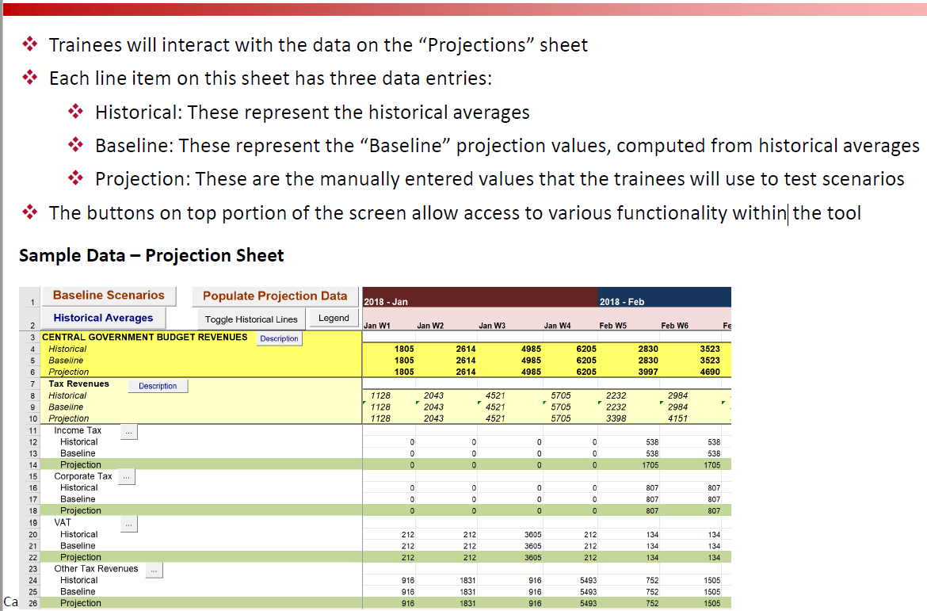
Notes:
Working data

Slide 13
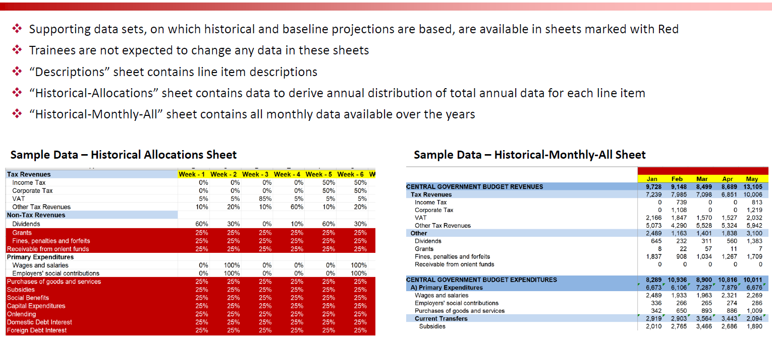
Notes:
Supporting data

Slide 14
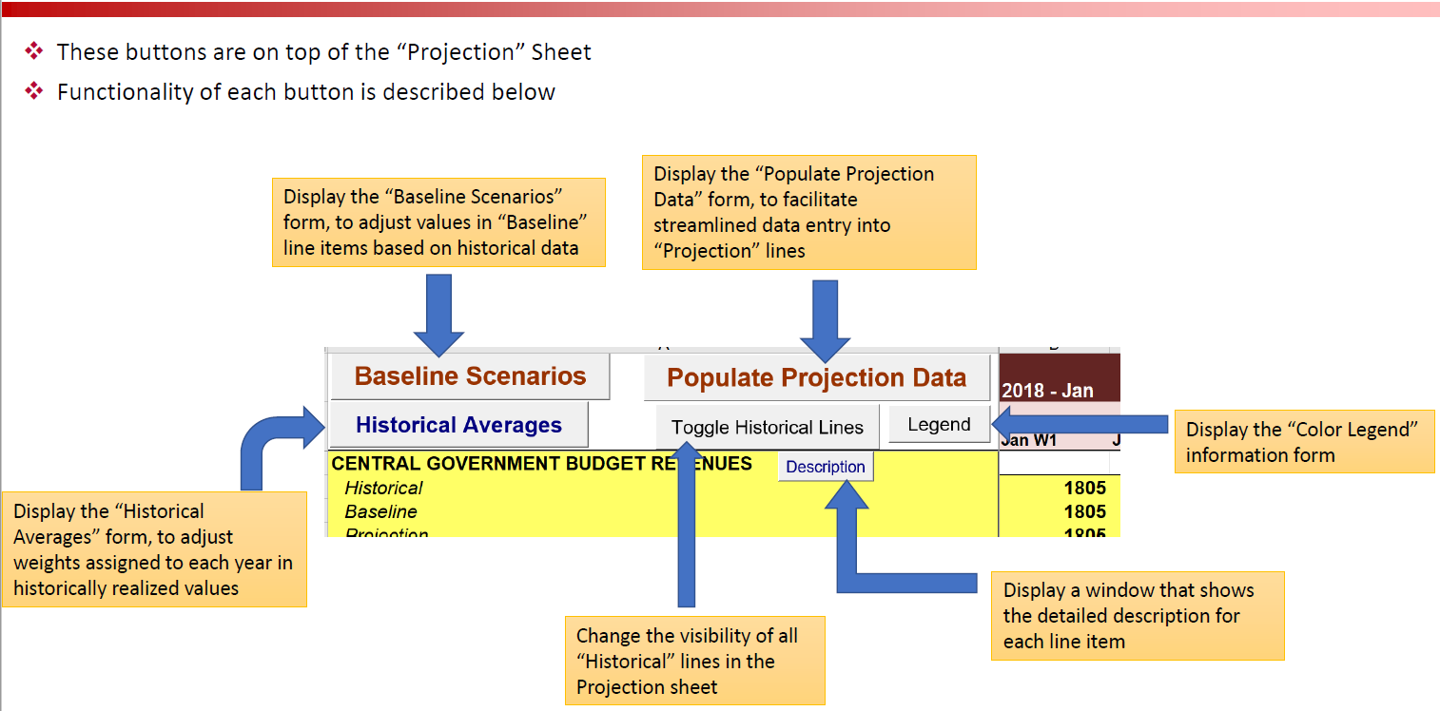
Notes:
Button on projection sheet

Slide 15
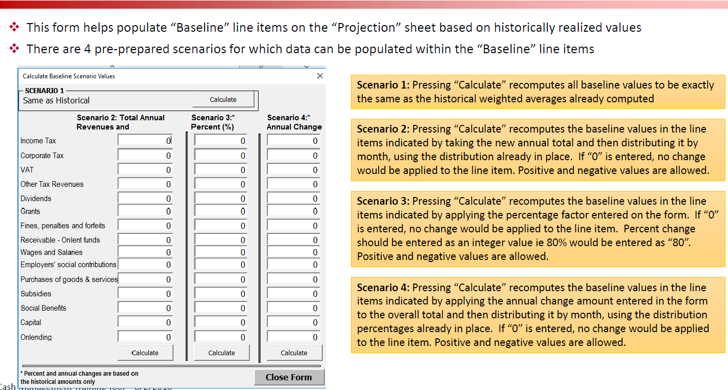
Notes:
Cash Management Training Tool –Baseline Scenarios Form

Slide 16
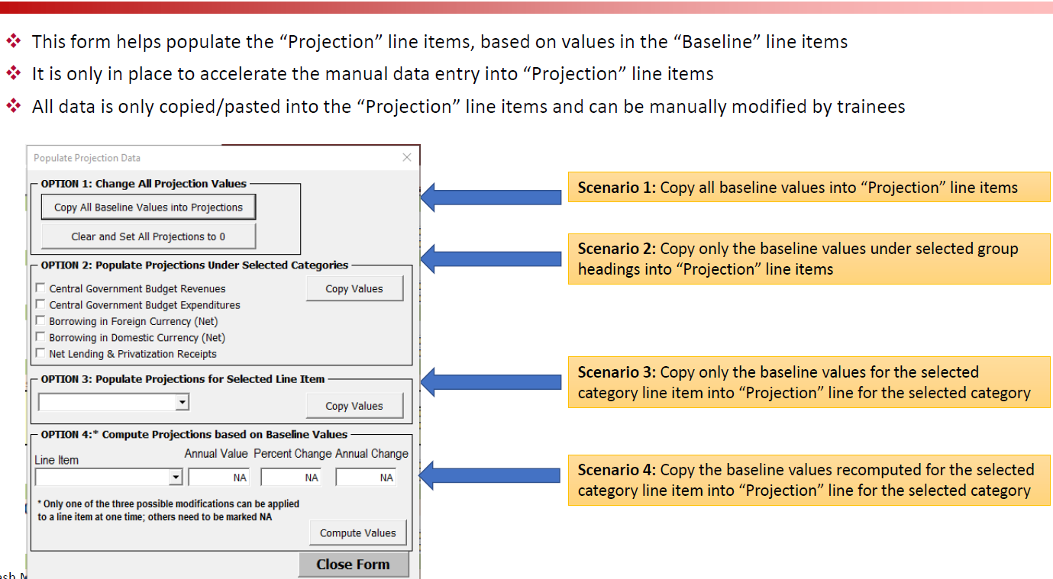
Notes:
Cash Management Training Tool –Populate Projection Data Form

Slide 17
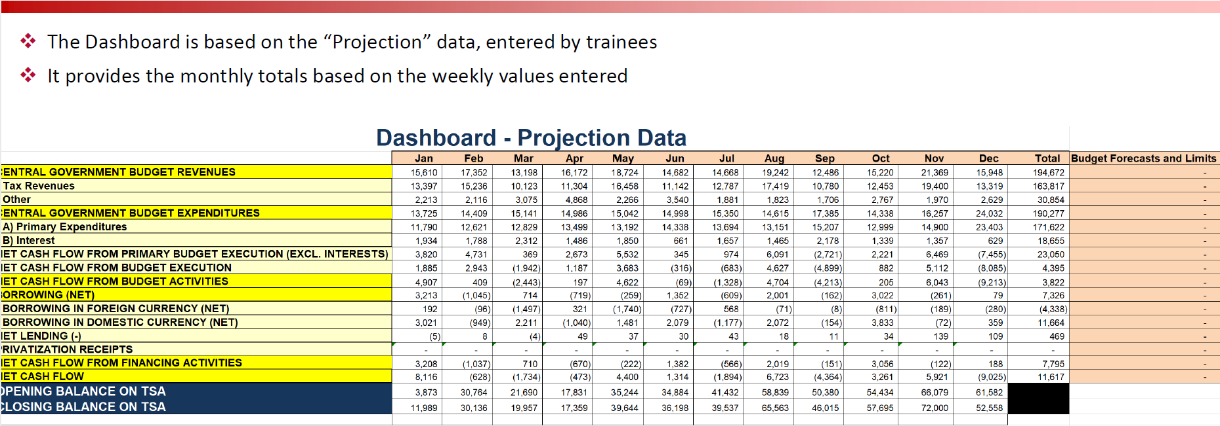

Slide 18
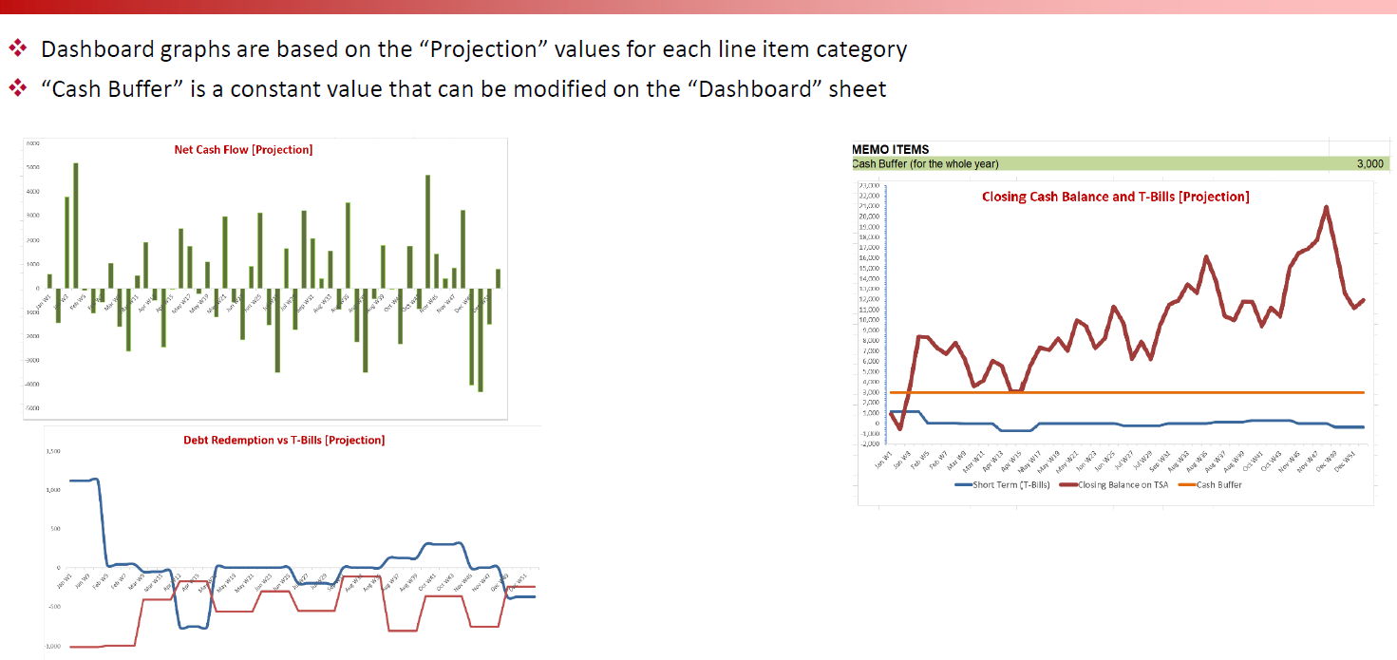
Notes:
Dashboard Graphs

Slide 19
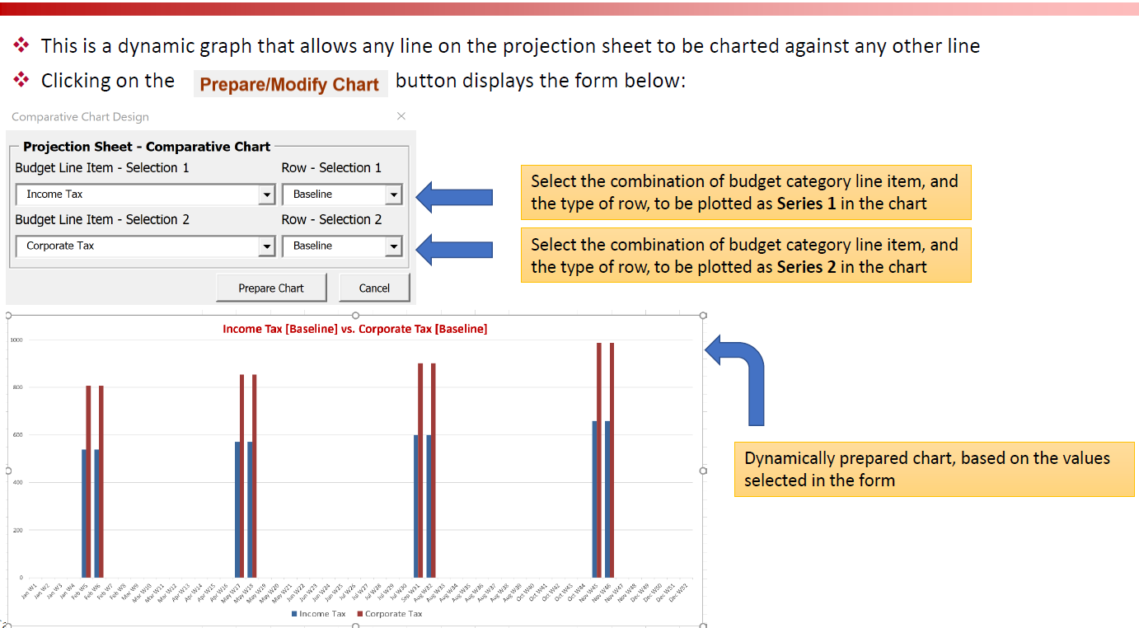
Notes:
Comparative Chart

Slide 20
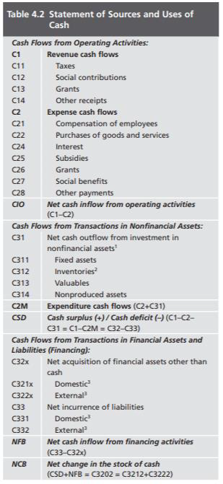
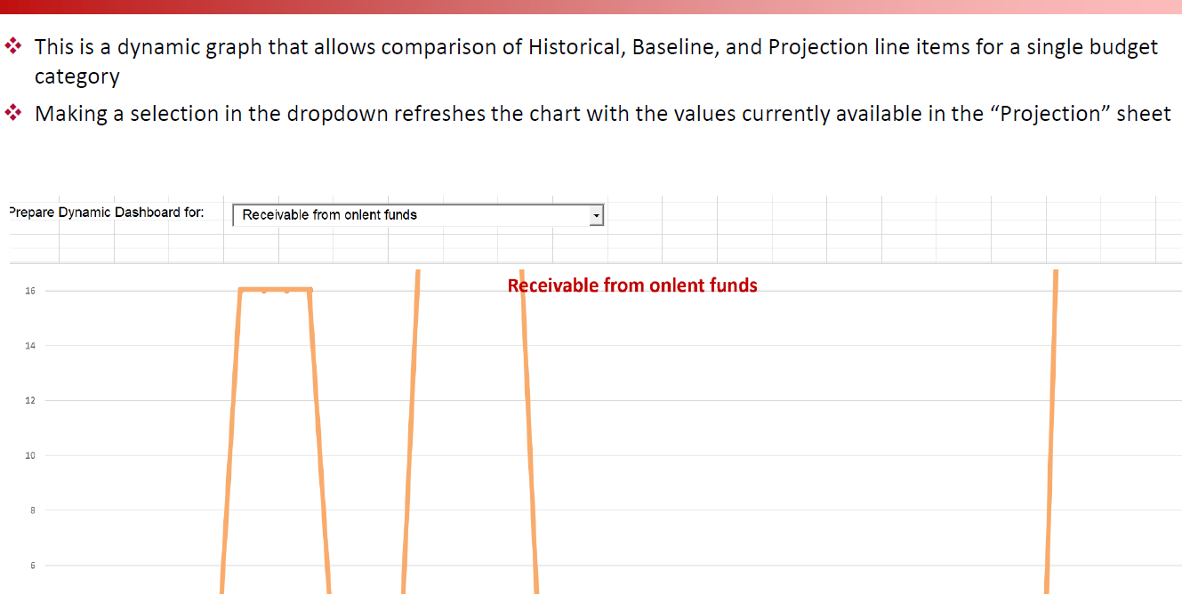
Notes:
Dynamic chart

Slide 21


Thank you for your attention!
The contact:
Mobile: +355684047161
E-mail: mimoza.peco@financa.gov.al

