Slide 1
REPUBLIC OF ALBANIA
“The evolution of the Treasury function & strategic plans for treasury system development”
MIMOZA PILKATI
Director
Treasury Operations’ Department
mimoza.peco@financa.gov.al
PEMPAL_TCOP Plenary Meeting
June 01-03, 2016
Notes:
Tresury is like an island in the ocean where all the government’s units that have to be financially managed to attain the balance of liquidity, are included. Its evolution is never-ending in several aspects just like the vast ocean. Therefore, we have to carefully guide this evolution in order for the treasury to function properly and to have a sustainable growth like a Palm tree under the sun.

Slide 2
Content
Background
Functions
Strategic Planning
Major Reforms
Challenges

Slide 3
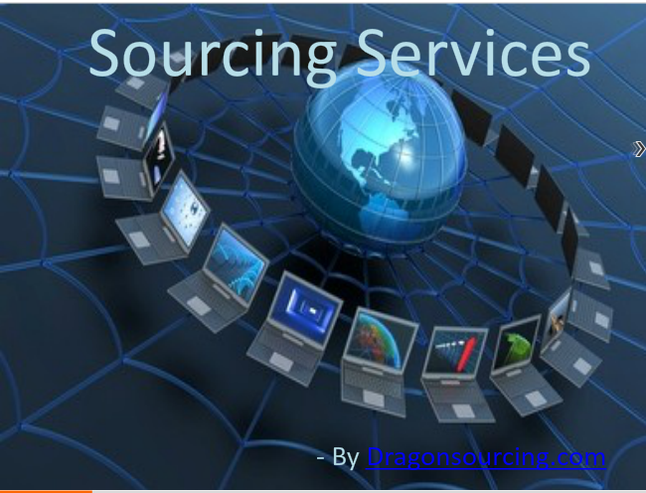
Accounting is an art, we need the wisdom of experienced staff to be shared with others to get the proper consolidated data of financial reporting, sound analysis and sustainability.
Treasury evolution has engaged all generation of working force.
Established Treasury System on 16th April 1993
General Directorate of Treasury consists in three departments: 1-Treasury Operations’ Department (1+3+11 employees) 2-Payments and Restitutions’ Department (1+5) 3-Bisness Processing’s Department (1+2+5)
On 2006 - Final Acceptance (design & test)
of the government financial information system.
On September,2010 - Fully Live Implementation
of the AGFIS.
It is a centralized web-based system.
It is build in Oracle E-Business Suite Architecture.
It has also some customized programs/functions.
Ministry of Finance-Central Treasury-CT
(29 employees)
36 Territorial Branches under CT (219)
Notes:
First of one the evolution is done by people.
Slide one – Background to the Treasury
Brief timeline on history of the Treasury
Are you a unit of the MoF, independent unit? YES
Organization Structure – staffing centrally and regionally, number of offices and locations
Relationship to ICT – is it part of Treasury or a separate unit (is the relationship strong or are there issues). Department of Business Processing support functions of the Treasury and has the strong relationship with ICT Department

Slide 4
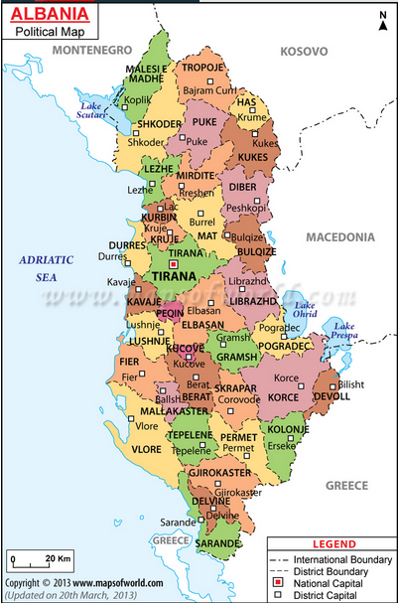
Geographical
Expansion
of Treasury Districts Branches
We are trying to be as near as possible to our clients to get effective and efficient service by treasury functions

Slide 5
Organization Chart
Albanian Ministry of Finance
Minister
Cabinet
General Directorate
Macroeconomic & Fiscal Policy
General Directorate BUDGET
General Secretary
General Directorate Harmonization of PIFControl
General Directorate TREASURY
Deputy Ministers
General Directorate Financing&Contracting of WB,BE, etc. Funds
General Directorate PUBLIC DEBT
General Directorate
Legal & Support Services
ICT
Department

Slide 6
Organization Chart
1-Treasury Operations’ Department
Treasury Operations’ Department
TSA Manag.
Division
Experts
(4)
36 TDO’s
Liquidity Manag.Division
Experts
(3)
36 TDO’s
Financial Reporting Division
Experts
(4)
36 TDO’s

Slide 7
Functions of the Treasury
1.Budget executor
2.Single cash manager
1.1. Ex-ante controller
1.2. Recorder
1.3. Authorizer
2.1. Forecaster of cash flows
2.2. Preparator of payments
2.3. Manager of liquidity
3. Govt’s Accountant
4. Data disseminator
4.1. Generator of financial reports
4.2. Statistician of financial data
4.3. Publisher
3.1. Data eliminator
3.2. Data consolidator
3.3. Data reconciliator
Notes:
It`s necessary because of:
market economy model,
expenditures control ,
the use of standard documents ,
information,
issuing securities and other debt instruments,
there were no system of cash management,
there were no government accounting system.
We have started with the function of budget execution
Slide two – Functions of the Treasury
What are the main functions of the Treasury? For example, payment processing, revenue collection; cash management and forecasting, budget execution, reporting
Does the Treasury have secondary functions which are not typically part of such an operation? examples might include providing payment and revenue collection services to non-budgetary organizations on a fee for service basis, selling ICT services -NO
Does the treasury charge for any services or receive supplementary budget transfers for services form budget entities or elsewhere? NO
Training and capacity building – is this part of the role of the Treasury. YES, partially for functions and operations of treasury, for public services it’s done by ASPA-Albanian School of Public Administration.

Slide 8
Strategic Planning Objectives
Pillar 1: Sustainable and prudent fiscal framework.
Pillar 2: Well integrated and efficient planning and budgeting of
public expenditure.
Pillar 3: Efficient execution of the Budget.
Pillar 4: Transparent government reporting.
Pillar 5: Effective internal control.
Pillar 6. Effective external oversight of the public finances.
Key issues of PFM Action Plan by Treasury
1/3.1. Improve forecasting methodologies for liquidity management.
1.2. Preparation of a inter-institutions memorandum for National Acc.
1.3. Creation of a full statistical system covering the needs for budget
and semi-budget entities with standardized information.
1.4. Design and implement a SOE financial reporting process.
2.1. Multi-year commitment controls.
2.2. Improve the information content and quality of the budget
documents that go to Parliament (include balance sheets data).
2.3. Approve the Law on "Local Government Finances“ (integrated).
3.1. Changing OBL on pre-commitment controls.
3.2. Configure AGFIS to allow tracking operational exp.by project code
3.3. Introduce e-invoice to foster timely recognition of expenses.
4.1. Implement IPSAS.
5.1. Review performance monitoring methodology.
Notes:
In both views: to be careful and to have the comprehensive (global) view.
Slide Three – Strategic Planning
Does the Treasury have a strategic Plan? YES. If so describe the key objectives of the plan
If no plan exists specifically, discuss the MoF or parent organization plan. If this does not exist discuss the broader government reform plan as it relates to PFM and the Treasury.
If you have a PFM Action plan-YES – also discuss the key issues relating to the Treasury here

Slide 9
Major Reforms
Results from manual treasury system to automated one –
Albanian Government Financial Information System (AGFIS) on
September, 2010. They consist in:
Preparation and updating of the treasury system legislation
resulted in the first PFM Strategy 2014-2020.
Enhancement budgetary control by AGFIS.
Enhancement liquidity management by AGFIS and realized
centralized electronically payments process through TSA.
Development of accounting and legal framework.
Since 2010, for the first time, in 2014 are generated
electronically Government Finance Statistics data by IMF
methodology with AGFIS.
Enhancement of managerial accountability by matching the
performance indicators through AGFIS data.
Supported by technical assistance and the best experiences exchange through pear assisted learning and training abroad.
WB/IMF/EU technical missions
TCOP-PEMPAL
SETS
JVI/CEF/SECO training
Notes:
Slide Four – Major Reforms – The following table presents examples of what you might present – they do not represent what each country should cover. Please identify up to six major changes in the Treasury since inception that had a big impact on government operations and the Treasury itself and present them in a table
Major Changes in Treasury Operations since Inception (limit this to the major changes that have had an impact on public finance and the operations of the Treasury)
Main drivers for the changes
First key change – implementation of first central accounting system
Improve budgetary controls
Second key change – TSA
Improved cash management

Slide 11
AFMIS will combine and integrate the following functional modules:
Medium-term budget planning and monitoring (MTBP)
Public investment management (PIM)
Budget project portfolio monitoring (BPPM) including the data warehouse solution
Budget execution and treasury (AGFIS) (integration with existing system)
AFMIS shall also include a number of interfaces with the following systems to improve information exchange :
Human resources management information system (HRMIS) interface for payroll data and electronic payments
Integrated Planning Systems information system (IPSIS) interface for monitoring strategic plans and results
External Assistance management information system (EAMIS) interface for donor funded project details
Debt management (DMFAS) to AGFIS interface for public debt management and cash management information needs
Public procurement system interface to exchange data on public procurement processes and contractual information
Improvement of existing AGFIS interfaces with other systems (e.g. Tax/Customs)

Slide 12
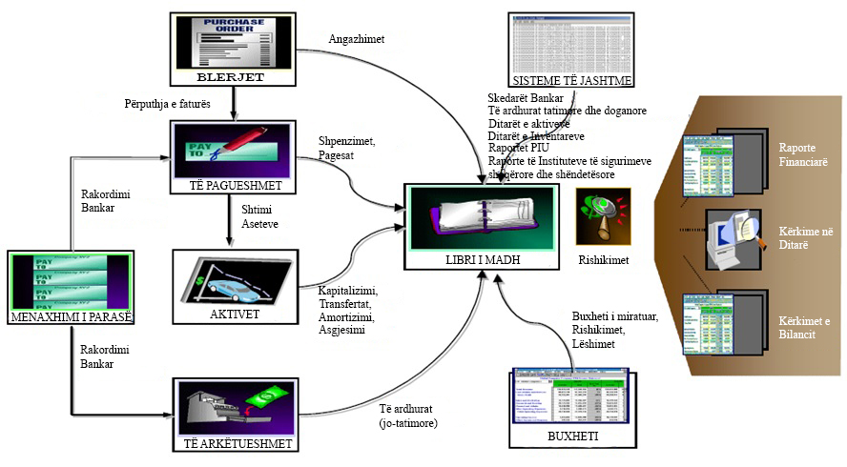
AGFIS PROCESSES
Notes:
AGFIS është produkt i kompanisë Oracle, E-Bussiness Suite. Nga ky produkt Ministria e Financave përdor modulet financial dhe purchasing, Oracle Discoverer, Oracle Application Server, Oracle Database Server Enterprise Edition, Oracle Real Application Cluster – One Node, Oracle Secure Backup.
Skema Logjike dhe Software
Zgjidhja e sistemit është bazuar në Databaze Relacionare (RDBMS), Oracle Data Base Enteprise Edition 11g R2 (11.2.0.4).
Komponentët e skemës llogjike janë:
Baza e tëDhënaveRelacionaleOracle Data Base Enteprise Edition 11g R2 (11.2.0.4)
Application Server
Oracle E-Business Suite R12 (12.1.3)
Oracle Real Application Cluster One Node
Modulet e arkitekturës së sistemit janë:
1-Financiare
Libri i madh / General Ledger (GL)/ Raportet
Buxheti i Sektorit Publik / Public Sector Budgeting (PSB)
Të Pagueshmet / Accounts Payables (AP)
/ Account Receiveables (AR)
Menaxhimi i Parasë / Cash Management (CM))
Aktivet / Fixed Assets (FA)
2-Zinxhiri i furnizimit (Supply Chain)
Blerjet / Purchasing (PO)

Slide 13
Physic infrastructure & topology
Notes:
AGFIS është produkt i kompanisë Oracle, E-Bussiness Suite. Nga ky produkt Ministria e Financave përdor modulet financial dhe purchasing, Oracle Discoverer, Oracle Application Server, Oracle Database Server Enterprise Edition, Oracle Real Application Cluster – One Node, Oracle Secure Backup.
Skema Logjike dhe Software
Zgjidhja e sistemit është bazuar në Databaze Relacionare (RDBMS), Oracle Data Base Enteprise Edition 11g R2 (11.2.0.4).
Komponentët e skemës llogjike janë:
Baza e tëDhënaveRelacionaleOracle Data Base Enteprise Edition 11g R2 (11.2.0.4)
Application Server
Oracle E-Business Suite R12 (12.1.3)
Oracle Real Application Cluster One Node
Modulet e arkitekturës së sistemit janë:
1-Financiare
Libri i madh / General Ledger (GL)/ Raportet
Buxheti i Sektorit Publik / Public Sector Budgeting (PSB)
Të Pagueshmet / Accounts Payables (AP)
/ Account Receiveables (AR)
Menaxhimi i Parasë / Cash Management (CM))
Aktivet / Fixed Assets (FA)
2-Zinxhiri i furnizimit (Supply Chain)
Blerjet / Purchasing (PO)

Slide 14
Data on Servers
Name | Role | Memory (RAM) | Processor (CPU) | Kujtesa e Jashtme (HDD) | Operative System
Oracle Sparc T5-2 | Application Server | 128 GB | 1-64bit x 16-core, CPU-@3.6 GHz | 2 x 600 GB | Oracle Solaris 11
Oracle Sparc T5-2 | Clustered Application Server | 128 GB | 1x64bit – 16 core, CPU-@3.6 GHz | 2 x 600 GB | Oracle Solaris 11
HP Proliant DL380 Gen9 | Database Server | 256 GB | 2-64-bit x 8-core Intel Xeon E5-2667 v3, CPU @ 3.2 GHz | 2 x 600 GB | Oracle Linux
HP Proliant DL380 Gen9 | Clustered Database Server | 256 GB | 2-64-bit x 8-core Intel Xeon E5-2667 v3, CPU @ 3.2 GHz | 2 x 600 GB | Oracle Linux

Slide 15
Other equipment of infrastructures
No | Name of HW equipment | Seller (firm) | Model
1 | Ethernet switch manageable | HP | HP HI 5500-24G-4SFP w/2 Intf Slts Switch
2 | Fiber Switch | HP | HP 8/24 Base 16-ports Enabled SAN Switch
3 | Pajisje Storage | HP | HP 3PAR StoreServ 7200c
4 | Tape Library | HP | HP StoreEver MSL2024

